Slide 1

Rules and Mindset
Introduction to Machine Learning
Bevezetés a Gépi tanulásba
Balázs Nagy, PhD

Slide 2
Contact info
János Botzheim
(removed for privacy)
László Gulyás
(removed for privacy)
Balázs Nagy
(removed for privacy)
In emails use the [Intro2ML]-tag in the subject:
[Intro2ML] Your specific subject…
In case of not using the proper tag answer is not guaranteed.

Slide 3

Information channels
Canvas
  Lecture presentations
  Assignments
  Points

Slide 4
Classes
Every week
45 min
In person
Catalogue
Lectures
Place | South building 0-821 Bolyai János room
Time | Monday 16:10 – 16:55
Catalogue rule:
Every student can miss 3 lectures without consequences
With more than 3 misses the student is not eligible to complete the course
Misses can be covered only with medical papers signed and certified by an official doctor
Students with good grades or students with international scholarships can be exempted from this rule

Slide 5
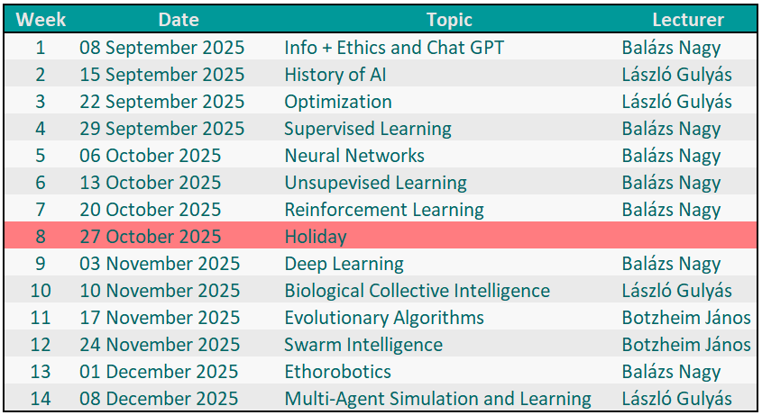
Projected Schedule

Slide 6
Grading
2 homework assignments (10 points each)
  Provided by the lecturers during the semester
  Not mandatory to be eligible for the exam
  Due dates are part of the assignment
Final exam (80 points)
  Time: 2025.12.15. – 2026.01.31.
  3 occasion – 2 tries
  New grade will overwrite the previous grade
  Paper and Pen style
Points | Grade
0-39 | 1
40-54 | 2
55-69 | 3
70-84 | 4
85-100 | 5

Slide 7
Thank you for your attention!

