Slide 1
HKNBP Description
(Source Key)

Slide 2
Revision History
Version | Date | Description | Author
1.0 | 2019.09.04 | Set Iframe display https://hknbp.org Connect Remote Key features | Source Key
1.1 | 2020.03.04 | Fix errors | Source Key

Slide 3
Contents
UI Structure
Usage Scenario
Menu & function description
Key policy
How to change languages

Slide 4
UI Structure
Whole UI Structure
IframePlayer
VirtualRemote
Some Window
EPG

Slide 5
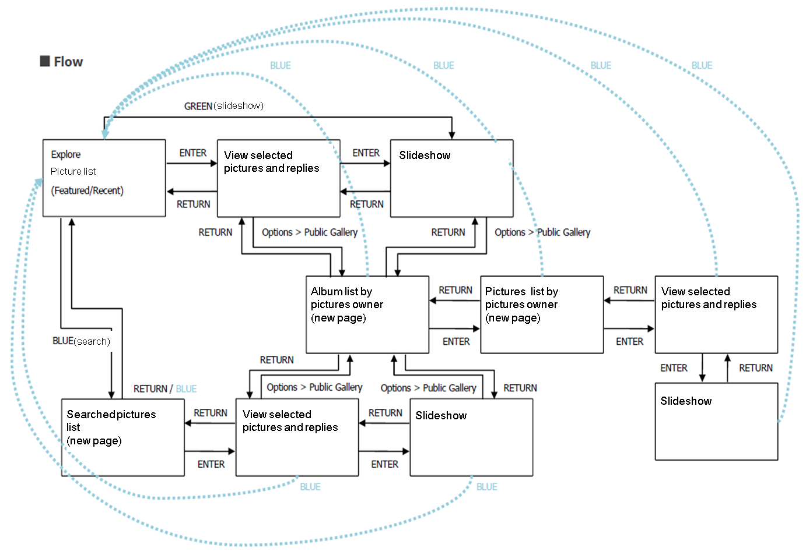
UI structure – (flow graph)
Some Window
Return
IframePlayer
VirtualRemote
Enter
Enter
Return
Enter
EPG

Slide 6
UI Structure – (depth navi.)
1st depth
2nd depth
3rd depth
4th depth
5th depth
1st depth
2nd depth
3rd depth
Picture list
View selected pictures and replies
Slideshow
Some Window
Album list by pictures owner
Picture list by pictures owner
View selected pictures and replies
Slideshow
IframePlayer
VirtualRemote
Searched pictures list
View selected pictures and replies
Slideshow
EPG

Slide 7
Usage Scenario
Start this App
Watch the Channel
You can change Channel for you like

Slide 8
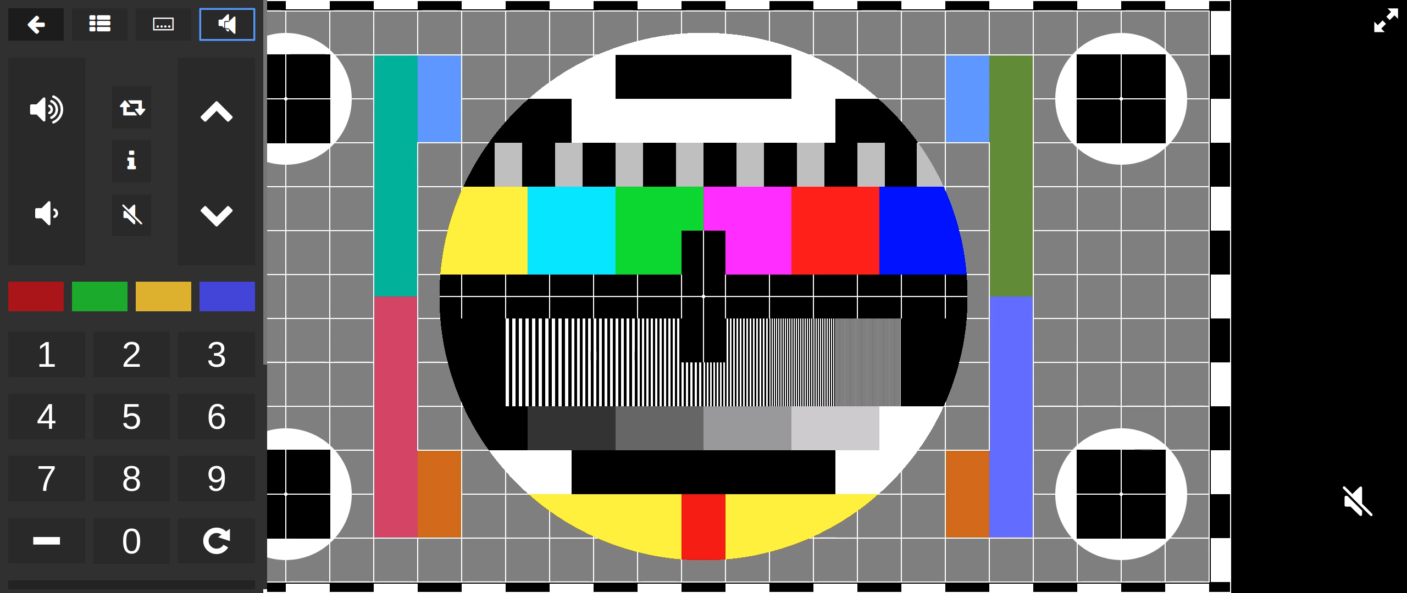
Menu & function description
Main Screen
No | Element | Attribute
1 | Iframe Player | Display Channel
2 | Virtual remote | Control App, Change Channel, Get Various Infomation
Virtual
Remote
Iframe Player
1
2

Slide 9
Menu & function description
Main Screen
No | Element | Attribute
1 | Virtual Remote Hide Button | Display Channel
2 | EPG Button | Show EPG
3 | Subtitle Button | Change Subtitle Track
4 | Audio Button | Change Audio Track
1
2
3
4

Slide 10
Menu & function description
Main Screen
No | Element | Attribute
1 | Volume Up Button | Volume Up
2 | Volume Down Button | Volume Down
3 | Channel Next Button | Go Next Channel
4 | Channel Previous Button | Go Previous Channel
1
3
2
4

Slide 11
Menu & function description
Main Screen
No | Element | Attribute
1 | LastTime Channel Button | Go LastTime Channel
2 | Channel DescriptionButton | Show Description Channel
3 | Volume Mute Button | Volume Mute
1
2
3

Slide 12
Key Policy
Button | Action | Remarks
ArrowLeft | Focus Left element
ArrowUp | Focus Up element
ArrowRight | Focus Right element
ArrowDown | Focus Down element
Enter | Click element
Back | Hide all UI
VolumeUp | Increase Volume
VolumeDown | Reduce Volume
VolumeMute | Mute Volume
ChannelUp | Change to next Channle
ChannelDown | Change to previous Channle

Slide 13
Key Policy
Button | Action | Remarks
ChannelList | List Channels
ColorF0Red | Run Color Red Program
ColorF1Green | Run Color Green Program
ColorF2Yellow | Run Color Yellow Program
ColorF3Blue | Run Color Blue Program
Key_Number | Enter Channel Number to change Channel
Info | Show Channel Info
Caption | Change subtitle track
MTS | Change audio track
PictureSize | Change video track
Guide | Show EPG

Slide 14
Key Policy
Button | Action | Remarks
Minus | Enter Minus Channels
PreviousChannel | Change to before watch Channel
Menu | Show Virtual Remote
Tools | Show Virtual Remote

Slide 15
Key Policy
Button | Action | Remarks
RETURN | Move to previous page | Samsung Mandatory
EXIT | Close the app and show broadcasting channel | Samsung Mandatory
RETURN/EXIT | In case of Game App, if game is terminated, the exit popup should be displayed. | Samsung Mandatory

Slide 16
How to change languages
Items | Contents
How to change languages | >Virtual Remote >Setting >Language

