Slide 1
UX Scenario Document File Version 4.2
HKNBP
Submission Date | 2019 / 12 / 10
App Ver. | 1.2.0
App Developer | Name: Source Key E-mail address: hknbp@sourcekey.org

Slide 2
Table of Contents
1. Basic Information
2. Document History
3. Main Page Description
4. EPG Page Description
5. Flow Chart
6. Key Policy
7. Key Policy
8. Key Policy

Slide 3
1. Basic Information
Category | Items | Input (By Developer) | Example
App Information | App Title | HKNBP
 | Category | Entertainment | Entertainment / Game / Life
 | File Type | Web | Web / Adobe Flash / Native App
 | Optimized Resolution | 1920*1080 | 1280*720 / 1910*1080
 | Service Area Information | Global , HK | Global / KR, US
 | App Service Language | 漢文 , English | English, Spanish
 | Geo-IP Block | No | Yes / No
 | SDK Version | webOS (1. 0. 0) | NetCast (XX. XX. XXX) / webOS (X. X. X)
 | In-App Ad | Enabled (Banner / VOD) | Enabled (Banner / VOD) / Disabled
 | In-App Purchase | Disabled | Enabled / Disabled
 | Sound (For Game Type) | BGM (No), Sound Effect (No) | BGM (Yes / No), Sound Effect (Yes / No)
Test Information | Service URL (For Web Type) | https://hknbp.org | URL for LG Smart World/LG Content Store
 | Test URL (For Web Type) | https://github.com/HKNBP | URL only for QA (If necessary, please attach a test .ipk file to Note for Tester section at LG Seller Lounge)
 | Service Platform | webOS | NetCast / webOS
Notes 1. Correct and detailed Basic Information required for App QA. 2. If you indicate Geo-IP Blocking as “Yes” you must white list the range of IPs required by the QA Team for testing. Please request the range of IPs to white list through the LG Seller Lounge 1:1 Inquiry. 3. You can use a 3rd party billing system for in-app purchase. You shall be aware that you are liable for all claims arising from the use of a 3rd party billing system. 4. You can monetize your application with in-app advertising services with a 3rd party ad platform. Seller shall not violate LG’s content guideline and will be solely responsible for any claims from violation of the content guideline. 5. Game apps: If there is sound, detailed description of the BGM / Sound Effects, etc. is required. 6. Even though there may be no payment process within the app itself, having any related payment process outside the app such as paying on the app’s website, converting to a paid account, etc., will categorize the app as having an in-app purchase. If this is the case for your app, add detailed guidelines regarding the app’s paid content on the UX Scenario document, and mark the In-App Purchase option as “Enabled” on the LG Seller Lounge.

Slide 4
2. Document History
No. | Sent | Version | File Name | Contents
1 | 10.12.2019 | 1.2.0 | HKNBP.ipk | Set Iframe display https://hknbp.org Connect Remote Key features

Slide 5
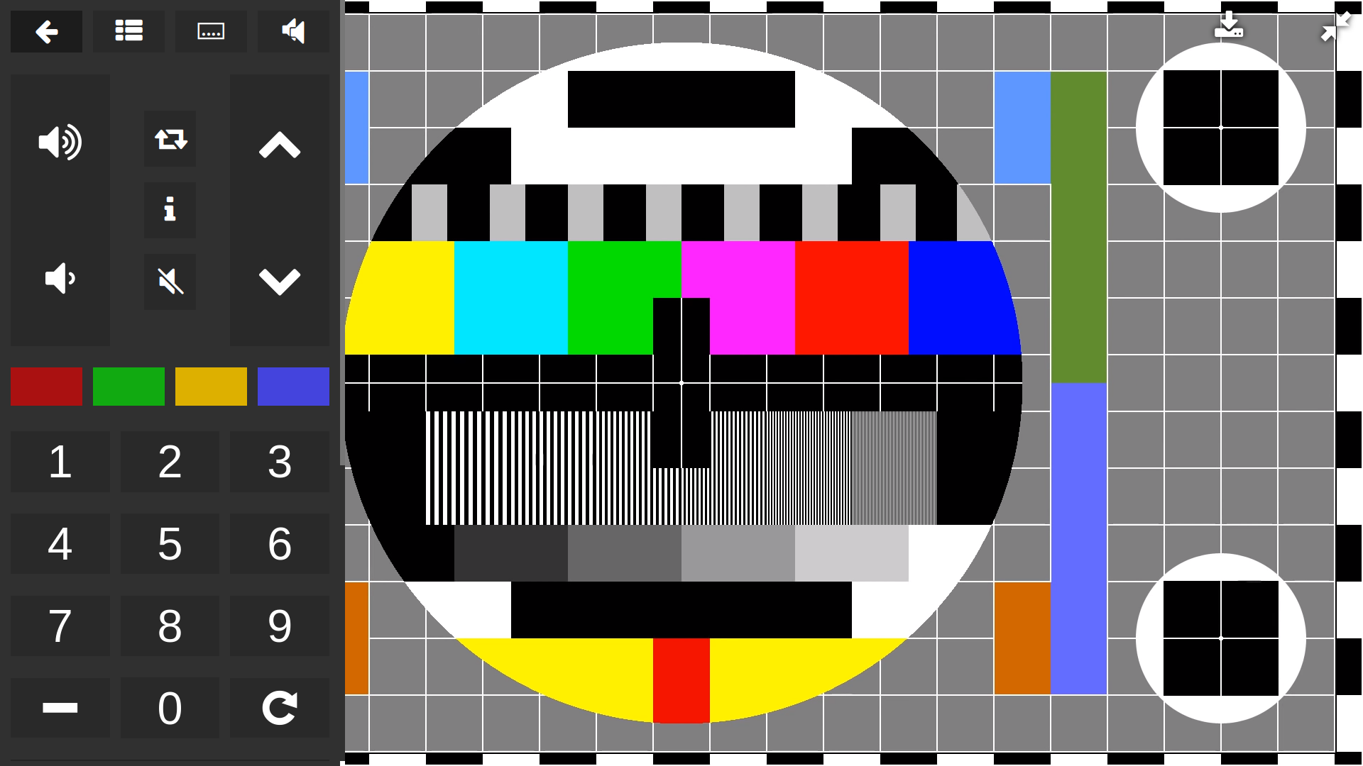
3. Main Page Description
Description
1 | Iframe Player
2 | Virtual remote
②
①
Detailed Information
- On this screen can use remote control the app
*Note
- Remote Key please see page 8, 9, 10 (Key Policy)

Slide 6
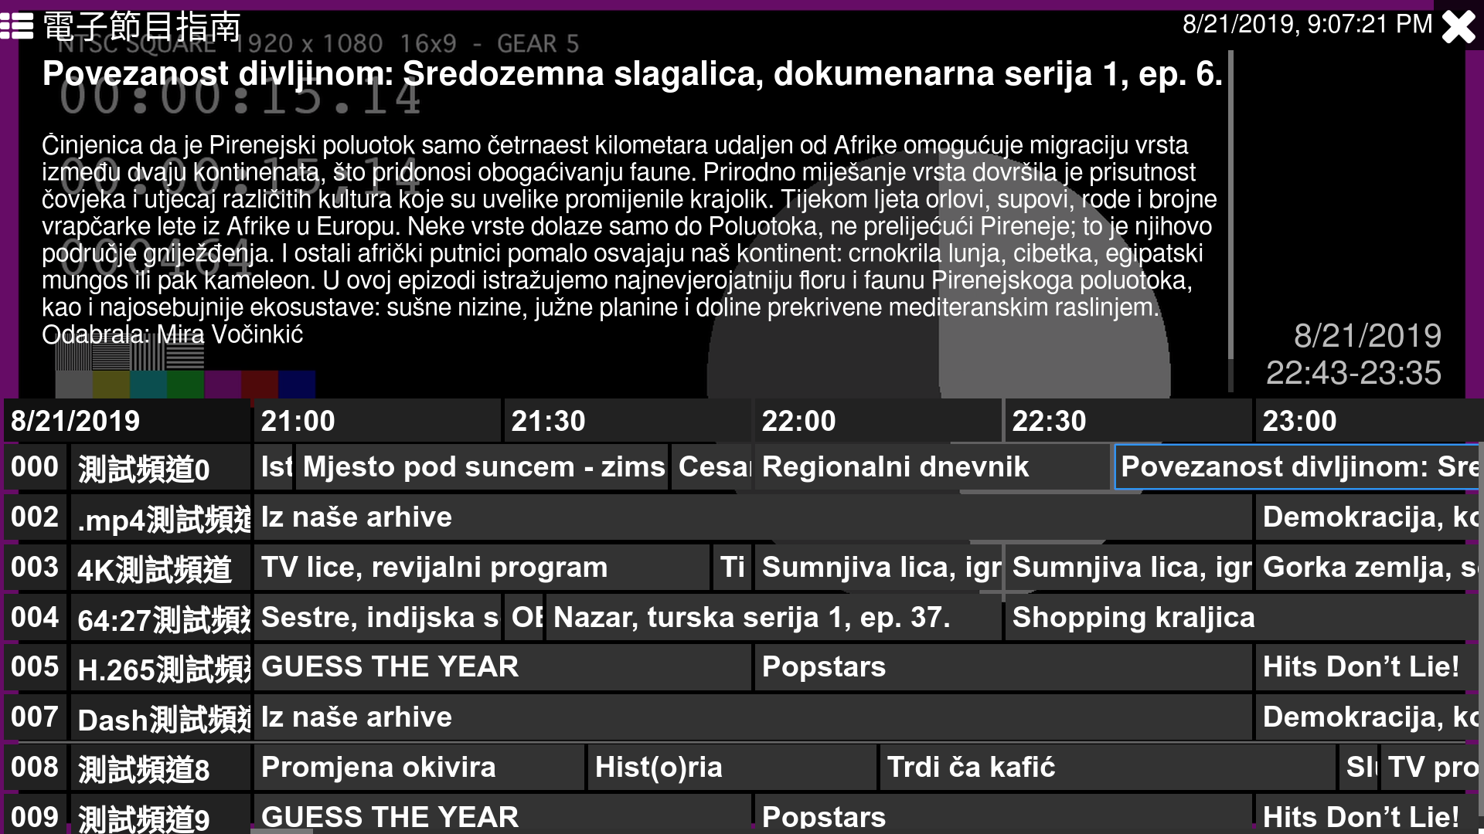
4. EPG Page Description
1. Start Page
Description
1 | EPG
①
Detailed Information
EPG can see program times.

Slide 7
5. Flow Chart
Some Window
Return
IframePlayer
VirtualRemote
Enter
Enter
Return
Enter
EPG
Return
Detailed Information
Please write the detailed information for the above image here, if needed.
*Note
- This page is added for better understanding for sub page’s location and movement during QA.

Slide 8
6.Key Policy
Button | Action | Remarks
ArrowLeft | Focus Left element
ArrowUp | Focus Up element
ArrowRight | Focus Right element
ArrowDown | Focus Down element
Enter | Click element
Back | Hide all UI
VolumeUp | Increase Volume
VolumeDown | Reduce Volume
VolumeMute | Mute Volume
ChannelUp | Change to next Channle
ChannelDown | Change to previous Channle

Slide 9
7.Key Policy
Button | Action | Remarks
ChannelList | List Channels
ColorF0Red | Run Color Red Program
ColorF1Green | Run Color Green Program
ColorF2Yellow | Run Color Yellow Program
ColorF3Blue | Run Color Blue Program
Key_Number | Enter Channel Number to change Channel
Info | Show Channel Info
Caption | Change subtitle track
MTS | Change audio track
PictureSize | Change video track
Guide | Show EPG

Slide 10
8.Key Policy
Button | Action | Remarks
Minus | Enter Minus Channels
PreviousChannel | Change to before watch Channel
Menu | Show Virtual Remote
Tools | Show Virtual Remote

Slide 11
END

