Slide 1
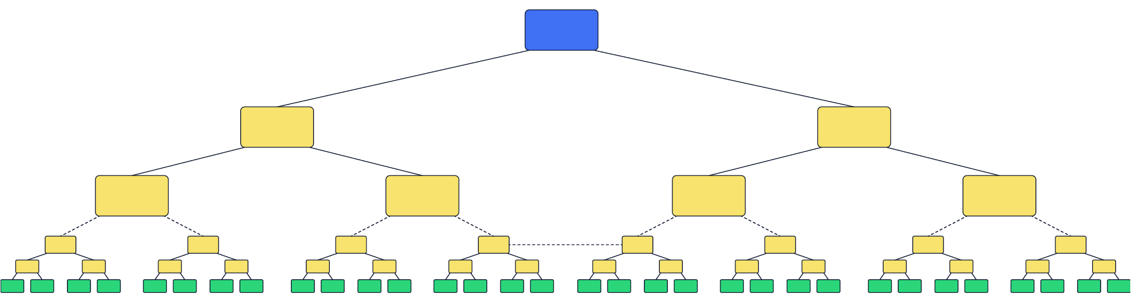



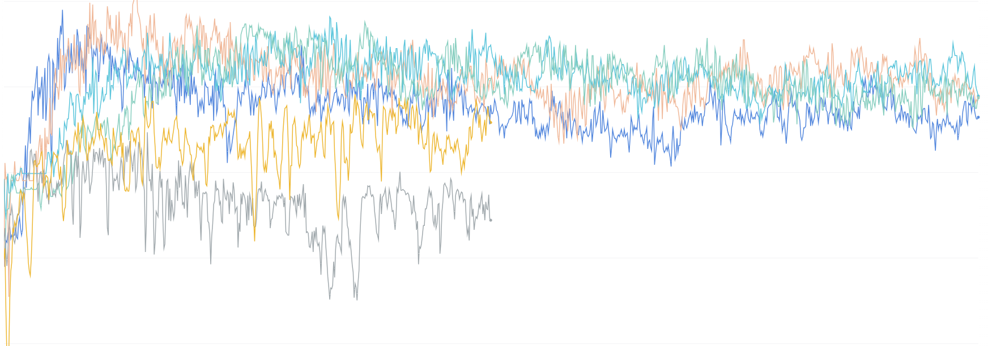




Structural
Sparsity
Lab Events
Clinical Reports
Diagnosis
EHR
Challenges
Noisiness
Length of Stay
Patient Demographics
Medications
Heterogeneity
Male
Discharged
Diabetes
Wight: 97kg
Female
Dead
Re-admitted
Wight: 55kg

