Slide 1
Multi-task Heterogeneous Graph Learning
On Electronic Health Records

Slide 2
Overview
The process of clinical decision heavily relies on the medical records of patients.
EHR however presents great degrees of heterogeneity and sparsity, which leads to severe confounding effects
The confounding effects affect representation learning and hence the downstream task performance
Moreover, EHR data are often surrounded by many downstream tasks
Effective multi-task aggregation design would integrate features from different tasks and lead to better representation learning

Slide 3
Related Works
Graph Neural Networks
Learn relational features by propagating information/features from neighboring nodes (e.g. GCN, GAT)
Also designs on heterogeneous graphs leveraging path-level or semantic-level information by incorporating node and edge heterogeneity (e.g., HAN, HGT)
Graph-level features can be obtained with specific pooling design
EHR Representation Learning
Sequential models
Are able to capture the temporal features
E.g., RNN, bi-directional LSTM, Dipole
Graph-based models
Leverage relational features in EHR data and learn node representation for each medical code
Mostly operate on homogeneous graphs – neglect the entity heterogeneity and meta-relations in the EHR data.
E.g., GRAM, GRASP

Slide 4
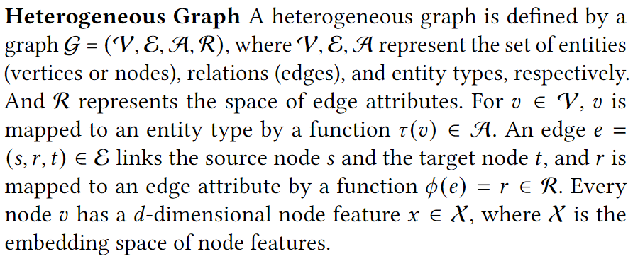
Preliminaries

Slide 5
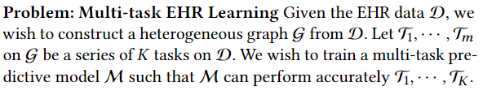
Problem: Multi-task EHR Learning

Slide 6
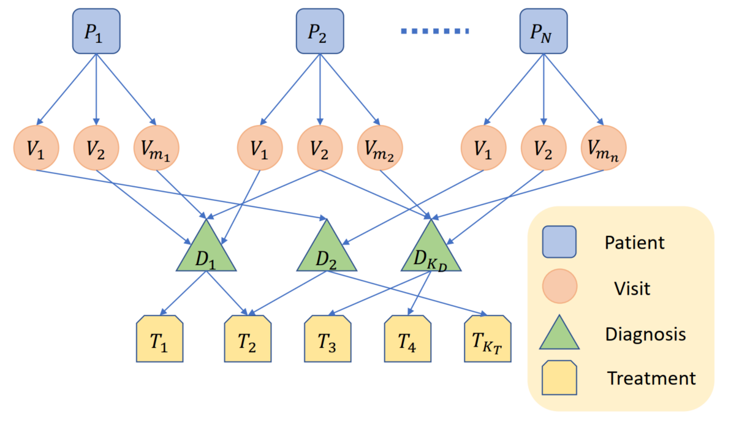

Heterogeneous Graph Construction
We construct $𝒢$ with patients, visits, diagnoses and treatments from the MIMICIII dataset

Slide 7
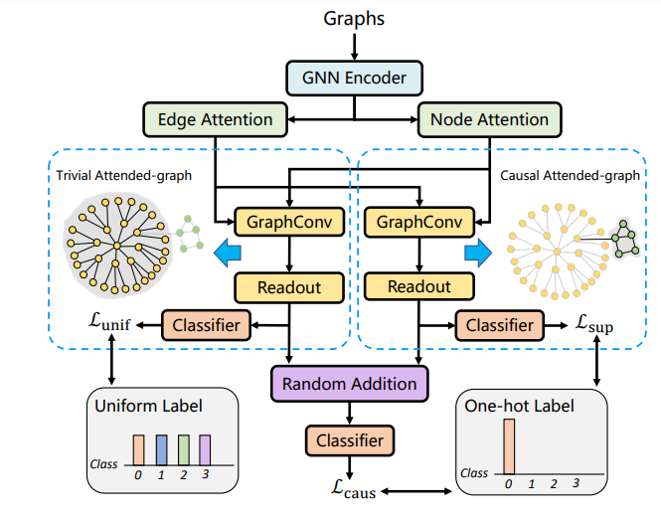

Adjusting confounding effects
Using causal disentanglement to distill the random features
Learn a uniform feature to disentangle causal features during representation learning
Causal features also enable interpretability
A graph-level learning example from Sui et al. (KDD 2022)

Slide 8
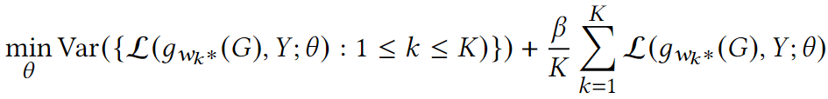
Multi-task Learning
Via environment-invariant objective to adapt task level representations
Where K can be interpreted as the number of tasks. We attempt to minimize the variance across different tasks, so that the cross-task extrapolation risks can be minimized.

Slide 9
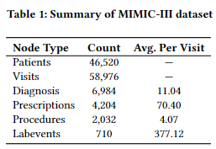
Data and Tasks
Dataset – MIMICIII
Contains ICU records of 46,520 patients over 11 years
Tasks
Length of stay prediction
Readmission prediction
In-hospital mortality prediction
Drug recommendation
Can be viewed as node-level prediction tasks

Slide 10
Implementation Details
Via pyhealth – a recently renowned EHR analysis package with python, which contains efficient data processing codes and implementations of SOTA methods
dgl to perform graph related computations
Adam optimizer with learning rate 0.0005 and weight decay 0.0001
Batch size: 1024

