Slide 1
ADVANCED Python (OOP)
Python 面向对象

Slide 2
Part 1 recap basic

Slide 3
Basic syntax
print(“hello, world”)
Basic numerical operator: +, -, *, /, //, %, **
Basic logical operator: and, or, not (&, |, !)
Comparison: <, >, <=, >=, ==, !=
Variable assignment: =, +=, -=, …
Comment: #, ‘’’ ‘’’

Slide 4
BASIC DATA type
Int 1, 2, 3, 4
Float 1.0, 2.0, 3.0, 4.0
Str ‘1’, ‘2’, ‘3’, ‘4’ str1 + str2
Bool True, False (1, 0)

Slide 5
BASIC DATAtype
List: [1, 2, 3] #(mutable)
Access: list_1[0] => out: 1
List_1.append(x) => [1, 2, 3, x]
List_1.remove(x) => [1, 2, 3]
List_1.insert(x)
List_1.pop(index)

Slide 6
BASIC DATA DATATYPE
Tuple: (1, 2, 3) #(immutable)
Access: tuple[0] out: 1
Dictionary: {key: value}. # map
Access: dictionary[key] return value

Slide 7
Basic control flow (branch)
If else:
If condition_1:
. . . .do_movement_1()
elif condition_2:
. . . .do_movement_2()
else:
. . . .exit()

Slide 8
Basic control flow (loop)
For:
E.g. for i in range(8):
. . . .do_something_1() indentation: TAB
. . . . Do_something_2()
** range(number) **
Return [0, 1, 2, 3, … , n – 1]

Slide 9
Basic control flow (loop)
While:
while condition_1 and condition_2:
do_something_1()
Repeat until the condition is no longer satisfied

Slide 10
Function
Def
def calculate_sqaure(x):
return x*x
x = calculate_sqaure(2)
print(x) # output: 4

Slide 11
Task 1: calculate
h1
h1 = h2 = h3 = 5 m
r3
h2
r1 = 10 m
r2
r1 = 6 m
h3
r1 = 2 m
r1
Question: V = ?

Slide 12
Part 2 INTRODUCTION to OOP

Slide 13
Object Oriented Programming
Class
Attribute
Method
* Feature
Abstraction (e.g. Dog class is a special case of Animal class)
Encapsulation
Inheritance (e.g. Dog class can inherit attribute of Animal class)
Polymorphism

Slide 14
OOP vs. Pop
Same capability of computation
Different view of structuring the world
OOP: Behavior and Interaction between objects (evolve of object(s), time consisting)
POP: behavior and changing between states (from start to end)

Slide 15


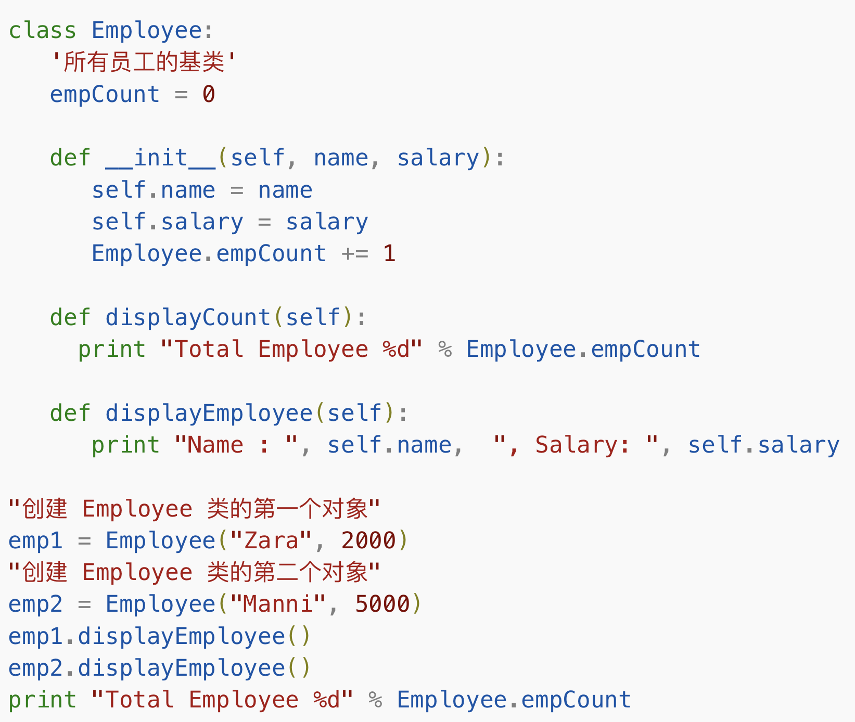
Oop in python
Key word:
class class_name(parent):
Method
def method_1(self, arg_1, arg_2, …):
…
Member
self.member_1 = …
Constructor (special function “__xxx__()”, automaticly run when created)
def __init__(self, arg1, arg2, …):
…

Slide 16
OOP in python
Create
Obj_1 = Dog_class(init_arg_1, init_arg_2, …)
Access
Obj_1.member = … / obj_1.method()

Slide 17

Task 2 model your tar

Slide 18
Part 3 OOP IN real project *

Slide 19
module
When others write some nodules, they often encapsulate their functions as some classes with their members and methods.
E.g. numpy, pandas, cv2 (opencv) …
If you want to use them, install and import
E.g. import numpy

Slide 20
Python environment
How to install and group all these modules in our projects?
Anaconda, pip
Anaconda: install python, create an environment with download packages and specified version of python.
Pip: Install python packages with simple command
E.g. pip install numpy

Slide 21
Our robot: from oop view
Sensor
Controller
Motor
…

