Slide 1

Passby@UST
Yuxuan (Rio) He 20227977
Zelong (Cedric) Liang 20220395
Zhitian (Kevin) Wang 20225577
2014.12.12

Slide 2

Outline
Background of Passby@UST
Design Plan
  Structure
  Features
  Key Technology
How to Play Passby@UST
Conclusions
Demo
Q&A

Slide 3
Background of Passby@UST
An Information Explosion Period
Opportunities are everywhere, but flow away in a flash
We need catch it at once, so we want to create a social software to realize this thought.
e.g. Wechat, Whatsapp, MOMO etc.
Same time, Same location. Instant software for instant message

Slide 4
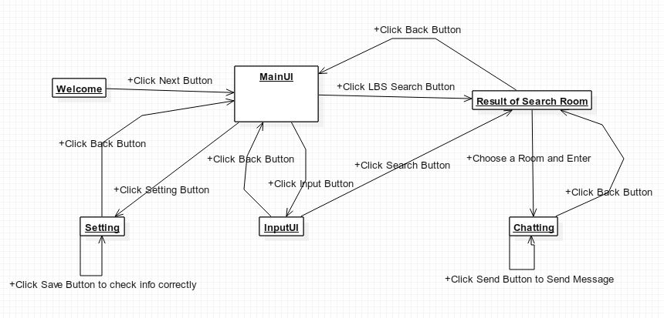
Design Plan - Structure

Slide 5
Design Plan - Features
1. Settings
2. Search Room
3. Show Room Result
6. Chatting

Slide 6
Design Plan - Key Technology
1. LBS - Location based Service
2. Database Service

Slide 7
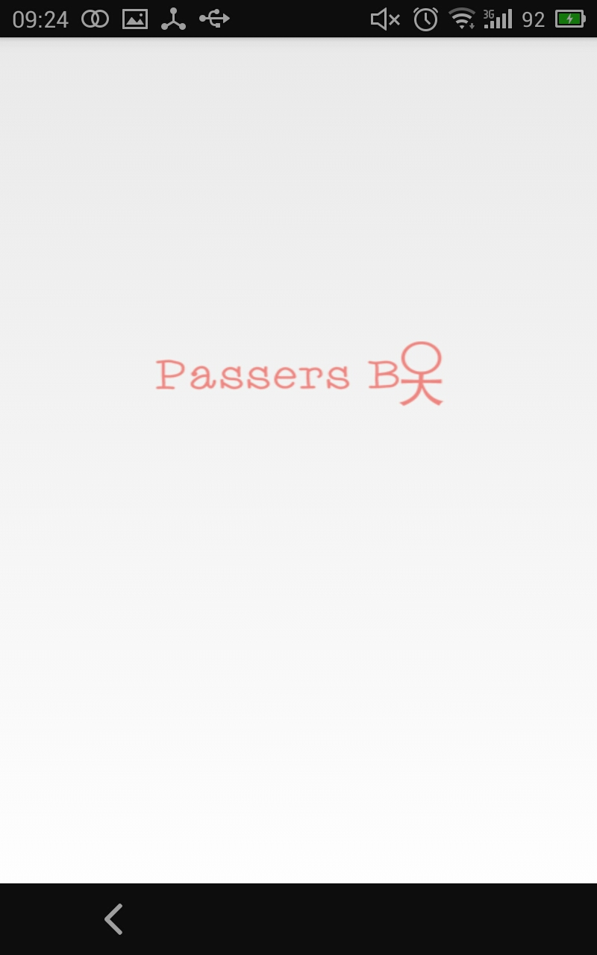
How to Play Passby@UST

Slide 8
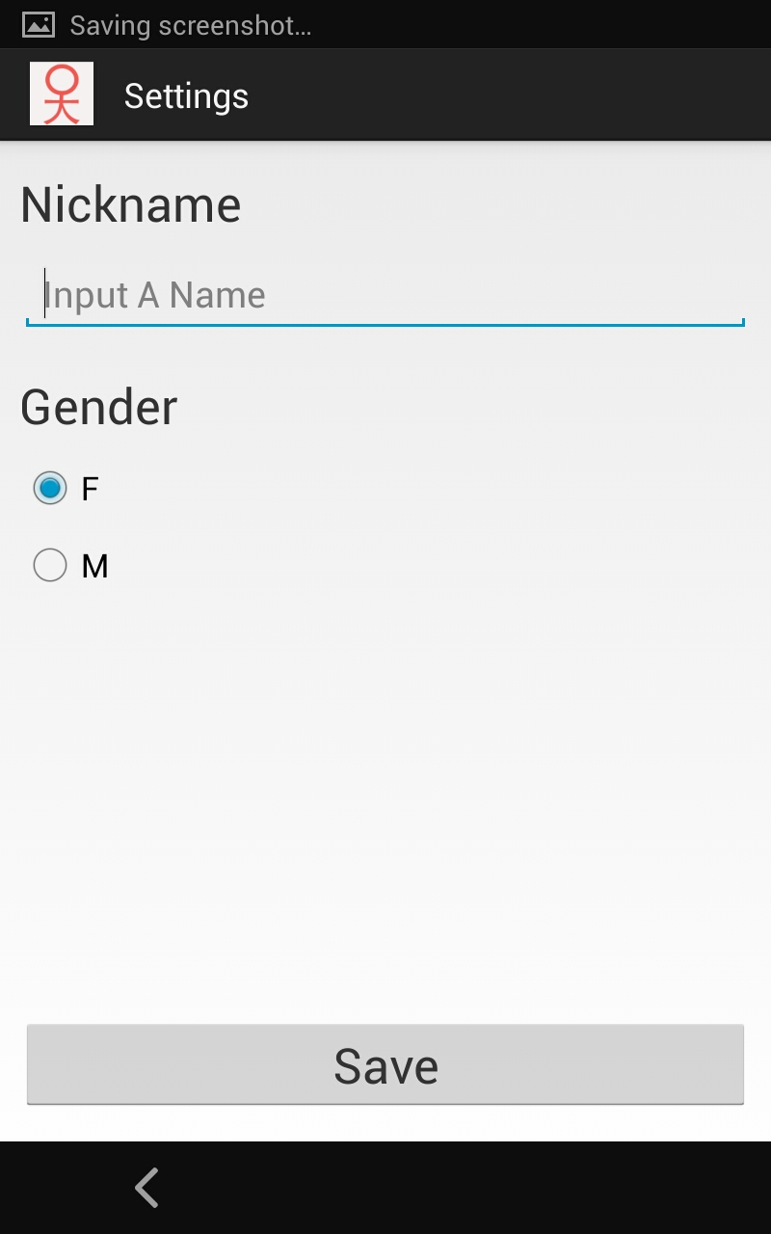
How to Play Passby@UST

Slide 9
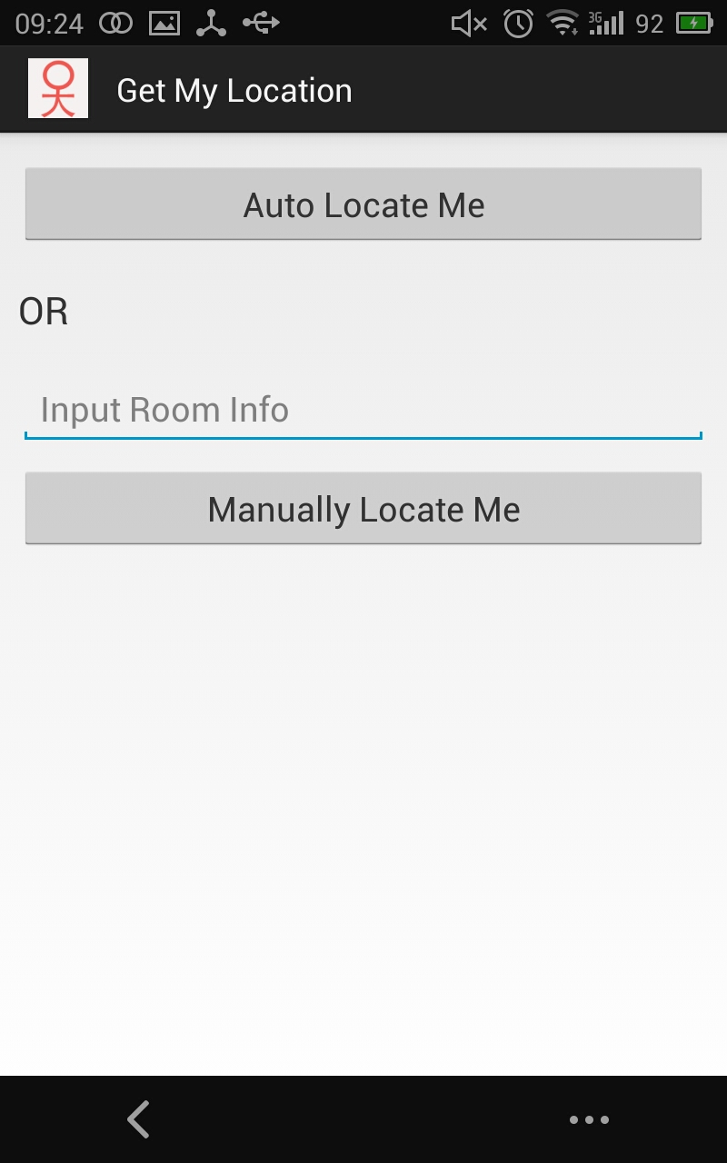
How to Play Passby@UST

Slide 10
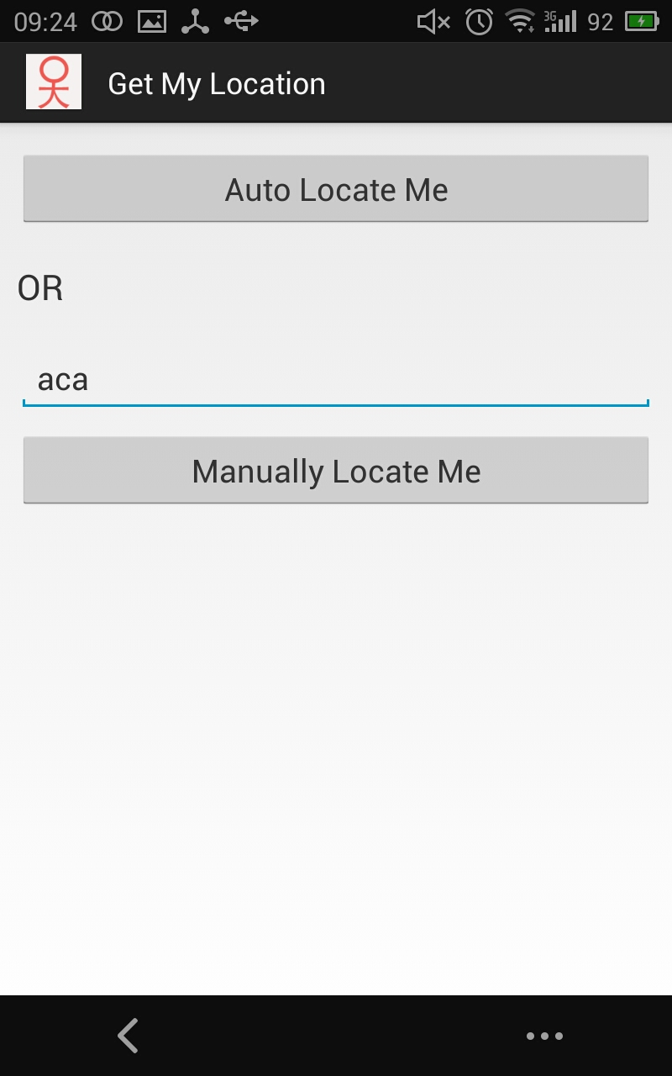
How to Play Passby@UST

Slide 11
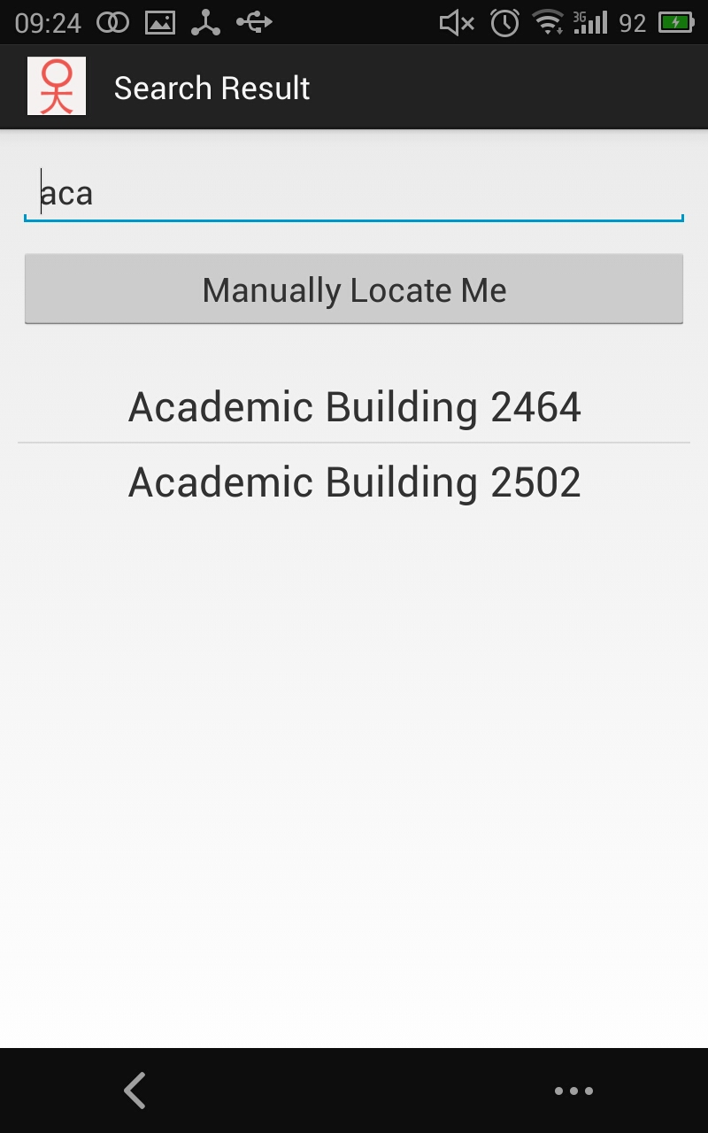
How to Play Passby@UST

Slide 12
Using GPS(global position system)
Get LocationManager provided by system.
Use LocationManager, get Location by LocationProvider.
Get position information stored in Location.

Slide 13
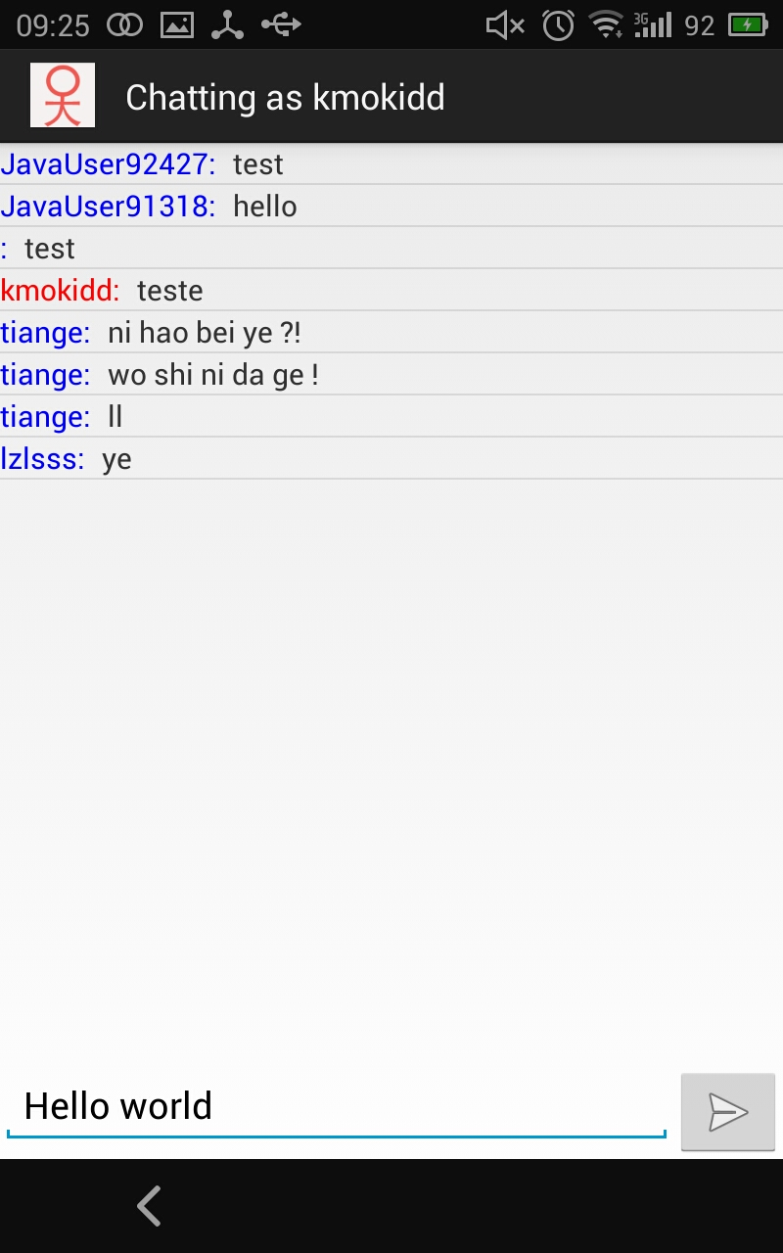
How to Play Passby@UST

Slide 14
Conclusions
In conclusion, an android application will be developed for social networking purpose, which is named as Passer-By. However, different from the applications have already published on public, Passer-By focuses on HKUST students and tries to provide a vintage feel to users by using the concept of ‘chatting room’.
In technique area, because of the usage of Passer-By, instant message and GPS tech will be involved. For the implementation part, there mainly six activities which will offer users searching, getting their location and chatting with others.
We used github to control our poject.

Slide 15
References
[1] Android Instant Messaging Application, Pirngruder,
https://github.com/Pirngruber/AndroidIM
[2] Android Location Based Services, tutorialspoint, Retrieved Nov. 3rd,
http://www.tutorialspoint.com/android/android_location_based_services.htm
[3] Location Strategies, Retrieved Nov. 3rd,
http://developer.android.com/guide/topics/location/strategies.html
[4] Google Maps Android API v2, Retrieved Nov. 3rd,
http://developer.android.com/google/play-services/maps.html

Slide 16
Demo

Slide 17
Q&A

