Slide 1
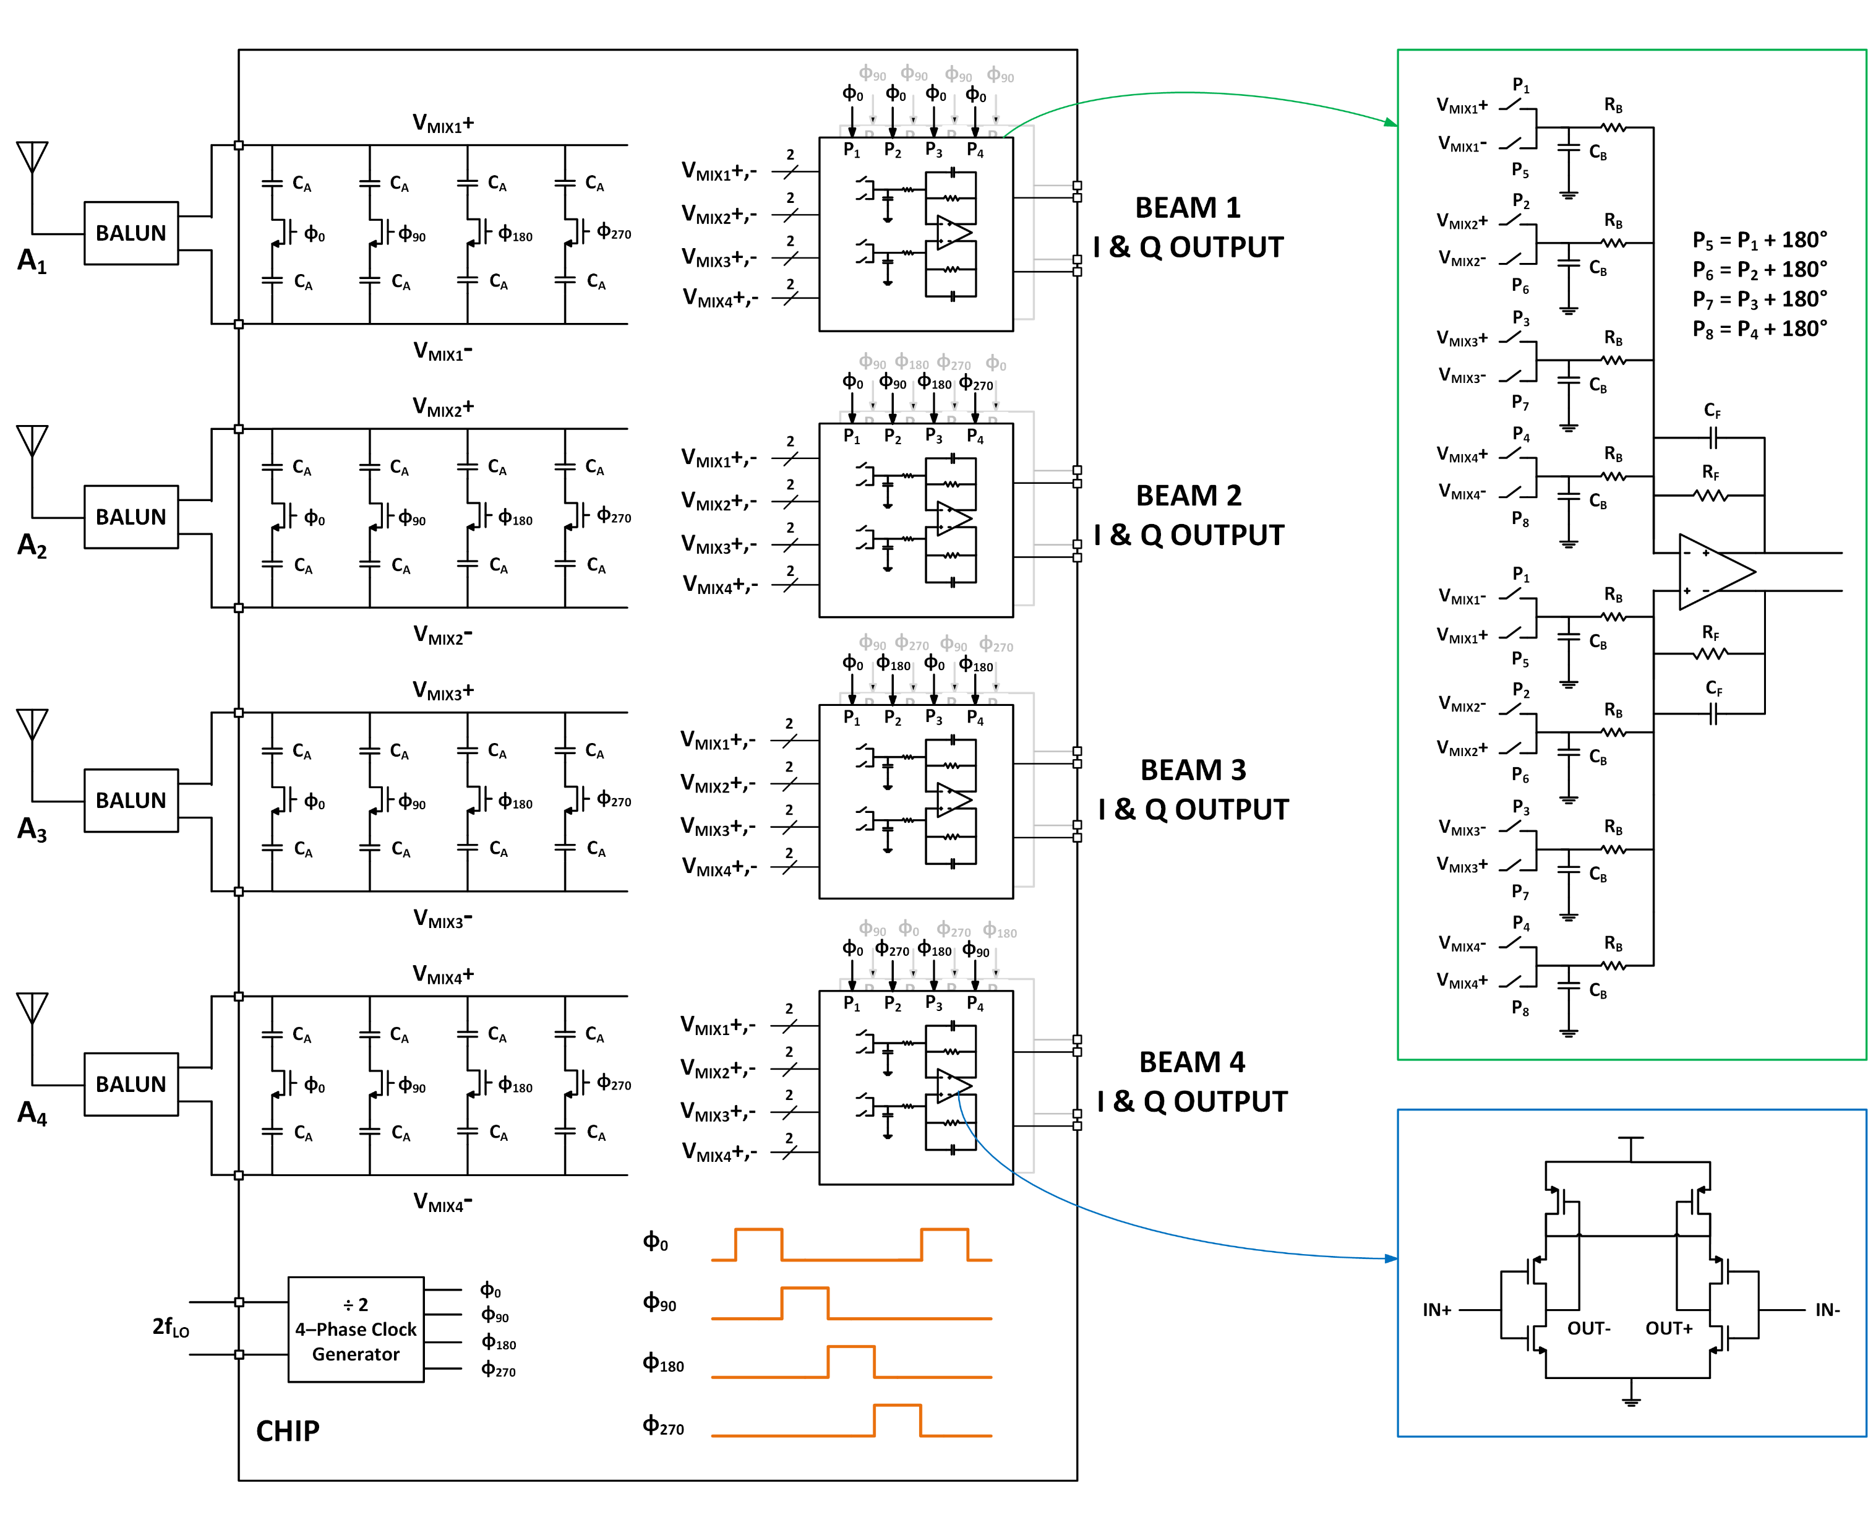
MIMO Receiver Architecture
Wireless testcase
Resistors, capacitors, transistors
No inductors
1-3 GHz operating frequency
Clock distribution network as digital block

Slide 2
Left-right-top-bottom
Relative pin position
ABCD
AB, AC, AD, BC, BD, CD(distance, relative-position (left/right/top/bottom))
Minimize -MST (AB+AC+AD+BC+BD+CD)
MST- PRIM algorithm
Greedy steiner approach
Obstacles
Dataset?
Matched net routing
Obstacles
Image translation of the problem
Wellgan
1906.08809.pdf (arxiv.org)
ANALOG_ICCAD2019_Zhu.pdf (yibolin.com)
Graph translation of the problem

Slide 3
MIMO Receiver Architecture
Wireless testcase
Resistors, capacitors, transistors
No inductors
1-3 GHz operating frequency
Clock distribution network as digital block
Main blocks
Spectral filter
Spatial filter (shown in green box)
Transimpedance amplifier (shown in blue box)
Clock distribution network

Slide 4
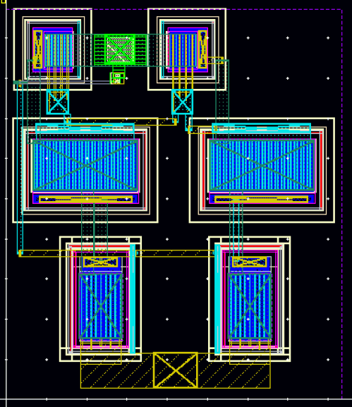
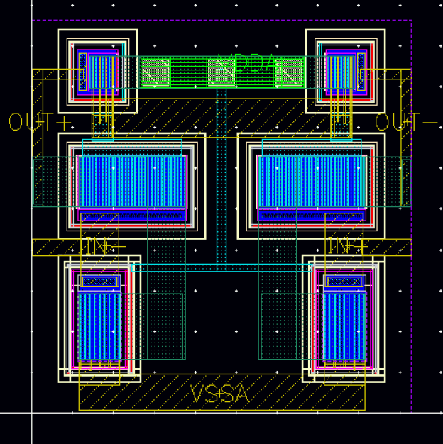
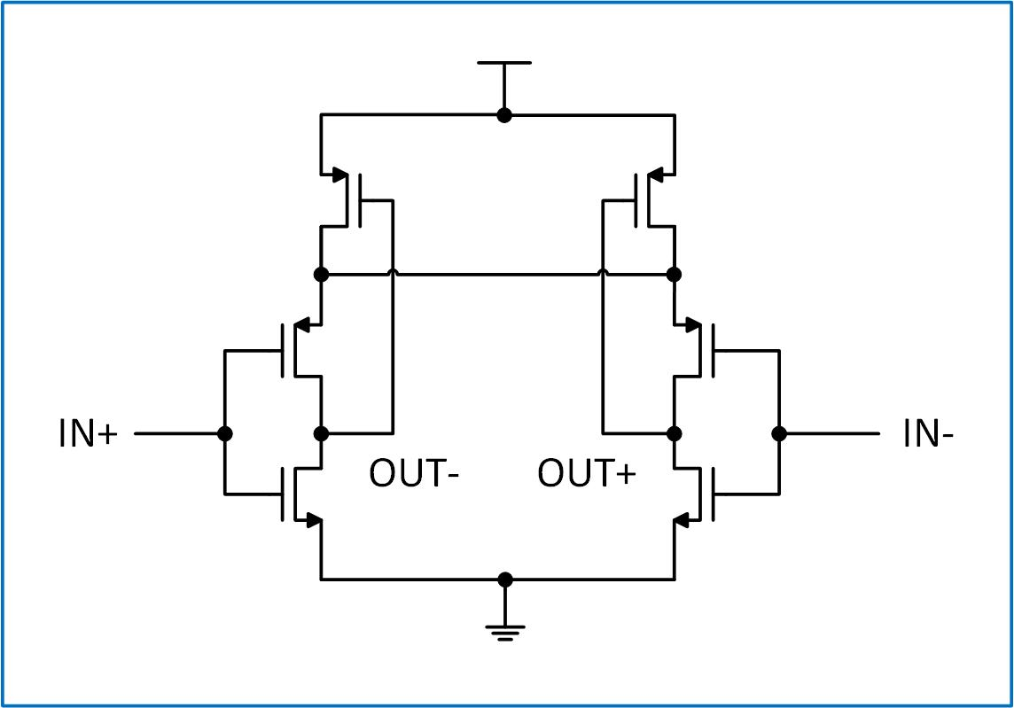
TIA Layout
ALIGN Layout
Manual Layout
Schematic
41.68μm × 48.585μm = 2025.02μm²
46.355μm × 48.18μm = 2233.38μm²
Notes:
In the presentation, point out the use of wide metal wires

Slide 5
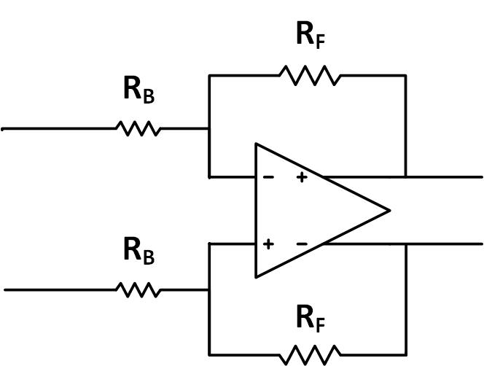
TIA Performance Verification
Test Setup
R_{B} and R_{F} were schematic models for simulation
Parameters | Schematic | Manual Layout | ALIGN Layout
Open Loop Gain (dB) | 25.25 | 24.95 | 23.26
OL 3dB Frequency (MHz) | 160 | 157.8 | 181.1
Closed Loop Gain (dB) | 18.49 | 18.34 | 17.58
CL 3dB Frequency (MHz) | 87.43 | 85.71 | 91.86

Slide 6
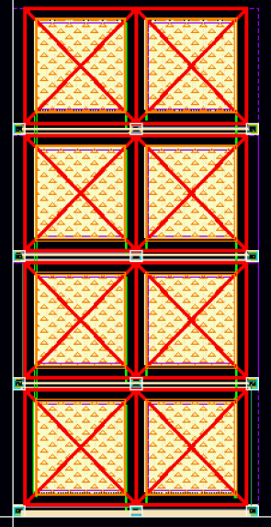
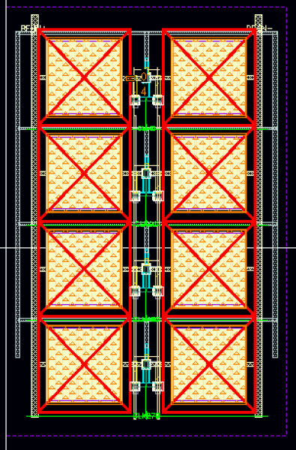
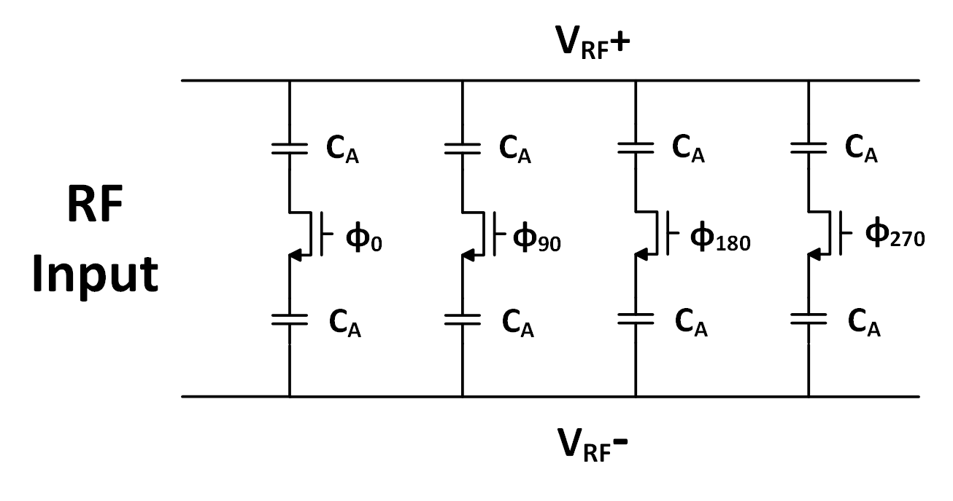
Spectral Filter Layout
ALIGN Layout
Manual Layout
Schematic
c3
c4
c5
c6
c7
c8
c9
c10
C_{A}
213.05μm × 441.56μm = 94074.36μm²
273.6μm × 420μm = 114912μm²
Notes:
I have used the rotated version here – moved the CA annotation to the ALIGN layout since it comes first. Please explain You could talk about the constraint orally during the presentation

Slide 7
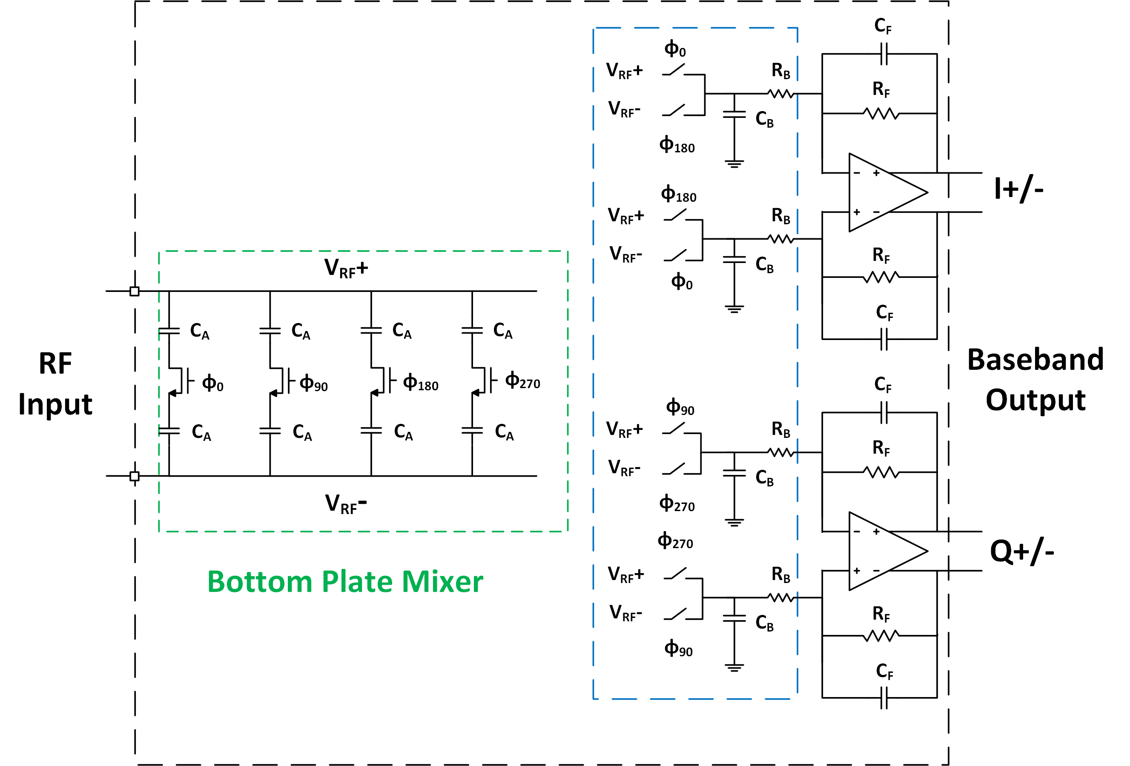
Mixer-First RX
Transimpedance
Amplifier (TIA)

Slide 8
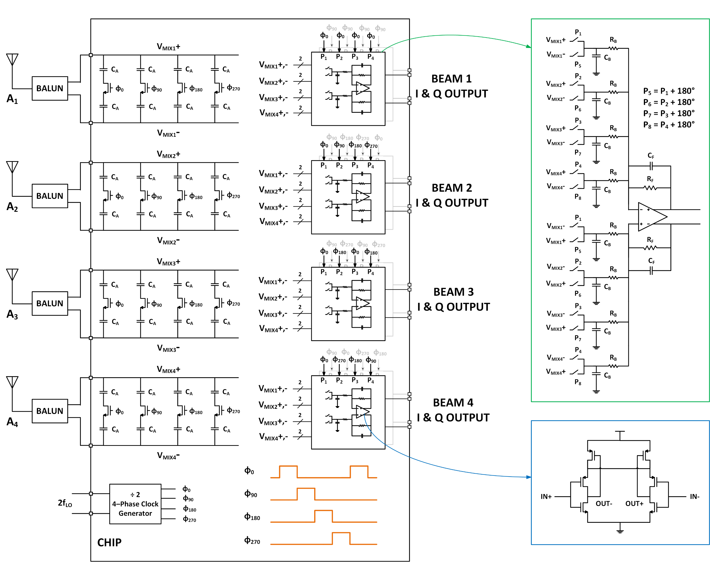
MIMO v/s Mixer First
MIMO RX
Mixer-First RX
TIA
Spectral Filter

Slide 9
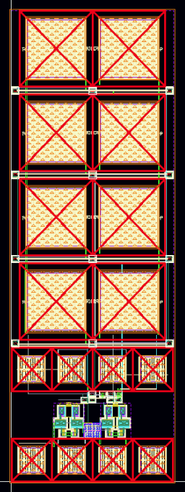
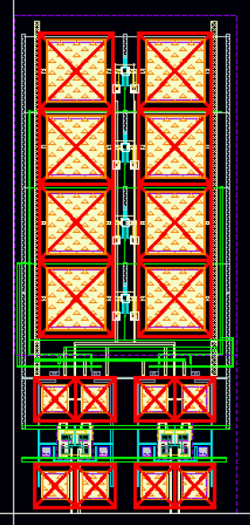
Top-Level Layout of Mixer-First RX
ALIGN Layout
Manual Layout
Schematic
132,901 μm²
189,841 μm²

Slide 10
Top Level Performance Verification: Mixer-first RX
Simulated at LO frequency of 1 GHz
Parameters | Schematic | Manual Layout | ALIGN Layout
Input Matching S₁₁ (dB) | -15.79 @ 960 MHz | -14.27 @ 960 MHz | -10.9 @ 960 MHz
Best S₁₁ (dB) | -15.79 @ 960 MHz | -19.17 @ 940 MHz | -17.35 @ 920 MHz
IF Bandwidth (MHz) | 118.5 | 107.78 | 114.45
Power Gain S₂₁ (dB) | 18.12 | 15.22 | 15.23
NF (dB) | 8.21 | 11.94 | 11.51
ALIGN Layout results consists PEX results using individual layout of bottom plate mixer and TIA

Slide 11

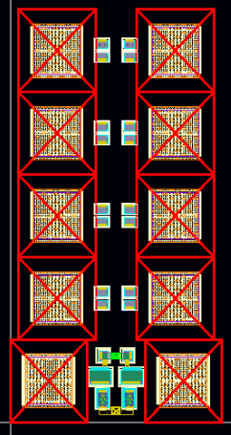
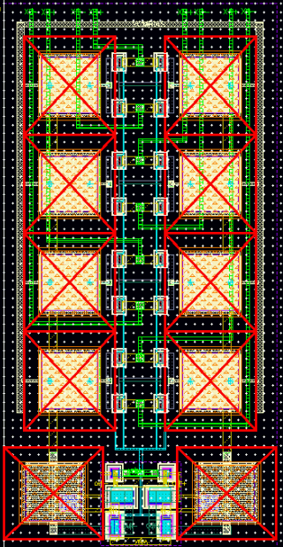
Spatial Filter Layout
Schematic
ALIGN Layout
Manual Layout
145.6μm × 284μm = 41350.4μm²
156.94μm × 309.47μm = 48568.22μm²

Slide 12
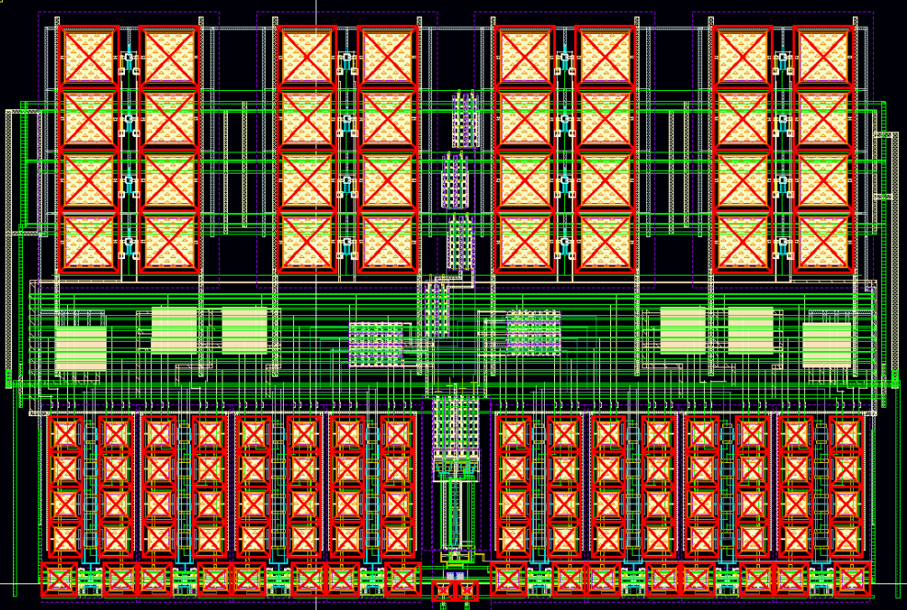
MIMO Layout
Schematic
Manual Layout

Slide 13
MIMO Layout
Manual Layout
Spectral filter hierarchy
Spatial beamformer hierarchy

Slide 14
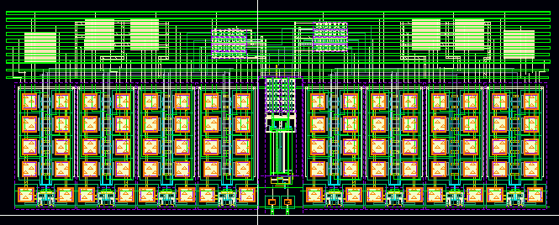
MIMO Sub-Hierarchy: Spatial Beamformers
Spatial beamformer block contains
8 Spatial filters
2 CLK driver buffers (used as black box input)
1 I/O CLK distribution block (used as black box input)
CLK Drivers
I/O CLK Distribution Block
Spatial filter
Manual Layout

Slide 15
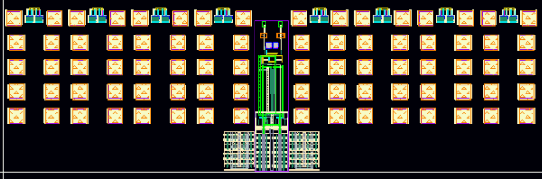
MIMO Sub-Hierarchy: Spatial Beamformers
ALIGN Layout 1
Manual Layout

Slide 16
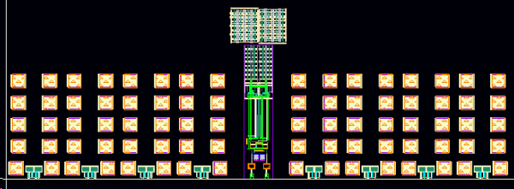
MIMO Sub-Hierarchy: Spatial Beamformers
ALIGN Layout 2
Manual Layout

Slide 17
TIA Layout
ALIGN Layout
Manual Layout
Schematic
41.68μm × 48.585μm = 2025.02μm²
46.355μm × 48.18μm = 2233.38μm²
Notes:
In the presentation, point out the use of wide metal wires

Slide 18
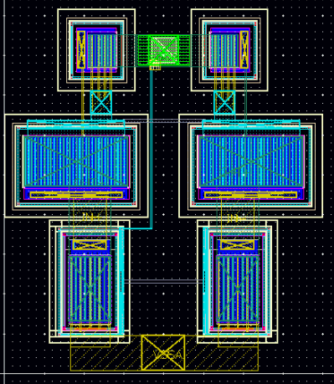
TIA Layout with new P&R
ALIGN Layout
Manual Layout
Schematic
39.98μm × 45.715μm = 1827.68μm²
46.355μm × 48.18μm = 2233.38μm²
Notes:
In the presentation, point out the use of wide metal wires

Slide 19
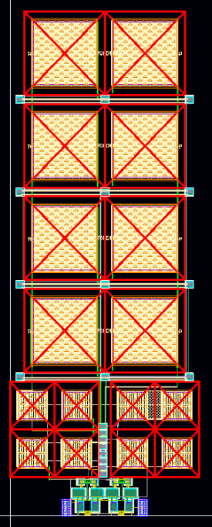
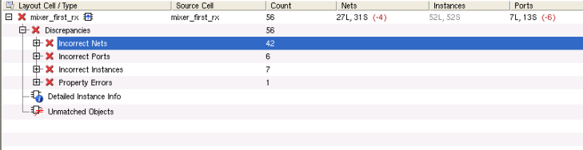
Update 02/07/2022
Mixer First RX
Placement looks symmetric and good for performance
Few wire shorts observed
LVS not clean
Ports have shorted

