Slide 1
Summary of results

Slide 2
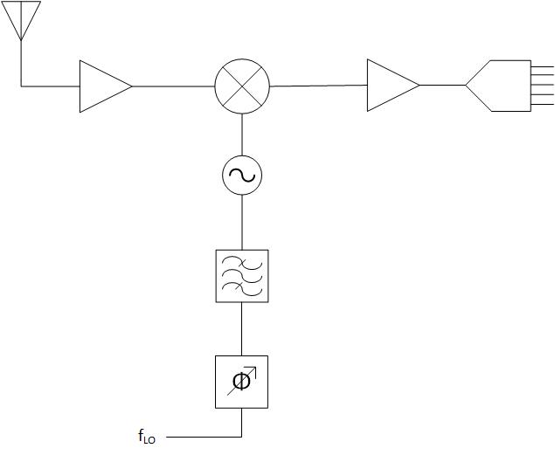
RF receiver system
RF section
Baseband Section
Radio Frequency Circuits
Low Noise Amplifier (LNA)
Mixers
Oscillators
Filters
Baseband Amplifier
LNA
Mixer
ADC
Oscillator
BPF
Phase Shifter
Fig 1. RF receiver system

Slide 3
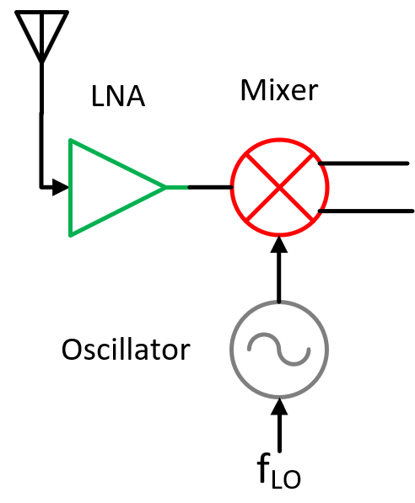
New training data: Rf section
Passive
Passive

Slide 4
New training data: Rf section
Passive
Passive

Slide 5
New training data: Rf and baseband section
Passive
Passive

Slide 6
Mixer first with oscillator: top

Slide 7
Mixer first with oscillator: top plate passive mixer (single topology)

Slide 8
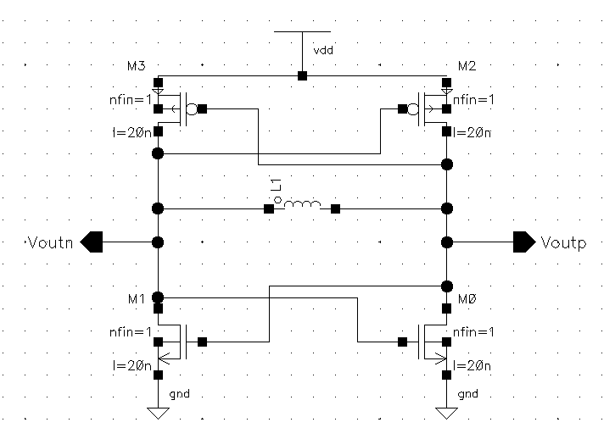
Mixer first with oscillator: oscillator
New training data

Slide 9
Mixer first with oscillator: baseband-amplifier

Slide 10
MIMO
off chip
clock generator
TIA

Slide 11
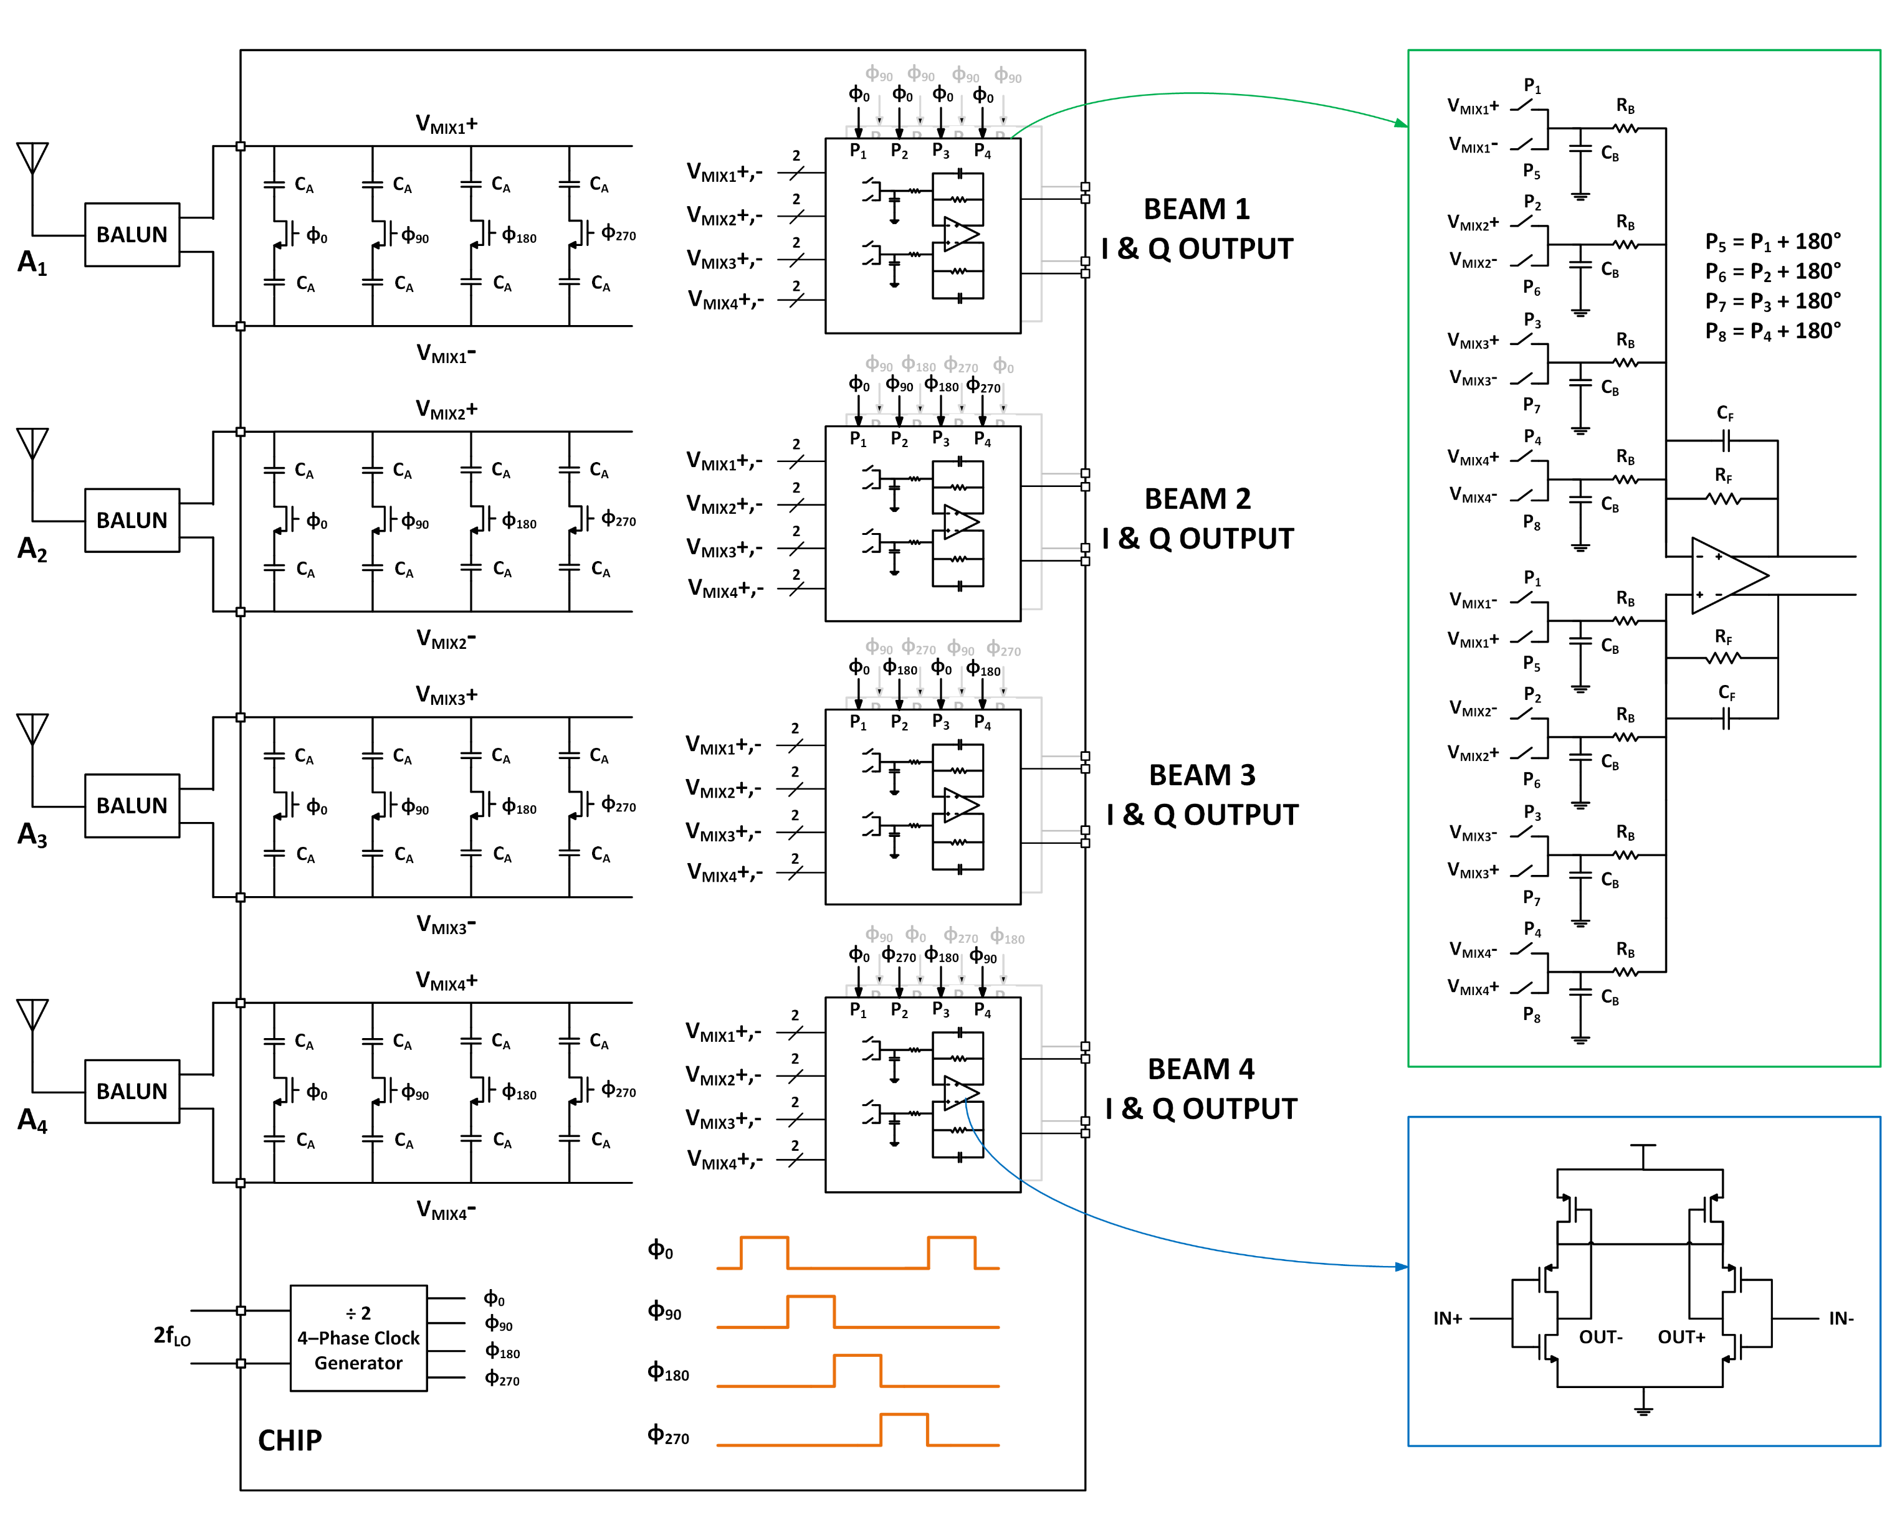
MIMO: top
off chip
clock generator
TIA

Slide 12
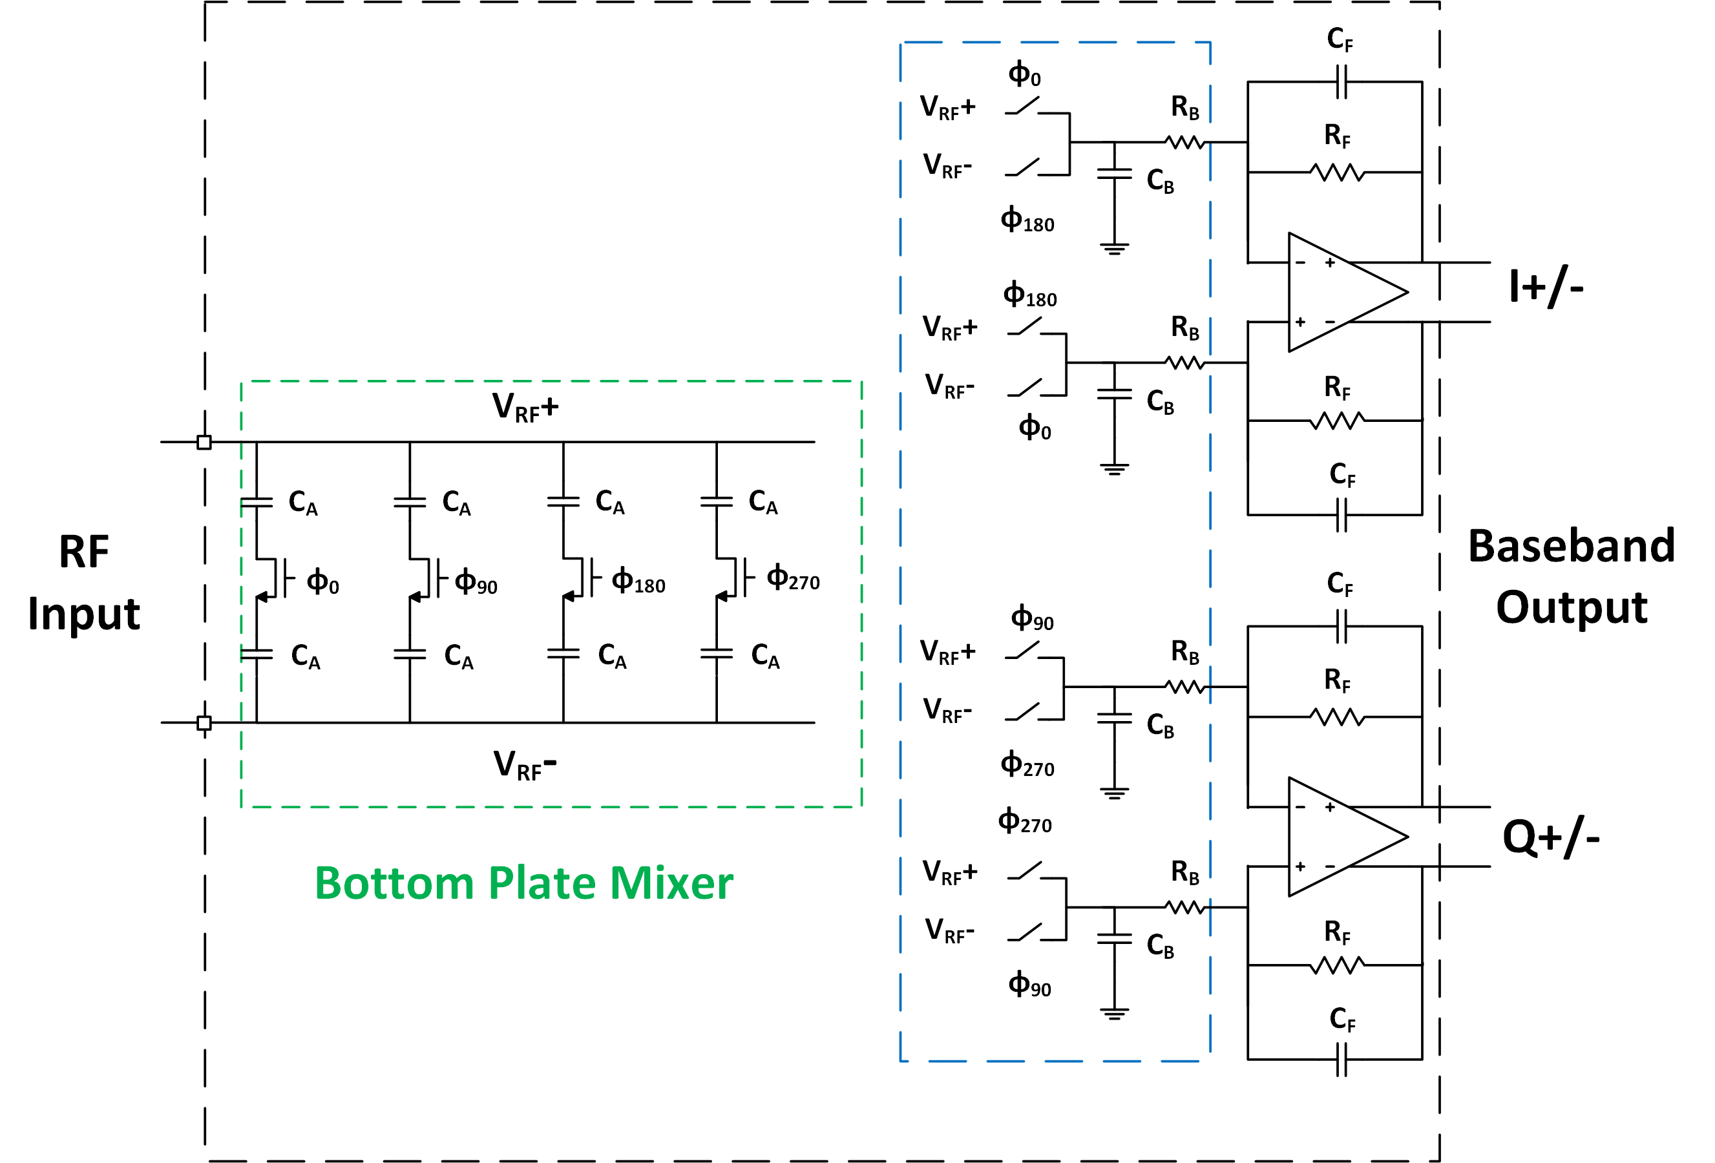
MIMO: bottom plate Single phase (Mixer-first RX)

Slide 13
MIMO: Mixer

Slide 14
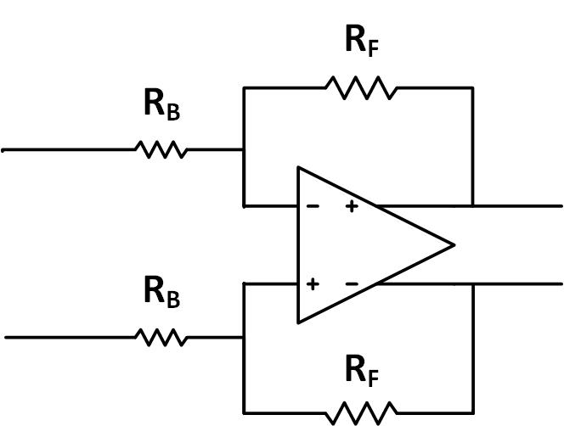
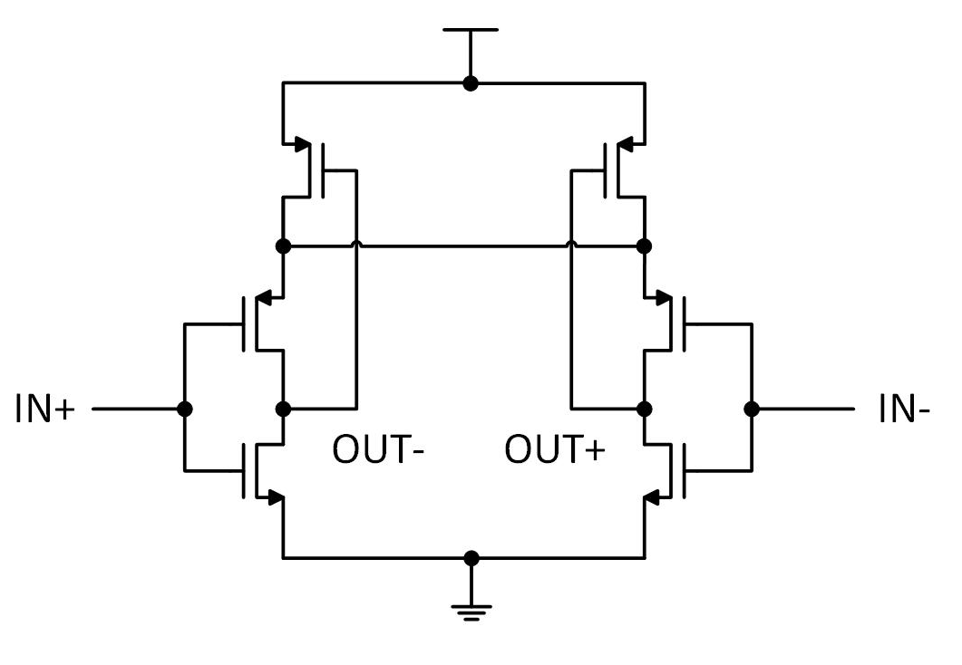
MIMO: TIA (transimpedance amplifier)
Changed to baseband
amplifier

Slide 15
MIMO: beamforming (no training data)- can be detected as switched cap’s

Slide 16
Phased array: total
RF section
Baseband Section
Radio Frequency Circuits
Low Noise Amplifier (LNA)
Mixers
Oscillators
Filters
Baseband Amplifier
LNA
Mixer
ADC
Oscillator
BPF
Fig 1. RF receiver system

Slide 17
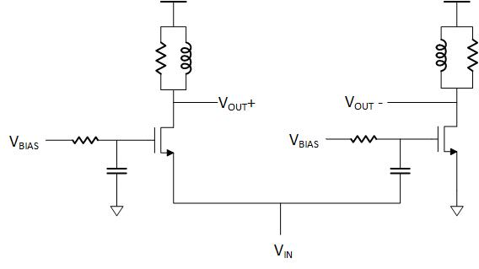
Phased array: Low noise amplifier (LNA)
LNA
Mixer
Oscillator
BPF

Slide 18
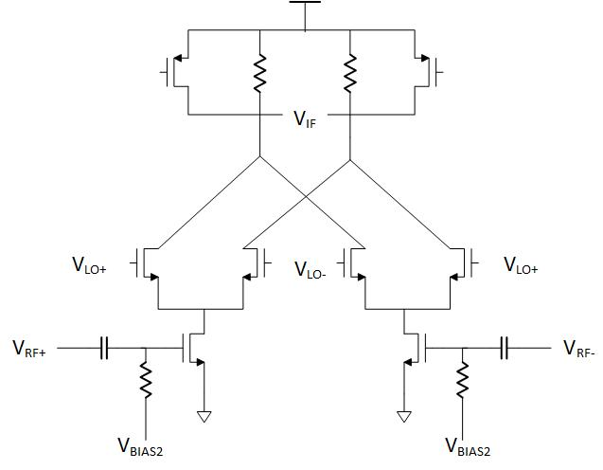
Phased array: mixer
LNA
Mixer
Oscillator
BPF

Slide 19
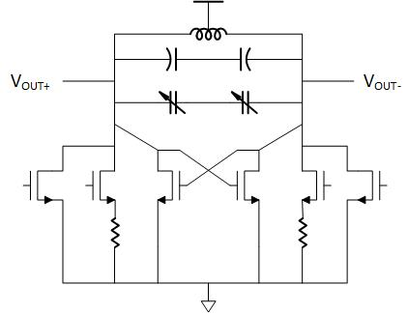
Phased array: oscillator
LNA
Mixer
Oscillator
BPF

Slide 20
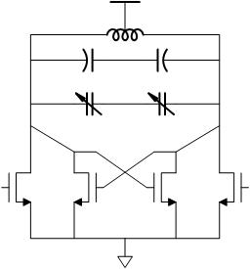
Phased array: band-pass filter
LNA
Mixer
Oscillator
BPF

