Slide 1
Secure Federated Transfer Learning
Presented by Qinghe
2019.03.09

Slide 2

Problems
Data is expensive(require human expertise and domain knowledge)
Data needed for a specific task may not be kept in one place.
Small data: few samples and features
Weak labels: few labels
Difficult for organizations to combine their data due to data privacy

Slide 3

Federated Learning System
A global machine learning model
Updated by a federation of distributed participants
Keep their data locally
Still problems:
Only applicable to either common features or common samples

Slide 4
Federated Transfer Learning
Provide solutions to entire sample and feature space under federation
In a privacy-preserving setting
End-to-end solution
Comparable convergence and accuracy to non-privacy-preserving approach
Homomorphic encryption to multi-party computation with NN
Only minimal modifications to NN
Accuracy is almost lossless
(E(a)+E(b)=E(a+b))

Slide 5
Related works
Server-end models
CryptoNets(2016): adapted NN to work with data encrypted with HE
CrytoDL(2016): approximate the activation functions in NN
DeepSecure(2017): use Yao’s Garbled Circuit Protocol for data encryption
Multi-party computation scheme
SecureML(2017): Yao’s Garbled Circuit Protocol recently extended with three-party computation
Differential Privacy(2008): raw data is possibly exposed

Slide 6
Transfer Learning
Powerful solution for applications with small dataset or weak supervision
Performance relies on how related the domains are

Slide 7

Problem Definition
Dataset
Source domain dataset: D_{A}
Target domain dataset: D_{B}
Co-occurrence dataset: D_{AB}
A small set of labels for B in party A: D_{C}
Assumption
only A have labels
A and B knows the common IDs
Objective
Build a transfer learning model to predict labels for the target-domain party as accurately as possible without exposing data to each other

Slide 8
Security Definition
All parties are honest but curious(t-private)
Assumption:
Only one of the two client can be corrupted.
Security Definition:
For a protocol P: (O_{A},O_{B}) = P(I_{A},I_{B}). If A collude, there are infinite number of (I_{B}’, O_{B}’) such that (O_{A},O_{B}’) = P(I_{A},I_{B}’).

Slide 9

Hidden representations of A and B
The computed result of the neural network A and B (u^{A},u^{B})

Slide 10
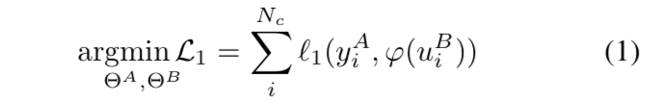
Objective function(3 parts)
Predict loss

Slide 11
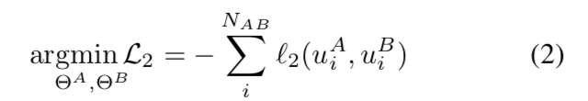

Objective function(3 parts)
Predict loss
Alignments loss between A and B

Slide 12

Objective function(3 parts)
Predict loss
Alignments loss between A and B
Regulation terms

Slide 13
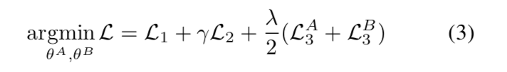
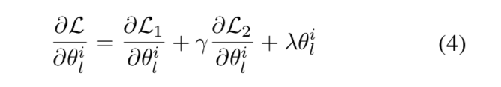
Objective function(3 parts)
Predict loss
Alignments loss between A and B
Regulation terms
Final objective function and gradient

Slide 14
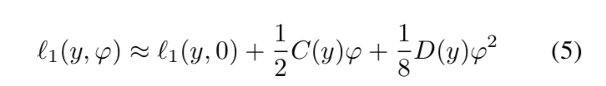
Additively Homomorphic Encryption
Use second order Taylor approximation for loss and gradient computation

Slide 15
Training
compute their hidden representations and encrypts to the other one
calculate their gradient and add a random mask(prevent gradient from leakage) the send gradient to the other side
helps decrypt the gradients and send back
Minus the mask and update the parameters
A responsible for computing the loss and send stop flag to B

Slide 16

Prediction
B computes the hidden represents, encrypts and sends to A
Computes result and add a mask, send to B
B decrypts the result, send back to A
A get label and send to B

Slide 17
Cross Validation
Input: model M and number of fold k
Train the model with training algorithm and predict the samples in B with predict algorithm
Combine the training set and the predicted result
Train the model with the new data set and predict the samples in the validation set
Compare the predicted label and the original ones, and get a loss
Calculate the average of the k losses

Slide 18
Security Analysis
The protocol in training and predicting algorithm do not reveal any information
random mask
Predicted label is only a scalar which is not enough to get the other’s information
raw data and models are never exposed
Performance gain is provided by the combination of
Transfer learning
Transfer cross validation

Slide 19
Experiments
Two real public datasets
Separate the features that has similar situations with the reality
Testing the effects of Taylor approximation, overlapping samples and Transfer Cross validation

Slide 20
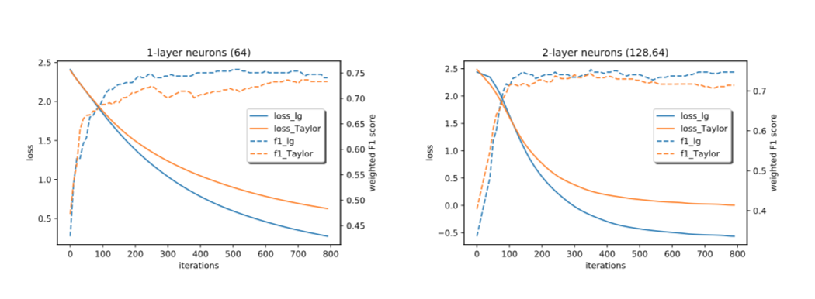
Taylor approximation
F1 score is comparable
Loss converge to a different minima

Slide 21
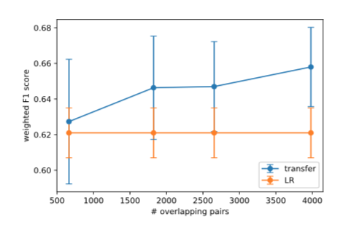
Overlapping samples
The overlapping sample pairs are used to bridge the hidden representations between the two parties
Performance improves as overlapping pairs increases

Slide 22
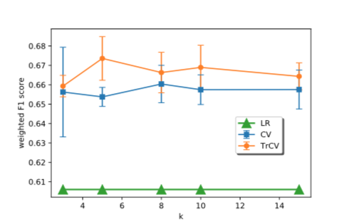
Transfer Cross Validation
Comparing to a plain cross validation(CV) approach
TrCV approach outperforms a CV approach at various values of k (folds)

