Slide 1
Hierarchical Heavy Hitter
TANG DING

Slide 2
Papers
Mitzenmacher, M., Steinke, T., & Thaler, J. Hierarchical heavy hitters with the space saving algorithm. (ALENEX 2012)
Ben Basat, R., Einziger, G., Friedman, R., Luizelli, M. C., & Waisbard, E. Constant time updates in hierarchical heavy hitters. (SIGCOMM 2017)

Slide 3
Application
Network traffic monitoring
Anomaly detection
DDoS detection.

Slide 4
Heavy Hitter
Basically, equals to frequent items
Identifies frequent:
Source.
Source-Destination pairs.

Slide 5
Example
We want to find Source IP whose frequency >= 2
21.132.161.13
21.132.161.13
21.132.161.14
21.132.161.15
22.133.161.13
22.132.161.13
IP: 21.132.161.13
COUNT: 2

Slide 6









Hierarchical Heavy Hitter
$$181.7.∗.∗$$
$$181.7.20.∗$$
$$220.7.16.∗$$
$$220.7.16.9$$
$$181.7.20.13$$
181.7.21.*
Destination
Source

Slide 7
1D Hierarchy example
Level4: *.*.*.*
Level3: 21.*.*.*
Level2: 21.132.*.*
Level1: 21.132.145.*, 21.132.146.*
Level0: 21.132.145.13, 21.132.146.14

Slide 8
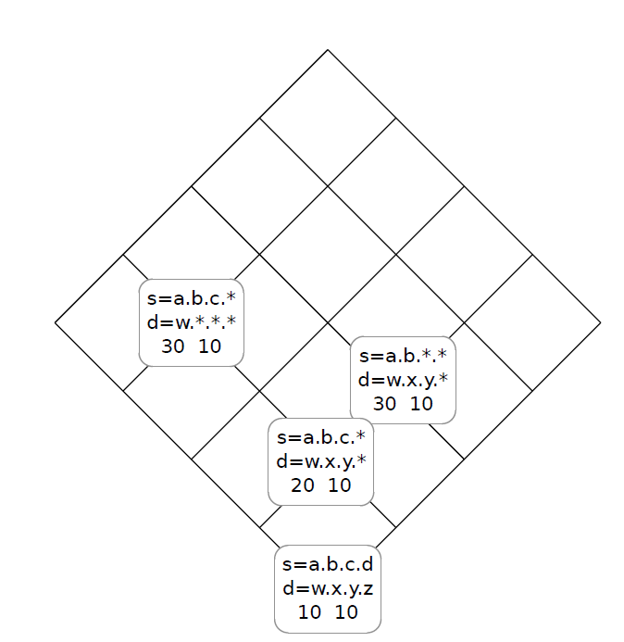
2D Hierarchy example

Slide 9
Example
We want to find HHH whose frequency >= 2
21.132.161.13
21.132.161.13
21.132.161.14
21.132.161.15
22.133.161.13
22.132.161.13
IP: 21.132.161.13
COUNT: 2
IP: 21.132.161.*
COUNT: 2
IP: 22.*.*.*
COUNT: 2
Why count of 21.132.161.* is 2?

Slide 10
Problems
Often, the large volume of network traffic makes it infeasible to store the relevant data in memory.
Space-saving streaming algorithm.

Slide 11
Example
We want to find HHH whose frequency >= 2
21.132.161.13
21.132.161.13
21.132.161.14
21.132.161.15
22.133.161.13
22.132.161.13
IP: 21.132.161.13
COUNT: [2,3]
IP: 21.132.161.*
COUNT: [2,4]
Output confidence interval instead of actual frequency

Slide 12
Target
Accuracy: Limited Errors
Coverage: No False Negatives

Slide 13
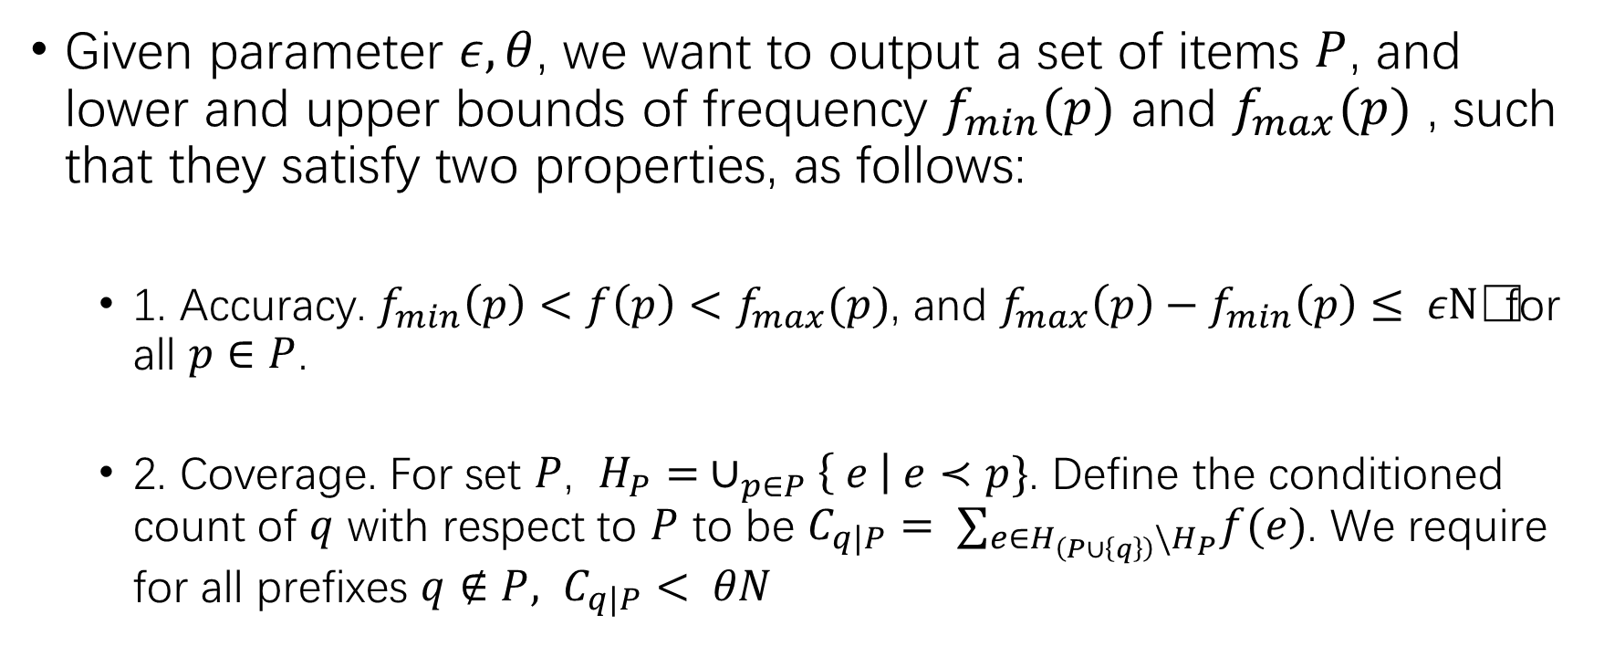
Target
Given parameter $ε,θ$, we want to output a set of items $P$, and lower and upper bounds of frequency $f_{min}(p)$ and $f_{max}(p)$ , such that they satisfy two properties, as follows:
1. Accuracy. $f_{min}\left(p\right)<f\left(p\right)<f_{max}(p)$, and $f_{max}\left(p\right)−f_{min}\left(p\right)≤ ε\text{N}$ for all $p∈P$.
2. Coverage. For set $P$, $H_{P}= ∪_{p∈P}\left\{ e \right| e≺p\}$. Define the conditioned count of $q$ with respect to $P$ to be $C_{q|P}= ∑_{e∈H_{\left(P∪\left\{q\right\}\right)}\backslash H_{P}}f(e)$. We require for all prefixes $q∉P, C_{q|P}< θN$

Slide 14
Algorithm
Two main procedures:
Update
Output

Slide 15
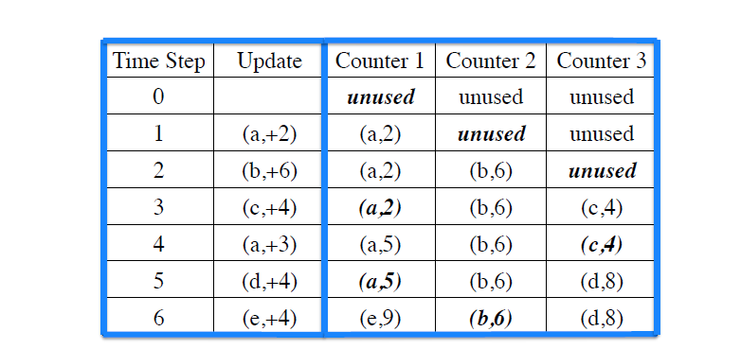
Update
For any item C being tracked, the actual frequency f(C) is in (Nc – Nmin, Nc),
where Nc is the count of that item, and Nmin is the minimum count in all counters

Slide 16
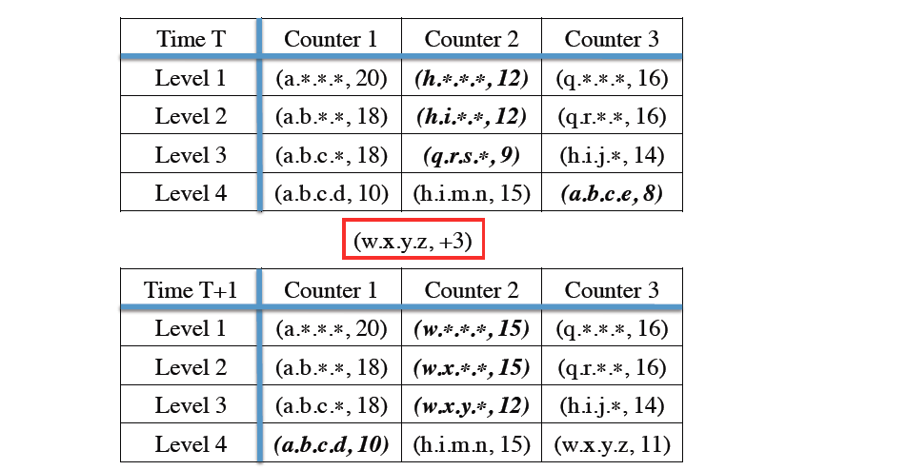
Update

Slide 17
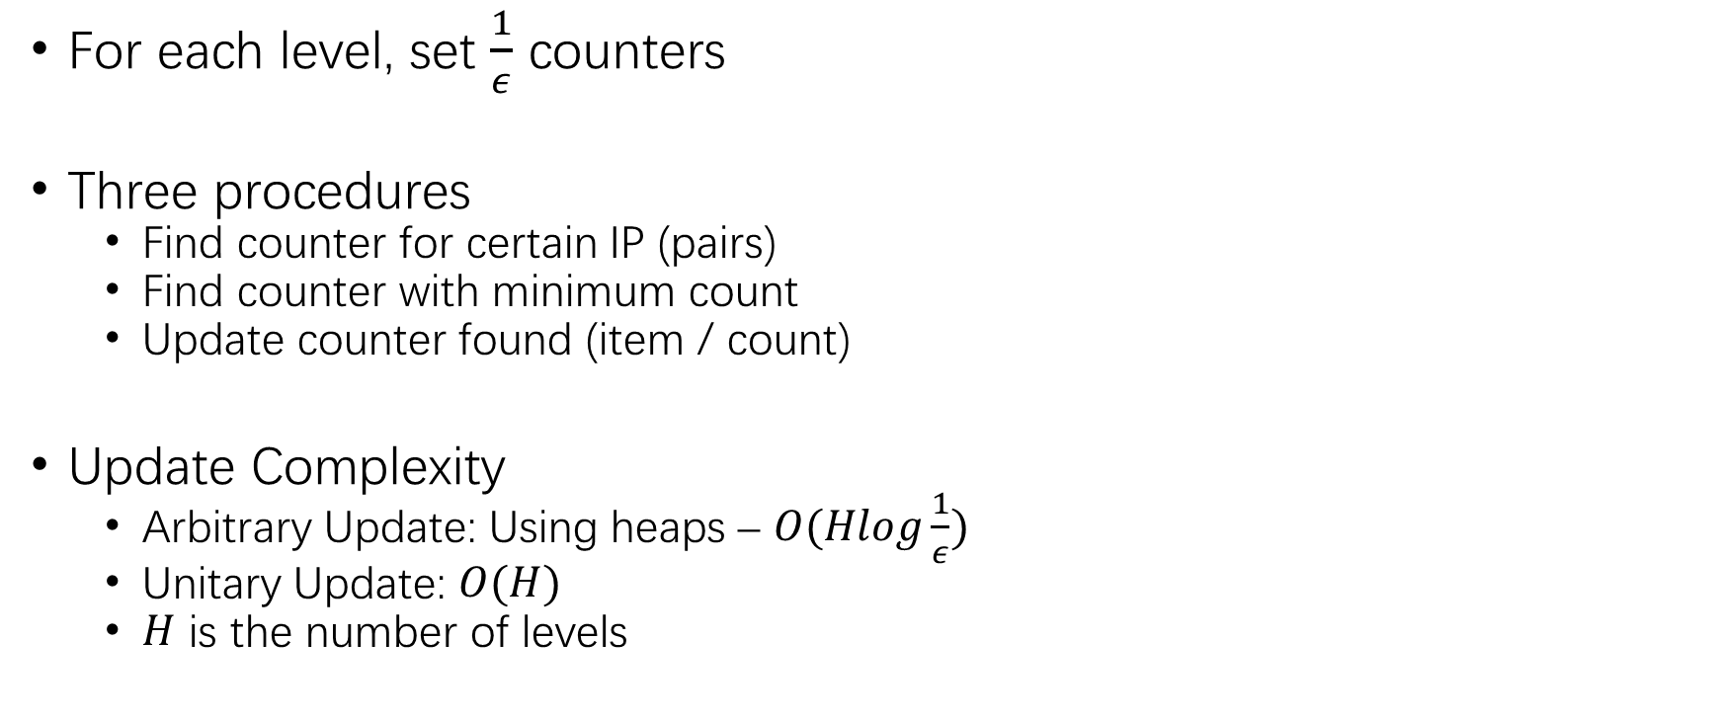
Update
For each level, set $\frac{1}{ε}$ counters
Three procedures
Find counter for certain IP (pairs)
Find counter with minimum count
Update counter found (item / count)
Update Complexity
Arbitrary Update: Using heaps – $O(Hlog\frac{1}{ε})$
Unitary Update: $O(H)$
$H$ is the number of levels

Slide 18
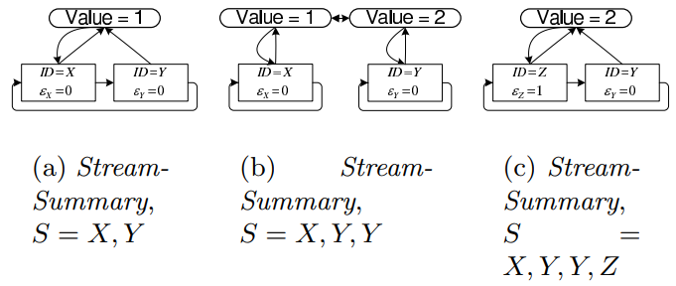
Unitary Update
Data Structure
HashTable
Item{HashEntry, GroupEntry , NextItemInGroup, PreviousItemInGroup}
Group {Items, Count, PreviousGroup, NextGroup}
Sorted link list with entries of same count combined

Slide 19
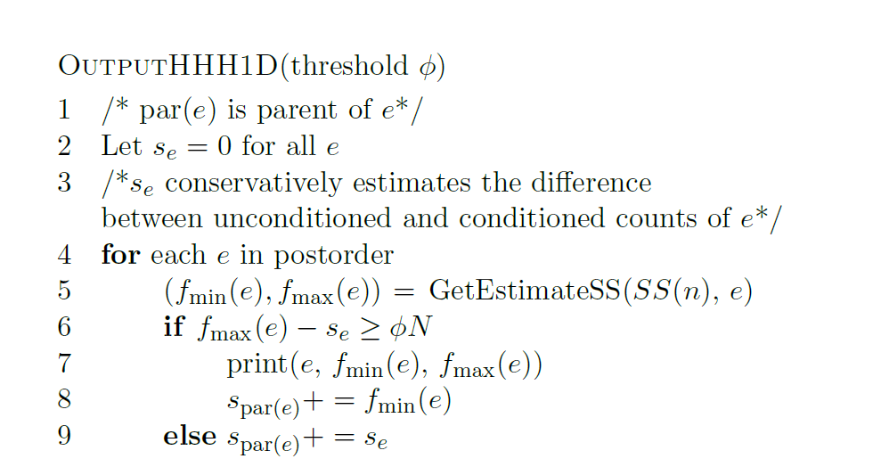
Output (for 1D)

Slide 20
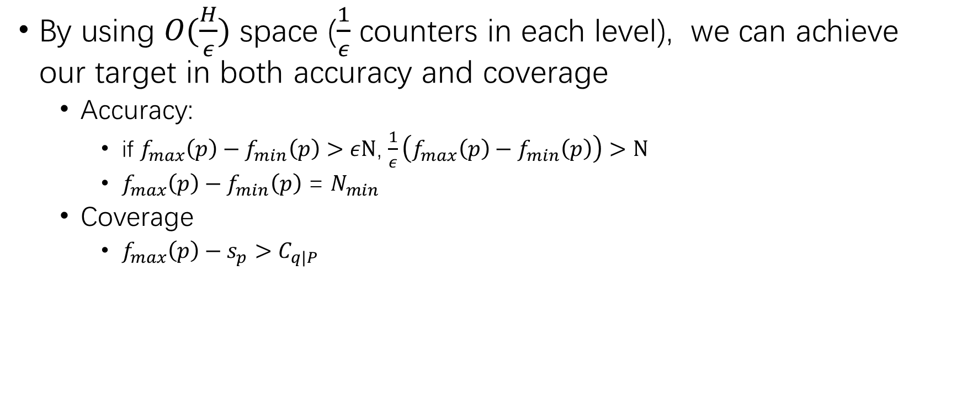
Proof
By using $O(\frac{H}{ε})$ space ($\frac{1}{ε}$ counters in each level), we can achieve our target in both accuracy and coverage
Accuracy:
if $f_{max}\left(p\right)−f_{min}\left(p\right)>ε\text{N}$, $\frac{1}{ε}\left(f_{max}\left(p\right)−f_{min}\left(p\right)\right)>N$
$f_{max}\left(p\right)−f_{min}\left(p\right)$ = $N_{min}$
Coverage
$f_{max}\left(p\right)−s_{p}>C_{q|P}$

Slide 21
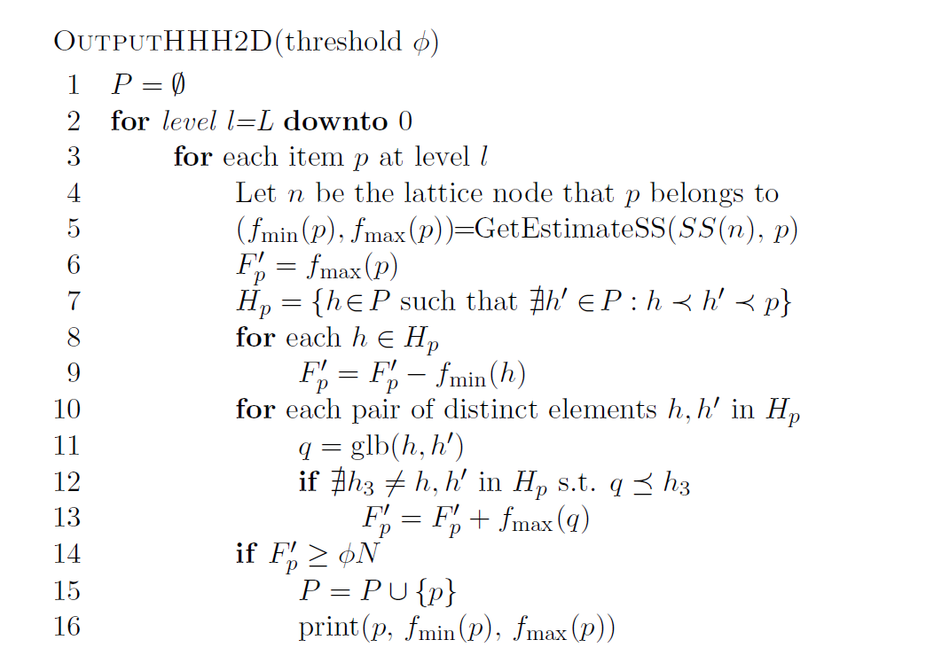
Output (for 2D)

Slide 22
Output

Slide 23
Randomized
Select a prefix at random and count it
Level0 Counting
Level1 Counting
Level1 Counting
Compute a random prefix
181.7.20.*
Level2 Counting
181.7.20.6
Level3 Counting
Level4 Counting

Slide 24

Additional Speedup
Level0 Counting
188.3.12.3
Level1 Counting
Level1 Counting
181.7.20.3
92.67.7.81
With
some
probability
Compute a random prefix
181.7.20.6
181.7.20.*
Level2 Counting
188.67.7.1
181.7.20.2
Level3 Counting
Level4 Counting
Ignore packet

Slide 25
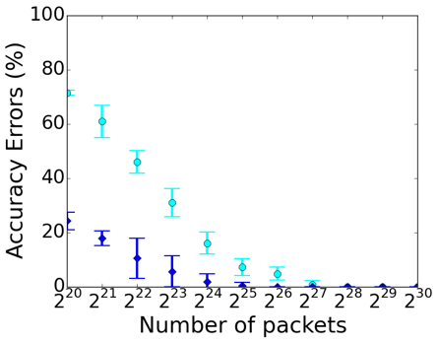
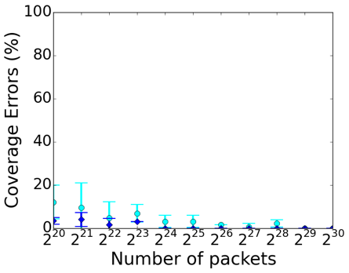


Accuracy
“Accuracy improves with the number of packets”
128M packets
128M packets
Counting Errors
False Negatives
32M packets
32M packets
One prefix packet
One prefix per 10 packets

Slide 26
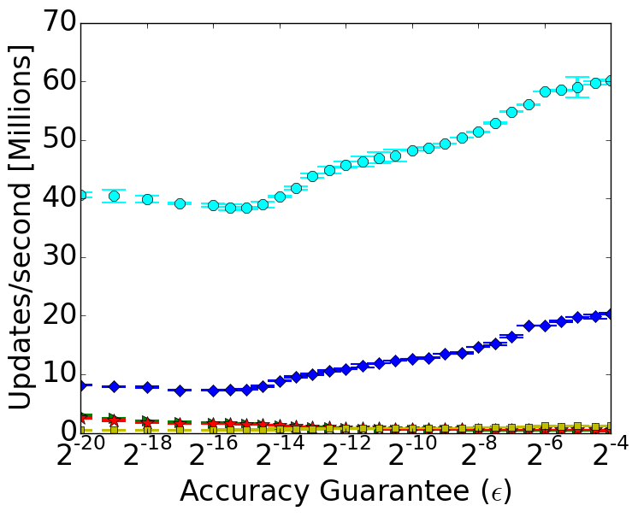

Performance
Up to X62 speedup!
One update per packet
One update per 10 packets
Mitzenmacher et al.

Slide 27
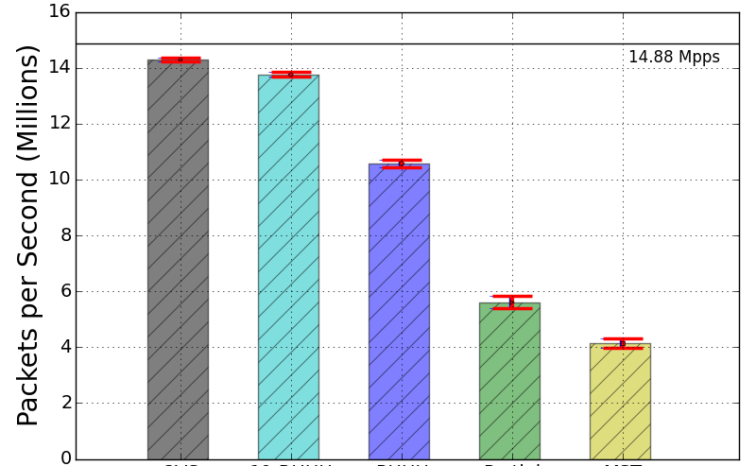


Performance
Highlights:
Only -4% overheads for HHH in the Open vSwitch data plane!
+250% throughput improvement compared to previous work.
One prefix per packet
One prefix per 10 packets
OVS
Mitzenmacher et al.

