Slide 1
Deep Reinforcement learning
Tian,Han

Slide 2
Problem Definition
Environment
Agent
observation
Action
Reward + new observation
Vs. Supervised learning : sequence input, cumulative reward.
Model-free RL vs. Model-based RL.
Notes:
图，与监督学习的区别：状态变化、序列输入、积累奖励目标
model-based RL根据历史信息对环境进行建模，model-free RL不对环境进行建模。

Slide 3
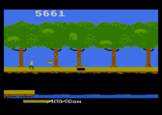
Example
 |  |  | +1
 |  |  | -1
START

Slide 4
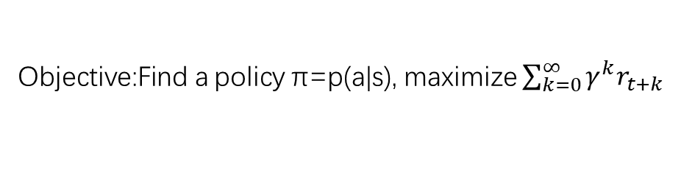
Review of MDP model
MDP model <S,T,A,R>
S– set of states
A– set of actions
T(s,a,s’) = P(s’|s,a)– the probability of transition from s to s’ given action a
R(s,a)– the expected reward for taking action a in state s
Agent
State
Action
Reward
Environment
a₀
a1
a2
s₀
s₁
s2
s3
r₀
r1
r2
Objective:Find a policy π=p(a|s), maximize $\sum_{k=0}^{∞}{γ^{k}r_{t+k}}$
Notes:
马尔可夫的含义：只需要当前状态就能够继续分析。

Slide 5


Value functions
state value function: V^{π}(s)
expected return when starting in s and following π
state-action value function: Q^{π}(s,a)
expected return when starting in s, performing a, and following π
useful for finding the optimal policy
can estimate from experience
pick the best action using Q^{π}(s,a)
Bellman equation for V
s
a
r
s’
Notes:
Policy pi的定义。由PI定义value function, state-action value function.

Slide 6
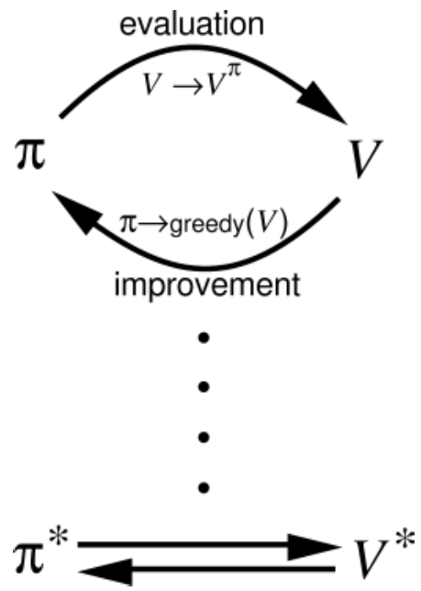
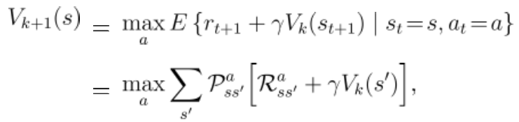
Model-based: Generalized Policy Iteration.
Policy Iteration
Value Iteration
Notes:
我在这张ppt上讲解的迭代学习过程只是包含value iteration的学习过程，实际上policy iteration是在固定policy的情况下利用bellman equation先把V学收敛，再用argmaxV的思路更新policy，如此反复，多轮之后policy收敛至最优；而value iteration则用bellman equation只跑一轮所有状态的V更新，就用这个未收敛的V更新policy，加快学习速率，让V和policy一起走向最优收敛，公式中policy更新和V更新一气呵成（max是policy更新，V_k+1是在新policy下的V更新）。
这里叫做model-based的原因是这里需要获得转移概率。

Slide 7
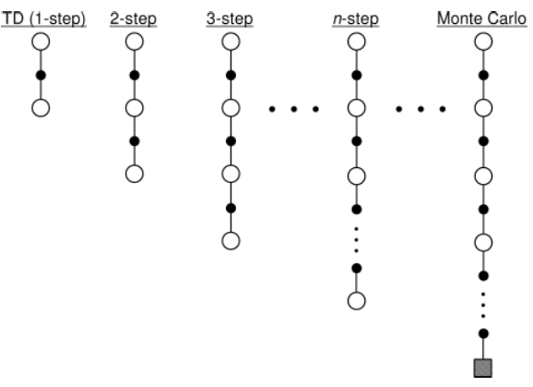
Model-free: TD-learning
Sample-based
Bootstrap : iteration to optimal
Online policy evaluation
Example: Sarsa, Q-learning,
MC method…
Notes:
为啥sample-based可以：期望的部分用数量替代。目标 让起点和终点的reward差拟合起来

Slide 8
On-policy vs. Off-policy
SARSA:
The policy we learned include exploration.
Q-learning
(Watkins, 1989):
converge to optimal.
Notes:
关键区别在于：估计的策略和实际使用的策略是否相同，我们可以仔细观察这两个公式，前者需要多跑一部，这个策略是当前策略，后者是直接使用max，也就是前面的Q和后面的Q的policy是有误差的。后者可以保证向最优收敛，所以一般使用后者。

Slide 9
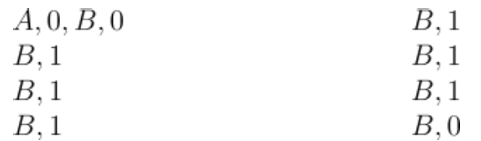
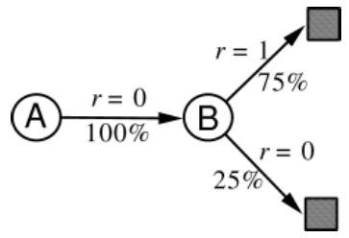
Monte Carlo vs. Q-learning (TD(0))
Batch Monte Carlo methods always find the estimates that minimize mean-squared error on the training set (use experience likelihood=the maximum-likelihood model), whereas batch TD(0) always finds the estimates that would be exactly correct for the maximum-likelihood model of the Markov process.
More data required by MC; model structure support for Q-learning.
Notes:
无偏估计

Slide 10

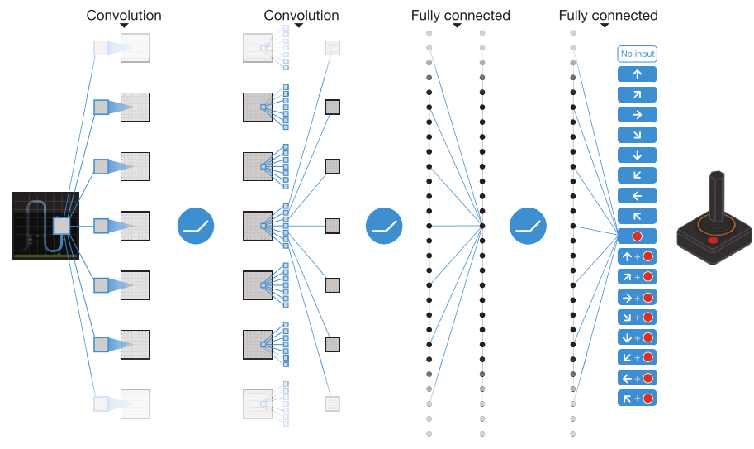
Deep Q-Network
Replay memory.
Target network. （pay attention to the -）
DOUBLE DQN, Prioritized Experience Replay……
Mnih, Volodymyr, et al. "Human-level control through deep reinforcement learning." Nature518.7540 (2015): 529-533.

Slide 11
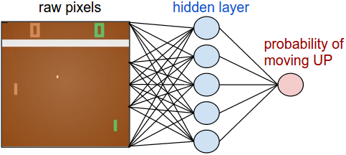
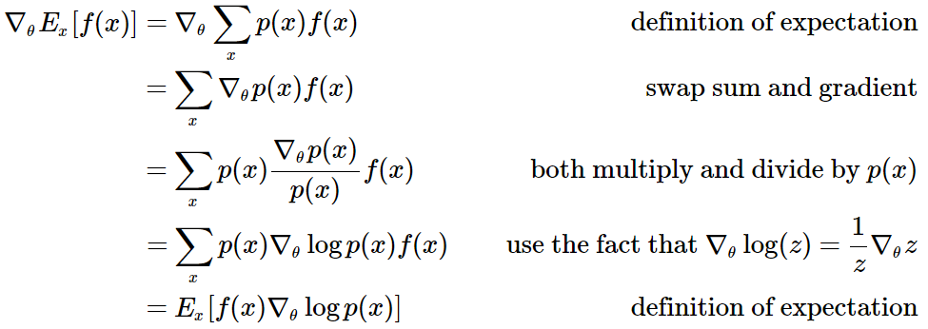
Policy Gradient Method (Sutton, McAllester, Singh, and Mansour, 2000)
Policy Network
Policy Gradient
Notes:
Policy gradient方法的特点：one-step, no Q-value. 而不是估值网络+策略网络。期望求导变成求导的期望。

Slide 12
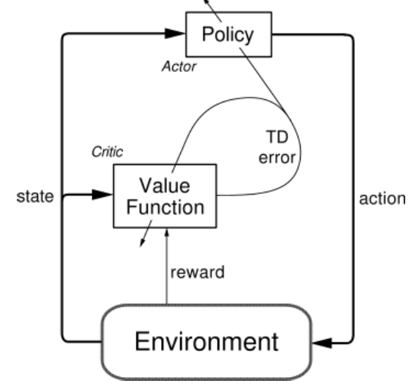
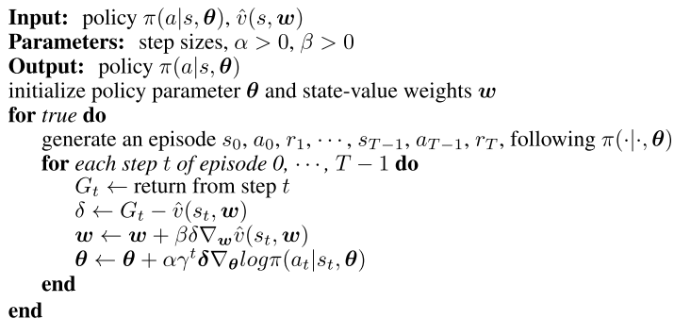
REINFORCE: Actor-Critic Method
Notes:
估值网络的作用：0 variance.

Slide 13
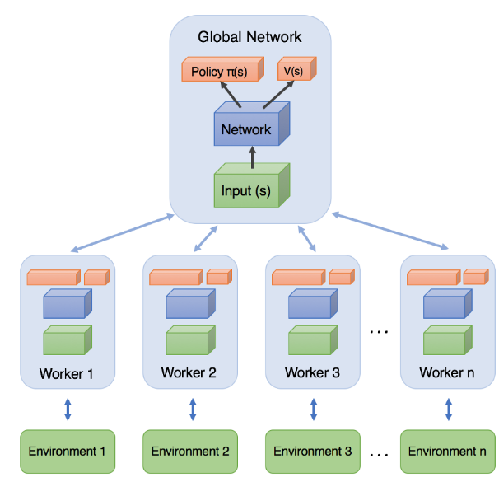
A3C: asynchronous advantage actor-critic
Mnih, Volodymyr, et al. "Asynchronous methods for deep reinforcement learning." International Conference on Machine Learning. 2016.
Simple Reinforcement Learning with Tensorflow Part 8: Asynchronous Actor-Critic Agents (A3C) : https://medium.com/emergent-future/simple-reinforcement-learning-with-tensorflow-part-8-asynchronous-actor-critic-agents-a3c-c88f72a5e9f2
Notes:
需要着重再看一下。

Slide 14
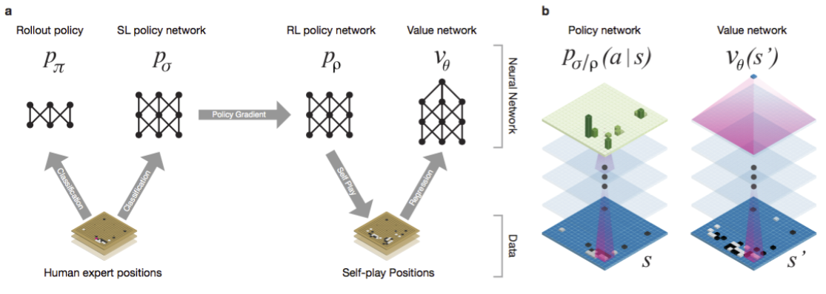
AlphaGo
Silver, David, et al. "Mastering the game of Go with deep neural networks and tree search." Nature 529.7587 (2016): 484-489.
Notes:
需要再看一下

Slide 15
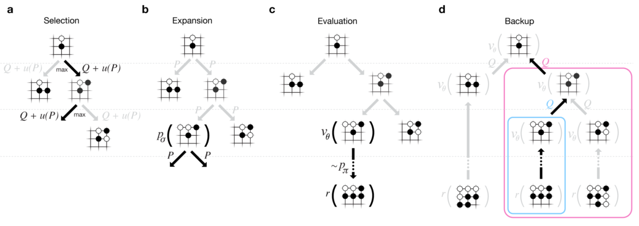

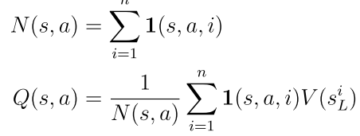


AlphaGo: Monte Carlo Tree Search (Not MC Learning!!)
Notes:
最终选择的是从这个root跑的最多的子节点。 然后所有过程不存储重新再跑一边。另外到扩展新节点为止，后面的都用rollout跑完。

Slide 16
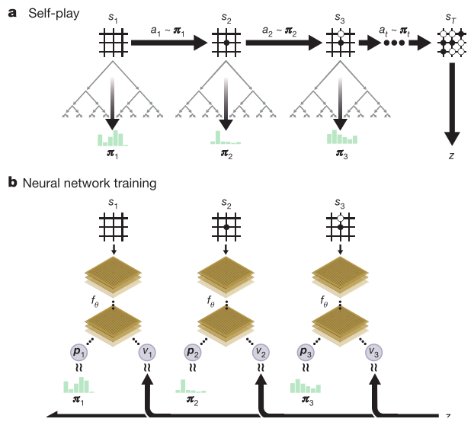
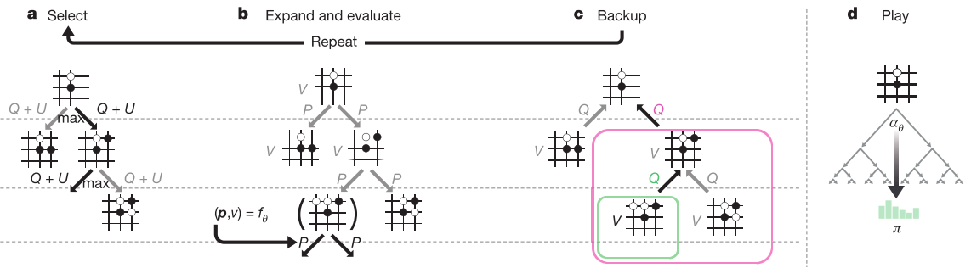
AlphaGo Zero
Return to zero : MCTS function as a policy improvement operator—highly efficiently self-play.
Silver, David, et al. "Mastering the game of go without human knowledge." Nature 550.7676 (2017): 354-359.
Notes:
特点：既然alphago实际使用MCTS来下棋，说明MCTS是一个improvement operator，能不能无限迭代这个提升的过程。这里使用MCTS来生成监督样本，然后使用deep network同时学习actor/critic，然后使用actor/critic继续指导新的MCTS来下棋，如此迭代。Rollout被抛弃而完全使用critic。MCTS策略选择改成使用正比于遍历次数退火次方的概率值，并逐渐退火到最优策略。MCTS充当了有效提升的方法，而不是AlphaGo时候的期待policy network随机探索更好了。

Slide 17
Thank you.

