Slide 1
JANUS: Fast and Flexible Deep Learning via Symbolic Graph Execution of Imperative Programs
Presented by
TANG DING

Slide 2
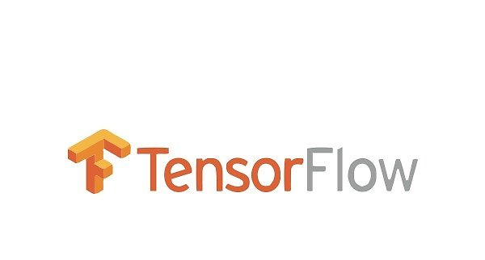

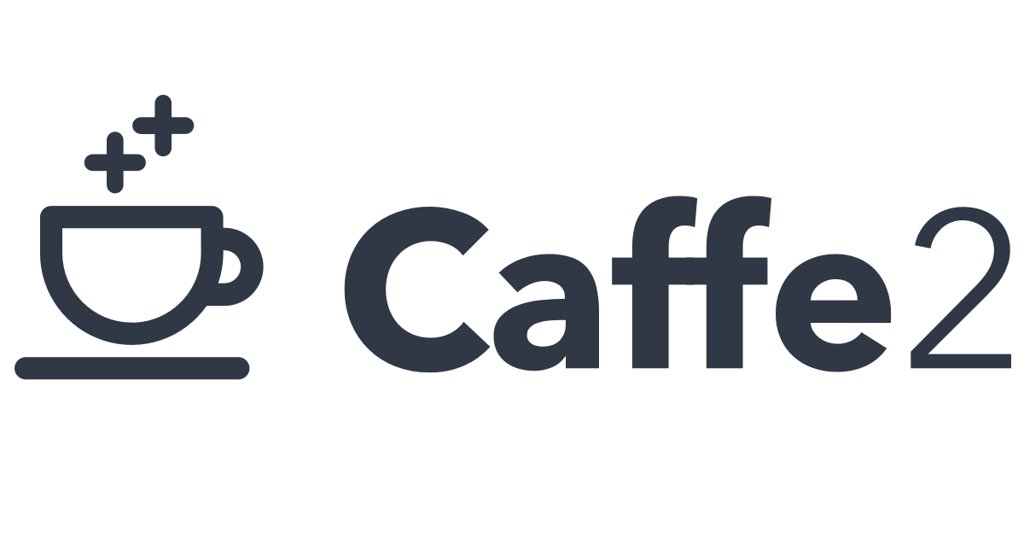
Symbolic graph execution
Pros:
Various optimization, such as common subexpression elimination or constant folding
Easy operation assignment to the appropriate device or machine.
Cons:
Complicate user experience
Notes:
common subexpression elimination :
a = b * c + g; d = b * c * e; => tmp = b * c; a = tmp + g; d = tmp * e;

Slide 3

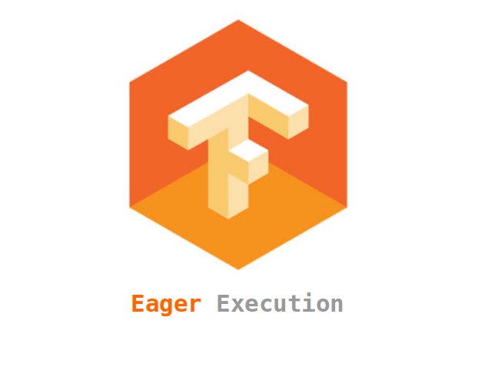
Imperative program execution
Pros:
Flexible programmability. Useful for rapidly experimenting and working with new and complex models.
Cons:
Worse Performance because of the loss of many optimizations

Slide 4
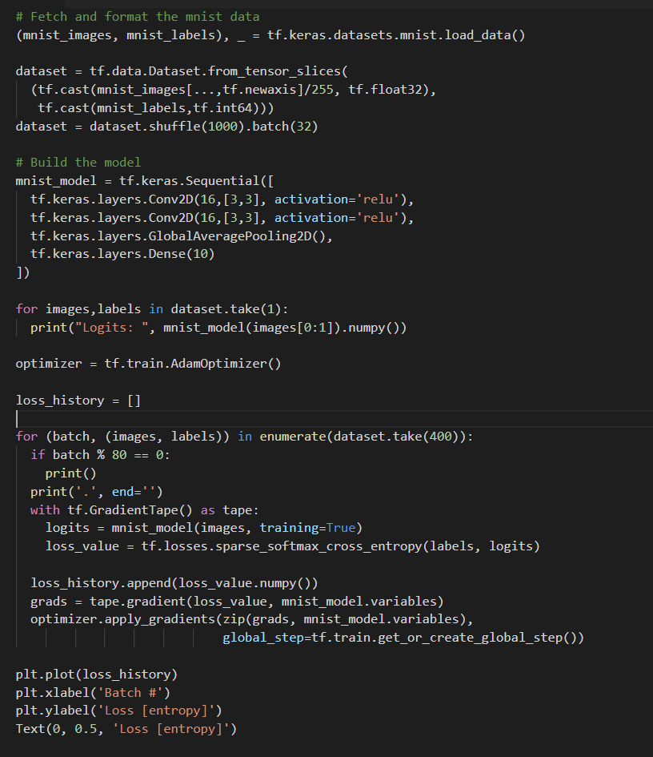
TensorFlow Eager Example

Slide 5
Imperative Interface to Symbolic graph execution
Goal
Program imperatively, generate symbolic dataflow graph
Challenge
Dynamic semantics of the programming language
Achieving the high performance

Slide 6
Speculative optimization
Make assumptions based on runtime profiling
Generate and optimize graph based on assumptions
If assumptions fail, fall back and update assumptions

Slide 7
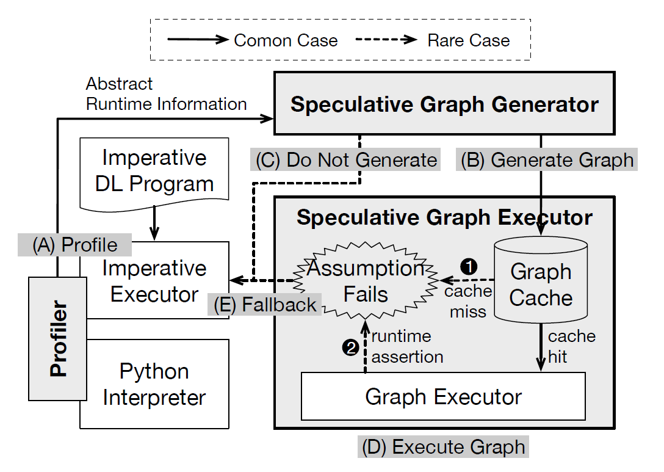
System Design

Slide 8
Fast Common Path
Runtime profiling
Symbolic graph generation
Graph execution

Slide 9
Rare Cases
Assumption Failure
Before execution: e.g. input type assumption
During execution: AssertOp
Abort the graph execution
Report the broken assumption
Give up further optimizations
Imperatively executed programs

Slide 10
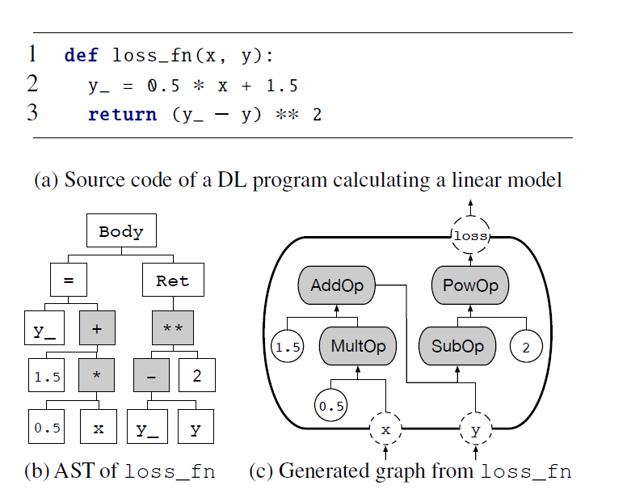
Symbolic Graph Generation - Basic
Input parameters → Placeholder
The return value → Computation target
Python literals → ConstantOp
Mathematical operators → Corresponding mathematical graph operations
+: AddOp , **: PowOp
Assignment to and retrieval from a Python local variable → Connection between two operations
Notes:
abstract syntax tree

Slide 11
Symbolic Graph Generation – Dynamic Control Flow
Conditional branches
By combining switch and merge primitives.
if → SwitchOp and MergeOp
Loop constructs
By combining the switch and merge primitives together with loop context primitives that hold iteration frames.
while , for → NextIterationOp
Function calls
Generate a separate graph for the callee function, and insert a function invocation operation that points to that graph
InvokeOp

Slide 12
Symbolic Graph Generation – Dynamic Control Flow
Unrolling
Assumptions in profiling:
Fixed side of the conditional branch
Fixed number of iterations
Control flow operation → AssertOp
Double-checks the assumption for this control flow decision
Remove control flow operation overheads
Apply graph optimizations
Common subexpression elimination
Constant folding
Fall back to imperative execution if assertion fails

Slide 13
Symbolic Graph Generation – Dynamic Control Flow
Inlining
Fixed and non-recursive callee function
Inline the callee function body inside the caller
For some callee functions already known, adds the corresponding graph operations
Framework functions: matmul() or conv2d()
Python built-in functions: print() or len()

Slide 14
Symbolic Graph Generation – Dynamic Type
Types of some expression can be inferred from other expressions
corresponding tensors
Numerical Python values:
Scalars, list of numbers, and numpy arrays
Nonnumerical values :
Arbitrary class instances
integer-typed scalar tensors which hold pointers to the corresponding Python values
Variable c in c = a + b is an integer if a and b are integers.

Slide 15
Symbolic Graph Generation – Dynamic Type
types of some expressions can’t be inferred
Input parameters for functions
Python object attribute accesses
Return types of recursive function
Profiler observes the types of the expressions during imperative executions
Expressions that always have same values → ConstantOp
Try to specialize the shape of tensors before constructing the graph
Optimize the graph even further with statically determined values or shapes

Slide 16
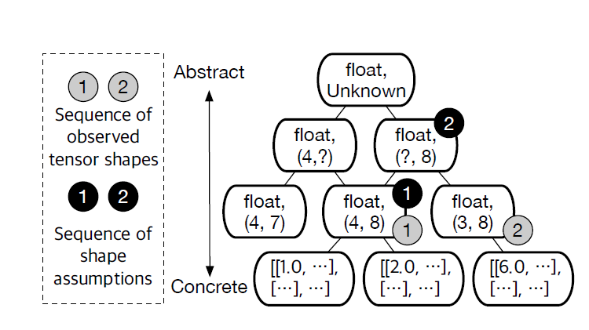
Symbolic Graph Generation – Dynamic Type
When assumption fails

Slide 17
Symbolic Graph Generation – Impure Function
Naive translation rules
Use PyFuncOps which can execute arbitrary Python functions as graph operations
Limitations
Only one Python function can be executed at a time due to the global interpreter lock
Complicates the fallback mechanism

Slide 18
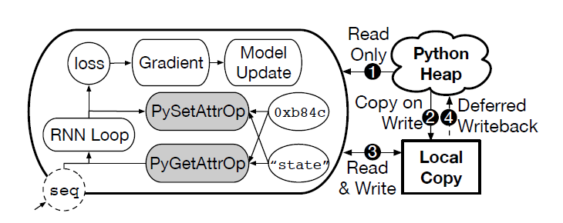
Symbolic Graph Generation – Impure Function
Deferred state update
Create local copies of global states
Mutate only the local copies during symbolic graph execution
After the graph executor finishes this run, the local copies are written back to the Python heap
Notes:
Each of them receives an object pointer (0xb84c) and a name of the attribute ("state") as inputs
1 The PyGetAttrOp can access Python heap to read the state unless a corresponding local copy exists. 2 When the PySetAttrOp wants to update the attribute, a new value is inserted to the local copy instead of directly updating the Python heap. 3 Further read and write operations are redirected to the local-copied attribute.

Slide 19
Limitations
Coverage Limitations from Design
Alignment with the design principles
Python object with custom accessor functions
Functions should return same type of value
External function calls
Based on white-list
Modification of the functions in whitelist is prohibited
Execution is deferred if a function includes state mutation
Coverage Limitations from Implementation
Coroutines, generators
Inline class definitions ,inline import statements
Notes:
to keep the implementation of local copies of global state simple, Python object with custom accessor functions (i.e., __getattr__ or __setattr__, ...) are not supported by the JANUS graph executor.

Slide 20
Implementation
Automatic differentiation functionality
Parameter storing mechanism
Several custom operations had been added
CPython has also been modified to have bytecode level instrumentation functionality for transparent profiling.
Integrate JANUS with Horovod, and insert appropriate communication operations to achieve distributed training.
Notes:
to transparently separate out the neural network computation from the entire Python program without extra user intervention, the automatic differentiation functionality of TensorFlow Eager is modified to trigger JANUS graph conversion
JANUS inserts appropriate communication operations to the graph in order to get the average of gradients generated by multiple workers. Since the generated dataflow graph contains both communication and computation operations, we can parallelize communication and computation operations and achieve better performance compared to distributed training with the imperative execution model

Slide 21
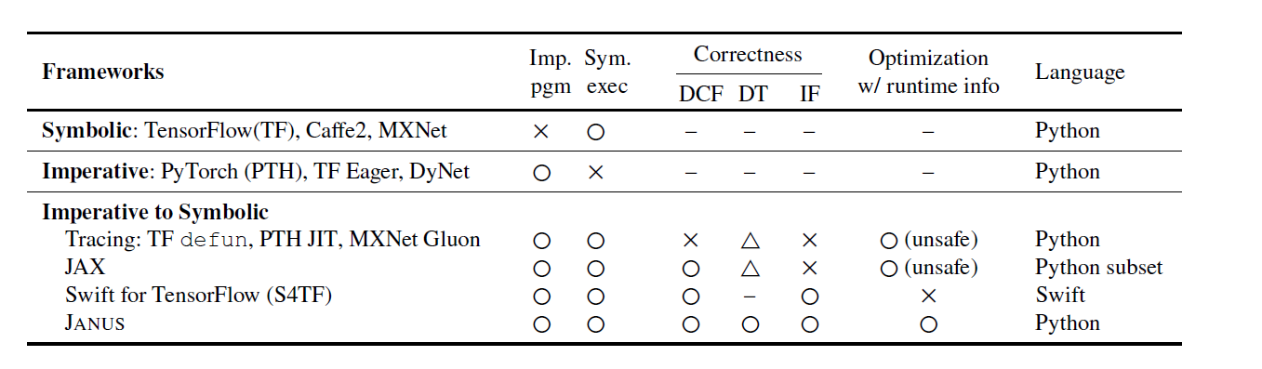
Previous Work
DCF: Dynamic Control Flow DT: Dynamic Type IF: Impure Function

Slide 22
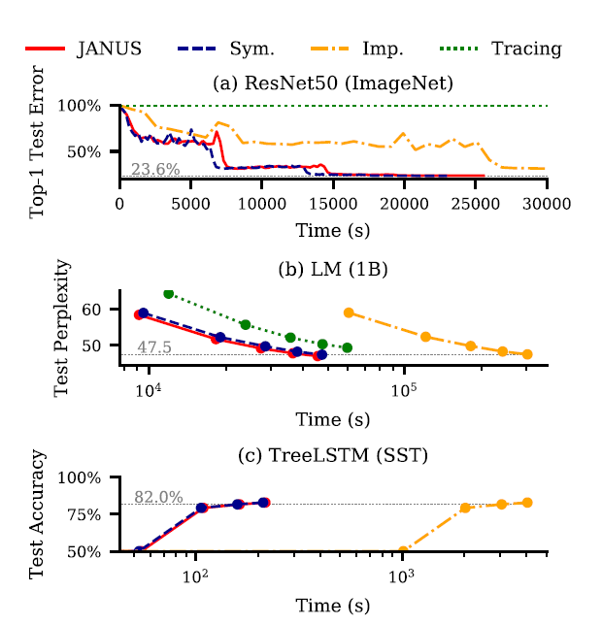
Evaluation

Slide 23
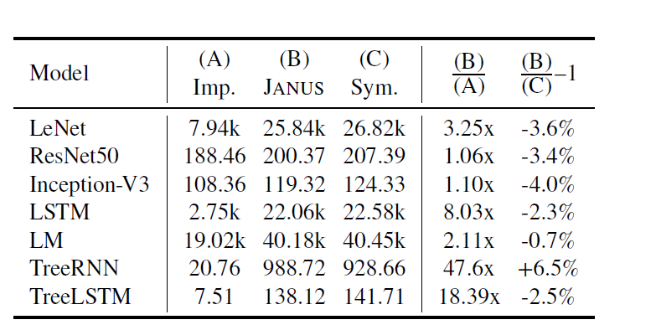
Evaluation
Notes:
images/s for CNN models, processed words/s for RNN models, and processed sentences/s for Recursive NN models.

Slide 24
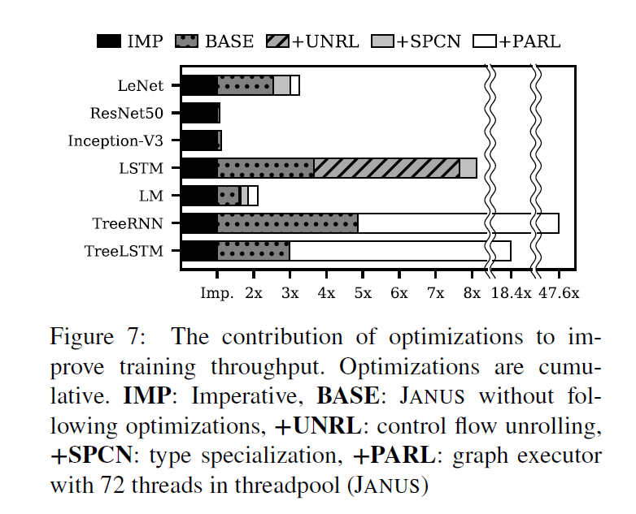
Evaluation

Slide 25
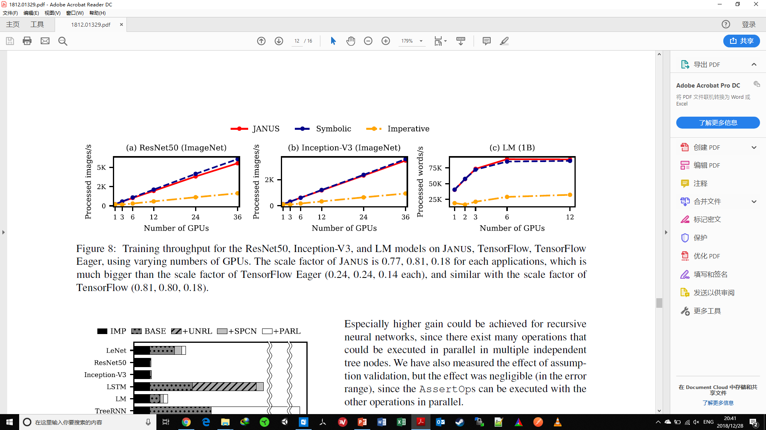
Evaluation

Slide 26
Thanks

