Slide 1
TVM: An Automated End-to-End Optimizing Compiler for Deep Learning
Tianqi Chen, Thierry Moreau, Ziheng Jiang, Lianmin Zheng, Eddie Yan, Meghan Cowan, Haichen Shen, Leyuan Wang, Yuwei Hu, Luis Ceze, Carlos Guestrin, Arvind Krishnamurthy

Slide 2
Outline today
The TVM paper
With a special focus on a learning-based optimizer
“Machine learning for machine learning systems”
Discussion 1: Learning based methods in system design
Related works
When does learning based method perform better
Discussion 2: Domain-specific features of ML-systems
Pick the core, ignore technical details

Slide 3
Executing ML Programs: 3 Steps
1. Writing the program in high-level language
2. Represent as data flow graphs
Graph-level optimizations: Too high-level for specific hardware.
3. Dataflow --> operators
Depends on operator level libraries (e.g., CuDNN for GPUs).
Currently rely on manual tuning, significant (engineering) effort.

Slide 4
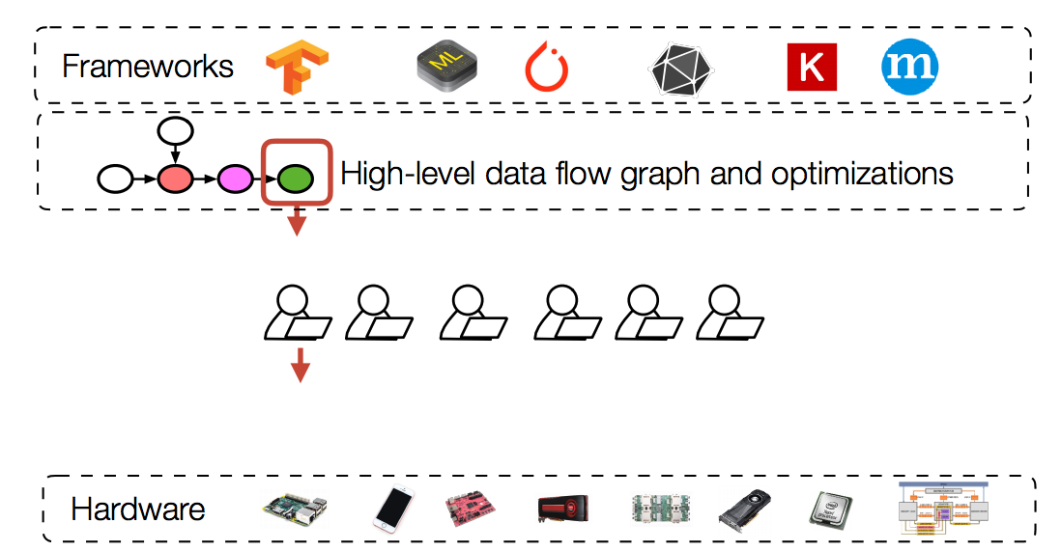
Diverging Hardware and Operators

Slide 5
TVM: End-to-end Optimization for ML
TVM

Slide 6
Challenges
Leveraging specific hardware features and abstractions
Divergence of hardware: CPU, GPU, TPU and FPGA-based accelerators
Hardware keeps evolving
Input operator description is complex
Large optimization search space
Combinatorial choices of memory access, threading pattern and hardware primitives
Building an accurate cost model is difficult
Separate cost model for each hardware

Slide 7
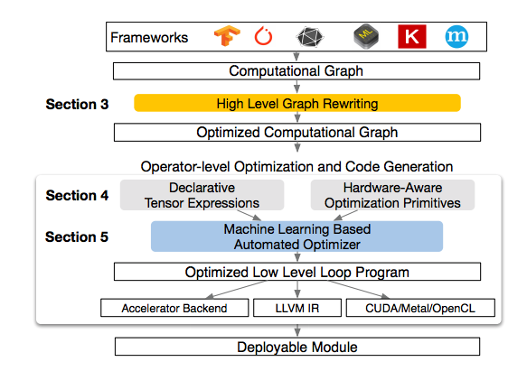
TVM in one page
Focus: ML-based optimizer
We first go through some parts in section 4.

Slide 8
Some Terms in TVM Paper
Schedule: Mapping from expression (what to do) to low-level code (how to do)
Schedule primitives: Specific computation rules
Transformation: Schedule primitives applied to the original program
Configuration: Schedule decisions, NOT hardware configuration

Slide 9
Generating Tensor Operations
Tensor expression language (TEL): Describes only shape of output, and how each output element is specified
Ignore execution details (e.g., loop structures)
Reason: flexible for hardware-specific optimizations
Incrementally applying transformations to build low-level code
Result: huge set of schedule choices

Slide 10
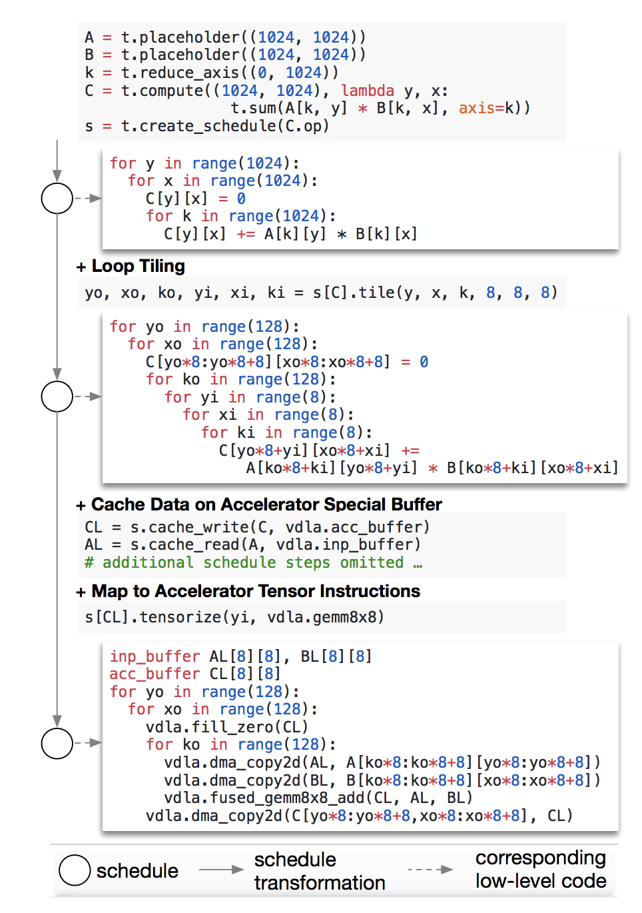
Example
TEL describes only shape of output, and how each output element is specified
Incrementally applying transformations to build low-level code

Slide 11
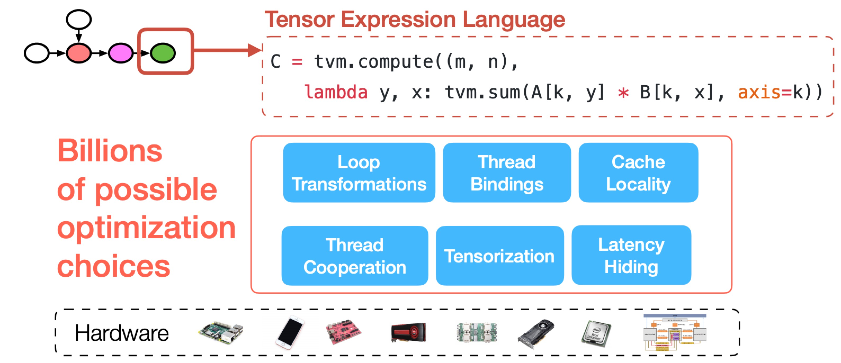
Hardware-aware Search Space

Slide 12
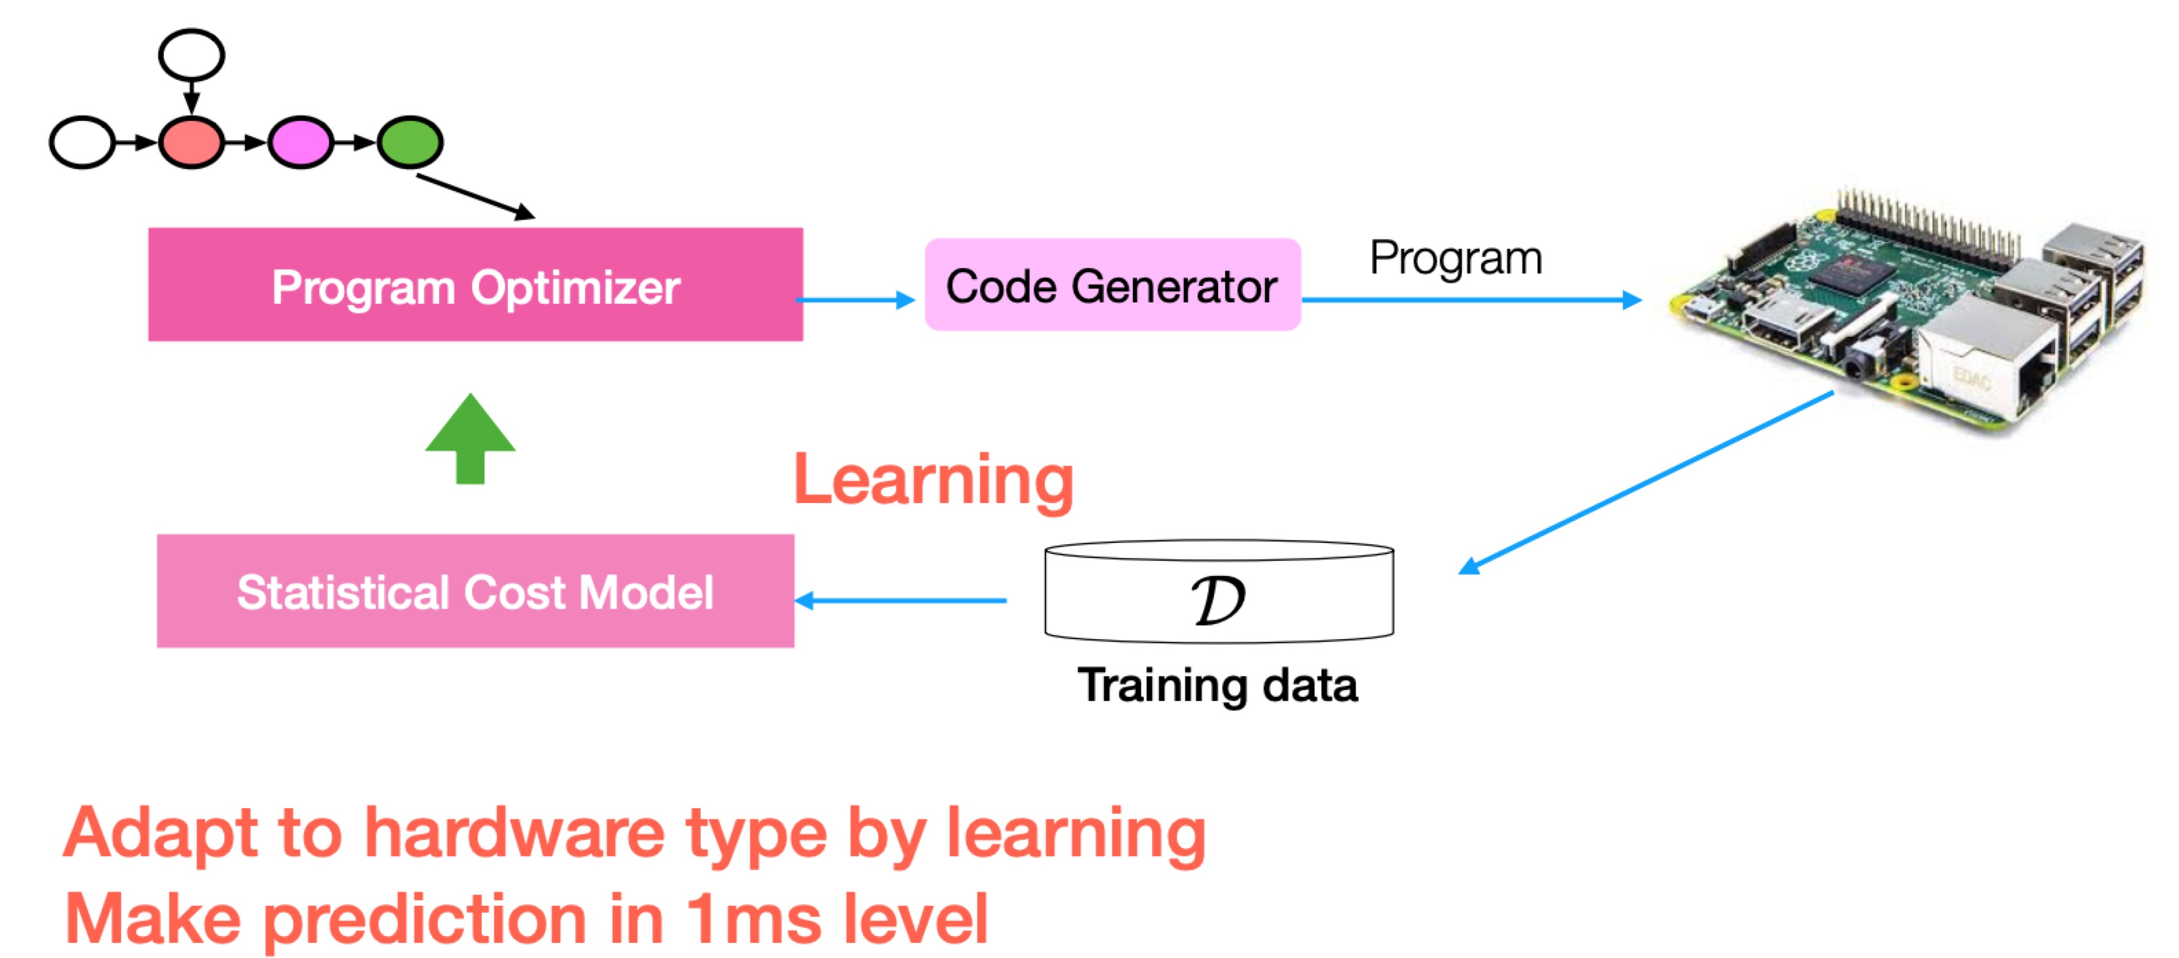
Learning based optimizer

Slide 13
Why ML based Cost Models?
Previous methods are infeasible
Auto-tuning: find from large configuration space
Requires Many experiments
Pre-define cost models
Difficult, requires a separate model for each hardware

Slide 14
Model Design
Requirements
Quality: More accurate than hand-crafted policy in the long run
Speed: Less time than actually run the tensor program
Model used: XGBoost, a boosting method (details skipped)
Recent publication of same author in NIPS, show how to train the model in transfer learning.

Slide 15
”Exploring” effective schedules
Simulated annealing: Random walk that starts from random configurations, and keeps the configurations better than the configurations of previous iterations.
Like “Repeated power of 2 choices”
Reason to use these methods: Too large search space

Slide 16
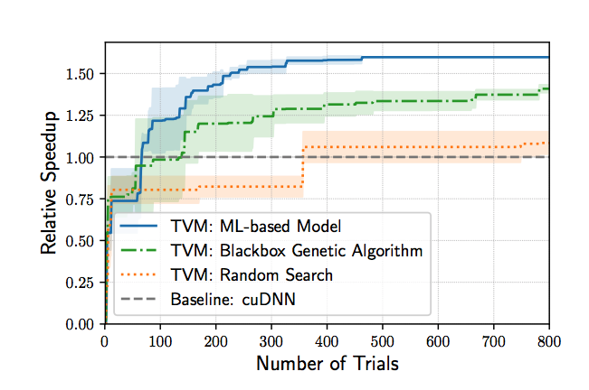
Impact of ML Based Model
Learning from repeated experience are better than hand-crafted policy in the long run

Slide 17
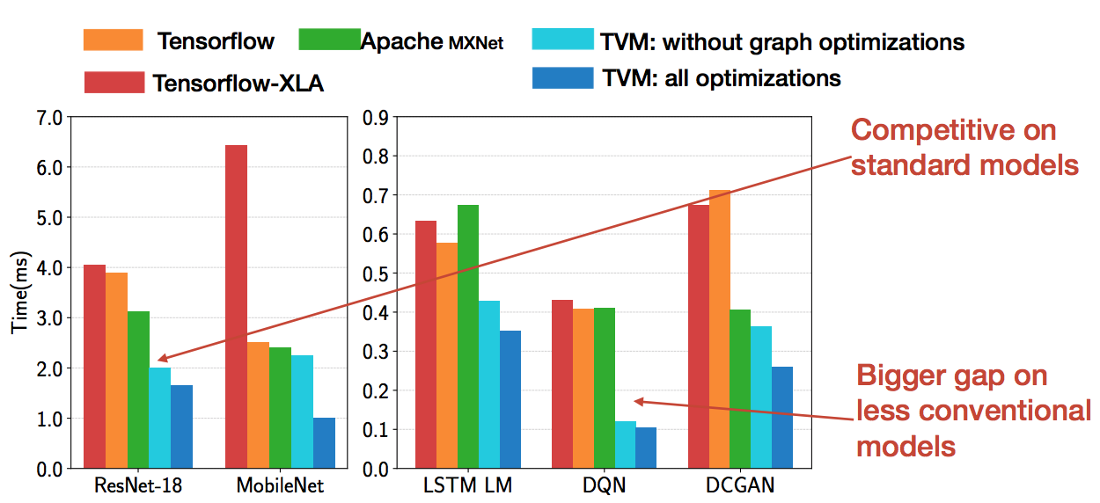
Evaluation on GPUs

Slide 18
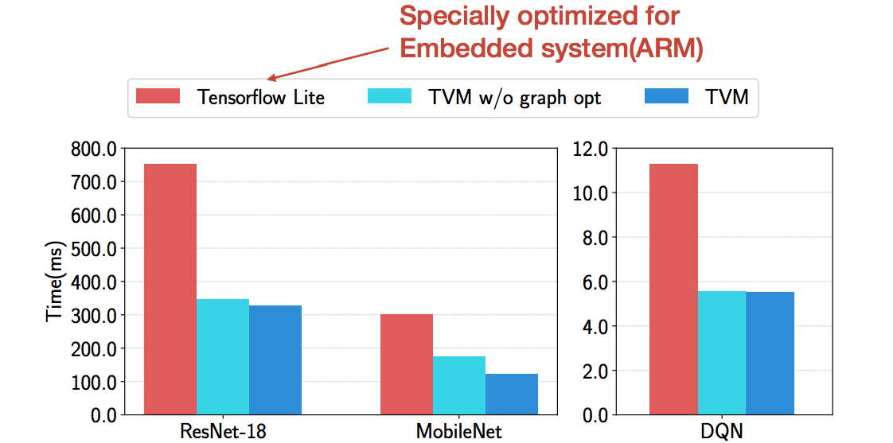
Evaluation on FPGA-based accelerators

Slide 19
Not Covered Contents
Graph optimizations
We assume a well-optimized graph
Detailed schedule-primitives
Compiler-related, more works from PL area
Not related to our work
More evaluations

Slide 20
Learning-based System Design: Related Works
1. Congestion control
TCP ex machina (SIGCOMM’ 13): Use decision tree to build congestion control algorithms.
Performance-oriented Congestion Control, aka PCC (NSDI '15, NSDI ’18): Use experiments to adjust rate to maximize utility (a function measuring performance).

Slide 21
Learning-based System Design: Related Works
2. Diagnostics:
Netpoirot (SIGCOMM’ 16): Learn from logs to analyze the root cause of failures in data centers.
3. Reinforcement learning related:
Pensieve (SIGCOMM’ 17): Select algorithm parameters for video streaming via RL.
AuTO

Slide 22
Discussion 1: Learning-based Design?
When does learning based design “make sense”? Please comment:
1. Handcrafted rules can not reflect the state / handle unstable environment: PCC & RL based methods
2. Human engineering is needed for every similar but different conditions (the environment is not necessarily changing): TVM, Netpoirot, TCP ex machina
Learning based methods generalize to similar problem with different settings

Slide 23
Discussion 2: Domain-specific features of ML-systems
Why is ML based model used in TVM?
Relatively low experiment cost
Running a tensor program requires a few seconds.
Domain specific problem structures
ML models are “simple”, we can leverage model structures to optimize programs
Large quantity of similar operators
ML models are “similar”, results can be reused

Slide 24
Gandiva: Deep Learning Scheduling
Gandiva: Introspective Cluster Scheduling for Deep Learning. OSDI’18 same session.
Use “intra-job predictability” for better scheduling decisions
Key feature: ML is an iterative job, different iterations should have similar completion time
Similar papers: SLAQ (SoCC’ 17) Optimus (Eurosys’ 18)

Slide 25
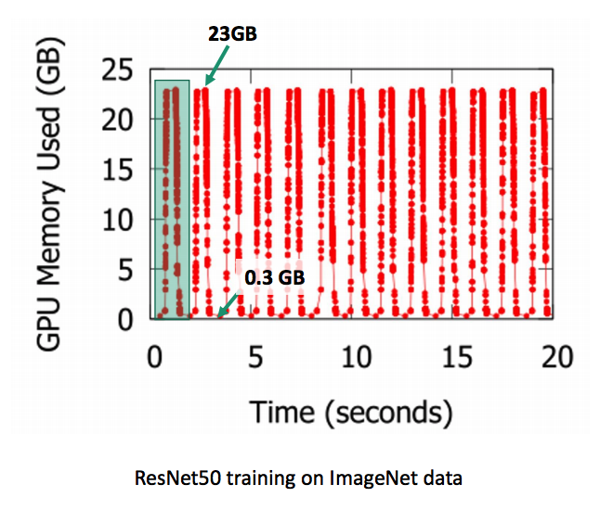
Intra-job predictability
Peak patterns indicate iterations.
Different iterations takes similar time, have same pattern of resource consumption.

Slide 26
Layered structures
Deep learning models requires multiple stages of computation (“layers”). The performance can be analyzed at layer level.
E.g. Poseidon (ATC’ 17). Pipeline layer’s computation and parameter synchronization.
E.g.2. Our recent submission for job completion time prediction. (Junxue and I): Use layered as well as repeated features to analyze.
Designs for certain problems come from domain-specific knowledges

