Slide 1
PRETZEL: Opening the Black Box of Machine Learning Prediction Serving Systems
Presented by Qinghe
2018.12.01
Notes:
构建和优化机器学习在线服务的系统

Slide 2
Outline
Background
Limitations of current solutions
Pretzel’s target
Pretzel’s Design
Evaluation

Slide 3
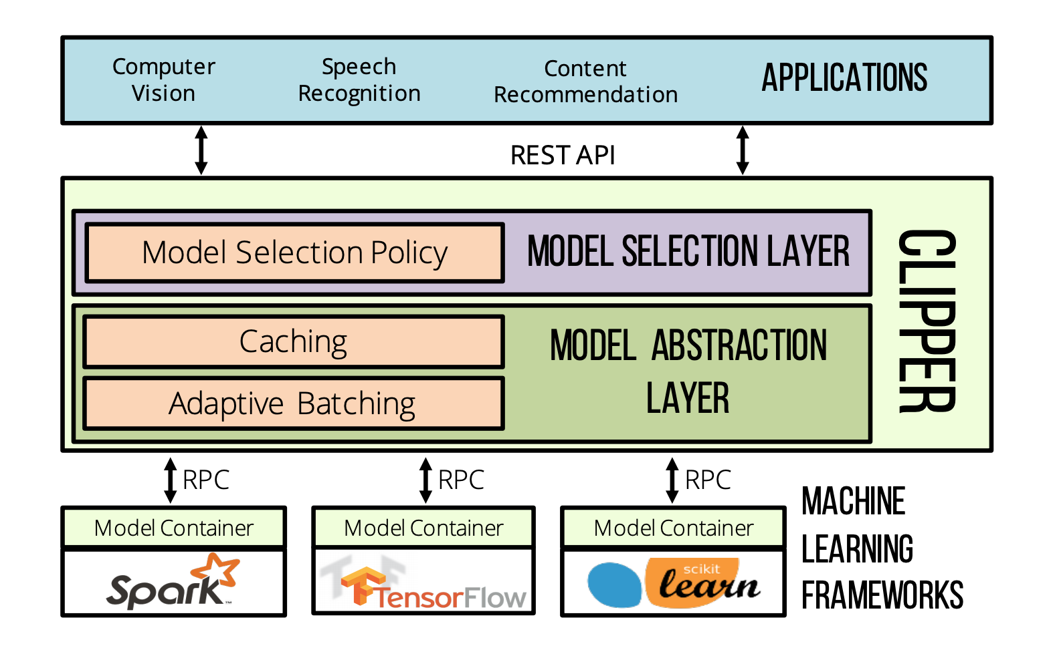
Machine Learning Prediction Serving
Model selection
Models are learned from data
Models are deployed and served together
Notes:
机器学习分training 和 inference
inference可以应用于一些在线服务比如：
inference需求多样而且需求量很大，所以需要一个prediction serving的系统
在这样一个框架里：系统把训练好的 model放在不同container里面
根据用户需求选择相应的model
经过model处理再把result返回

Slide 4
Performance goal of prediction service
Low latency
High throughput
Minimal resource usage
Notes:
系统对性能有三个要求：
低延迟 ：用户从request到response时间尽可能短
高吞吐量 ：系统在单位时间内处理尽可能多的request
尽可能少的资源利用：因为在计算的时候要消耗内存和计算资源，所以当model或request变多能更好地处理

Slide 5
Current serving systems(Clipper)
Assumption: models are black box
Encapsulate all operations into a function call
Apply external optimizations
Request batching
Result caching
Replication
Notes:
现有一个系统叫clipper
用户通过前段给出request
系统根据需求选择对应的model
在进行caching和batching的优化
然后将request放入相应model所在的container，给出结果
但是现有的系统把 model当作一个黑盒，不关心系统内部是如何做的
优化也是在model外进行的
batching： 把类似的request打包，提高吞吐量
caching：把经常用到的结果放在缓存，减少数据/结果读取时间
replication： 当container资源不够或者出现性能衰减，复制一个相同的

Slide 6
Outline
Background
Limitations of current solutions
Pretzel’s target
Pretzel’s Design
Evaluation
Notes:
现有的把model当作黑盒的缺点

Slide 7
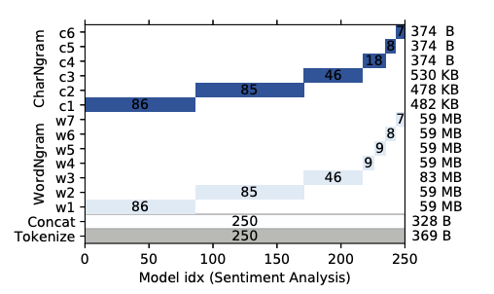
Limitation 1: Memory waste
Resources are isolated across Black boxes
Unable to share memory space
No coordination for CPU resources between boxes
Notes:
因为在现有的系统里不同的model是放在相对独立的container中
所以model间无法做到资源共享
作者在实验中用到的250个情感分析模型
其中有些operator的复用率很高
所以在现有系统里是存在内存浪费的

Slide 8
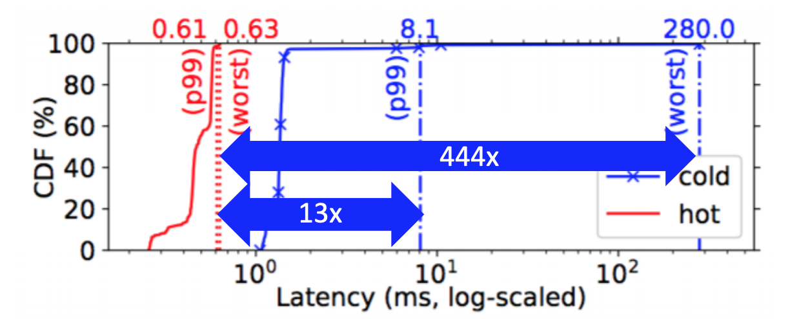
Limitation 2: Prediction initialization and Infrequent accesses
ML.Net initializes code and memory lazily (efficient in training phase)
Long-tail latency in the cold case
Difficult to provide strong Service-Level-Agreement
Notes:
在一个程序的启动时，有两种机制lazy和eager
Eager全部load出来，有可能造成资源浪费
Lazy function在需要的时候才被load，方便做一些计算优化（训练时很高效）
在机器学习中采用的是lazy
在inference的时候，因为结构是确定的，所以采用eager的方式比较好
为了防止这种懒启动的现象，现有框架将model load在内存里面，几个小时不用了再放回去
所以对于不经常用的model还是会存在懒启动问题

Slide 9
Limitation 3: Operator-at-a-time model
Operators have different performance characteristics
Current solution of ML.NET ignores how operators behave together
There can be a better plan if such characteristics are considered
Eliminating operations
Saving related buffers for intermediate results
Notes:
因为系统把model当作黑盒，所以不会了解model内部operator的关系
Training中也有类似的问题
为了提高灵活性，机器学习框架把operator定义在代数运算粒度上，一个训练模型的训练流图包括上千个节点，意味着数千次的内核执行
数据流图的调度开销，GPU内核函数的启动开销，以及内核函数之间的数据传输开销
直接方法内核融合（kernel fusion）减少开销
所以在inference过程中，如果知道operator之间的关系，合并带来同样效果

Slide 10
Limitation 4: Coarse Grained scheduling
One container is used for same model pipelines
Shared operators are instantiated multiple times independently (once per container)
Load balancing is achieved externally by replicating containers when performance degradation is observed
Problems when a small amount of models are frequently used

Slide 11
Outline
Background
Limitations of current solutions
Pretzel’s target
Pretzel’s Design
Evaluation

Slide 12
PRETZEL: White-box Prediction Serving
Analyze models to optimize the internal execution
Let models co-exist on the same runtime, sharing computation and memory resources
Optimize models in two directions:
End-to-end optimizations
Multi-model optimizations
Notes:
解决 operator at a time 问题
进而可以将model切开，允许不同model共享资源进行相似计算，解决内存浪费问题。又因将model切开解决粗力度调度问题。

Slide 13
End-to-End Optimizations
1. Ahead-of-time Compilation instead of Just-in-time Compilation
Compile operators’ code in advance → No JIT overhead
2. Vector pooling
Pre-allocate data structures → No memory allocation on the data path

Slide 14
Multi-model Optimizations
Share computation and memory across models
Object Store
Share Operators parameters/weights → Maintain only one copy
Sub-plan Materialization
Reuse intermediate results computed by other models → Save computation

Slide 15
Outline
Background
Limitations of current solutions
Pretzel’s target
Pretzel’s Design
Evaluation

Slide 16
System Components
Flour: Intermediate Representation
Oven: Compiler/Optimizer
Runtime: Execute inference queries
FrontEnd: Handle user requests
Offline phase
Online phase

Slide 17
OVEN:
Rule-based optimizer
From transformations to logical plans/stage graph
Model plan Compiler
From logical stages to physical stages(1 to n mapping)
AOT-compilation

Slide 18
Optimizer
Input graph validator step: Ensures a final predictor exists
Stage graph builder step: Transformations to stages
Stage graph optimizer step: Optimize stage graphs by
Removing unnecessary branches / stages
Merging stages with equal transformations
Pushing linear models through Concat operations
Output graph validator Step: Ensures stage graph is well-formed

Slide 19
Runtime
Initialization: Register vector and thread pools for execution
Execution: request-response engine / batch engine
Scheduler: coordinates the execution of multiple stages

Slide 20
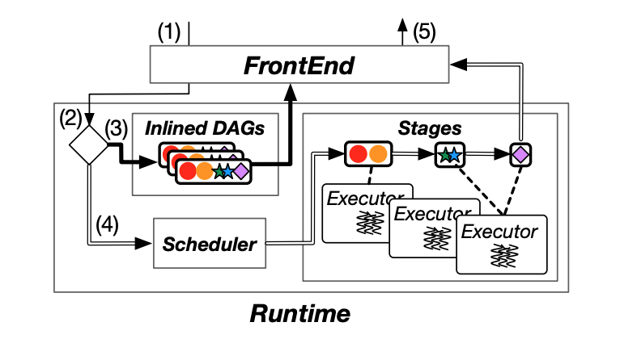
Runtime

Slide 21
Scheduler
Late binding scheduling mechanism
All executors pull works from a shared pair of queues
Low priority for newly submitted plans
High priority for already started stages

Slide 22
Outline
Background
Limitations of current solutions
Pretzel’s target
Pretzel’s Design
Evaluation

Slide 23
Evaluation
500 Models for 2 different tasks
250 Sentiment Analysis (Memory-bound)
250 Attendee Count (Compute-bound)
Compared with black-box approaches in terms of
Latency, memory and throughput

Slide 24
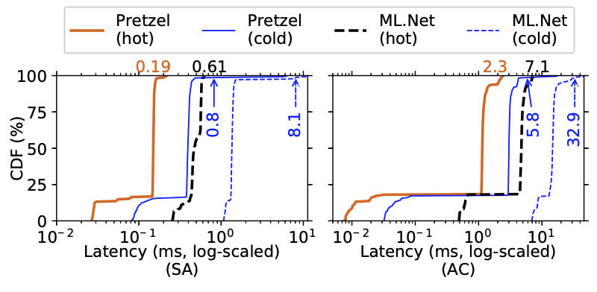
Evaluation: Latency
Pretzel performs better because of
AOT-compilation
Vector pooling
Sub-plan materialization

Slide 25
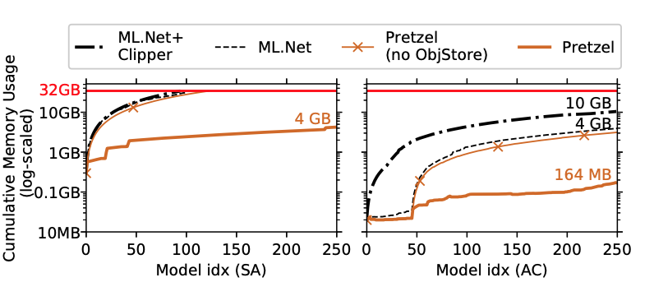
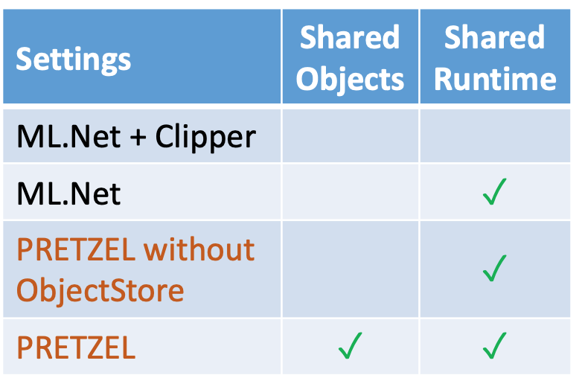
Evaluation: Memory
Measure Cumulative Memory Usage after loading 250 model
4 settings for Comparison

Slide 26
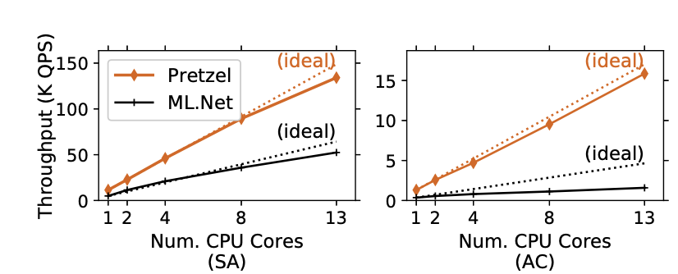
Evaluation: Throughput
Black-box solutions has lower scalability:
Model projects are allocated to different memory areas
Increase CPU core will cause more pressure on memory systems

Slide 27
Conclusion
PRETZEL is the first white-box prediction serving system for ML pipelines(inference phase)
Enables two types of optimizations:
End-to-end optimizations generate efficient execution plans for a model
Multi-model optimizations let models share computation and memory resources
Evaluation shows that PRETZEL can improve performance compared to Black-box systems
Decrease latency and memory footprint
Increase resource utilization and throughput

