Slide 1
Flare: Optimizing Apache Spark with Native Compilation
for Scale-Up Architectures and Medium-Size Data
(OSDI’18)
Grégory M. Essertel¹, Ruby Y. Tahboub¹, James M. Decker¹, Kevin J. Brown², Kunle Olukotun², Tiark Rompf¹
¹Purdue University, ²Stanford University

Slide 2
Outline
Workflow in ML
Data pre-processing, computation (and storage)
Spark SQL
How it works? (Spark SQL in SIGMOD’15, DataFrame, Catalyst, Tungsten)
Spark SQL limitations
Data exchange between code boundaries
Java limitation (vs. C codes)
Link with external libraries (e.g. TensorFlow)
Flare
Query compilation
Optimizing data loading
ETL + UDF
Experiments
TPC-H
Spark SQL + TensorFlow

Slide 3





How data flow in machine learning, from end to end
Data Pre-processing
Storage
Database
……
Notes:
Spark SQL is widely used
Flexible API, multi-languages

Slide 4
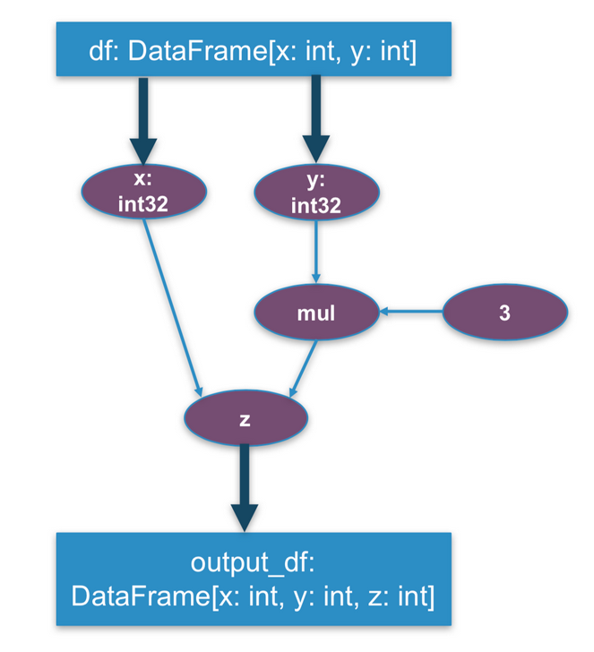
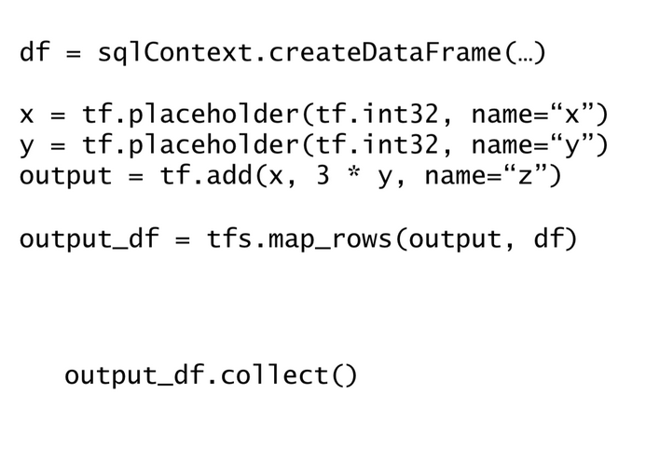
How data flow in machine learning, from end to end
A machine learning example using Spark SQL and TensorFlow

Slide 5
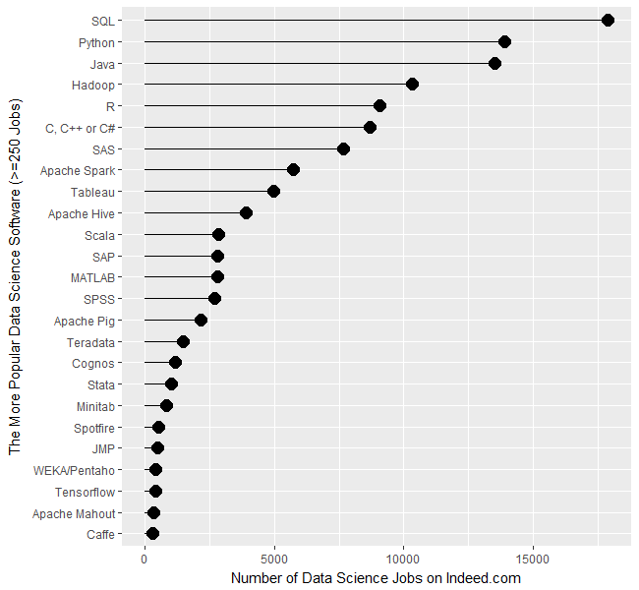
Spark SQL is a popular tool
Rank 1
Rank 8

Slide 6
Machine learning = big data + training
Big data 3V (Volume, Velocity and Variety) properties.
Need ETL (Extract, transform, load) and feature engineering support.
IO-intensive.
Training is computing-intensive.
Computing graph becomes more and more complicated

Slide 7
Outline
Workflow in ML
Data pre-processing, computation (and storage)
Spark SQL
How it works? (Spark SQL in SIGMOD’15, DataFrame, Catalyst, Tungsten)
Spark SQL limitations
Data exchange between code boundaries
Java limitation (vs. C codes)
Link with external libraries (e.g. TensorFlow)
Flare
Query compilation
Optimizing data loading
ETL + UDF
Experiments
TPC-H
Spark SQL + TensorFlow

Slide 8
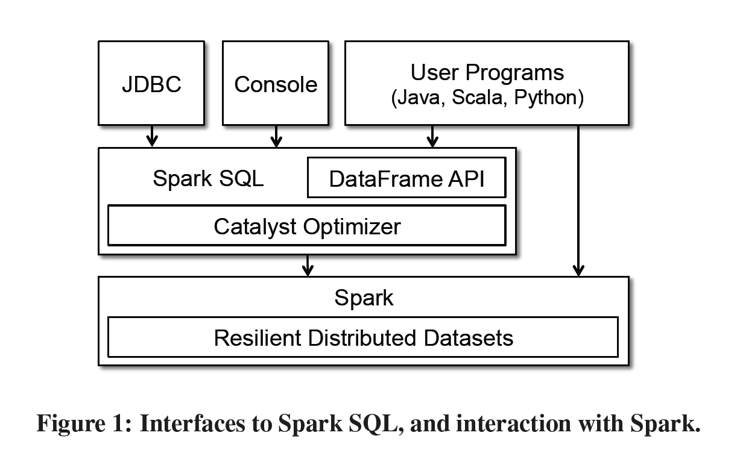
Spark SQL = Spark + DataFrame + Catalyst
DataFrame: API that can perform relational operations on both external data sources and Spark’s built-in RDDs.
Catalyst: A highly extensible optimizer that uses features of Scala to add composable rules, control code generation, and define extension points.

Slide 9
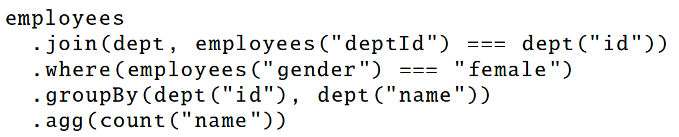
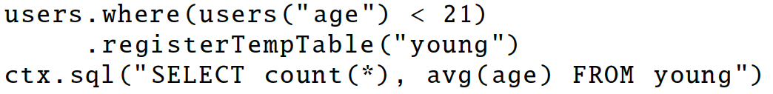
DataFrame Operation
Deferred API (similar to TensorFlow).
Relational operation (select, where, join, groupby) via DSL
Alternatively, register as temp SQL table and perform traditional SQL query strings.
Operator build up an abstract syntax tree (AST), which is then optimized by Catalyst.

Slide 10
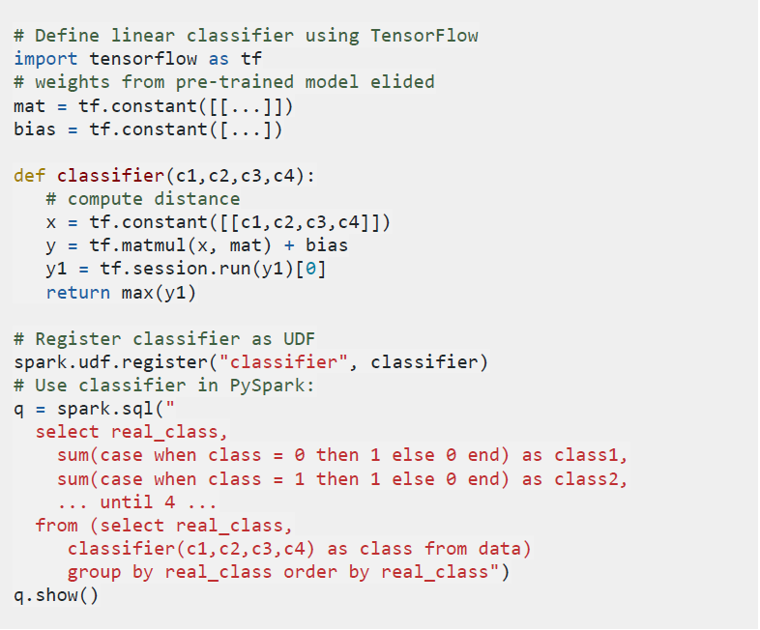
DataFrame Operation
Also, DataFrame support UDF (User-defined function) for flexibility.
Example:
DataFrame register a TensorFlow function as UDF and use it in later SQL query.
1. Define function
2. Register function
3. Call function

Slide 11
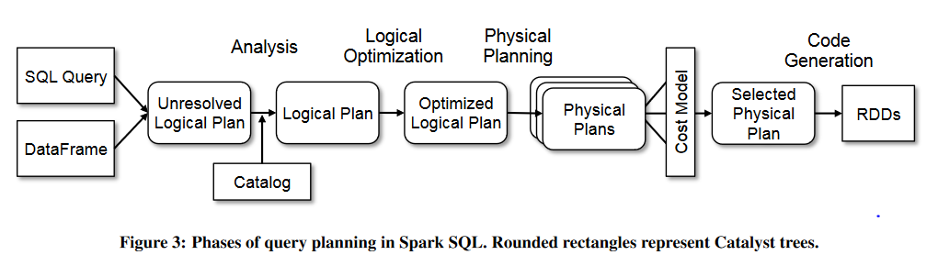
Catalyst: query optimizer
Projection push down
Filter push down
Catalyst
Tungsten
(generate JVM bytecode and objects off-heap allocation)
Join methods selection
……
Notes:
Catalyst: push down & join methods

Slide 12
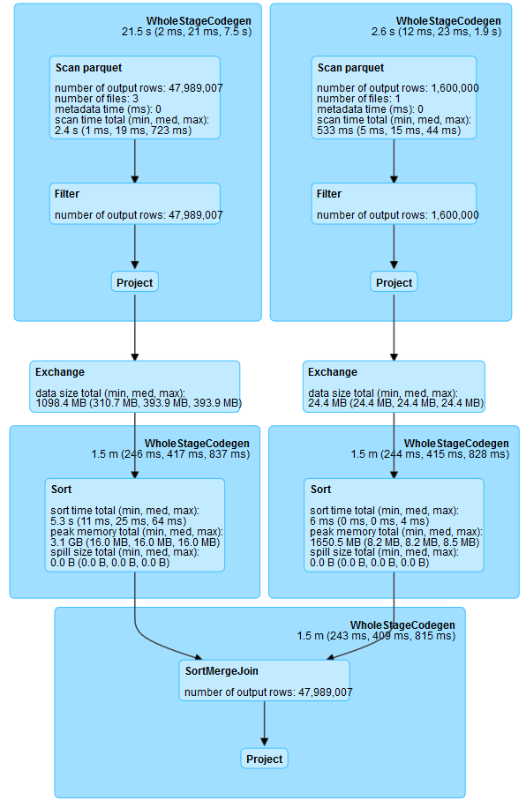
Spark SQL stages example
Tungsten generates code based on SQL stages.
Example:
select l_extendedprice
from lineitem, part
where l_partkey = p_partkey

Slide 13
Outline
Workflow in ML
Data pre-processing, computation (and storage)
Spark SQL
How it works? (Spark SQL in SIGMOD’15, DataFrame, Catalyst, Tungsten)
Spark SQL limitations
Data exchange between code boundaries
Java limitation (vs. C codes)
Link with external libraries (e.g. TensorFlow)
Flare
Query compilation
Optimizing data loading
ETL + UDF
Experiments
TPC-H
Spark SQL + TensorFlow

Slide 14
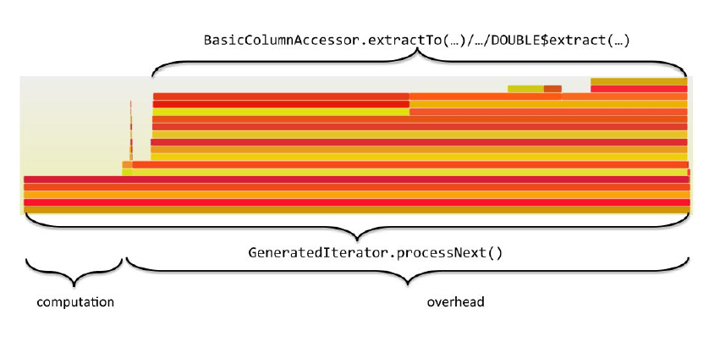
Spark SQL limitations: data exchange overhead
CPU profile of Spark SQL
80%
Accessing and decoding the in-memory data representation
Moving between the two pieces of generated code through code paths

Slide 15
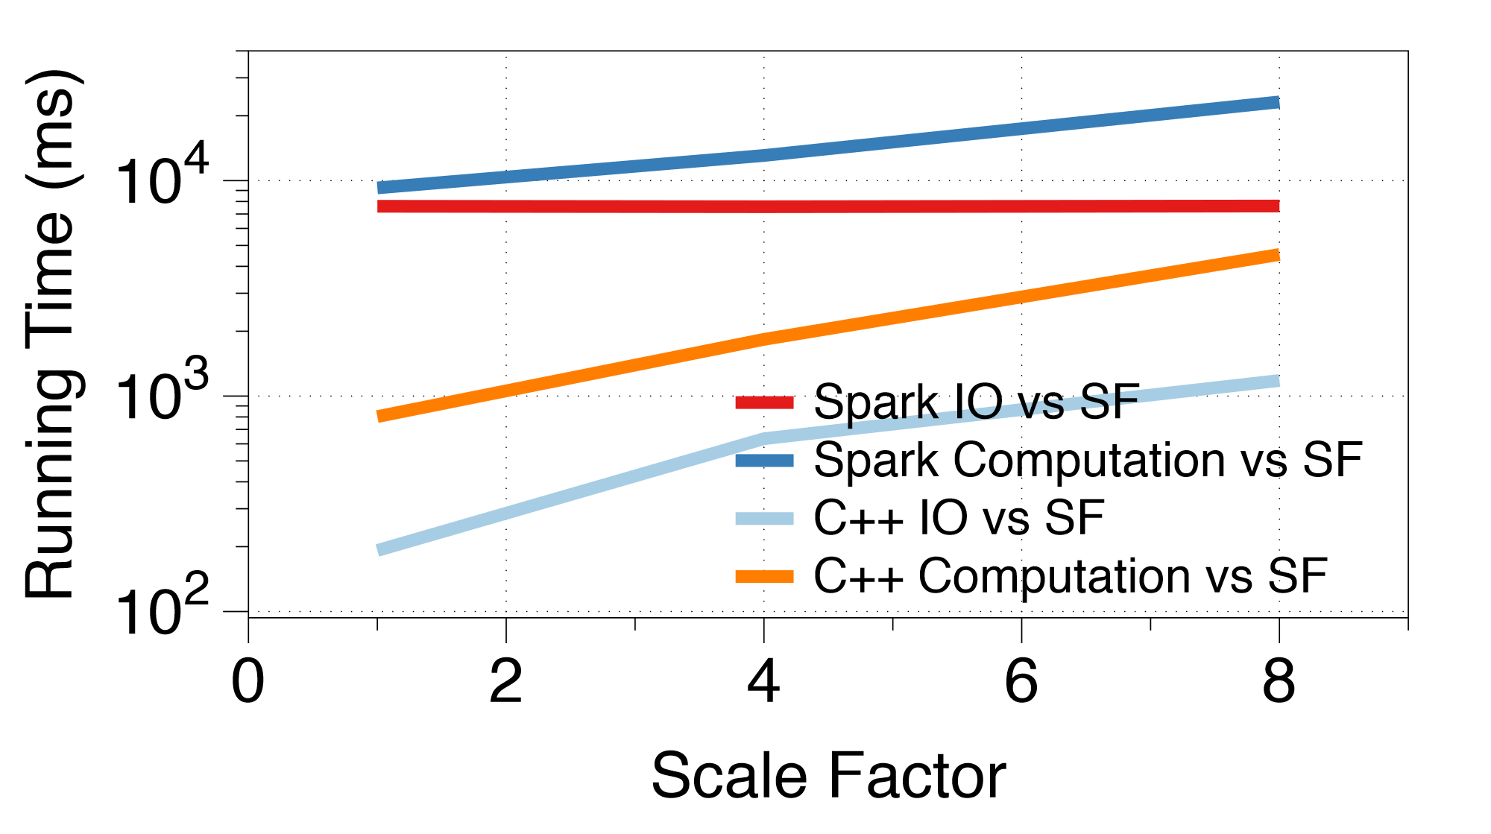
Spark SQL limitations: JVM overhead

Slide 16
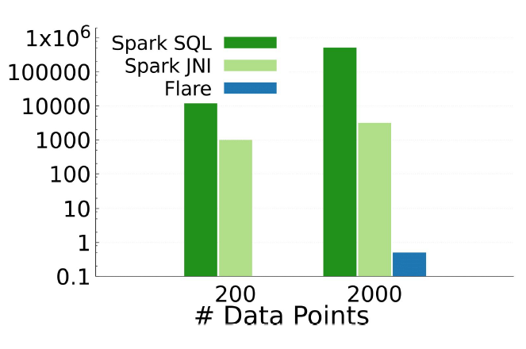
Spark SQL limitations: link overhead with external libraries
Same example as before
522 s
3 s
0.5 ms
Python code compile in run time.
JNI can utilize TensorFlow Ahead-of-Time compiler, XLA.
Flare will discuss later
Notes:
Running time (ms)
Data loading becomes bottleneck of the system

Slide 17
Outline
Workflow in ML
Data pre-processing, computation (and storage)
Spark SQL
How it works? (Spark SQL in SIGMOD’15, DataFrame, Catalyst, Tungsten)
Spark SQL limitations
Data exchange between code boundaries
Java limitation (vs. C codes)
Link with external libraries (e.g. TensorFlow)
Flare
Query compilation
Optimizing data loading
ETL + UDF
Experiments
TPC-H
Spark SQL + TensorFlow

Slide 18
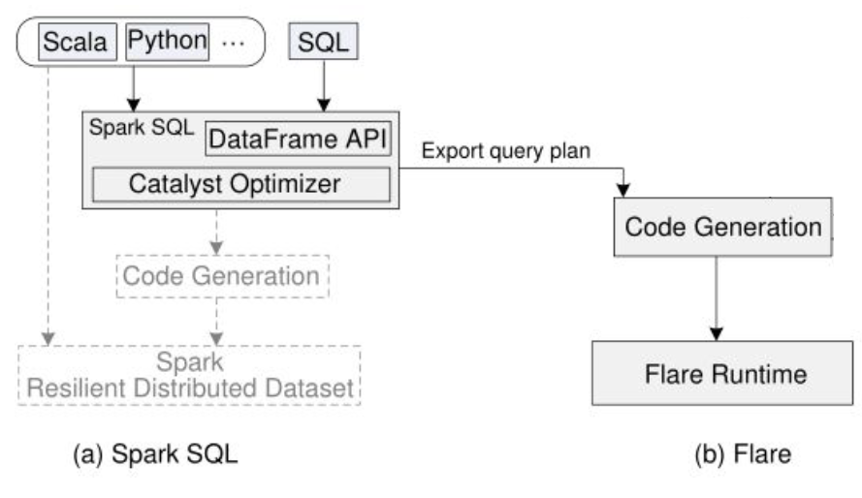
System overview
TensorFlow
XLA
Notes:
Remove RDD

Slide 19
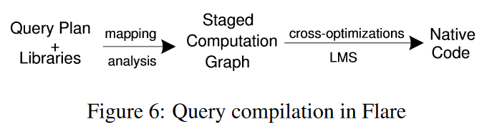
Query compilation
Solving Spark SQL’s data exchange overhead
Flare compiles whole queries instead of only query stages.
Flare compiler adapt HyPer^{[1]} query compilation model.
[1] T. Neumann. Efficiently compiling efficient query plans for modern hardware. PVLDB, 4(9):539–550, 2011.

Slide 20
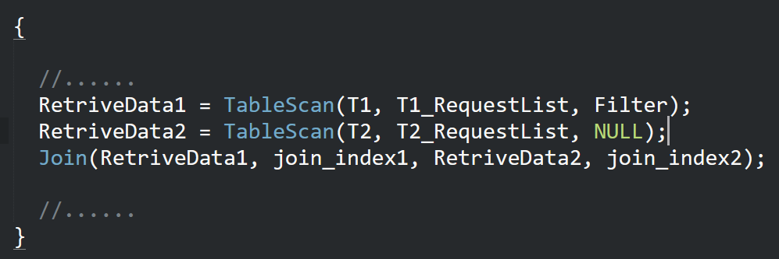
Query compilation example
SQL query:
SELECT T1.A, T2.B FROM T1, T2 WHERE T1.A = T2.A AND T1.A > 100
Join
T1.A = T2.A
SQL physical plan
Flare Compiler
Project
T1.A
Project
T2.A, T2.B
C Code
Filter
T1.A > 100
Scan
T1
Scan
T2

Slide 21
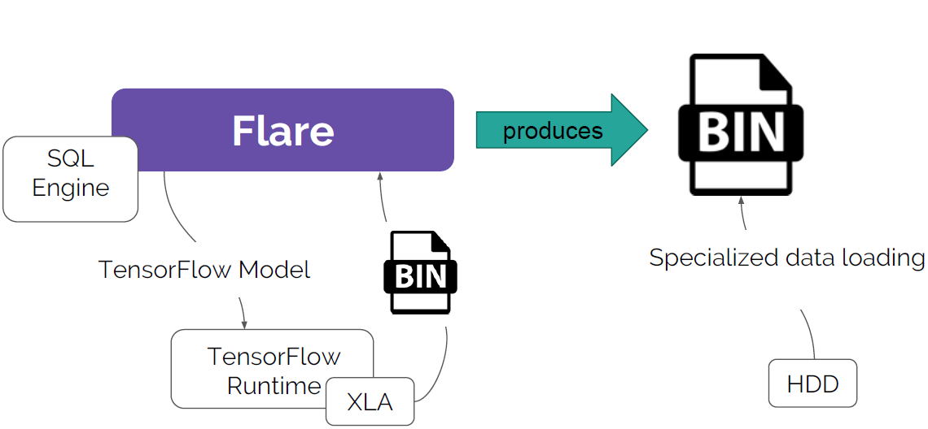
Extract, transform, load phase(ETL) + UDF
Solving Spark SQL’s JVM overhead and linking overhead

Slide 22
Experiments
TPC-H
Single-Core Running Time
Parallel Scaling
Spark SQL + TensorFlow (has shown before)

Slide 23
TPC-H is a decision support benchmark
It consists of a suite of business oriented ad-hoc queries and concurrent data modifications. The queries and the data populating the database have been chosen to have broad industry-wide relevance.
8 tables + 22 queries

Slide 24
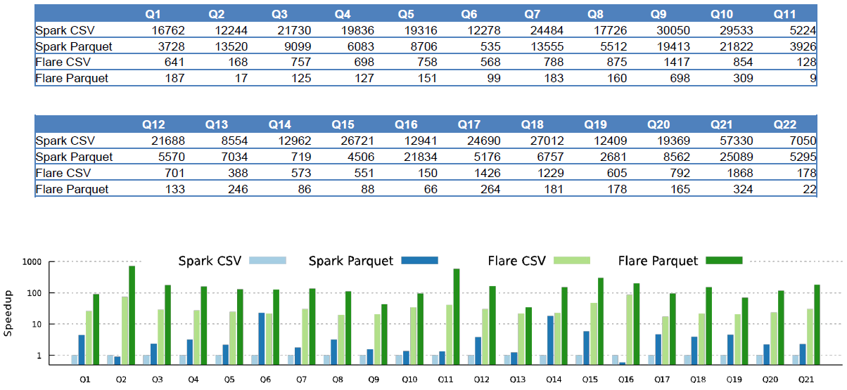
Data loading
Notes:
Speedup for TPC-H SF1 when streaming data from SSD on a single thread

Slide 25
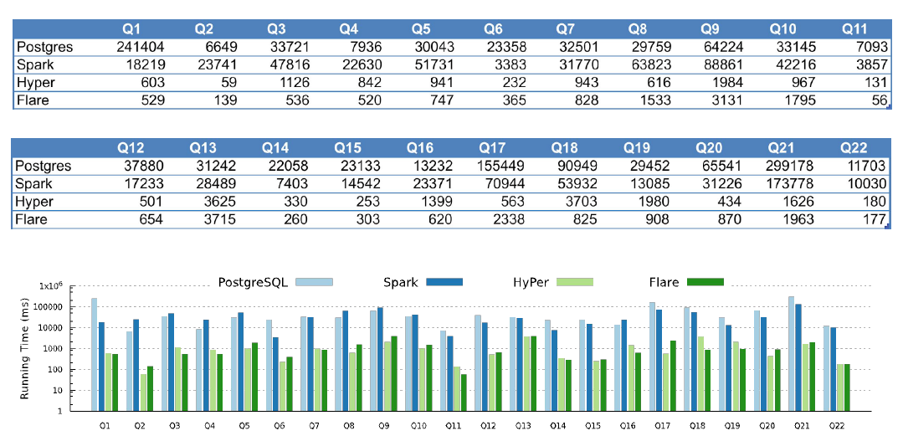
Single-core running time
Notes:
Absolute running time in ms for four software in SF10
Spark < Flare:
low-level data access on the JVM
Distributed-first strategy, e.g. sort-merge join and broadcast hash join
Overhead of RDD operations and communication through Spark’s runtime system

Slide 26
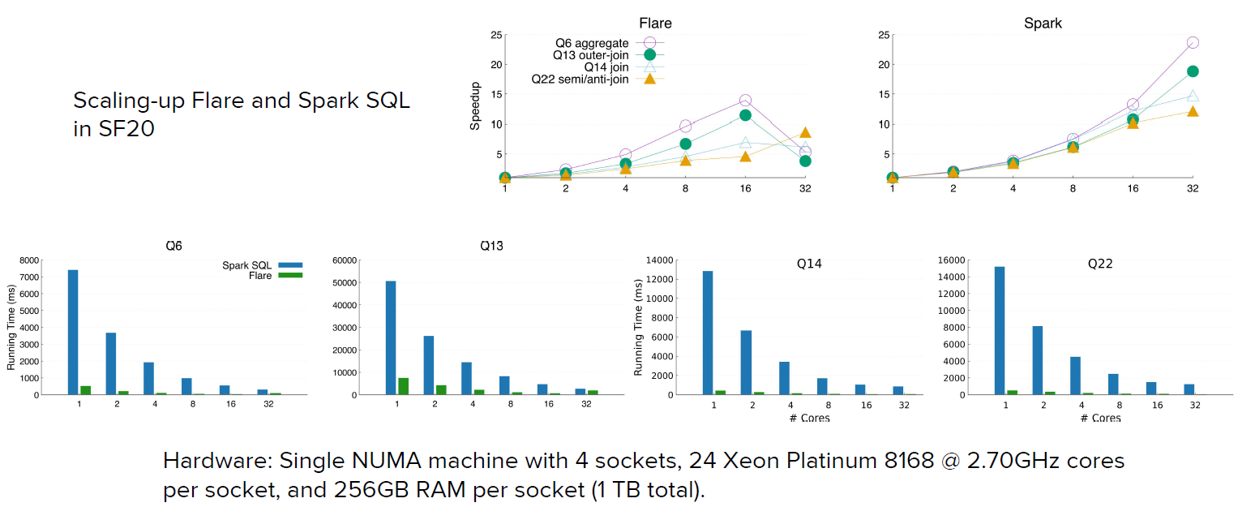
Parallel scaling
Notes:
Configuration that Outperforms a Single Thread (COST)

