Slide 1
Learning-based Congestion Control
Gaoxiong Zeng
^{SINGLab, CSE, HKUST}

Slide 2
Outline
Background: Congestion Control
Offline learning based congestion control
Remy (SIGCOMM’13)
Online learning based congestion control
PCC Allegro (NSDI’15)
PCC Vivace (NSDI’18)

Slide 3
Background: Congestion Control
There is a long history of congestion control:
1988 – TCP [*] is proposed by Van Jacobson.
Evolvement: Tahoe -> Reno -> New Reno -> SACK
2000s – High Speed Internet: XCP, RCP, BIC, Cubic…
2010s – Data Center Network: DCTCP, HULL, D2TCP, L2DCT…
Human-designed Hard-wired Point Solutions
[*] V. Jacobson, “Congestion avoidance and control,” in SIGCOMM, 1988.
Notes:
Tahoe: fast retransmission – 3 duplicate Acks indicates loss.
Reno: fast recovery – reduce CWND to half instead of one under 3 duplicate Acks.
New Reno: to avoid multiple CWND cut due to multiple packet loss in a window, stay ‘fast recovery’ until all outstanding acked.
SACK: can identify and resend multiple packet loss in a window.
XCP & RCP: In-network feedback assistance.
BIC & Cubic: Fast convergence in high BDP network. Cubic uses a cubic function of time to increase CWND to achieve RTT-fairness.

Slide 4
Outline
Background: Congestion Control
Offline learning based congestion control
Remy (SIGCOMM’13)
Online learning based congestion control
PCC Allegro (NSDI’15)
PCC Vivace (NSDI’18)

Slide 5
Motivation
Legacy congestion control (CC) is human-designed point solution:
Limitations:
Hard-wired point solution
Inflexible to adapt to different network and goals.
Human-designed
Simple but coarse-grained, suboptimal CC rules.
Remy [*]:
Free the congestion control to evolve with the network and goals.
Brute-force search/learn best CC by offline computer simulation.
[*] K. Winstein, etc. “TCP ex Machina: Computer-Generated Congestion Control,” in SIGCOMM, 2013.
Notes:
Point solution: Cubic <-> DCTCP. DCTCP cannot converge fast in high BDP Internet like Cubic. Cubic cannot work well under DCN shallow buffer.
CC is essentially a set of match action rules. Match (states or events) to (actions, e.g., rate or cwnd or send time adjustment).

Slide 6
Remy Framework
Remy: a program that generates
congestion-control schemes offline
Input:
Prior assumptions (Learning setup of target network)
Goals (Formulated as objective function)
Output:
Congestion control algorithm for sender (RemyCC)
Format: Rule(r_ewma, s_ewma, rtt_ratio) → <m, b, τ>

Slide 7
RemyCC: Match-Action Rule Table
Rule(r_ewma, s_ewma, rtt_ratio) → <m, b, τ>
Match states / memory:
r_ewma moving average of interval between ACKs
s_ewma EWMA between timestamps echoed in ACKs
rtt_ratio ratio of last RTT to smallest RTT so far
Actions:
m Multiple to congestion window
b Increment to congestion window
τ Minimum interval between two outgoing packets
Notes:
What is r_ewma and s_ewma? Exponential weighted moving average of receive/send time intervals of last two ACKs/data.

Slide 8
Remy Example: Prior Assumptions
Quantity | Distribution | Units
Link speed | Uniform(10, 20) | Mbps
RTT | Uniform(100, 200) | ms
Flow # (N) | Uniform(1, 16)
On-off pattern | Exp[µ=5] | Secs

Slide 9
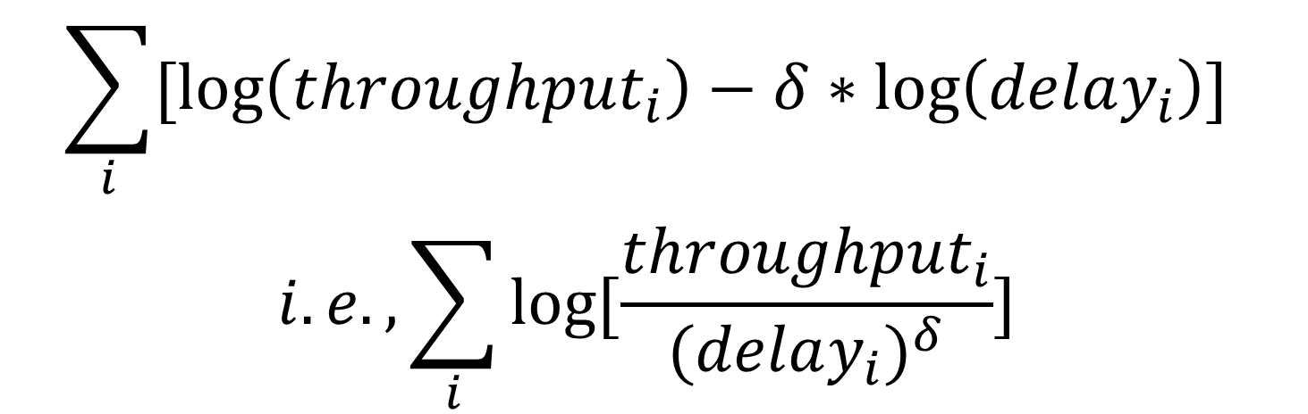
Remy Example: Objective Function
Guarantees proportional fairness
$$\sum_{i}{[log\left(throughput_{i}\right)−δ∗\log\left(delay_{i}\right)]}$$
$$i.e.,\sum_{i}{log⁡[\frac{throughput_{i}}{{(delay_{i})}^{δ}}]}$$
where δ is a positive parameter to tune the delay significance.
Notes:
Why use this objective function? Log(throughput) guarantees proportional fairness (i.e., throughput inversely proportional to resource consumed, e.g., contending flow # or RTT). Max-min fairness = proportional fairness when all flows consumes equal resource.
Can we guarantee fairness? Yes.

Slide 10
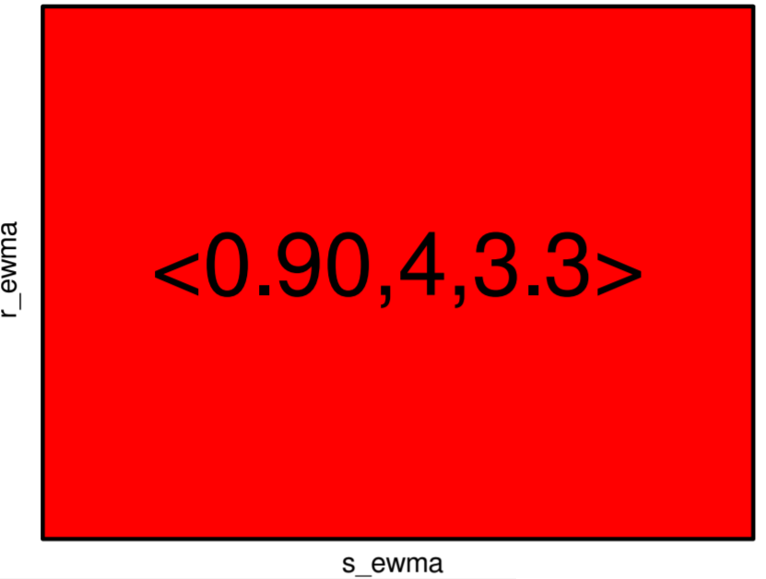
Remy Example: Learn the RemyCC Rules
Epoch 0

Slide 11
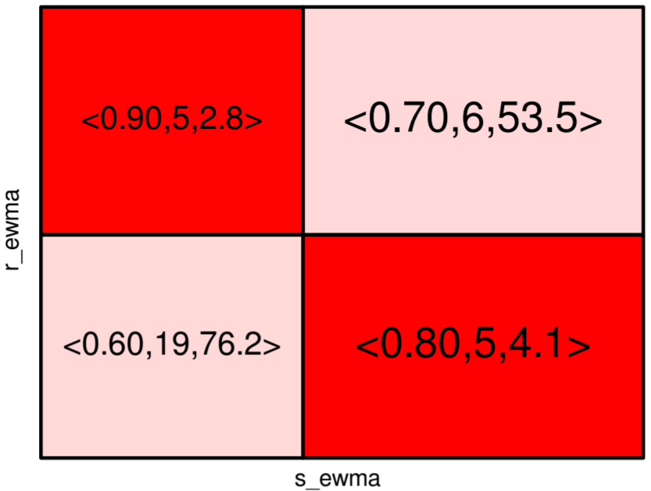
Remy Example: Learn the RemyCC Rules
Epoch 1
Split & learn the most-used rule.

Slide 12
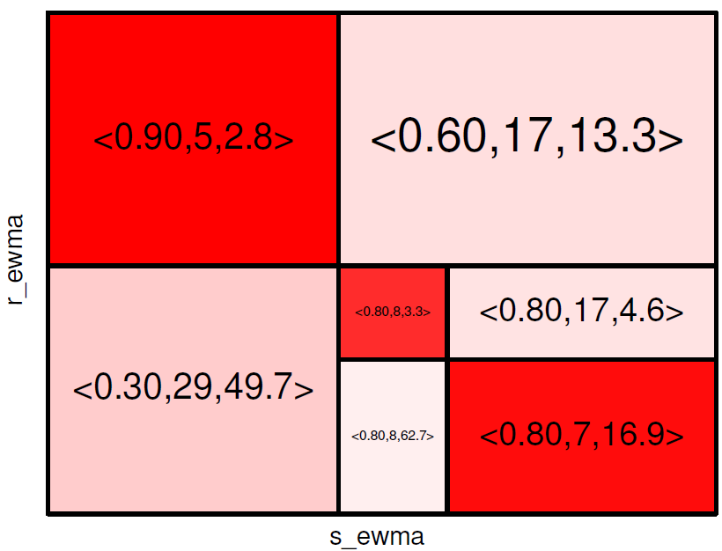
Remy Example: Learn the RemyCC Rules
Epoch 2
Split & learn the most-used rule.

Slide 13
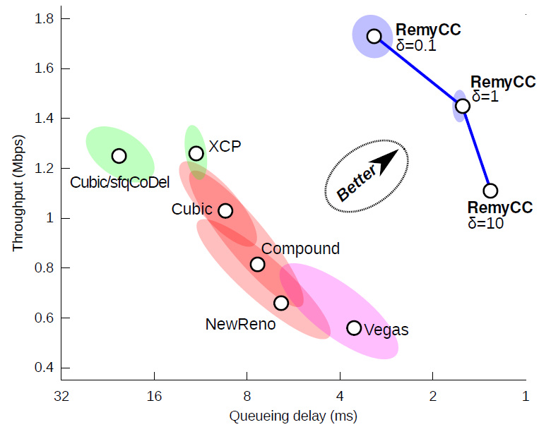
Remy Example: Performance
Notes:
How does Remy perform when assumptions are inaccurate?

Slide 14
Outline
Background: Congestion Control
Offline learning based congestion control
Remy (SIGCOMM’13)
Online learning based congestion control
PCC Allegro (NSDI’15)
PCC Vivace (NSDI’18)

Slide 15






Internet Congestion Control
ACKs
…
Data Packets
…
Assumptions on
When is a packet sent
Change
Whether a packet is lost
^{Sending Rate Network} When is a packet acked
Packet loss indicates congestion

Slide 16


Internet Congestion Control
Self-induced congestion
Random loss
Congestion from other heavy flows
Shallow buffer

Slide 17

Strong Assumptions Cause Problem
Underlying cause Best response
Self-induced
Decrease rate a lot
congestion
Congestion from other heavy flows
Maintain rate
Packet loss
Decrease rate slightly
Shallow buffer
Random loss
Maybe even increase rate
Assumptions may not capture the Internet complexity

Slide 18
Performance-oriented Congestion Control (PCC)
Move to r₁
r₁
r₂
u₁
u₂
Internet
u₁ >u₂?
Move to r₂
(Causal relation) (Online learning)
Utility Function Rate Control Algorithm
Sender selfishly maximizes its own utility (online learning in non-cooperative game)
Notes:
What is non-cooperative game? In game theory, a non-cooperative game is a game with competition between individual players and in which only self-enforcing (e.g. through credible threats) alliances (or competition between groups of players, called "coalitions") are possible due to the absence of external means to enforce cooperative behavior (e.g. contract law), as opposed to cooperative games.

Slide 19
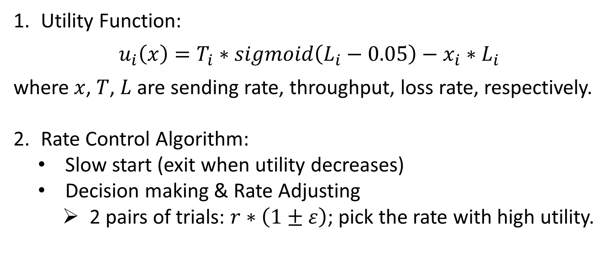
PCC Allegro
[Dong et al. NSDI 2015]
Guarantees unique and fair Nash equilibrium
Utility Function:
$$u_{i}\left(x\right)=T_{i}∗sigmoid\left(L_{i}−0.05\right)−x_{i}∗L_{i}$$
where $x$, $T$, $L$ are sending rate, throughput, loss rate, respectively.
Rate Control Algorithm:
Slow start (exit when utility decreases)
Decision making & Rate Adjusting
2 pairs of trials: $r∗\left(1±ε\right)$; pick the rate with high utility.
Caps loss rate at 0.05
Shapes convergence behavior
Notes:
Explain the utility function. Need to guarantee unique and fair Nash equilibrium.
In fact, the convergence guarantee does not rely on the rate control. Any combination of AIMD, AIAD, MIMD, MIAD can work.

Slide 20
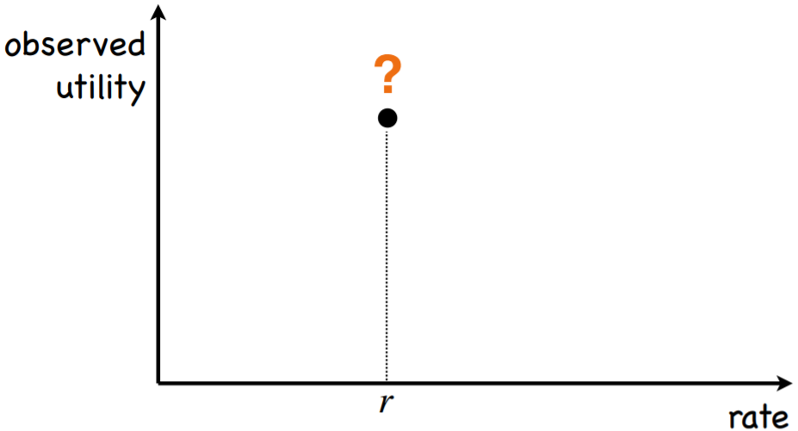
PCC Allegro: Rate Control Illustration

Slide 21
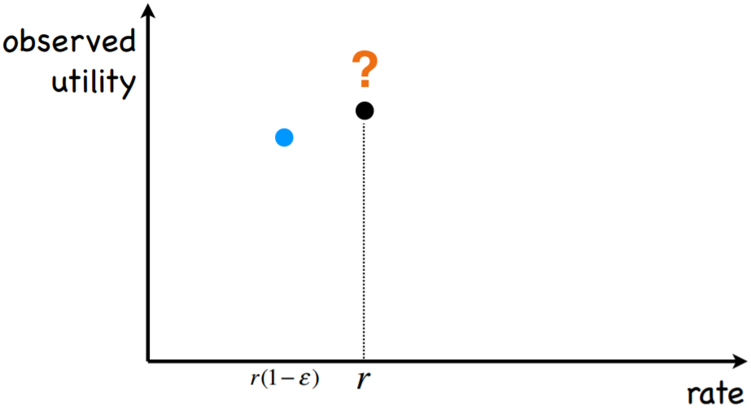
PCC Allegro: Rate Control Illustration

Slide 22
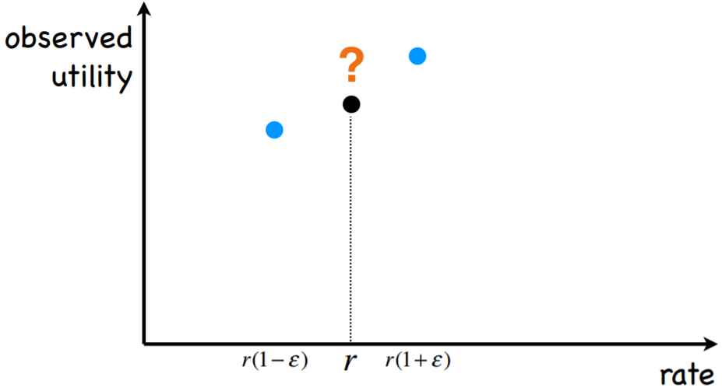
PCC Allegro: Rate Control Illustration

Slide 23
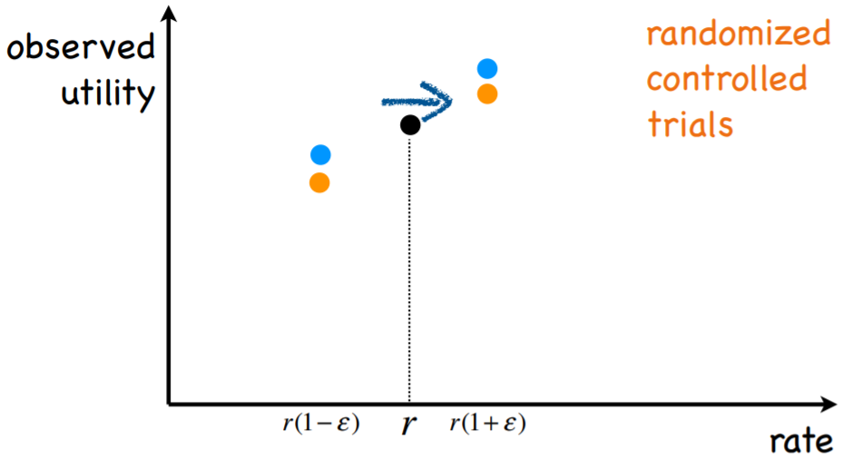

PCC Allegro: Rate Control Illustration
$$ε=0.01 by default$$

Slide 24
Slow convergence
Limitations of PCC Allegro
Utility Function: No latency-awareness
Buffer bloat
Rate Control: Fixed rate change step size
Naïvely adding latency -> Fair convergence & TCP friendly?
Large and frequent vibration
r₁ C
(Small step size)
r₂
r₁ C
r₂
(Large step size)
Notes:
There is a latency-aware utility function in Allegro, which does not guarantee fair Nash equilibrium and TCP friendly.

Slide 25
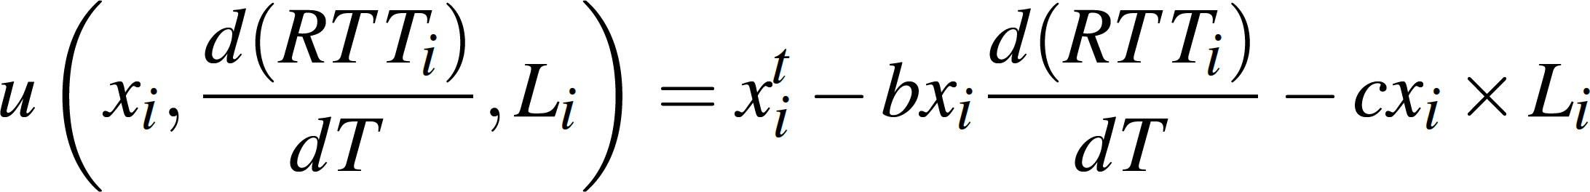
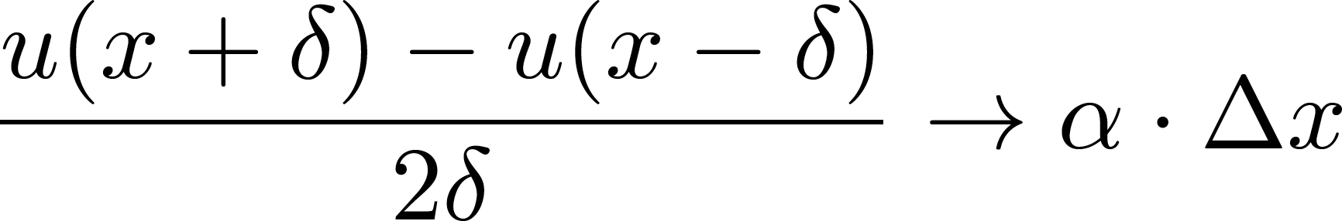
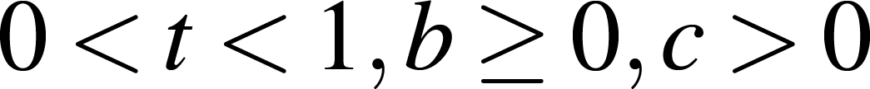
PCC Vivace
[Dong et al. NSDI 2018]
Strictly concave utility function
Gradient-ascent rate control
Notes:
What does strictly concave mean? Concave game <-> All utility functions are concave.
What is gradient-ascent? Taking steps proportional to the negative of the gradient. Gradient ascent finds the local maximum while gradient descent finds the local minimum.

Slide 26
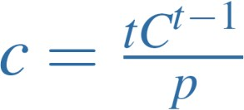

PCC Vivace: Utility Function
Strictly concave utility function
Strict socially concave game Unique convergence equilibrium
Tolerate p-random-loss if
No latency inflation upon convergence if
Notes:
What does strictly concave mean? Concave game <-> All utility functions are concave. → Unique convergence equilibrium
P-loss-resilient -> Does not decrease sending rate under random loss < p.

Slide 27

PCC Vivace: Rate Control Algorithm
Gradient-ascent rate control
Observed utility
?
Techniques to deal with measurement noise:
Sending rate
Linear regression
RTT gradient low-pass filter
Double check
x-δ x x+δ
Notes:
What is gradient-ascent? Taking steps proportional to the negative of the gradient. Gradient ascent finds the local maximum while gradient descent finds the local minimum.
Linear regression to calculate gradient.
Low-pass filter to remove small RTT noise.
Double check by re-run under abnormal cases (e.g., low rate leads high loss).

Slide 28
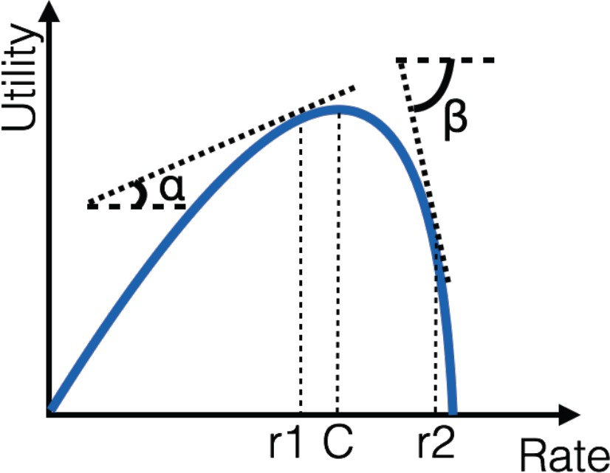
Large utility gradient
PCC Vivace: Rate Control Algorithm
Gradient-ascent rate control
Small utility gradient
r₁ C
r₂
Notes:
What is gradient-ascent? Taking steps proportional to the negative of the gradient. Gradient ascent finds the local maximum while gradient descent finds the local minimum.

Slide 29
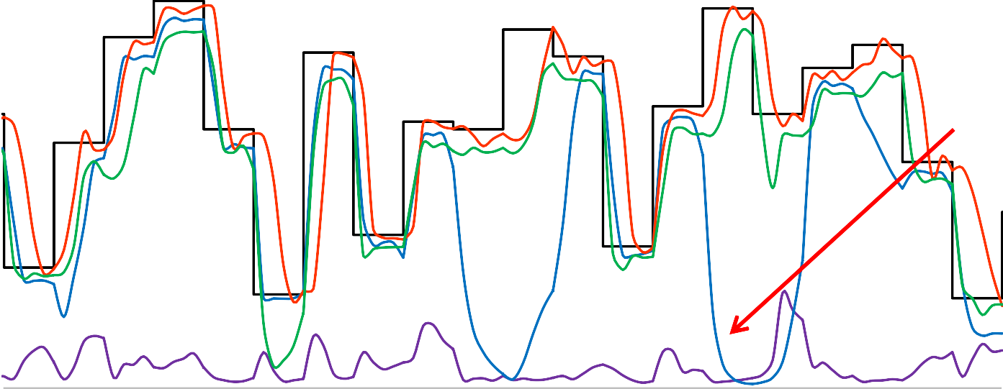
PCC Performance
Emulab network (10-100Mbps, 10-100ms RTT, 0-1% random loss)
PCC Allegro PCC Vivace
100
80
60
40
20
0
Cannot resist
random loss
Sending Rate (Mbps)
Slow reaction upon RTT surge
BBR
Less Packet Losses
140 160 180
Time (sec)
TCP CUBIC
200
100
120
Notes:
Cubic cannot tolerate random loss.
BBR has occasional throughput loss due to RTT increase / surge.
PCC tracks the changing network well. Vivace reacts faster than Allegro because of the gradient-ascent rate control.

Slide 30
Summary
Congestion Control:
Human vs Online Learning vs Offline Learning
Online learning catches local info and performs local optimization, while offline learning performs global optimization with a global view.
Online learning treats network as a ‘black box’, while offline learning and human-designed protocols treat the network as a ‘white box’.
Machine interprets the ‘box’ better than human.
Machine generates more fine-grained and effective CC rules.
Machine learns CC rules more flexibly given network and goals.

Slide 31
References
TCP ex Machina: Computer-Generated Congestion Control, SIGCOMM’13.
PCC: Re-architecting Congestion Control for Consistent High Performance, NSDI’15.
PCC Vivace: Online-Learning Congestion Control, NSDI’18.
Congestion-Control Throwdown, HotNets’17.
Internet Congestion Control via Deep Reinforcement Learning, ArXiv’18.
Improving TCP Congestion Control with Machine Intelligence, NetAI’18.
QTCP: Adaptive Congestion Control with Reinforcement Learning, TNSE’18.
Reducing Web Latency through Dynamically Setting TCP Initial Window with Reinforcement Learning, IWQoS’18.

Slide 32
Thanks!

Slide 33
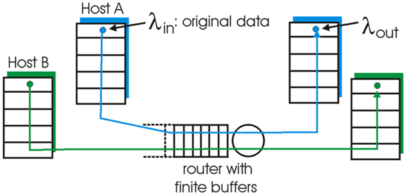
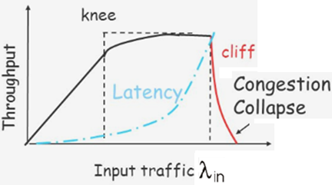
Background: Congestion Control
What is the target question of congestion control?
Allocating network resources among contending flows.
Typical goals: high throughput, low latency, low loss.

Slide 34






PCC Allegro → PCC Vivace
Gradient-ascent
Heuristic
rate control
Observed utility
?
Sending rate
x-δ x x+δ

Slide 35
PCC Allegro → PCC Vivace
Strictly concave Loss-based utility function
Gradient-ascent
Heuristic
rate control
L(x+δ) = 0.01% L(x-δ) = 2.0%
Double check
Linear regression Low pass filter (> 0.01)

Slide 36
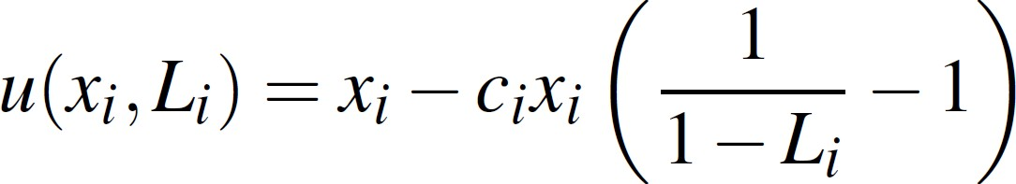
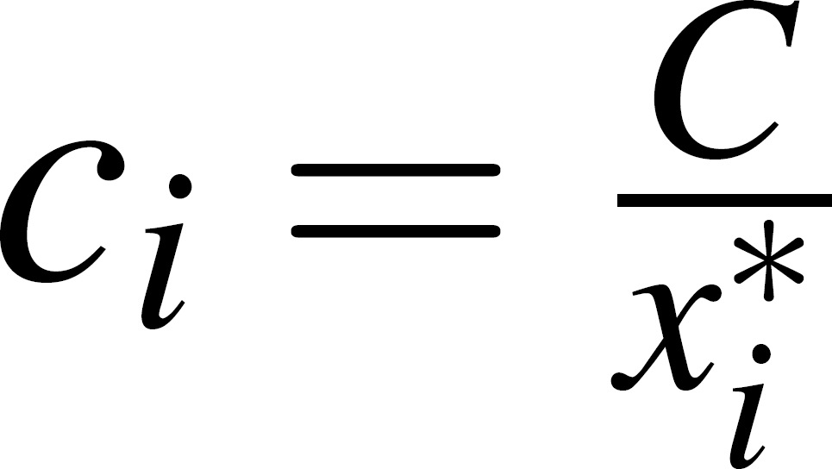
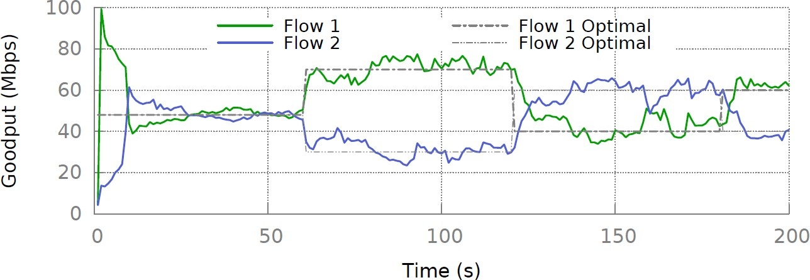
Insights from Learning-Theoretic Tools
Flexible equilibrium state with heterogeneous senders

Slide 37
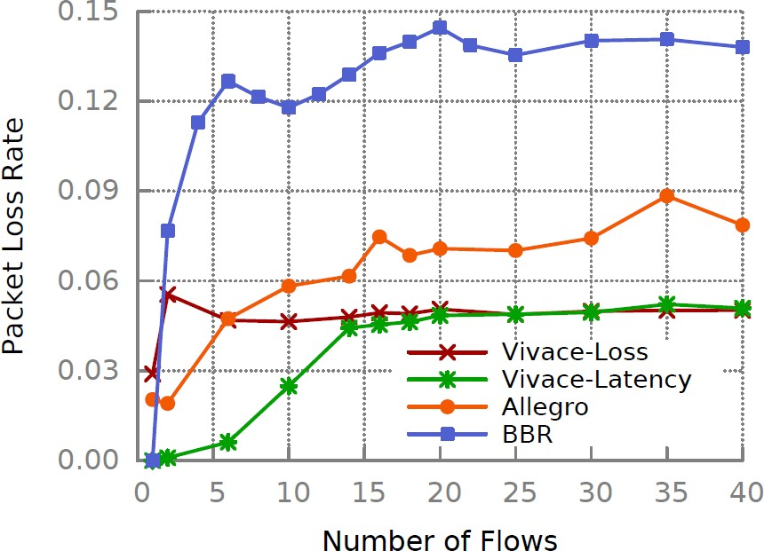

Insights from No-Regret Guarantee
Random loss tolerance vs. Congestion loss (8Mbps, 25KB per-flow share)
~15
~ 5

Slide 38
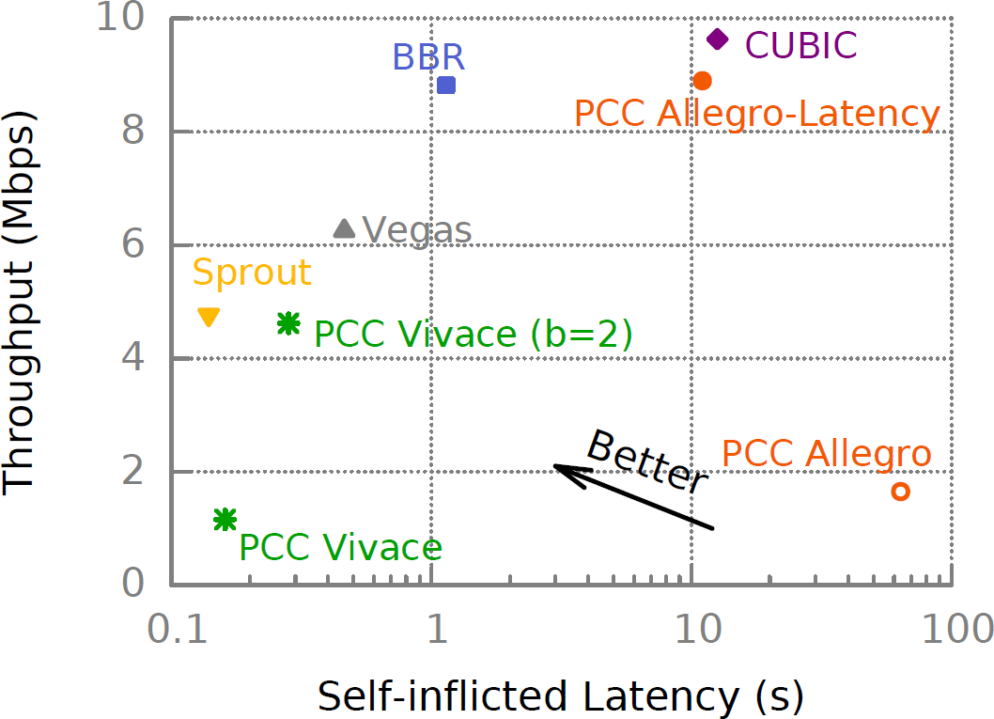
Limitation in Extremely Dynamic Networks
LTE (Mahimahi emulator [Netravali et al. ATC 2015])
Low Throughput

Slide 39
Limitation of No-Regret
“Sender's choices of rates are asymptotically (across time) no worse, utility-wise, than sending at what would have been (in hindsight) the best fixed rate”
Still make sense in highly dynamic environment?

Slide 40



PCC In Action
Open source release on GitHub (https://github.com/pccproject)
UDP implementation used in experiments presented here
QUIC implementation with
Pantheon implementation for test purpose
Kernel implementation in the works
VACC variant of PCC by and
Kernel implementation with optimizations for video over LTE
Ongoing research project with successful field tests
Google

