Slide 1
Selecta: Heterogeneous Cloud Storage Configuration for Data Analytics
Ana Klimovic, Heiner Litz, Christos Kozyrakis
Stanford & UC Santa Cruz

Slide 2
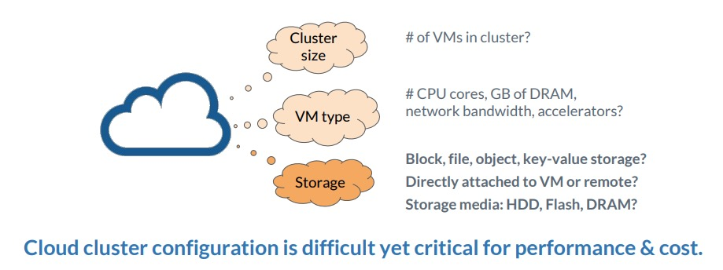
Work discussed today
Selecta, a tool that recommends near-optimal configurations of cloud compute and storage resources for data analytics workloads.

Slide 3
Outline
Problem formulation: Cloud configuration for data analytics
Selecta go-through
Related works & limitations
What is collaborative filtering?
Shortcomings of other machine learning models
Special works for resource configurations.
Lessons learned and future thoughts

Slide 4
Problem Formulation
Input: A data-analytics job, typically spark job
Output: The correct configuration for this job
Instance type
The scale of cluster
Metrics: Self-defined features describing the results
Cost of renting instances
Job completion time

Slide 5
Challenges
1. Complex configuration space (storage type, instance type)
2. Performance-cost objectives: Hard to optimize for complex goals, e.g., maximizing performance within certain budget
3. Heterogeneous application data, different in:
Data lifetime (long-live input/output, short-live intermediate data)
Data access type (random/sequential)
I/O frequency
4. Storage decision (ignored by previous works)

Slide 6
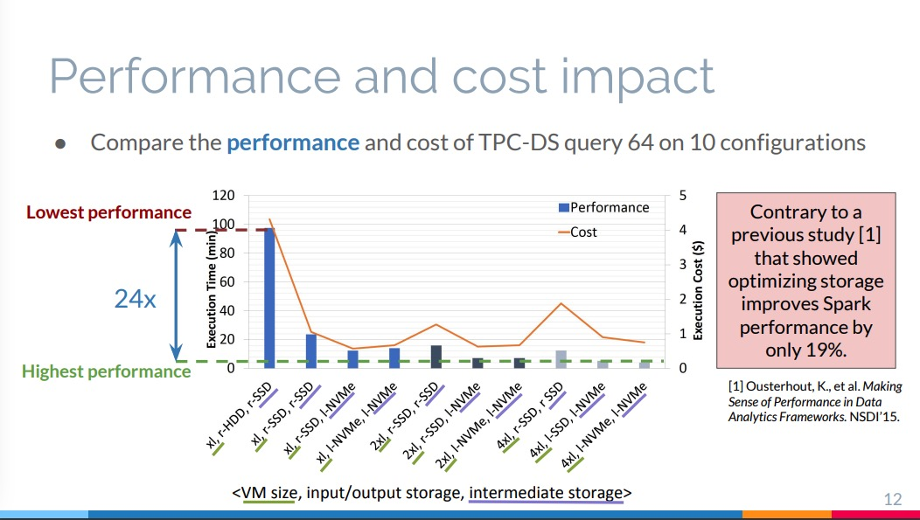

Slide 7
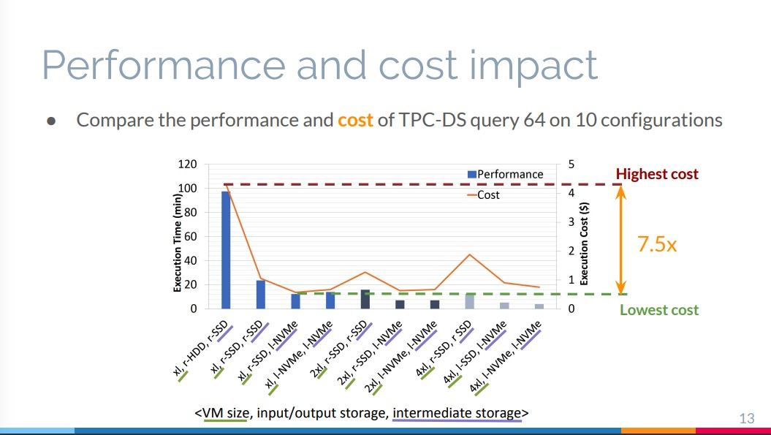

Slide 8
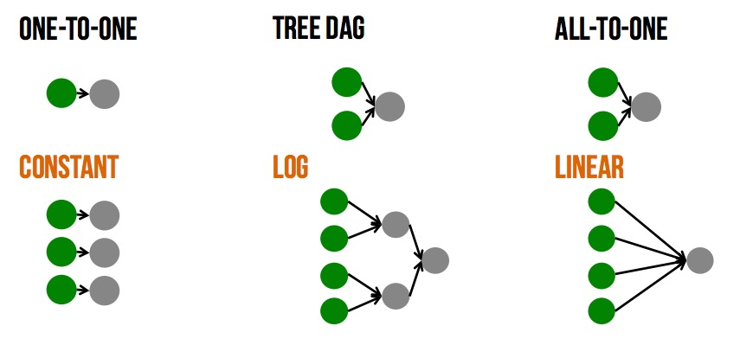
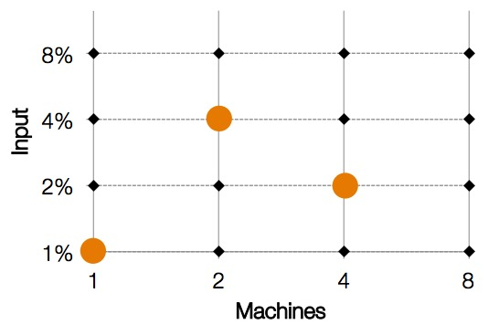
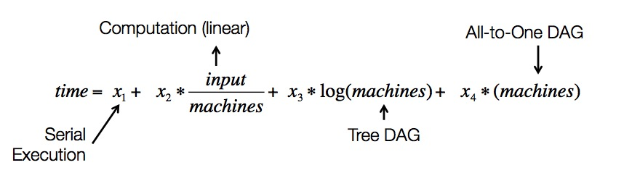
Related Work: Ernest (NSDI’16)
Model pattern + optimal experiment design (reduce experiment no.)

Slide 9
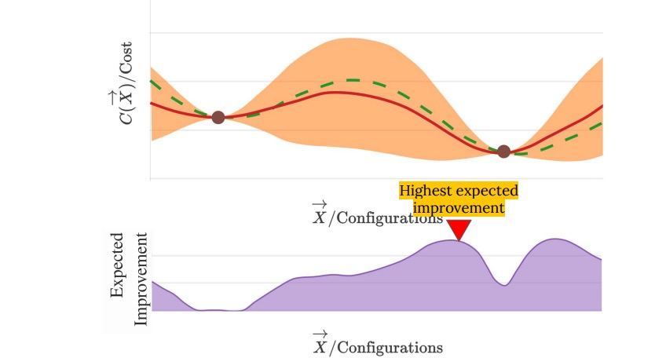
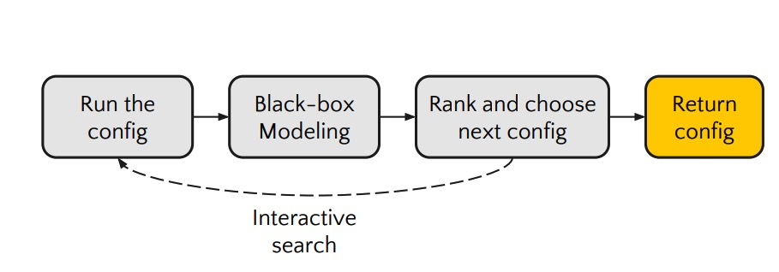
Related Work: CherryPick (NSDI’17)
Bayesian optimization to find near-optimal config

Slide 10
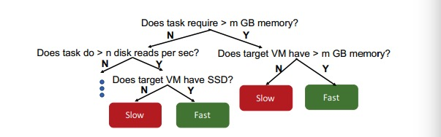
Related Work: PARIS (SoCC’17)
Build random forest to select the best VM instance.
Input: Job features include profiled info (e.g., CPU util%)
Intuitively multiple decision trees

Slide 11
Limitations of Current Works
Require information of target application
Need to run the target application many times
Gather information during application runs (PARIS)
Can’t utilize information of other applications
Did not consider different storage options

Slide 12
Collaborative Filtering in Recommendation
Problem: Recommend item to users
Input: An incomplete relationship (e.g., movie rating) of user-items
Method: Find a ”hidden feature” describing user-item relationship

Slide 13
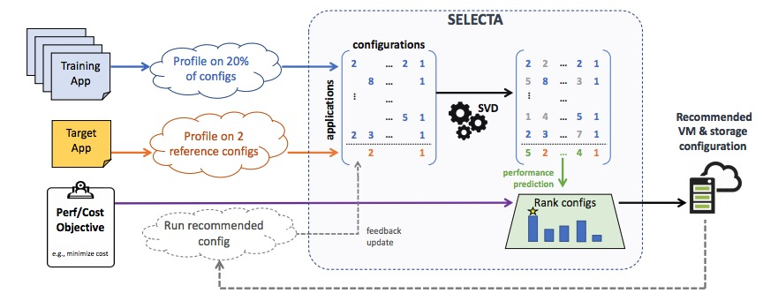
Key Method of Selecta
Directly apply collaborative filtering technique to config selection

Slide 14
CF vs Content-based Approaches
Collaborative filtering doesn’t have “contents”: multiple features with numerical values.
Goal is to model relationship with hidden variables
Users with similar hidden features are likely to be recommended with similar items
Content based approaches: Input contains features with numerical values (e.g., linear regression)

Slide 15
Why Collaborative Filtering?
Agnostic to details of data analytics frameworks
Leverage training data available from multiple applications to converge to accurate recommendations
Content-based approaches (Linear regression, random forests) requires features like application/configuration characteristics, i.e., the numerical values.
Run the applications and collect are impractical

Slide 16
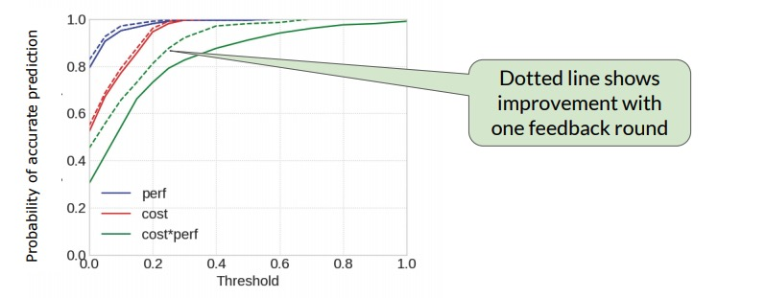
Evaluation
Near optimal (error from optimal < 10%): perf 94%, cost 80%, perf*cost improve with one feedback round

Slide 17
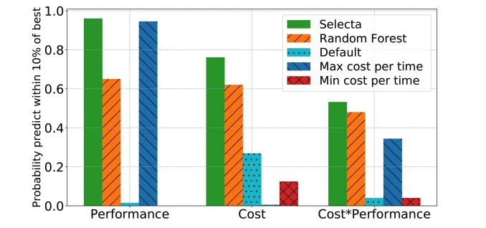
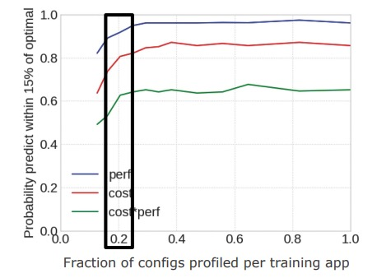
Comparison with Other Schemes
Selecta can leverage sparse data (~20% of profiling is enough)
Random Forest: PARIS; Default: Databrick docs
Max: Most expensive per unit time
Min: Least expensive per unit time

Slide 18
Topics not Included Today
Discussions on storage selection for cloud applications
Evaluation w/ application changes
Please refer to the paper for more details

Slide 19
Comments on This Work
Contribution consists of two parts:
1. Collaborative filtering technique: Find implicit relationship between applications
2. Discussion on storage options
1 itself is good contribution, by modeling comparison as recommendation problem, CF should be intuitively working well.
2 seems to fill up contents

