Slide 1
TicTac: Accelerating Distributed Deep Learning with Communication Scheduling
Yang Zhaoxiong

Slide 2
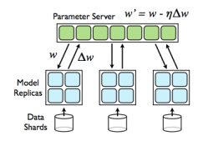
Background
Workers receive parameters from PS at the beginning of iteration, but consume them based on dependencies in DAG
Iteration time may depend on the order of parameter transfers
Notes:
In frameworks like TensorFlow, computation represented in DAG, when each trainable variable is a parameter, whose transmission is represented by a pair of send/recv nodes.
During scheduling, framework sorts the nodes in topological order, and all nodes with no dependency are put into ready queue. (so initially all recv node are in the ready queue?)

Slide 3
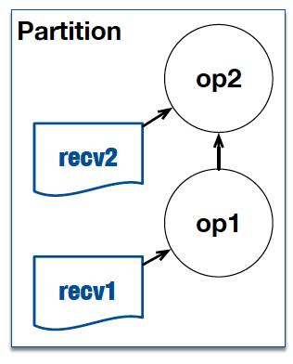
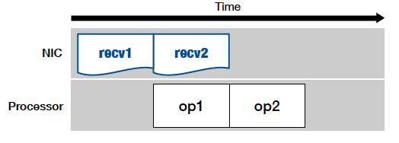
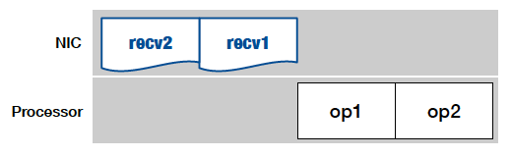
Background—A toy example
Good Execution Order
Bad Execution Order
Notes:
Bad execution order may block computation with outstanding recv ops, while a good execution order should overlap communication with computation as much as possible

Slide 4

Background
Existing systems schedule parameter transfers in arbitrary order
Increased iteration time, and degraded throughput
Lead to straggler during synchronized training
Running 1000 iterations of learning over Resnet-152 (363 parameters), results in unique orders
Similar results with Inception, VGG

Slide 5
Background
Previous studies focus on systems with layer-by-layer model representation
GeePS: Scalable deep learning on distributed GPUs with a GPU-specialized parameter server, EuroSys 2016
Poseidon: An Efficient Communication Architecture for Distributed Deep Learning on GPU Clusters, ATC ‘17
Finding optimal schedule for DAG is non-trivial

Slide 6
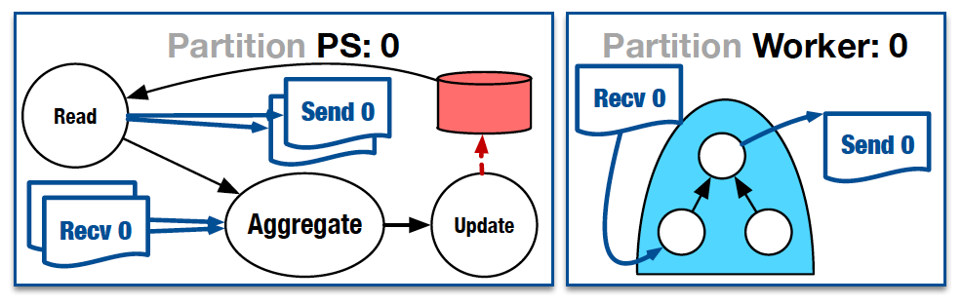

Scheduling problem
Input
Partitioned graph: computation graph with resource tags associated to each op
Time oracle $Time(op)$: execution time of a given op
Output
Schedule of ops, achieve by assigning priority numbers
Target
Minimizing makespan
Notes:
This paper focus on parameter server architecture. Parameter server only transmits parameters and performs simple aggregations, thus does not have the need of overlapping communication and computation. On worker, the DAG always begins with recv node and ends with send node.

Slide 7
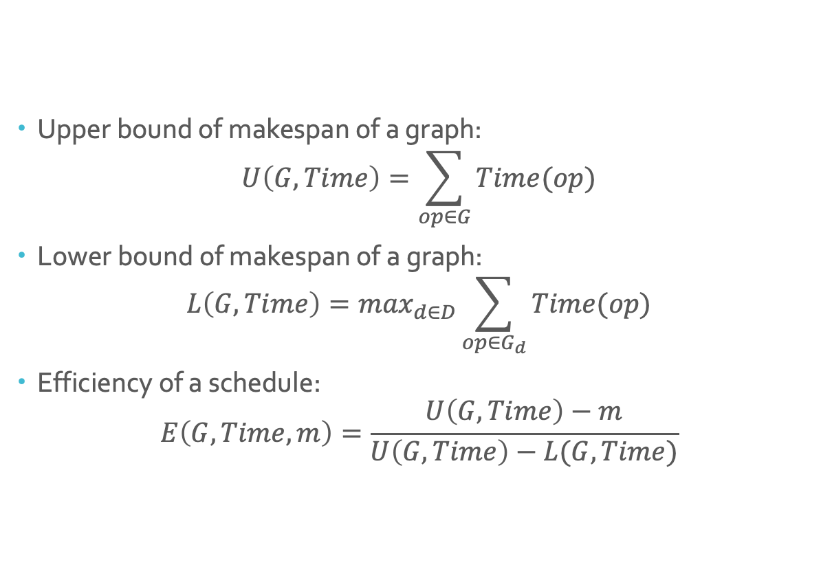
Scheduling efficiency metric
Upper bound of makespan of a graph:
$$U\left(G, Time\right)=\sum_{op∈G}{Time(op)}$$
Lower bound of makespan of a graph:
$$L\left(G, Time\right)=\max_{d∈D}\sum_{op∈G_{d}}{Time(op)}$$
Efficiency of a schedule:
$$E\left(G, Time, m\right)=\frac{U\left(G, Time\right)−m}{U\left(G, Time\right)−L(G, Time)}$$

Slide 8
Overview of algorithm
Two heuristics:
Timing-Independent Communication Scheduling (TIC): ignore the time oracle, and assume all ops have equal cost
Timing-Aware Communication Scheduling (TAC): use information of execution time of ops and dependencies in DAG to maximize communication/computation overlap
Assign priorities to ops (In this paper, op with lower prio. value is executed first)

Slide 9
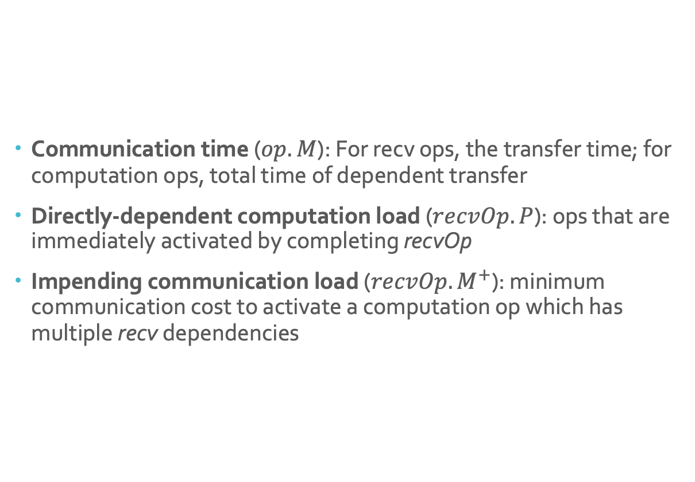
Op properties
Communication time ($op.M$): For recv ops, the transfer time; for computation ops, total time of dependent transfer
Directly-dependent computation load ($recvOp.P$): ops that are immediately activated by completing recvOp
Impending communication load ($recvOp.M^{+}$): minimum communication cost to activate a computation op which has multiple recv dependencies

Slide 10
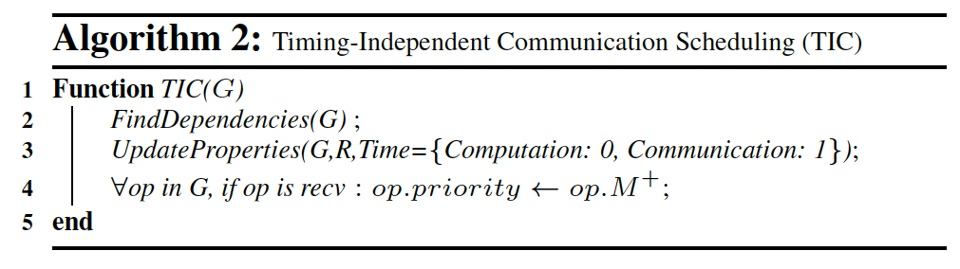
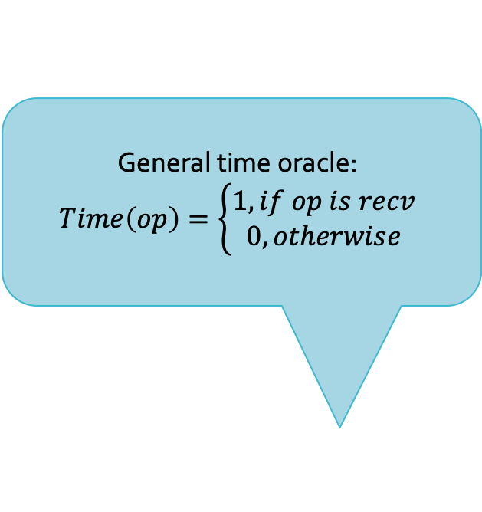
Timing-Independent Communication Scheduling (TIC)
General time oracle:
$$Time\left(op\right)=\left\{\begin{aligned}1, if op is recv \\ 0, otherwise\end{aligned}\right.$$
Intuition: assign to each recv op its impending communication cost, so that we can activate some computation asap

Slide 11
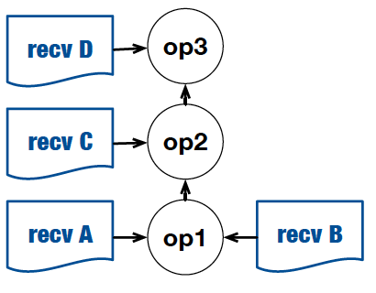
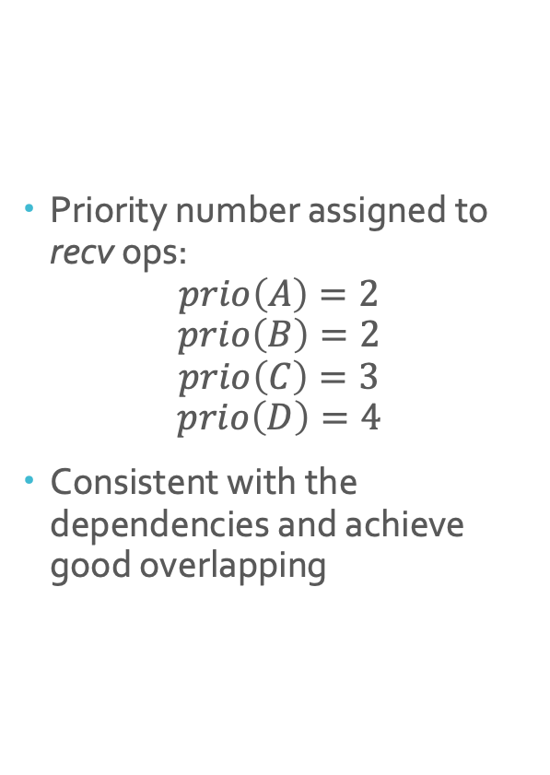
Timing-Independent Communication Scheduling (TIC)
Priority number assigned to recv ops:
$$prio\left(A\right)=2$$
$$prio\left(B\right)=2$$
$$prio\left(C\right)=3$$
$$prio\left(D\right)=4$$
Consistent with the dependencies and achieve good overlapping

Slide 12
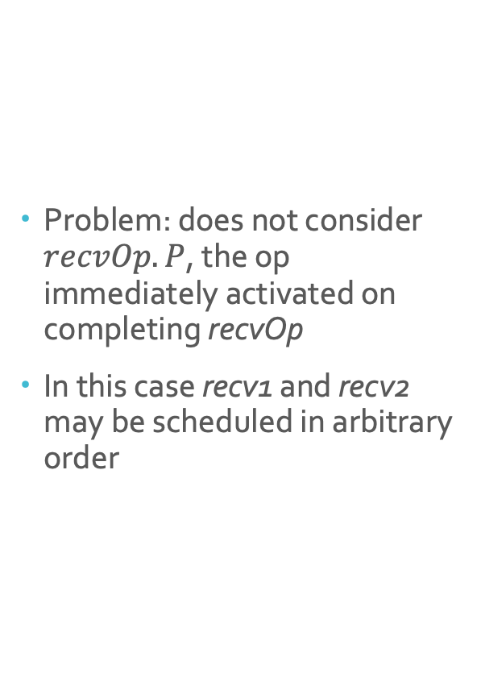
Timing-Independent Communication Scheduling (TIC)
Problem: does not consider $recvOp.P$, the op immediately activated on completing recvOp
In this case recv1 and recv2 may be scheduled in arbitrary order
Notes:
A minor bug: do not consider recvOp.P, i.e. the op that can be immediately activated on completing recvOp. In this case, recv1 and recv2 have the same priority, and may be scheduled in arbitrary order

Slide 13
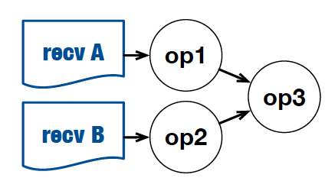
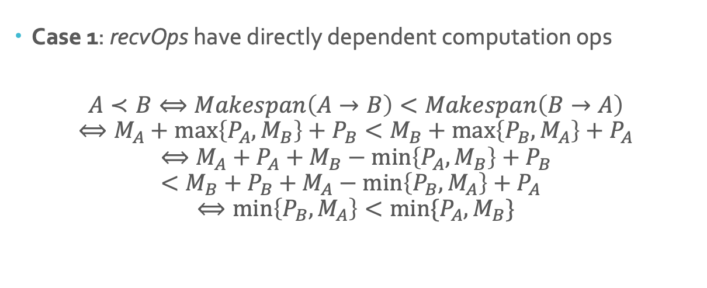
Timing-Aware Communication Scheduling (TAC)
Case 1: recvOps have directly dependent computation ops
$$A≺B⟺Makespan\left(A→B\right)<Makespan\left(B→A\right)$$
$$⟺M_{A}+\max\left\{P_{A}, M_{B}\right\}+P_{B}<M_{B}+\max\left\{P_{B}, M_{A}\right\}+P_{A}$$
$$⟺M_{A}+P_{A}+M_{B}−\min\left\{P_{A}, M_{B}\right\}+P_{B}<M_{B}+P_{B}+M_{A}−\min\left\{P_{B}, M_{A}\right\}+P_{A}$$
$$⟺\min\left\{P_{B}, M_{A}\right\}<min⁡\{P_{A}, M_{B}\}$$
Notes:
How to determine the order of recv ops with execution/transfer time known?

Slide 14

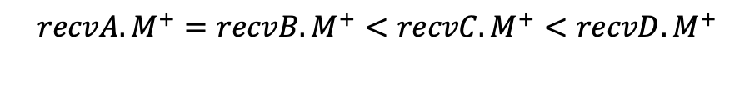
Timing-Aware Communication Scheduling (TAC)
Case 2: No directly-dependent computation op
Fall back to comparing $recvOp.M^{+}$
$$recvA.M^{+}=recvB.M^{+}<recvC.M^{+}<recvD.M^{+}$$

Slide 15
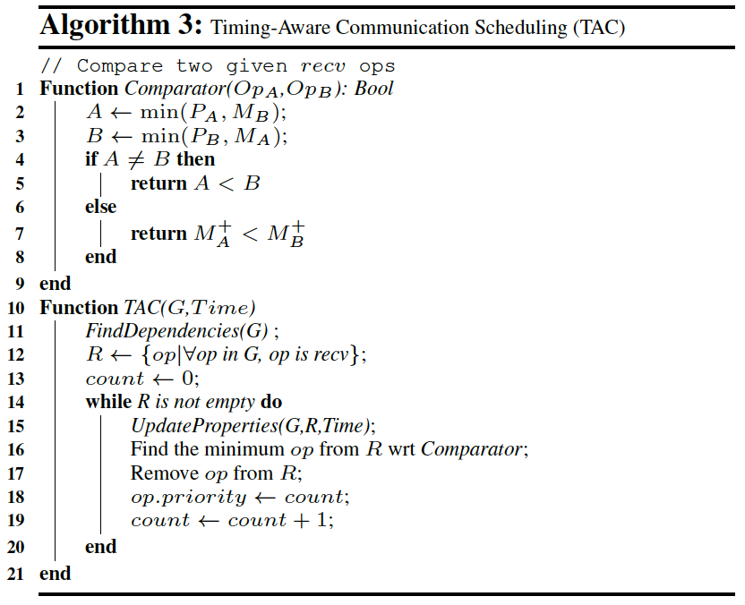
Timing-Aware Communication Scheduling (TAC)
Notes:
Maintain an increasing counter to assign priorities. While there are recv ops not processed, compare each pair of them using previous formula. Fetch the minimum recv op, assign the current value of counter and increment the counter

Slide 16
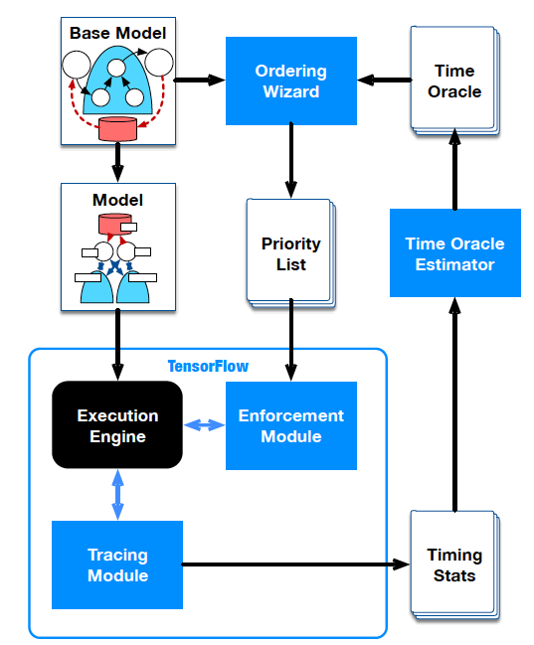
System design
Tracing Module: collects runtime stats from execution, which is later fed to the time oracle estimator
Time Oracle: responsible for estimating the runtime of each op in the system based on the execution timing stats

Slide 17
System design
Ordering Wizard: responsible for assigning priorities to recv ops on a single worker. The priority list is calculated offline before the execution.
Enforcement Module: enforces the order on network transfers per worker

Slide 18
Implementation
Time Oracle: use the TensorFlow internal tracer to measure the time of computation ops. Extend the tracer (115LOC C++) to collect information on network transfer.
Ordering Wizard: implement TIC and TAC as offline analyzers (250LOC python)
Enforcement Module: implemented over the gRPC submodule of TensorFlow (40LOC C++)

Slide 19
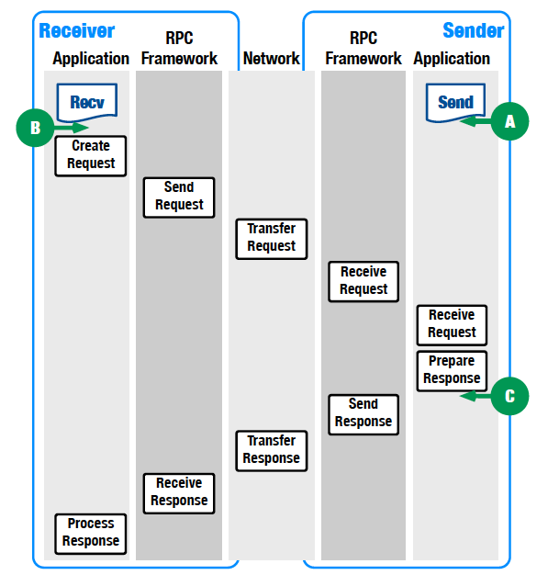
Implementation
There are 3 choices of locations to enforce the transfer order: A, B, C.
In the implementation, C (before the sender handles transfer to gRPC) is adopted.

Slide 20
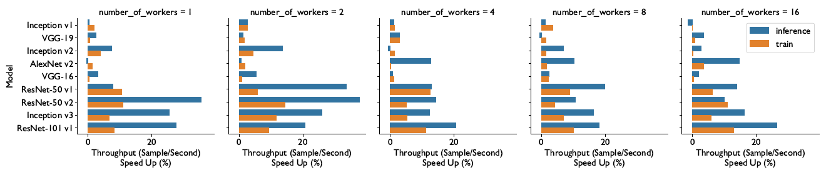
Evaluation—Scalability
Notes:
Inference maintains the PS architecture. Without the backpropagation part of the workload, there is less computation and larger room for accelerating.
Number of workers increases the communication load on PS. When the number of workers goes beyond some threshold, the benefit of scheduling diminishes.
The result shows that the benefit of scheduling remains stable with different number of workers. However, because the baseline is no scheduling which gives a random order, the speedup may vary. In the worst case, there is a slow down of 4.2% because of scheduling overhead.

Slide 21
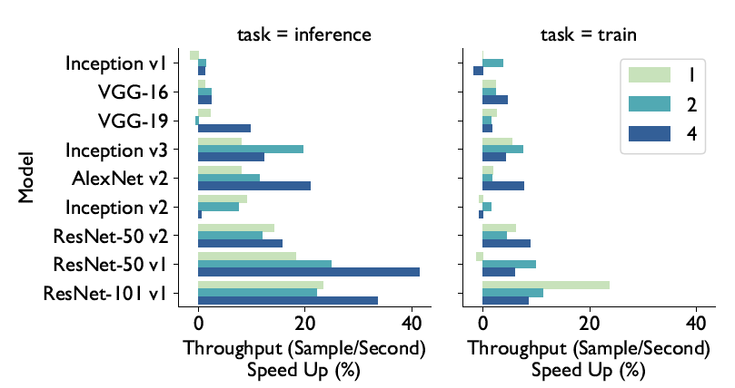
Evaluation—Effect of #parameter servers
Notes:
The relation between speedup and the number of parameter servers seems obscure?
In general, inference gets larger gains.
ResNet obtain higher gains (because the network is “larger” and has more parameters?) In contrast, VGG has the largest total size of parameters, but gains very little.

Slide 22
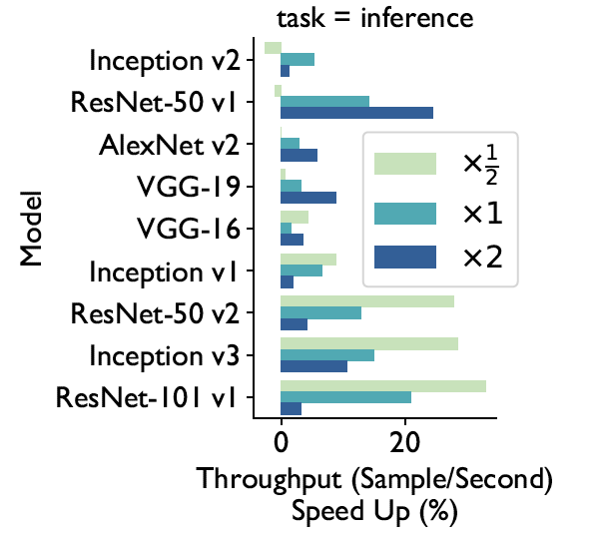
Evaluation—Effect of batch size
Notes:
As the batch size increases, the computation load increases, and the ratio of communication to computation is lower, leading to less room for speedup.

Slide 23
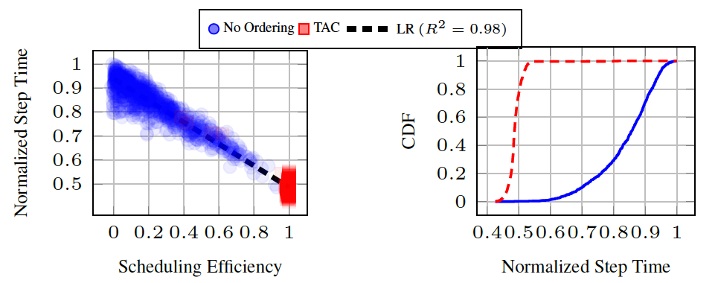
Evaluation—Scheduling efficiency
Notes:
Scheduling efficiency metric can predict step time accurately.
The scheduling efficiency of TAC stay close to 1.
Without ordering, the step time varies.

Slide 24
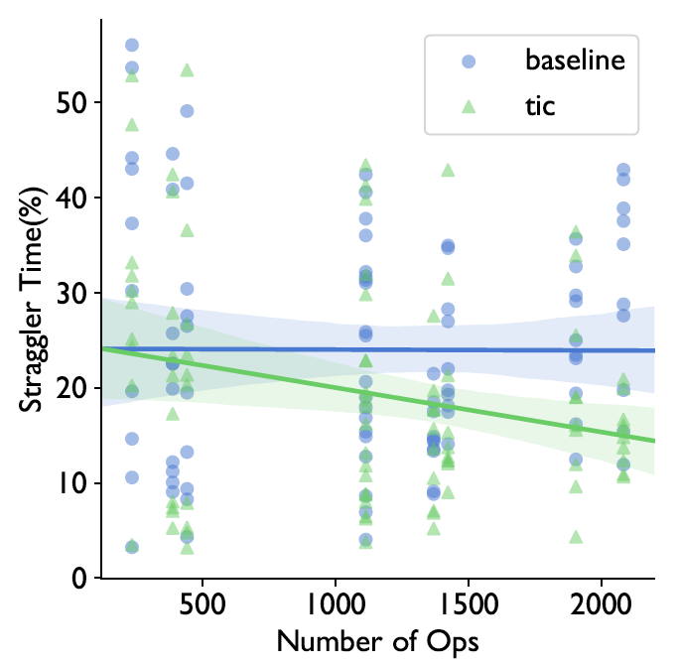
Evaluation—Mitigating stragglers
Notes:
Straggler time is quantified as the maximum time spent in waiting to the iteration time.
Straggler effect is caused by two factors: system-level performance variations and efficiency of scheduling on individual workers. On average, scheduling gains greater benefit from larger networks.

Slide 25
Comment
Strength
Identify the problem of random parameter transfer order in existing frameworks
Extend the communication scheduling from layer-level to operation-level, utilizing dependency information in DAG
Weakness
Only focus on parameter server update strategy
Consider network and intra-machine (e.g. GPU) topology and network condition

