Slide 1
Floem: Programming System for NIC-Accelerated Network Applications
—Xinchen
11/01/2019
Notes:
通过NIC offload部分CPU计算功能来使得服务器端网络应用达到网络加速的programming system

Slide 2
Outline
NIC Offload Background
System Architecture
Design
Evaluation

Slide 3




Background
< 2X
3 GHz → 5 GHz
Data-Center Network
100x
1 Gbps → 100 Gbps
Notes:
大背景：在过去十年时间内，网络带宽增长速度远远快于CPU主频速度，这也就间接说明了端上CPU处理速度与网络传输速度逐渐不匹配的现象

Slide 4
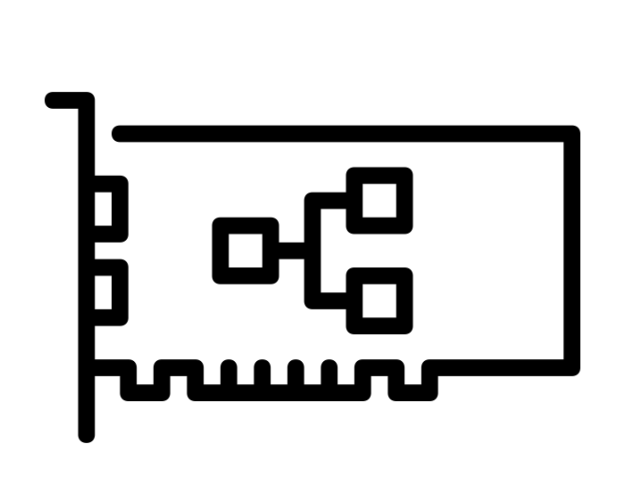
NIC Offload
Offload Computation
Fast path processing:
filtering, classifying, caching, etc.
Transformation: encryption/decryption, compression, etc.
Steering
Congestion control
Offload Network functions
IP sec function
Switch & routing
Data-Center Network
Notes:
很多研究设计在思考如何加速端上的应用处理速度以满足外来的网络请求，一种非常有效的方法是将部分CPU上的运算功能迁移到一个accelerator，例如现在非常流行的可编程网卡。
快速路径处理，数据转换
SmartNIC Tips:
SoC-based SmartNICs 优点：易编程 缺点：高延迟，低可扩展性（要求统一网卡）
FPGA-based SmartNICs 优点：低延迟，高带宽，FPGA与NIC之间的通信不涉及CPU，且FPGA与主存及其他主机资源之间有快速数据传输路径

Slide 5











Offload Strategies Example
Example: Key-value store
Key-based steering
30-45% higher throughput
Require: multiple CPU cores
[Kaufmann et al. 2016]
hash & steer pkt
KVS
prepare response
KVS
N threads
to network
PCIe
CPU
memory
Using NIC as Cache
3x power efficiency
Require: enough memory on NIC
[Li et al. 2017]
KVS
KVS cache
KVS
KVS
update cache
to network
PCIe
CPU
memory
Notes:
这里以key-value store作为例子来描述一些CPU计算offload到网卡上的情况。
我们可以将一些比较简单的CPU计算功能offload到网卡上，例如对数据包的hash操作以及打包response数据包返回给客户端。
对于那些CPU上有多核的机器，我们为了让performance更加efficiency，会选择对key-value进行分片，让每个核处理部分key-value并行化提高吞吐量，因此就会在网卡上做一个packet steering的操作，也就是根据key值将数据包引导到指定CPU核上让线程处理。
另外我们还可以将网卡用于其他用途，比如让网卡作为一个cache来cache一些key-value store，这样对于网络中的一些请求，如果cache hit的话就能够进行快速应答，而如果不命中的话就需要采用cache memory一致性的办法来同步cache和CPU中的变化。
当然这两种offload策略甚至可以组合起来，但是这里要说的是，对于不同的server应用，比较有效的offload策略是不同的，并且为这些offload策略在原有server程序的基础上进行的修改也是非常巨大的工程量。

Slide 6

Challenge: Packet Marshaling
hash, key, value, keylen, vallen
// Define what fields to send
struct set_request_entry { uint16_t flags; uint16_t len;
Example: Key-value store
tedious & error-prone
uint32_t hash; uint32_t keylen; uint32_t vallen; uint8_t other[];
create item
hash
}
update table
// Copy those fields
extra = it->keylen + it->vallen;
entry = queue_alloc(sizeof(*entry) + extra, SET); entry->hash = hash;
entry->keylen = it->keylen; entry->vallen = it->vallen;
memcpy(entry->other, it->key, extra);
item pointer
struct set_request_entry { uint16_t flags; uint16_t len;
uint64_t item;
}
hash
create item
update table
entry = queue_alloc(sizeof(*entry), SET); entry->item = ialloc_to_offset(item);
Notes:
进行NIC offload的时候会遭遇很多challenge，例如为了进行网卡与CPU之间的communication，这里programmer可能手动控制数据包中的哪些数据需要通过PCIe发送给内存来减小communication的数据量。
所以这里programmer需要手动为数据包设计message structure来send message给内存。并且如果programmer想要了解哪一种offload策略对performance的提升更加有效的话，可能会需要设计更多的message,也就是改变更多的代码，这样的操作是非常tedious和容易出错的。

Slide 7




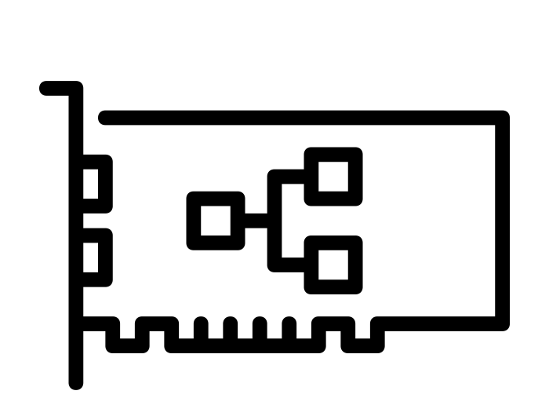




Challenge: Communication Strategies
No steering
Example: Key-value store
hash & steer pkt
KVS
KVS
Key-based steering
hash & steer pkt
KVS
KVS
Separate GET & SET
hash & steer pkt
KVS
KVS
Notes:
此外对于一个specific strategy，我们可能会需要设计NIC和CPU之间的通信策略，例如我们想要packet no steering，或者想要packet进行key-based steering或者将GET和SET请求分离在不同核上运行。

Slide 8
Floem Design
DSL: easier to explore different offload design
Compiler: minimize communication between CPU and NIC and generate code for NIC and CPU
Runtime: backend to manage data transfer over PCIe
Notes:
Compiler内部封装了CPU和NIC之间的通信机制

Slide 9








Language Overview
Contributions
Data-flow programming model
Goal: Explore offload designs
Inferred data transfer
Logical-to-physical queue mapping
3. Caching construct
Extend to support:
Goal: Integration with existing app
Heterogeneity
Parallelism
4. Interface to external programs
app.c

Slide 10
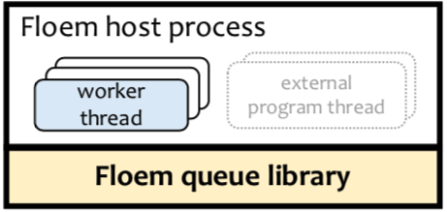
Compiler & Runtime
Floem program
Floem compiler
Cache expansion
Infer data transfer
Data-flow to C
External C program
NIC
C code
CPU
C code
Cavium SDK
GCC
Floem NIC process wwoork^{r}reker^{r}rth^{th}rd^{rd runtime} _{thread} thread
Floem queue library
Floem queue synchronization
Cavium DMA primitives
Floem host process
_{ex}e_{t}x_{e}t_{r}e_{n}r_{a}n_{l}al pro^{p}g^{r}rºa^{g}m^{ra}t^{m}hr^{t}e^{h}a^{r}d
wwoork^{r}r^{k}eker^{r}rth^{th}rd^{rd} thread
Floem queue library
NIC memory
NIC Host
host memory

Slide 11
Data Flow Model
Data-flow programming model
Contributions
Goal: Explore offload designs
1. Inferred data transfer
2. Logical-to-physical queue mapping
3. Caching construct
Goal: Integration with existing app
_{app.c} 4. Interface to
external programs
Extend to support:
Heterogeneity
Parallelism

Slide 12








Data Flow Model
from_net
Element
hash
class Classify(Element):
def configure(self):
self.inp = Input(pointer(kvs_message))
self.get = Output(pointer(kvs_message)) self.set = Output(pointer(kvs_message))
GET request
classify
SET request
create_item
def impl(self): self.run_c(r'''
// C code
kvs_message *p = inp();
uint8_t cmd = p->mcr.request.opcode; output switch {
hasht_get
hasht_put
get_resp
set_resp
// switch
case (cmd case (cmd
}''')
--> emit one output port
== PROTOCOL_BINARY_CMD_GET): get(p);
== PROTOCOL_BINARY_CMD_SET): set(p);
to_net
classify = Classify()
# Instantiate an element
Notes:
Element是Floem中的操作原语，至少包含input port, output port以及impl函数

Slide 13


Data Flow Model
@CPU
from_net
hash
Segment
GET request
classify
SET request
class Seg1(Segment):
def impl(self):
from_net >> hash >> classify
classify.get >> hasht_get >> get_resp >> to_net classify.set >> item >> hasht_put >> set_resp \\
>> to_net
s1 = Seg1()
create_item
hasht_get
hasht_put
get_resp
set_resp
to_net
Notes:
Segment是一组连接的element，可以理解为在同一个设备上顺序执行的一组element，CPU上每个线程运行一个segment

Slide 14
Data Parallelism
@CPU
from_net
Each segment is accelerated in a thread on a device
And there are some other parallel optimizations in the experiments
hash
GET request
classify
SET request
create_item
Seg1(cores=[0,1,2,3])
hasht_get
get_resp
hasht_put
set_resp
to_net

Slide 15












Pipeline Parallelism
from_net
hash
classify
SET request
GET request
create_item
Q1
Multiple
segments
Insert queues
hasht_get
hasht_put
23
Q2
get_resp
set_resp
to_net

Slide 16












NIC Offload
@NIC
from_net
hash
Seg1(device=NIC)
classify
SET request
GET request
create_item
Q1
hasht_get
hasht_put
Seg2(device=CPU)
@CPU
24
Q2
get_resp
set_resp
Seg3(device=NIC)
@NIC
to_net

Slide 17
Inferred Data Transfer
_{Data-flow} Contributions
programming model Goal: Explore offload designs
2. Logical-to-physical queue mapping
3. Caching construct
_{Extend to support:} Goal: Integration with existing app
• Heterogeneity _{app.c 4. Interface to}
^{• Parallelism} external programs
1. Inferred data transfer

Slide 18





Solution: Infer Fields to Send
Per-packet state: a packet and its metadata can be accessed anywhere in the program.
Compiler infers which fields of packet and metadata to send.
from_net
hash
GET request
classify
SET request
Virtual Channel C1 uint32_t hash; uint16_t keylen; uint8_t key[];
create_item
Q1
Virtual Channel C2
item* it;
hasht_get
…
hasht_put
Notes:
Compiler自行推断出要将packet的哪个部分以及metadata分发给其他element，来方便编程者免于考虑这些问题。
这里描述他所采用的方法是编译器里面常用的 liveness analysis。（首先对整个程序词法分析提取每个element里面所用到的data，然后反向告知给前面的其他element 这个element所需要的data的数据集，从而可以减小数据传输量并增加吞吐率）

Slide 19
Logical to Physical Queue Mapping
_{Data-flow} Contributions
programming model Goal: Explore offload designs
1. Inferred data transfer
3. Caching construct
_{Extend to support:} Goal: Integration with existing app
• Heterogeneity _{app.c 4. Interface to}
^{• Parallelism} external programs
2. Logical-to-physical queue mapping

Slide 20
Queue Construct
Observation: Different communication strategies can be expressed by mapping logical queues to physical queues.
Degrees of resource sharing
Dynamic packet steering
Packet ordering
Solution: Queue construct with explicit logical-to-physical queue mapping.
logical queues physical queues
Queue(channels=2,instances=3)
Notes:
这里发现不同的NIC-CPU传输策略可以以逻辑队列到物理队列映射的方式来表达，于是就在不同segment之间通过queue的方式来完成通信，queue是floem program中数据传输的抽象概念，存储在每个设备中，channel指的是逻辑queue中的不同传输通道，比如在key-value例子中2个channel是分别作为GET请求和SET请求的通道，并且映射到3个物理队列中

Slide 21






No Steering
Strategy:
No steering
hash & steer pkt
KVS
KVS
Program:
…
classify
SET request
GET request
create_item
Q1
class Seg2(Segment):
def impl(self):
hasht_get
…
hasht_put
Q1.deq[0] >> hasht_get >> ...
Q1.deq[1] >> hasht_put >> ...

Slide 22
Key-Based Steering
Strategy:
Key-based steering
hash & steer pkt
KVS
KVS
Program:
…
classify
SET request
GET request
create_item
Q1
class Seg2(Segment):
def impl(self):
hasht_get
…
hasht_put
Q1.deq[0] >> hasht_get >> ...
Q1.deq[1] >> hasht_put >> ...

Slide 23

Key-Based Steering
Strategy:
Key-based steering
hash & steer pkt
KVS
KVS
Program:
que…ue_id
Key-based steering:
state.qid = state.hv % 2
classify
SET request
GET request
create_item
Q1
class Seg2(Segment): def impl(self):
self.core_id >> Q1.qid
hasht_get
…
hasht_put
Q1.deq[0] >> hasht_get >> ...
Q1.deq[1] >> hasht_put >> ...
Notes:
这样可以使得每个线程分别对应一个物理队列来处理数据，在数据没有相互依赖的情况下达到并行的效果

Slide 24
Caching Construct
_{Data-flow} Contributions
programming model Goal: Explore offload designs
1. Inferred data transfer
2. Logical-to-physical queue mapping
_{Extend to support:} Goal: Integration with existing app
• Heterogeneity _{app.c 4. Interface to}
^{• Parallelism} external programs
3. Caching construct
Notes:
第三个是进行了NIC-as-a-cache的抽象

Slide 25









Caching Construct
@NIC
from_net
hash
GET request
classify
SET request
Cache lookup
set_start
Difficult to implement a complete cache protocol:
get query
set query
Q1
create_item hasht_put
Q2
Maintain consistency of data on NIC and CPU
High performance
cache
hit
@CPU
hasht_get
get_end
set_end
get_resp
set_resp
@NIC
to_net
Notes:
编译器帮助用户直接设计了cache protocol以保证NIC和CPU的数据一致性，比如cache常用的write-through和write-back

Slide 26



Get Expansion
User’s program
Write-through
Write-back
before get
before get
before get
get_start
cache get
cache get
miss
get query
miss
OR
get query
cache set
get query
hit
hit
get_end
evict?
cache set
no
yes set query
after get
after get
after get

Slide 27


Set Expansion
User’s program
Write-through
Write-back
before set
before set
before set
set_start
cache del
cache set
OR
set query
exe both
evict?
no
set query
yes
set_end
set query
after set cache set
after set
after set

Slide 28
Interface to External Programs
_{Data-flow} Contributions
programming model Goal: Explore offload designs
1. Inferred data transfer
2. Logical-to-physical queue mapping
_{Extend to support:} Goal: Integration with existing app
• Heterogeneity _{app.c 4. Interface to}
^{• Parallelism} external programs
3. Caching construct
Notes:
满足对已有的应用进行代码重用的情况，这样可以减少很多对现有代码的修改量

Slide 29
Interface to External Programs
Embed C code in elements
Implement elements that call external C functions available in linkable object files
Expose segments as functions callable from any C program

Slide 30
Runtime
P1 P3
Queue library
P2
Queue library
Queue sync
DMA primitives
Q1 Q2
DMA
Q1
Q2
PCIe
NIC memory
Host memory
Notes:
Runtime部分是他所抽象的NIC和CPU之间的通信方式queue能够进行数据传输的原因，因为Runtime部分是充当了backend来异步执行queue传出的指令并进行DMA读写操作

Slide 31
Evaluation
Implemented several applications in Floem.
Complex applications:
Key-value store
Real-time data analytics
Less complex network functions:
Encryption
Flow classification
Network sequencer

Slide 32
Server Setup
With Smart NIC
Cavium LiquidIO NIC
two 10Gbps ports
12-core 1.20GHz cnMIPS64 processor
4GB memory
6-core Intel X5650
Without Smart NIC
Intel X710 NICs
two 10Gbps ports
DPDK (bypass OS networking stack)

Slide 33
Case Study: Key-Value Store
Workload
100,000 key-value pairs
32-byte keys and 64-byte values
Zipf distribution (s=0.9)
90% GET and 10% SET
Notes:
每个NIC负载配备一个CPU核，从而让其他CPU核可以用于同步执行其他应用程序

Slide 34
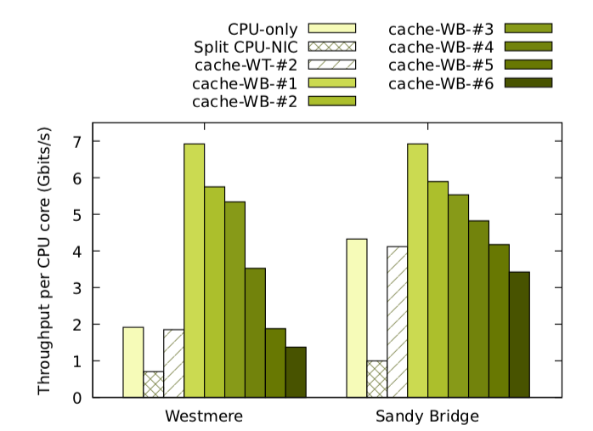
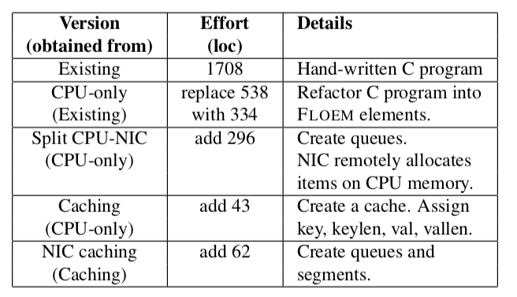
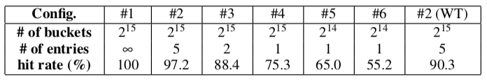
Case Study: Key-Value Store
Programming Effort
Throughput
Cache set
Notes:
这里会看到在 split CPU-NIC时，throughput相较于CPU-only的情况要更差了，分析应用后发现主要的瓶颈在于NIC上准备GET response的element，这个element会发出阻塞DMA read请求来根据指针获取主存中的内容。由于队列中只是传输了指针，因此runtiime并不能管理DMA read，从而导致了额外的DMA开销。
在高命中率的情况下，该offload strategy所产生的吞吐量使得westmere和sandy bridge的performance相同，也就印证了有效的NIC offload能够减少工作负载对CPU处理速度的依赖。

Slide 35
Thank you!
Notes:
这篇论文主要是对两种NIC offload的方式，分别是fast path processing以及将NIC作为cache，进行抽象，然后设计成一门语言并且用compiler将他们实现出来方便编程者自主管理offload strategy，并且通过设置一个backend实现了queue在PCIe上的协调。
整体思路比较简单但是实现起来比较麻烦。
启发：调研一下哪些功能offload到网卡上的效果提升显著，然后思考设计实验

Slide 36
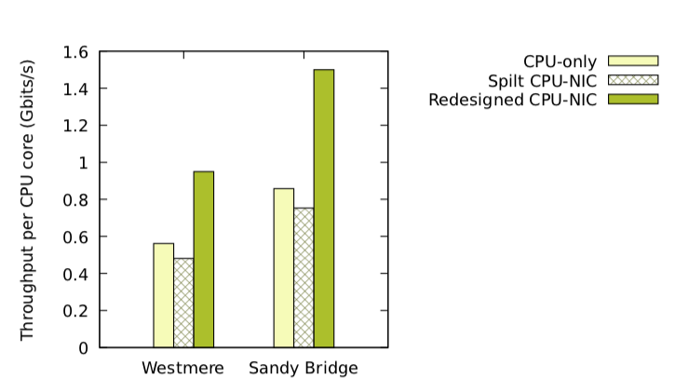
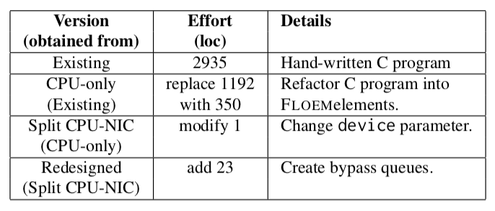
Case Study: Distributed Real-Time Data Analytics
from_net tuple
demultiplxer
local worker tuple
local worker tuple
multiplxer
other server tuple
Throughput
Programming Effort
Notes:
Distributed Reat-Time Data Analytics:
用于分析经常改变的数据集， apache storm是这种类型的流行框架，里面的数据传输主要是：
de-multiplexer线程路由来自网络中的元组到local worker，multplexer线程路由local worker中的元组到其他server并执行必要的flow control。因此split CPU-NIC的做法是把这两个线程以及flow control放到NIC上来卸下负载，不过throughput不是很好。
考虑到其中会出现多次这种情况：worker将tuple发送给其他local worker，然而split CPU-NIC会导致无论是multiplex过程还是de-multiplex过程都需要经过CPU-NIC-CPU的round-trip，很显然这种load是没有意义的，所以更新的design是给worker增加bypass queue来旁路掉(de-)multiplexer。最终的优化效果是96%和75%

Slide 37
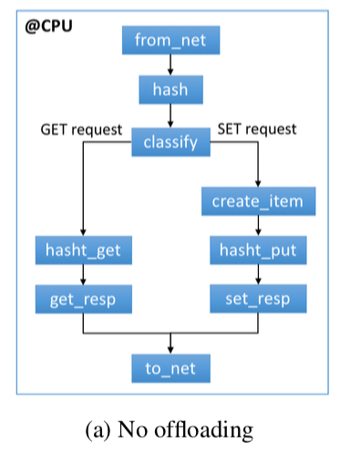
Original

Slide 38
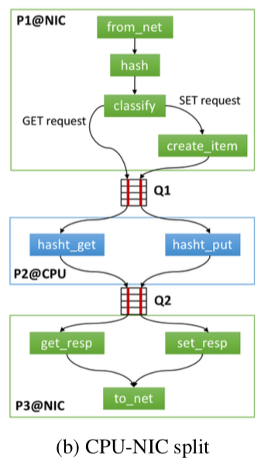
L-to-P Queue Mapping

Slide 39
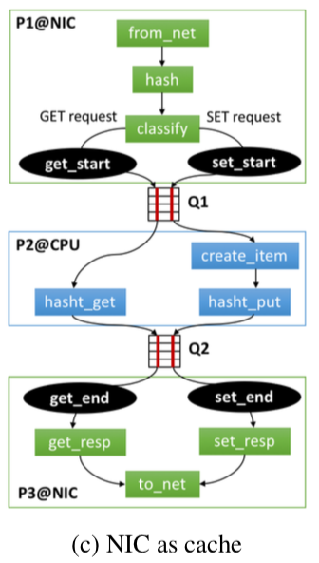
NIC as a cache

Slide 40
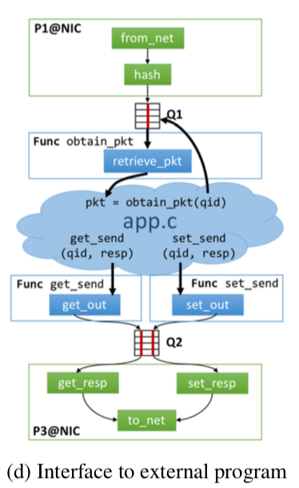
Integrate with External Code

