Slide 1
Deep Reinforcement learning
Tian,Han

Slide 2
Problem Definition
Environment
Agent
observation
Action
Reward + new observation
Vs. Supervised learning : sequence input, cumulative reward.
Model-free RL vs. Model-based RL.

Slide 3
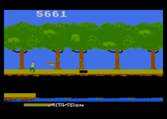
Example
 |  |  | +1
 |  |  | -1
START

Slide 4
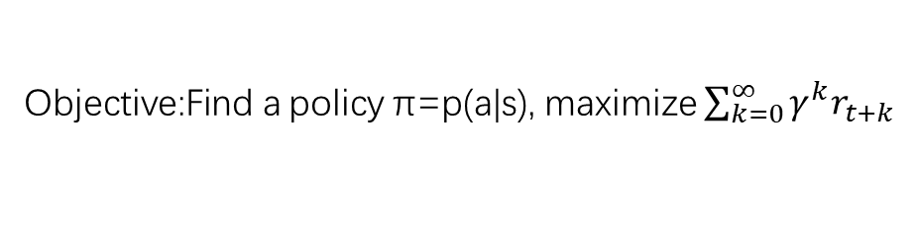
Review of MDP model
MDP model <S,T,A,R>
S– set of states
A– set of actions
T(s,a,s’) = P(s’|s,a)– the probability of transition from s to s’ given action a
R(s,a)– the expected reward for taking action a in state s
Agent
State
Action
Reward
Environment
a₀
a1
a2
s₀
s₁
s2
s3
r₀
r1
r2
Objective:Find a policy π=p(a|s), maximize $\sum_{k=0}^{∞}{γ^{k}r_{t+k}}$

Slide 5


Value functions
state value function: V^{π}(s)
expected return when starting in s and following π
state-action value function: Q^{π}(s,a)
expected return when starting in s, performing a, and following π
useful for finding the optimal policy
can estimate from experience
pick the best action using Q^{π}(s,a)
Bellman equation for V
s
a
r
s’

Slide 6
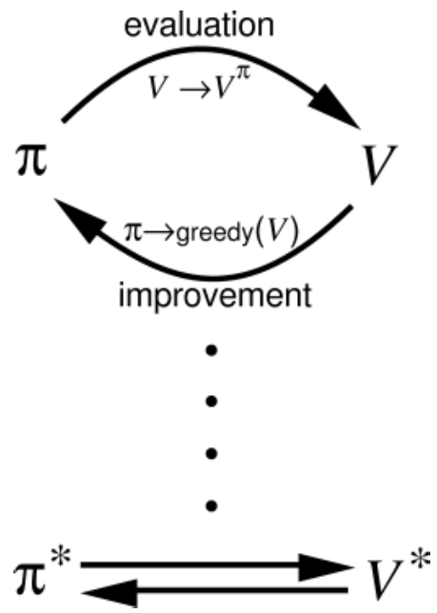
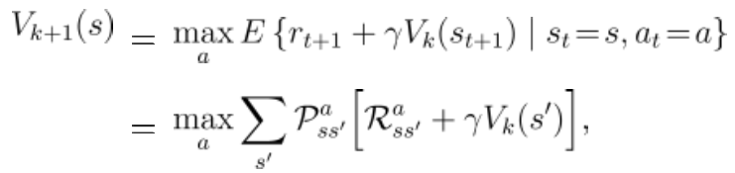
Model-based: Generalized Policy Iteration.
Policy Iteration
Value Iteration
Notes:
我在这张ppt上讲解的迭代学习过程只是包含value iteration的学习过程，实际上policy iteration是在固定policy的情况下利用bellman equation先把V学收敛，再用argmaxV的思路更新policy，如此反复，多轮之后policy收敛至最优；而value iteration则用bellman equation只跑一轮所有状态的V更新，就用这个未收敛的V更新policy，加快学习速率，让V和policy一起走向最优收敛，公式中policy更新和V更新一气呵成（max是policy更新，V_k+1是在新policy下的V更新）。这里ppt没准备充分实际没讲policy iteration，容易引起误解，抱歉，如果之后遇到policy iteration的相关问题可以再问我。@邓锦亮 @张翔 感谢指出

Slide 7
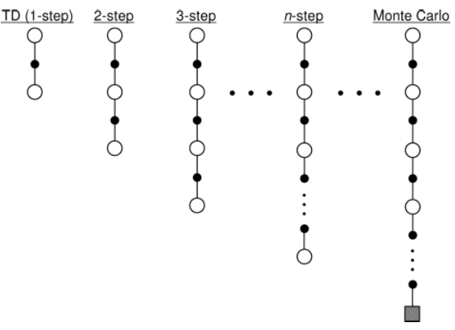
Model-free: TD-learning
Sample-based
Bootstrap : iteration to optimal
Online policy evaluation
Example: Sarsa, Q-learning,
MC method…

Slide 8
On-policy vs. Off-policy
SARSA:
The policy we learned include exploration.
Q-learning
(Watkins, 1989):
converge to optimal.

Slide 9
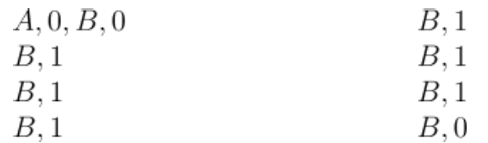
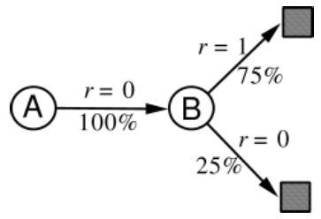
Monte Carlo vs. Q-learning (TD(0))
Batch Monte Carlo methods always find the estimates that minimize mean-squared error on the training set (use experience likelihood=the maximum-likelihood model), whereas batch TD(0) always finds the estimates that would be exactly correct for the maximum-likelihood model of the Markov process.
More data required by MC; model structure support for Q-learning.

Slide 10

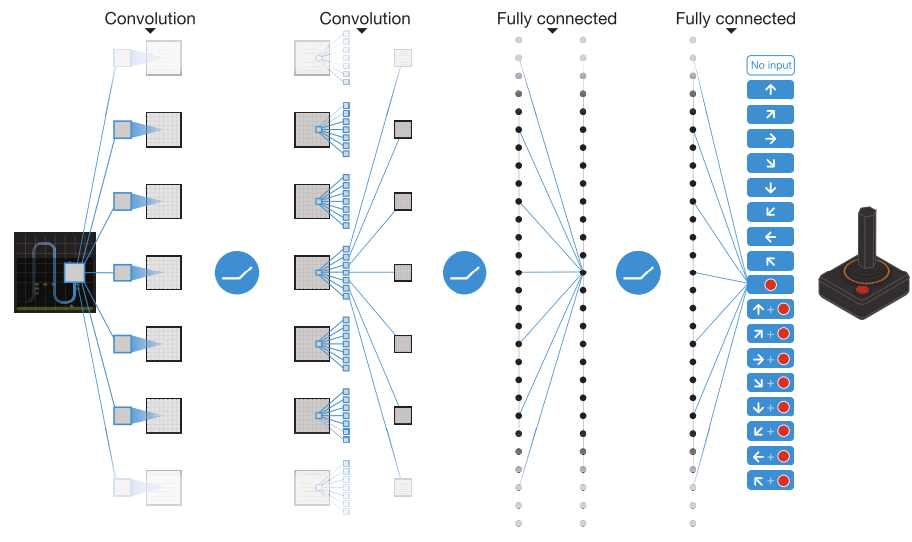
Deep Q-Network
Replay memory.
Target network. （pay attention to the -）
DOUBLE DQN, Prioritized Experience Replay……
Mnih, Volodymyr, et al. "Human-level control through deep reinforcement learning." Nature518.7540 (2015): 529-533.

Slide 11
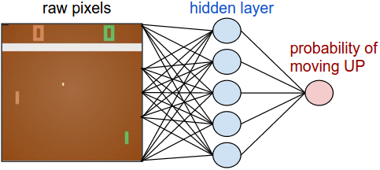
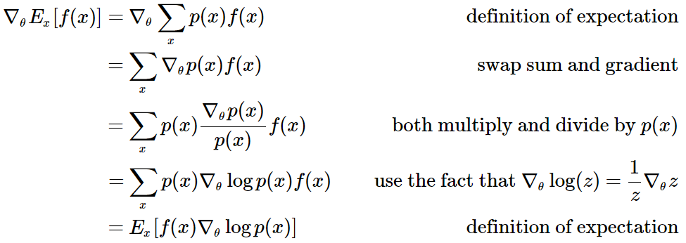
Policy Gradient Method (Sutton, McAllester, Singh, and Mansour, 2000)
Policy Network
Policy Gradient

Slide 12
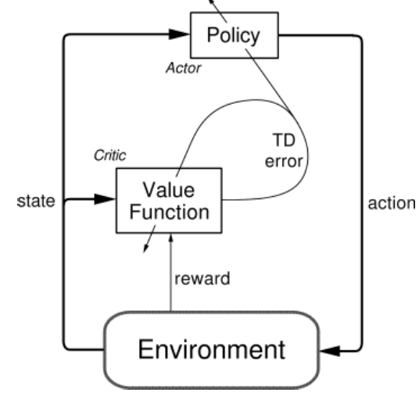
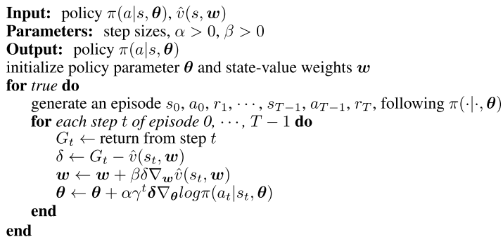
REINFORCE: Actor-Critic Method

Slide 13
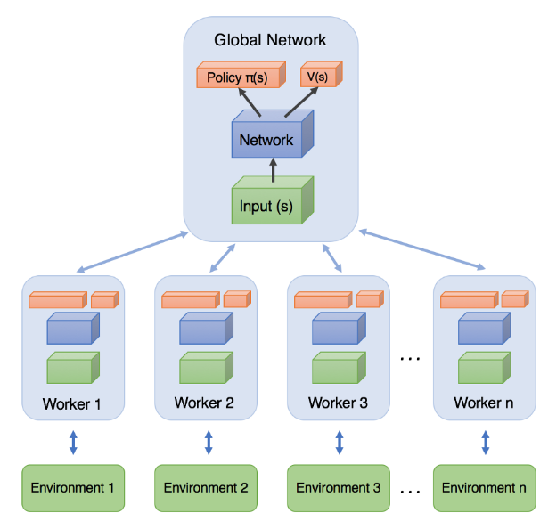
A3C: asynchronous advantage actor-critic
Mnih, Volodymyr, et al. "Asynchronous methods for deep reinforcement learning." International Conference on Machine Learning. 2016.
Simple Reinforcement Learning with Tensorflow Part 8: Asynchronous Actor-Critic Agents (A3C) : https://medium.com/emergent-future/simple-reinforcement-learning-with-tensorflow-part-8-asynchronous-actor-critic-agents-a3c-c88f72a5e9f2

Slide 14
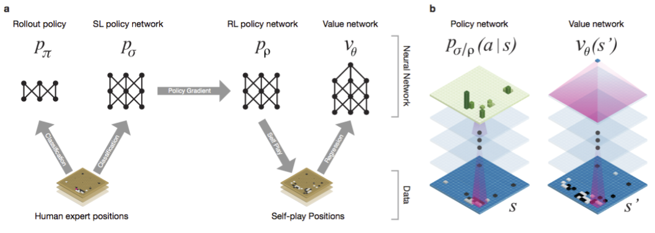
AlphaGo
Silver, David, et al. "Mastering the game of Go with deep neural networks and tree search." Nature 529.7587 (2016): 484-489.

Slide 15
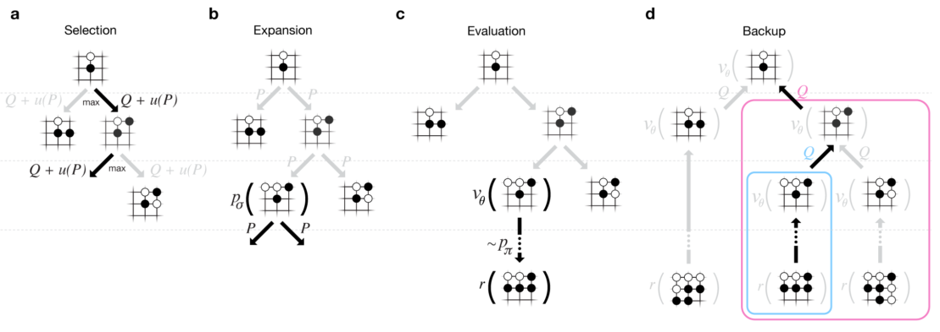
AlphaGo: Monte Carlo Tree Search (Not MC Learning!!)
No backup
Expansion for the mutually dependent relation between tree depth and sampling number.

Slide 16
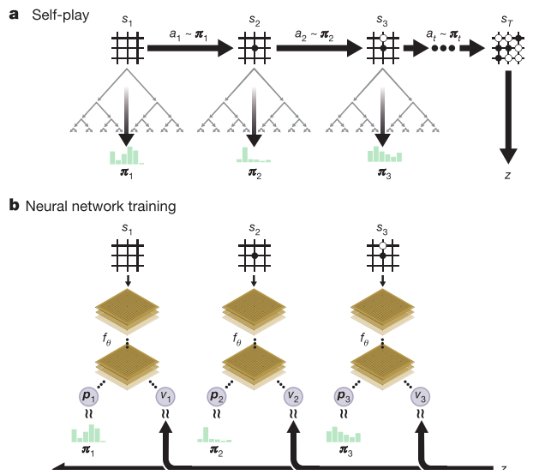
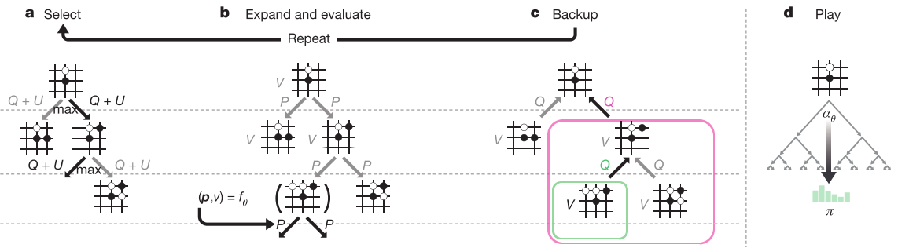
AlphaGo Zero (Not Alpha Zero!!)
Return to zero : MCTS function as a policy improvement operator—highly efficiently self-play.
Silver, David, et al. "Mastering the game of go without human knowledge." Nature 550.7676 (2017): 354-359.

Slide 17
Thank you.

