Slide 1
AutoML: Why, What and How
Weiyan Wang

Slide 2
Motivation: Why to do AutoML
Manually machine learning pipeline:
Preprocess and clean the data.
Select and construct appropriate features or network architecture.
Select an appropriate model or loss family.
Optimize model hyperparameters.
Postprocess machine learning models.
Critically analyze the results obtained.
Features matter a lot
No free lunch theorem
Sensitive to hyperparam
Solution: Graduate Student Decent to Make
Good Design Choice
Notes:
Optimization algorithm, learning rates, momentum, batch normalization, batch sizes, dropout rates, weight decay, data augmentation,

Slide 3

Definition: What is AutoML
Model the design choice as a learning/optimization problem to solve
Expert chooses features / network architecture & hyperparameters
Learning model
Meta level Learning&
Optimization
Learning model

Slide 4
Categories: What is AutoML
Hyperparameter Optimization
Classical and deep models
Automatic Feature Engineering
Classical models
Network Architecture Searching
Deep models

Slide 5
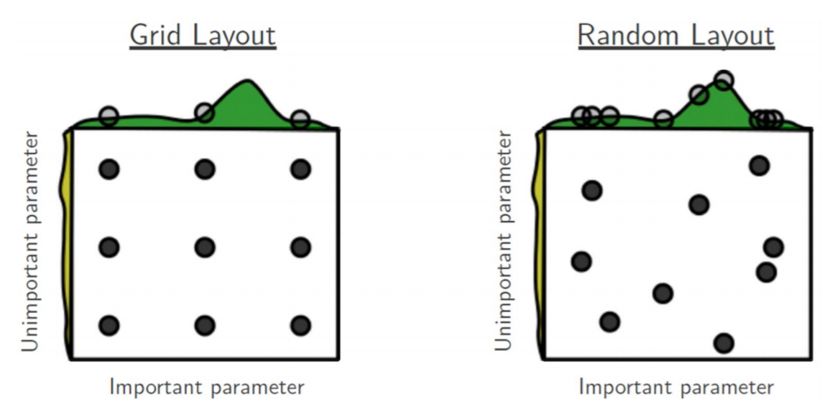
How: exhausted searching
Grid Search & Random Search
Fails in the high dimension and large space (Simple hper-parameter Tuning Only)
Sample information is not utilized

Slide 6
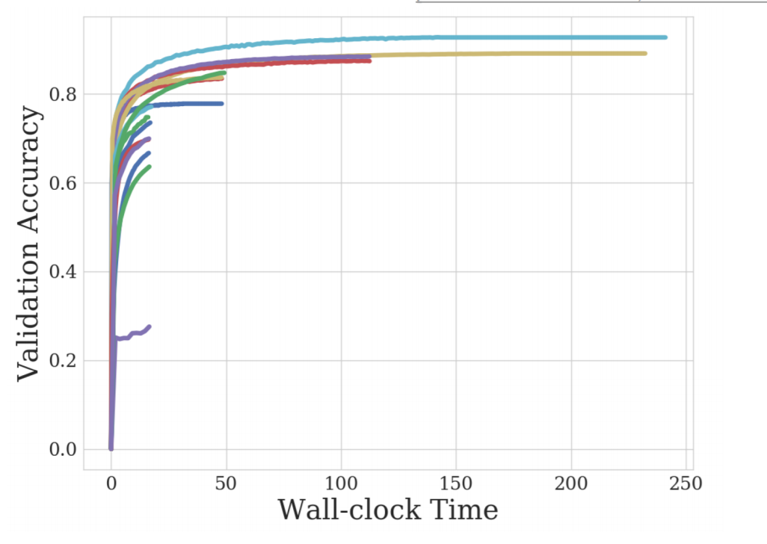
How: Heuristic Search
Successive Halving
Randomly pick the initial candidate populate
Kill the worst half candidate in every stage

Slide 7
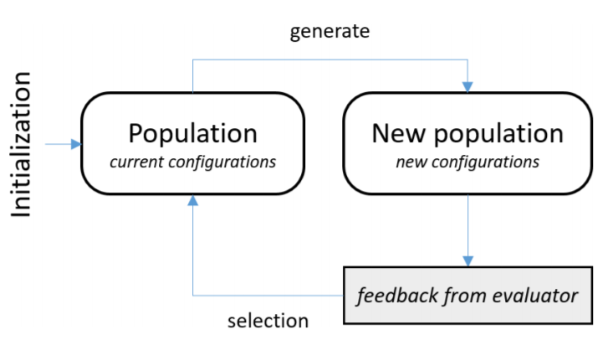
How: Heuristic Search
Evolve Algorithm: Generate new candidate population
Crossover: pick promising candidates to combine
Mutation: slightly modify the candidates

Slide 8
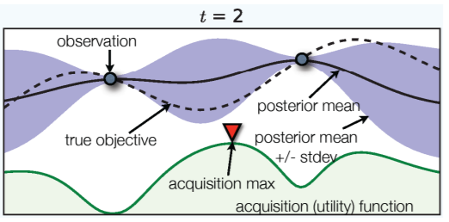
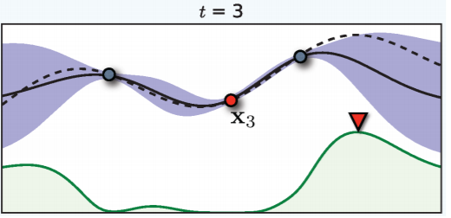
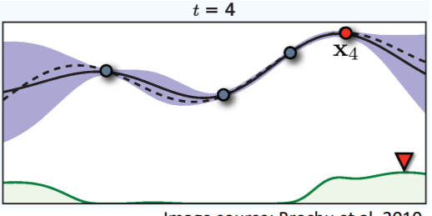
How: Bayesian Optimization
Learn to maps the configurations to their performance with uncertainty
Generate the new configuration based on the learning algorithm

Slide 9
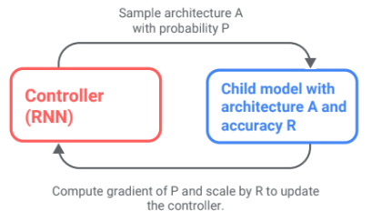
How: Reinforcement Learning
Controller: RNN network make one design decision at each layer and generate the child model candidate
Child model: the generated model is trained on the target task and its performance is the RL reward

Slide 10
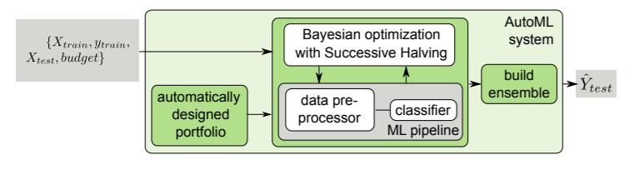
Successful Examples: Auto-Sklearn
Hyperparameter Tuning + Classifier Selecting
AutoML competition Winner for twice(the 1st and 2nd competition)

Slide 11
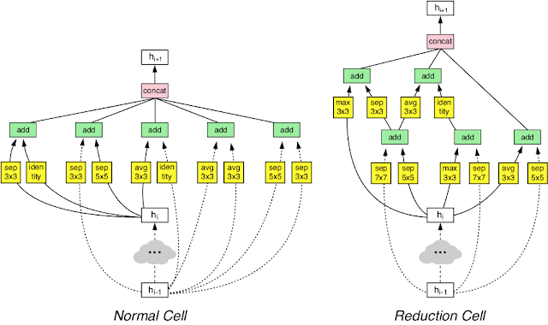
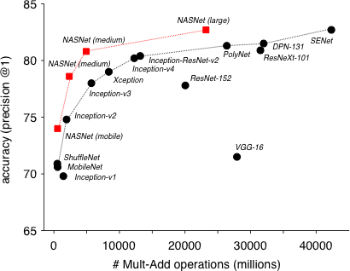
Successful Examples: Google AutoML Cloud

Slide 12
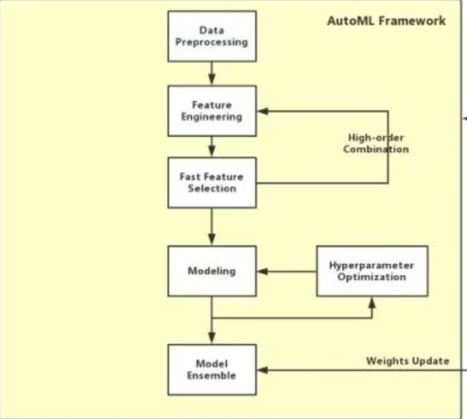
Successful Examples: High-order Feature Generation
Deep Smart solution (winner of the phase 1, 3rd AutoML compeition)
7.004% higher AUC than the winner of the phase 2
Feature combination of numerical, categorical, time
Notes:
最终 Top 6 中的第 1、2、3、5、6 名的队伍都因为内存超过 16G 的限制而未能在 Blind-Test 阶段得到有效成绩。

Slide 13
Some other existing systems
Auto-WEKA
768 hyperparameters, 4 levels of conditionality – Based on WEKA and SMAC
Hyperopt-sklearn
Based on scikit-learn & TPE
TPOT
Based on scikit-learn and evolutionary algorithms
H2O AutoML
Based on random search and stacking
AutoKeras
Neural architecture search based on Bayesian Optimization

Slide 14
Challenges
Each Trial is expensive to evaluate and may be a large-scale learning problem
Subsets of the data
Fewer epochs of iterative training
Down sampled images like Cifar10 instead of ImageNet
Algorithm: How to utilize the trial efficiently?
Pick the sample trial wisely
Utilize the information wisely
System: How to speed up trials?
More trials means more data for the meta model
More data means better estimation and accuracy

Slide 15
Potential Direction
Large Scale Learning Trial
Model parallel / Data parallel
Communication/Sync latency
Parallel Multiply Trials
Data load sharing across Trials
Part Computing sharing across Trials (feature generation, data aug.)
Dynamic task schedule and resource allocation for balancing

