Slide 1
Loom: Flexible and Efficient NIC Packet Scheduling
——Presented by Xinchen Wan

Slide 2
Outline
Background
Contributions
Evaluation
Conclusion
Weakness

Slide 3
Background
Aim: In multi-tenants environment, it’s desirable to achieve high-throughput, low latency and tenants’ fairness
1. What is current NIC problem?
Single Queue NIC packet scheduling
MultiQueue NIC packet scheduling

Slide 4

Single Queue NIC Packet Scheduling Limitations
Single queue throughput is limited
Especially with very small packets
Lack scalability
Software scheduling consumes CPU
Core-to-core communication increases latency
App 1 App 2
CPU
NIC
NIC
SQ struggles to drive line-rate
Wire

Slide 5
MultiQueue NIC Packet Scheduling Limitations
Multi-Queue NICs enable parallelism
Multi-Queue NICs have packet scheduler that choose which queue to send packets
MQ struggles to enforce policies

Slide 6
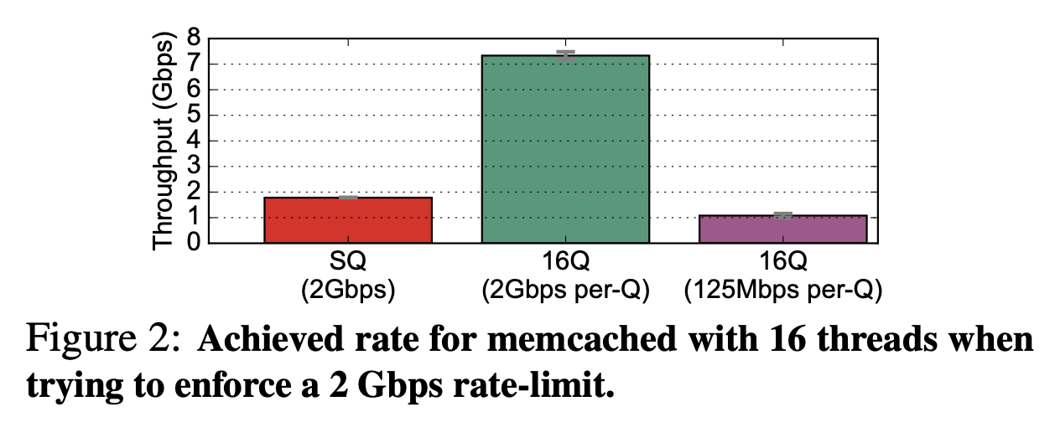
MultiQueue NIC Struggles to enforce policies
Rate-limit Policy
Network traffic is not uniformly spread across application threads.
Notes:
对一个16线程的memcached程序进行限速，理想状况是整体流速限制在2Gbps

Slide 7
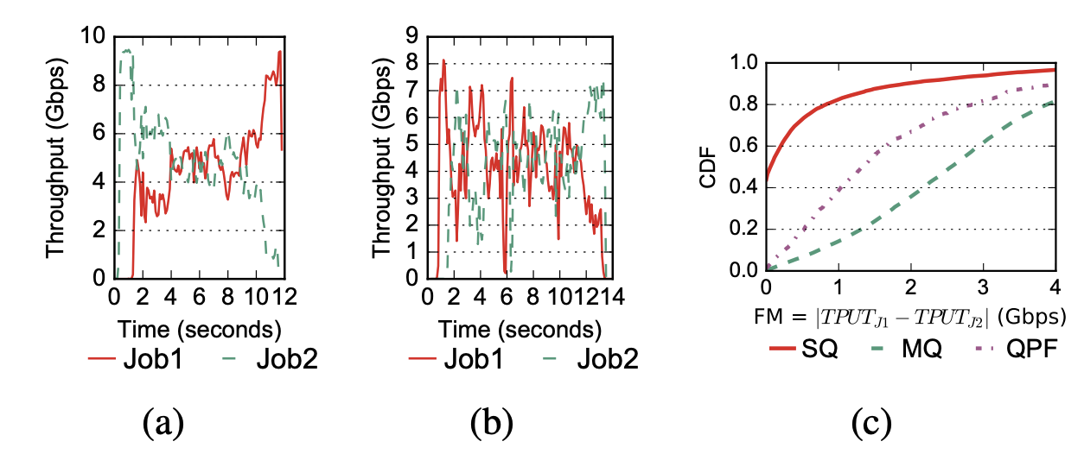
MultiQueue NIC Struggles to enforce policies
Per-queue fair scheduling policy
MQ
QPF
Active flows are not uniformly spread across the cores.
Each job doesn’t have same number of active flows.
Notes:
运行两个spark程序，希望达到共享网络带宽.

Slide 8
Background
1. What is current NIC problem?
2. Why offload all packet scheduling on NIC?

Slide 9
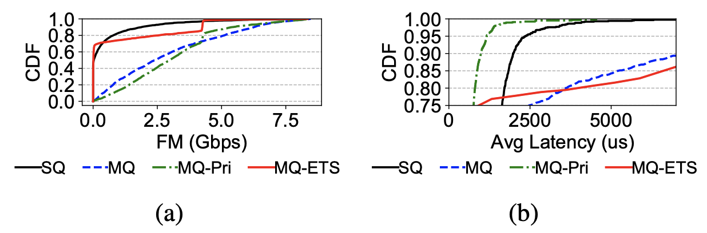
Why offload all packet scheduling on NIC?
Two tenants:
One runs Spark.
The other runs Spark and memcached.
Require:
1. Fairness for two tenants.
2. Memcached has higher priority
MQ-Pri: Strict priority in hardware, fairness in software.
MQ-ETS: Fairness in hardware, strict priority in software.

Slide 10
Loom is a new NIC design that moves all per-flow scheduling decisions out of the OS and into the NIC
Loom uses a queue per flow and offloads all packet scheduling to the NIC

Slide 11
Contributions
1. Specification: A new network policy abstraction: restricted directed acyclic graphs(DAGs)
2. Enforcement: A new programmable packet scheduling hierarchy designed for NICs
3. Updating: A new expressive and efficient OS/NIC interface

Slide 12
Contributions
1. Specification: A new network policy abstraction: restricted directed acyclic graphs(DAGs)
2. Enforcement: A new programmable packet scheduling hierarchy designed for NICs
3. Updating: A new expressive and efficient OS/NIC interface

Slide 13



Loom policy DAG
Two types of nodes:
Scheduling Node
Shaping Node
Scheduling nodes: Work-conserving policies for sharing the local link bandwidth
Shaping nodes: Rate-limiting policies for sharing the network core (WAN and DCN)
Programmability: Every node is programmable with a custom enqueue and dequeue function
VM1 VM1
VM2
Pri_1
RL_WAN
RL_None
FIFO_1
Fair_1
Wire

Slide 14
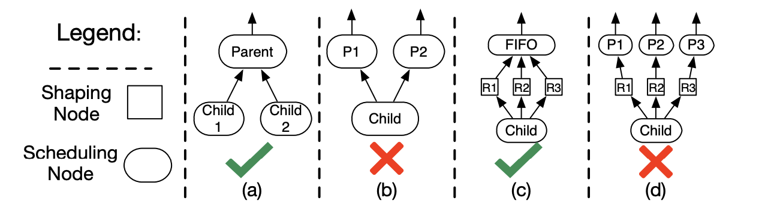
Loom: Policy Abstraction
DAG restriction: Scheduling nodes form a tree when the shaping nodes are removed
(b) and (d) are prevented because they allow parents to reorder packets that were already ordered by a child node.

Slide 15
Contributions
1. Specification: A new network policy abstraction: restricted directed acyclic graphs(DAGs)
2. Enforcement: A new programmable packet scheduling hierarchy designed for NICs
3. Updating: A new expressive and efficient OS/NIC interface

Slide 16



Loom enforcement challenge
No existing hardware scheduler can efficiently enforce Loom Policy DAGs
Domino PIFO Block
1 x 1 x
Scheduling Shaping
New PIFO Block?
1 x
N x
Scheduling
Shaping
To implement Loom, there should be a lot of shaping queues in the hardware, which may exists the queue
number size in NIC.

Slide 17
Insight: All shaping can be done with a single queue because all shaping can use wall clock time as a rank

Slide 18
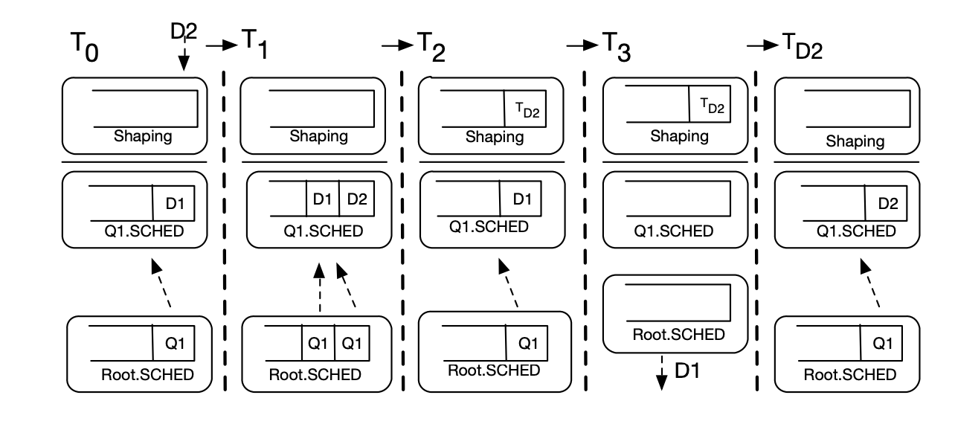
Solution: Set a global shaping queue in PIFO
Procedures:
All traffic is first only placed in scheduling queues
If a packet is dequeued before its shaping time, it is placed in a global shaping queue
After shaping, the packet is placed back in scheduling queues
Notes:
Extra enqueue and dequeue operations
T2, no packet is transferred
What if there exists another packet at head at TD2?
What if the number of rate-limit packets exceeds the shaping queue size?

Slide 19
Contributions
1. Specification: A new network policy abstraction: restricted directed acyclic graphs(DAGs)
2. Enforcement: A new programmable packet scheduling hierarchy designed for NICs
3. Updating: A new expressive and efficient OS/NIC interface

Slide 20
PCIe Limitations
NIC doorbell and update limitations:¹
Core
1
Latency Limitations:
120-900ns
App
PCIe
1
2
Throughput Limitations:
~3Mops (Intel XL710 40Gbps)
DB1
DB2
DB3
PCIe
Engine
2
DB4
…
DB_F
1
PSPAT: software packet scheduling at hardware speed
Luigi Rizzo¹, Paolo Valente², Giuseppe Lettieri¹, Vincenzo Maffione² ¹Univ. di Pisa, ²Univ.di Modena e Reggio Emilia
rizzo.unipi@gmail.com. Work supported by H2020 project SSICLOPS.
NIC

Slide 21

Batched Doorbells
Core
App
Using on-NIC Doorbell FIFOs allows for updates to different queues(flows) to be batched
PCIe
Per-core Doorbell
FIFO
NIC

Slide 22

Inline Metadata
Scheduling metadata (traffic class and scheduling updates) is inlined to reduce PCIe writes
Desciptor inlining allows for scheduling before reading packet data
Mem
Q2 Q3
Q1
Q5
Q_F
…
DMA Engine
PIFOs
NIC
Wire

Slide 23
Evaluation
Software prototype of Loom in Linux on the Berkeley Extensible Software Switch (BESS)
C++ PIFO implementations is used for scheduling
10Gbps and 40Gbps CloudLab evaluation

Slide 24
Loom Evaluation
Can Loom drive line rate? Can Loom enforce network policies?
Experiment: Microbenchmarks with iPerf
Can Loom isolate real applications?
Experiment: CloudLab experiments with memcached and Spark
How effective is Loom’s efficient OS/NIC interface?
Experiment: Analysis of PCIe writes in Linux(QPF) versus Loom

Slide 25

Loom 40Gbps Evaluation
SQ
40
30
20
10
Throughput
(Gbps)
Policy: All tenants should receive an equal share.
0
0
10
Time (seconds) T1 T2 T3
MQ
5
15
20
T4
T1
T2
T3 T4
Fair
40
30
20
10
0
Throughput
(Gbps)
Setup:
Every 2s a new tenant starts or stops
Each tenant i starts 4 flows (4-256 total flows)
0
5
10
Time (seconds) T2 T3
Loom
15
20
T1
T4
i
40
30
20
10
0
Throughput
(Gbps)
0
5
10
Time (seconds)
15
20
105
105
T1 T2 T3
T4

Slide 26





Application Performance: Latency
vs
4000
90th Percentile Latency (us)
3000
Latency Sensitive
Bandwidth Hungry
2000
Setup: Linux software packet scheduling (Qdisc) is configured to prioritize memcached traffic over Spark traffic
1000
Pri
0
Loom
Linux (MQ)
109

Slide 27
Loom Interface Evaluation
Worse case scenario:
Packets are sent in 64KB batches and each packet is from a different flow
Line-rate | Existing approaches: PCIe Writes per second | Loom: PCIe Writes per second
10 Gbps | 833K | 19K
40 Gbps | 3.3M | 76K
100 Gbps | 8.3M | 191K
111

Slide 28
Conclusion
Current NICs cannot ensure that competing applications are isolated
Loom is a new NIC design that completely offloads all packet scheduling to the NIC with low CPU overhead
Loom’s benefits translate into reductions in latency, increases in throughput, and improvements in fairness

Slide 29
Weakness
DAG policy cannot be enforced network-wide.
Not proof that all algorithms can be expressed by DAG.
Rate-limit design has much to improve:
Extra enqueue and dequeue operations
Issues exists in global shaping queue

Slide 30
Thank you!

