Slide 1
Pantheon: the training ground for Internet congestion-control research
WANG HAO
2019.6.27

Slide 2
Outlines
Background and motivation
Design overview
Findings

Slide 3
Background&Motivation
transport-layer protocols such as CC need to achieve high throughput/low latency/fairness/… which needs to be proved by experiments.
It’s hard to do such experiments
1) baselines
2) real environment
3) reproducible

Slide 4
Simulation vs Emulation
a network simulator uses mathematical formulas to create a theoretical and entirely virtual model of a network .
These emulators provide increasing numbers of parameters and mechanisms to recreate different network behaviors, such as traffic shapers, policers, queue disciplines, stochastic i.i.d. or autocorrelated loss, reordering, bit errors, and MAC dynamics.

Slide 5
Contribution
a software library containing a growing collection of transport protocols and congestion-control algorithms
a diverse testbed of network nodes on wireless and wired networks around the world
a collection of network emulators, each calibrated to match the performance of a real network path
a continuous-testing system that regularly evaluates the Pantheon protocols over the real Internet between pairs of testbed nodes

Slide 6
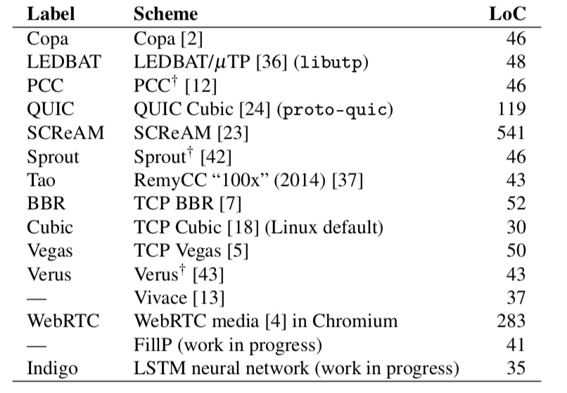
Design overview
A collection of transport algorithms, each exposing the same interface

Slide 7
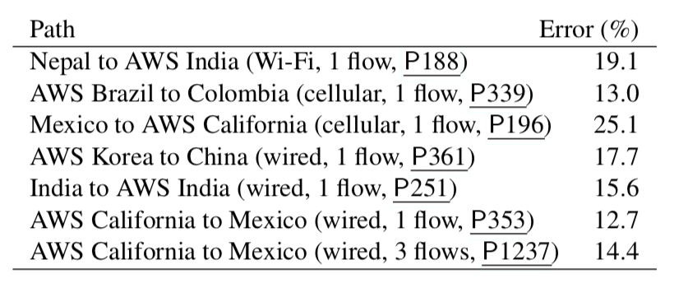
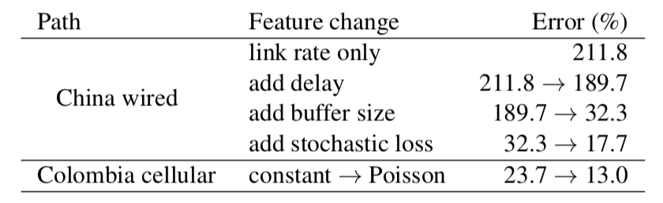
Design overview
testing infrastructure that runs transport protocols in scripted scenarios
Calibrated emulators(use parameters <rate, propagation delay, queue size, loss rate> , base on Bayesian optimization)
)

Slide 8
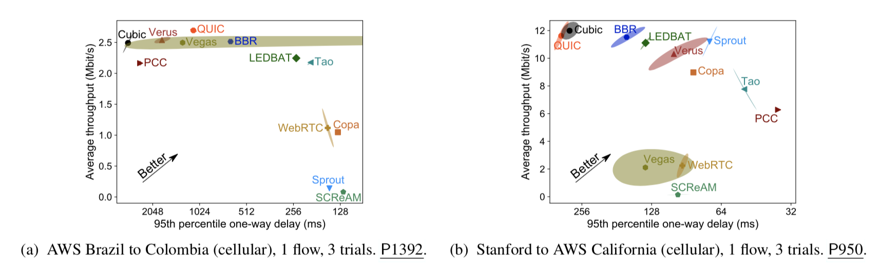
Findings
Which protocol performs best varies by path.

Slide 9
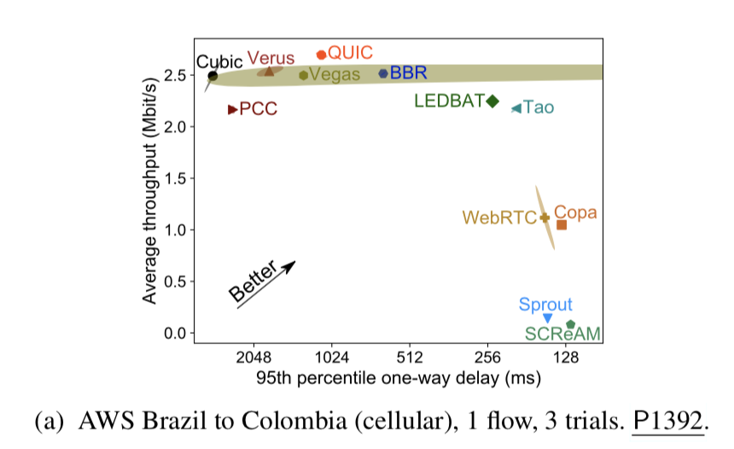
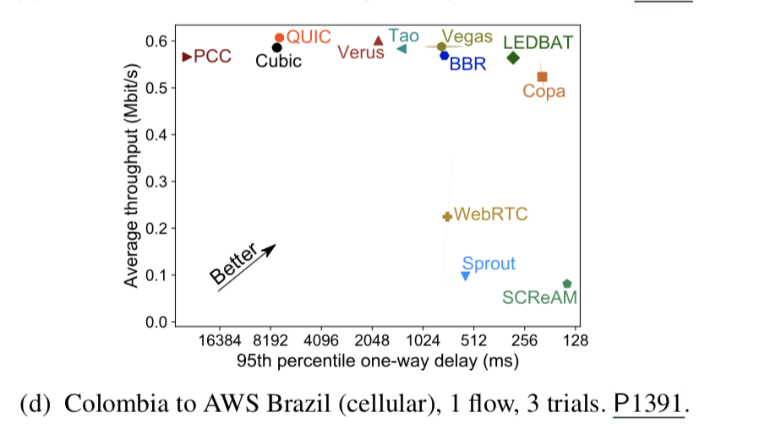
Findings
Which protocol performs best varies by path direction.

Slide 10
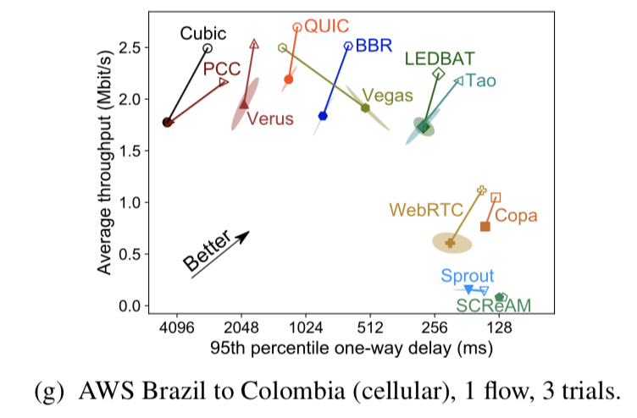
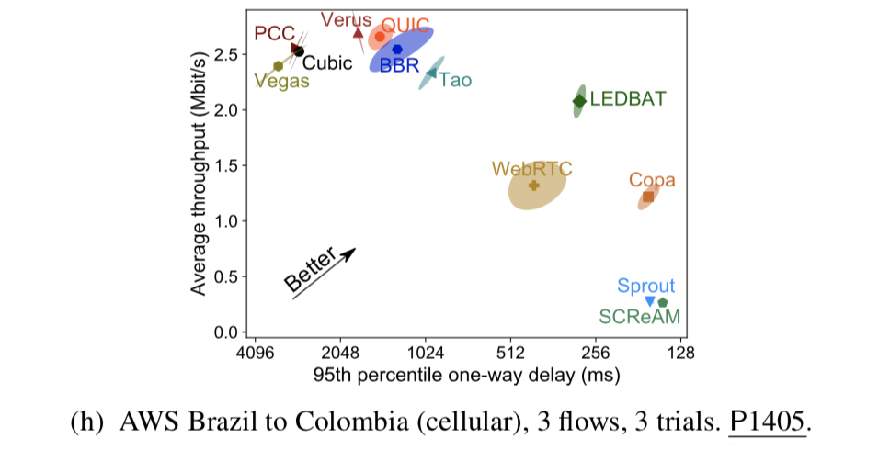
Findings
Protocol performance varies in time and only slightly based on competing flows.

