Slide 1
Mainstream : Dynamic Stem-Sharing for Multi-Tenant Video Processing
Consider Deep Learning techniques together with practical applications.

Slide 2
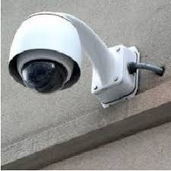
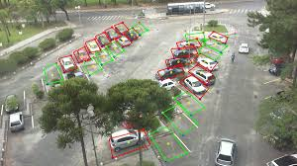
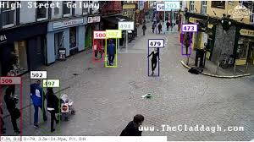
Problem Description
Multi-Tenant: Multiple concurrent applications on one input stream.
A parking lot camera might be used for: reporting open parking spots, tracking each car’s parking duration for billing and recoding fender benders.
They may be trained on different training set, at different times and locations.

Slide 3
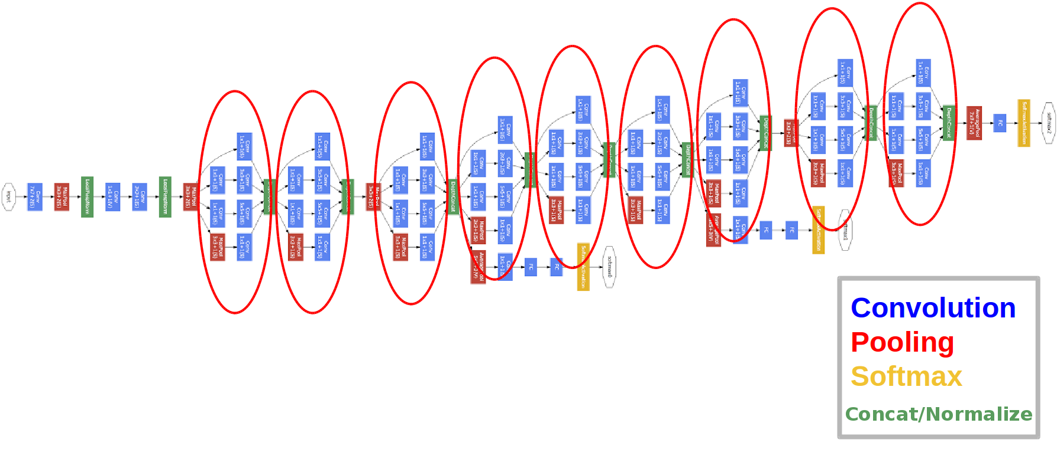
Optimizing execution of visual computing pipelines
Common approach: execute every application’s DNN model independently.
VideoStorm: black-box; trade-off between resource and quality.
While-box: try to sharing some computations between applications.
Notes:
VideoStorm

Slide 4
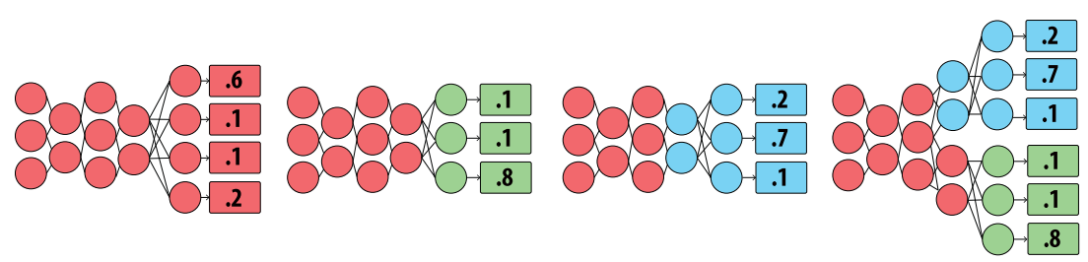
Transfer Learning makes sharing possible.
Pre-trained on some big and general training set, and then fine-tune on the target training set.
Faster-RCNN for Object Detection: the convolution layers can be pre-trained on ImageNet, Coco, etc.
Pre-trained on the same training set + freeze some shallow layers when fine-tune = the same weight values that can be shared.
Pre-trained

Slide 5
Problem Description
Decreasing specialization | Increasing specialization
More shared computation Higher frequent sampling More possible an event being detected Better recall | Reduces shared computation Less frequent sampling Some events may be missed Worse recall
Decrease per-frame accuracy Worse precision | Improve per-frame accuracy Better precision

Slide 6
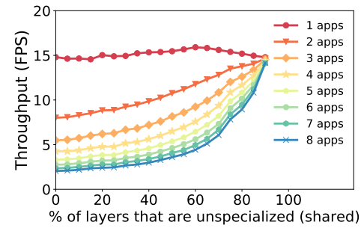
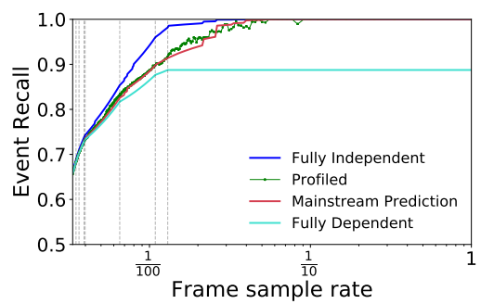
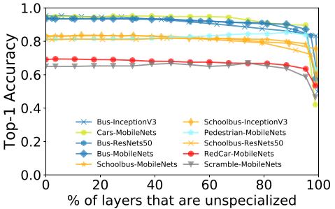

Event F1 score:
Notes:
Argmax sigma(F1(specialization degree, frame rate)) s.t. computation constraint
离散背包问题：NP

Slide 7





Analytical model for event detection：benifit
Specialization
Dataset statistics
Event Configuration:
Length d, frequency f.
Frame rate: 1/stride
Accuracy
Correlation:
Similar with precision.
Notes:
原文概率应该是(stride-(d%stride))/stride.
此处为单应用，frame rate不受限制。

Slide 8
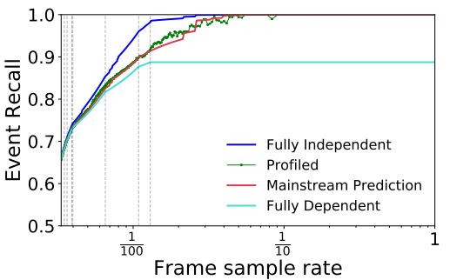
The performance of recall modelling.

Slide 9
Analytical model for event detection: cost
The cost value considered represents the computational resources (e.g., CPU- seconds per second) consumed by a given schedule arrangement.
B
A
Cost = F · CA + F · CB + F · Cc
C
F: frame rate of two models.

Slide 10
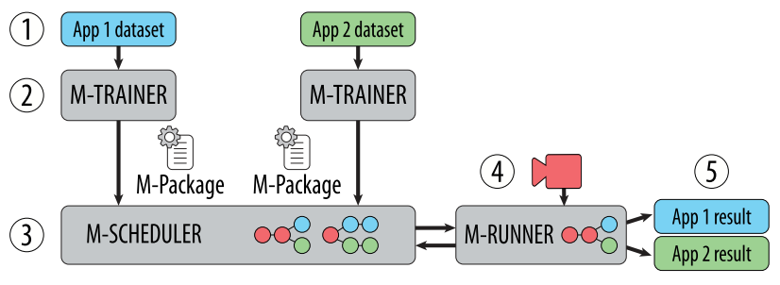
Mainstream
M-Trainer: (event duration, event frequency), (specialization degree)->(accuracy, correlation)
M-Scheduler: Find the best combination (specialization degree, frame rate) of applications under the computation constraint.
M-Runner: Runtime system, run the selected DNN with shared unspecialized layers.

Slide 11
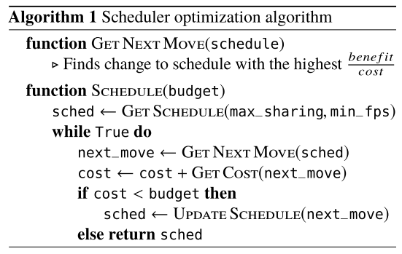
M-Scheduler: Greedy algorithm
With >4,800 workloads each consisting of up to 10 applications, the greedy schedules are on average within 0.89% of optimal.
Notes:
有个BUG：应该是当所有的都选完了之后，如果BUDGET还有多，直接生成规划方案。

Slide 12
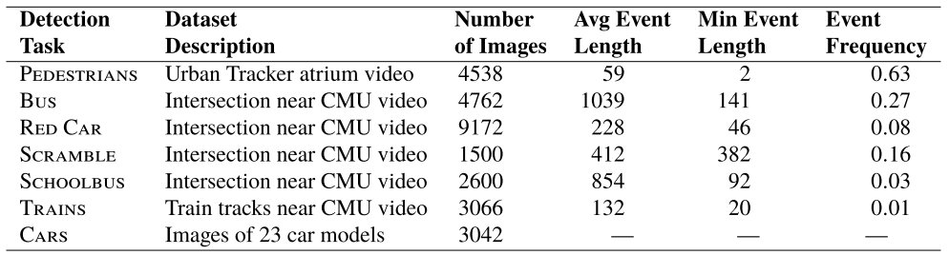
Experiment Setting: 7-Hybrid
Models : MobileNets-224 model pretrained on ImageNet as a base DNN.
Training :Intel® Xeon® E5-2698Bv3 processors (2.0 GHz, 16 cores) and an Nvidia Titan X GPU.
Edge processing device : an Intel® NUC with an Intel® Core™ i7- 6770HQ processor and 32 GiB DRAM
Agument the applications: 7->30.

Slide 13
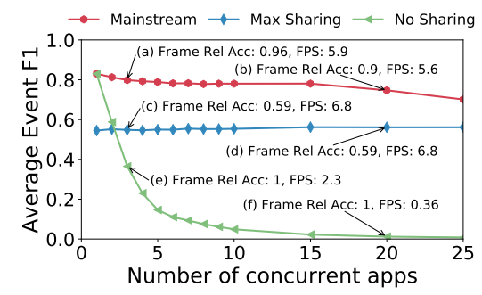
Mainstream outperforms static approaches.

Slide 14
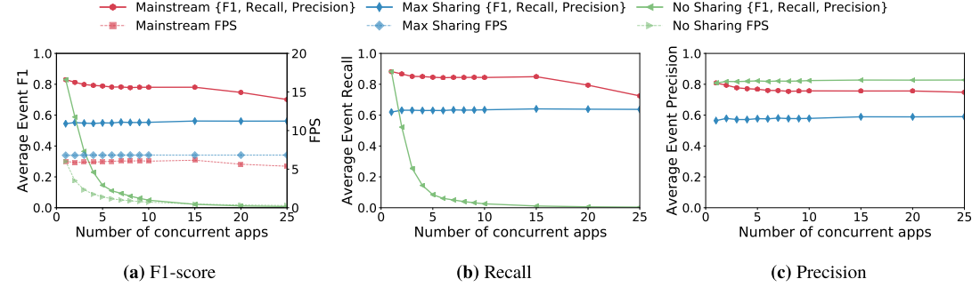
Mainstream dynamically balances precision and recall.

Slide 15
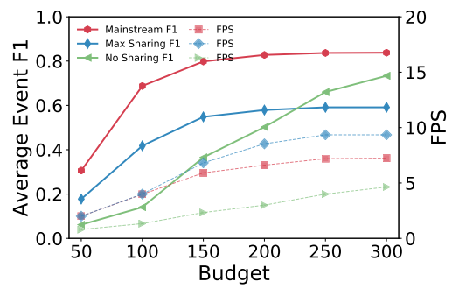
Mainstream improves upon Max-Sharing even under tight resource constraints.

Slide 16
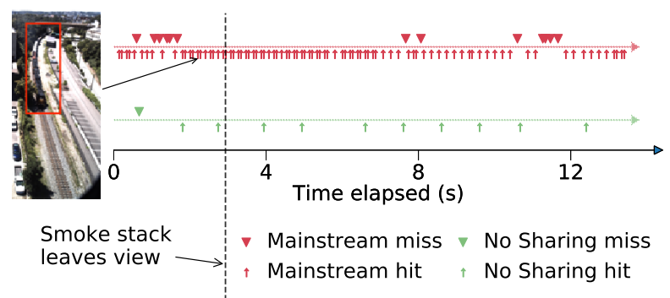
Mainstream Deployment: more frequent, earlier
Requiring Mainstream to have two positive samples before an event is classified. The false positive rate of the Train video drops from 0.028 to 0.00056.

Slide 17
Discussion
Advantages: faster, more efficient, no extra training cost, independent training, data privacy.
Disadvantages: same pre-trained dataset, no fine-tune on unspecialized layers, greedy may not be the best.

Slide 18
Thanks
More training parameter adjustable after training.
Multi-tenant dynamic batch.
trade-off: query frequency, other apps’ query frequency.
Partial observable: AIMD(Clipper) -> omniscience: better policy?
Notes:
类比网络拥塞窗口，使用AIMD的原因是不知道别人的状态，但是我们是全知全能的。从所有的当前query frequency vector推导当前的batching vector.

