Slide 1
Tiresias:A GPU Cluster Manager for
Distributed Deep Learning
Juncheng Gu, Mosharaf Chowdhury, Kang G. Shin, Yibo Zhu,
Myeongjae Jeon, Junjie Qian, Hongqiang (Harry) Liu, Chuanxiong Guo
Presented by Duowen

Slide 2
Outline
Background & Motivation
Challenges
Tiresias Ideas and Designs
Evaluation
Future Work

Slide 3
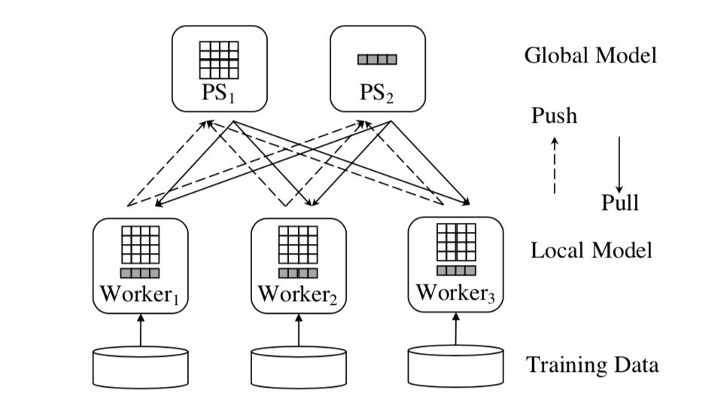
Background & Motivation
Peroidic iterations
Parameter server architecture
Trial-and-error exploration

Slide 4
Challenges
Unpredictable job duration
SJF(shortest-job-first) or SRTF(shortest-remaining-time-first) need to know job’s (remaining) execution time, which is often unknown to DL jobs.
Optimus[1] predicts DL job’s remaining time, but loss curves are not always smooth. eg hyperparameter-tuning & AutoML
[1] Y. Peng, Y. Bao, Y. Chen, C. Wu, and C. Guo. Opti- mus: An efficient dynamic resource scheduler for deep learning clusters. In EuroSys, 2018.

Slide 5
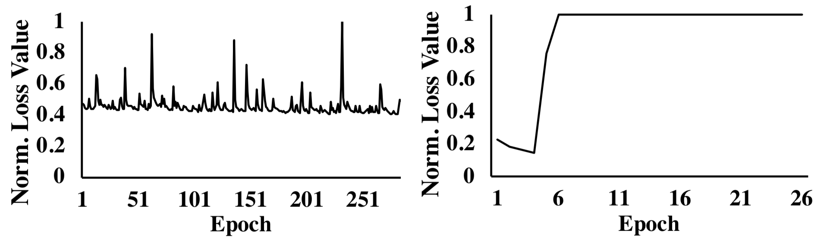
Challenges
Unpredictable job duration

Slide 6
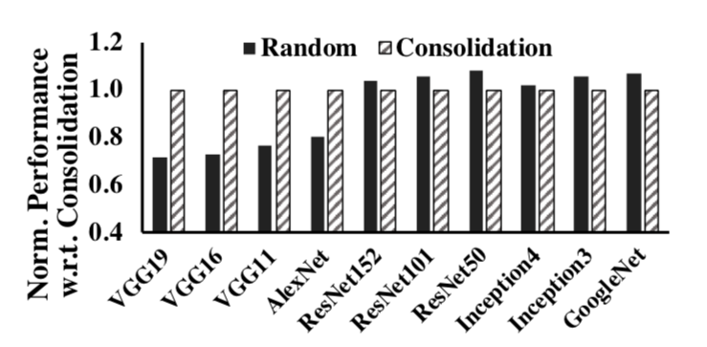
Challenges
Over-aggressive job consolidation
Consolidation to minimize network communication time duing model aggregation.
Jobs usually wait until they can be consolidated.

Slide 7
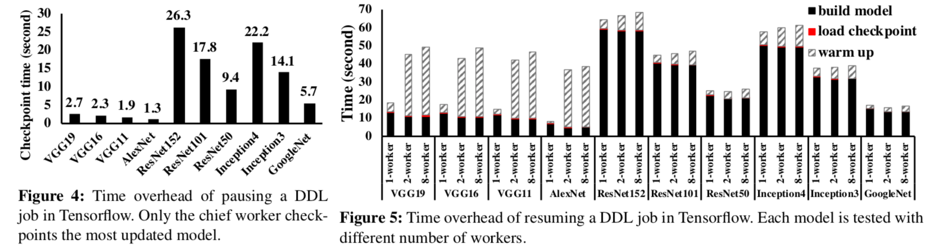
Challenges
Time overhead of preemption

Slide 8
Ideas and Designs
The manager aims to:
Minimize Cluster Wide Avg Job Completion Time(JCT)
Maximize Resource(GPU) Utilization
No starvation (jobs should not wait for too long)

Slide 9
Ideas and Designs
Constraints and assumptions
Resource requirement unknown prior to job arrival
Don’t know job durations
Don’t know how DL framework assign tensors
All-or-nothing resource allocation
Notes:
All-or-nothing resource allocation:servers and works should be simultaneously active.

Slide 10
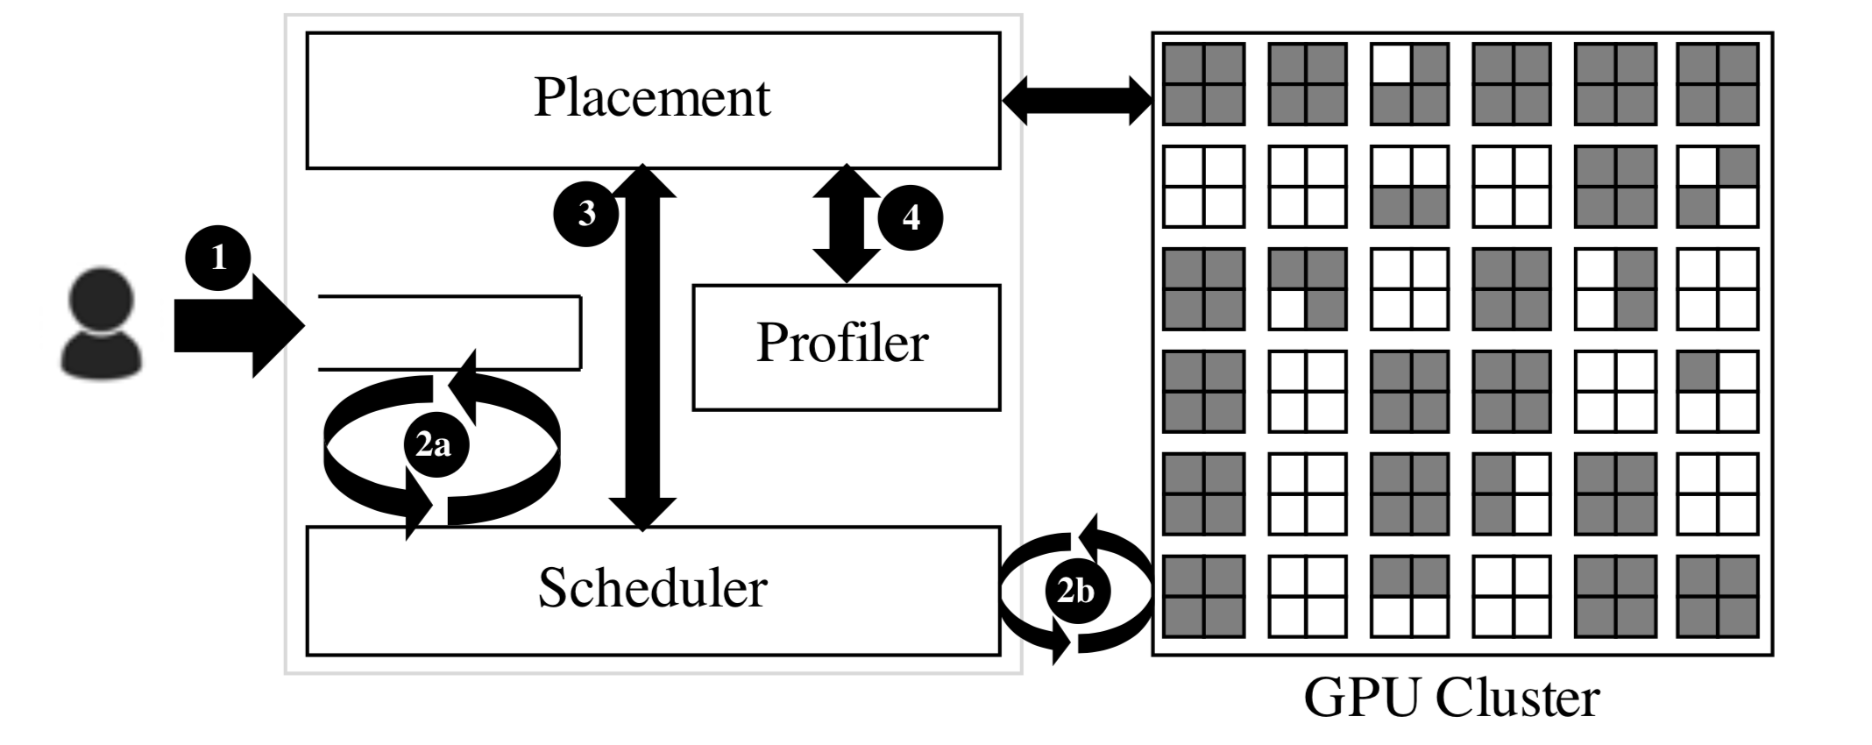
Components of the Manager
Notes:
Scheduling and Placement

Slide 11
Components of the Manager

Slide 12
Scheduler
The scheduler is responsible for:
Minimizing average JCT (goal 1)
Avoiding starvation (goal 3)
To achieve these goals, we need Two-Dimensional Scheduling (?) :
Spatial, time-based algorithm
Temporal, occupied GPU size based algorithm
Notes:
Why Two Dimensional?
smallest-first (w.r.t. the number of GPUs), then large jobs may be blocked by a stream of small jobs even if they are close to completion;
shorttest-first will cause large but short jobs block small but short jobs, this will increase avg JCT

Slide 13
avg JCT: 1.2/4 = 0.3
GPU 1
Time 1.2
GPU 1
Time 1.2
GPU 1
Time 1.2
GPU 1
Time 1.2
GPU
GPU
GPU 4
Time 1
GPU 4
Time 1
GPU 4
Time 1
GPU 4
Time 1
GPU
GPU
avg JCT: 4/1 = 1
Notes:
Why Two Dimensional?
smallest-first (w.r.t. the number of GPUs), then large jobs may be blocked by a stream of small jobs even if they are close to completion;
shorttest-first will cause large but short jobs block small but short jobs, this will increase avg JCT

Slide 14
Scheduler
Two-Dimensional Attained Service-Based Scheduler (2DAS)
Wj : number of GPUs the job uses
tj : The time job has been running so far
Define attained service as Wj * tj

Slide 15
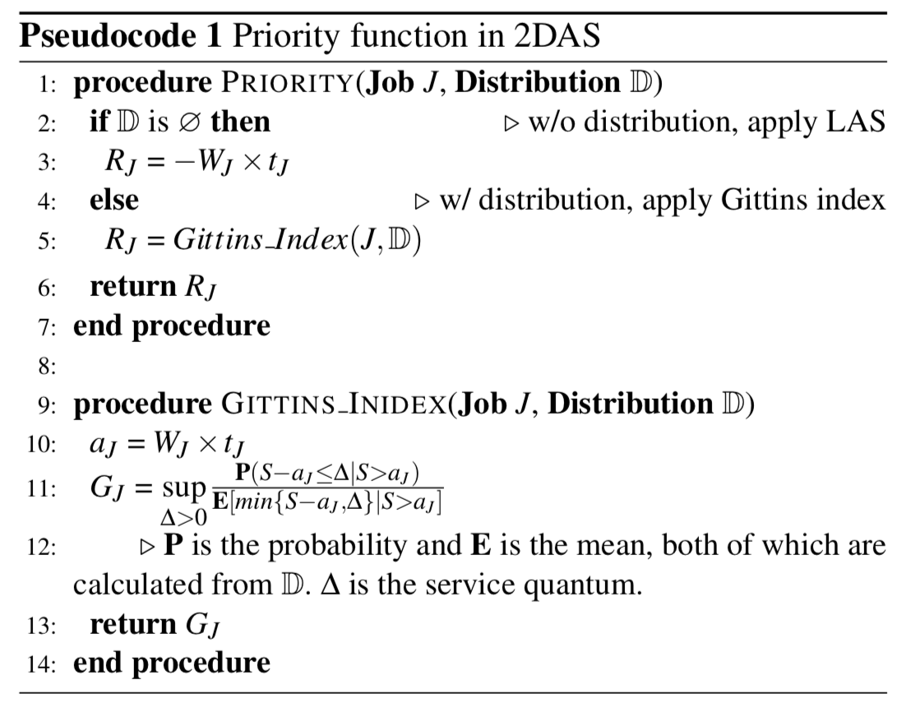
Scheduler
All jobs start with highest priority
(tj = 0)
How likely the job can complete
within next service quantum

Slide 16
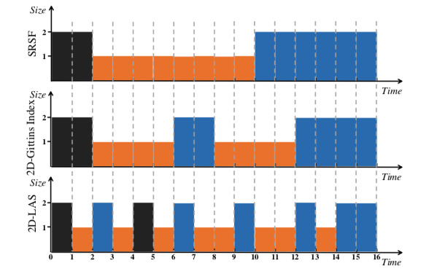
Schedule Example
Represent job by
(num of GPU, duration) pair
and they arrive at same time
Job1(black) (2, 2)
Job2(orange) (1,8)
Job3(blue) (2,6)

Slide 17
Schedule Example
avg JCT for:
SRSF: 9.3
2D-Gittins index: 10
2D-LAS: 11.7
(unit of time)
Notes:
In general, algorithms with more information perform better in minimizing the average JCT.

Slide 18
Priority Discretization
Previous priority is continuous，thus leading to preemptions & resumptions
According to “Challenge”, this is time-consuming and expensive
Solution: Multi-level Feedback Queue

Slide 19
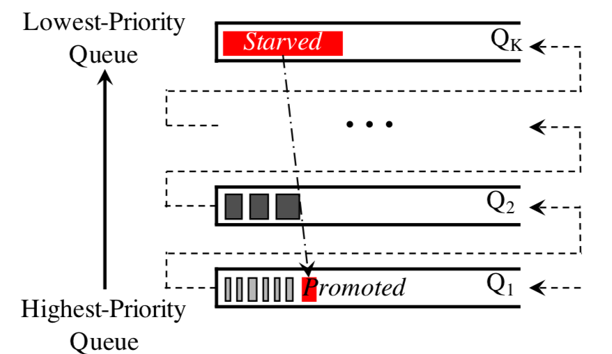
Priority Discretization
Queue priorities decreasing from 1 to k;
i-th queue contains jobs attained service(Wj*tj) within [Q_{i}^{low}, Q_{i}^{high});
Q₁^{low} = 0, Q_{K}^{high} = ∞ ;

Slide 20
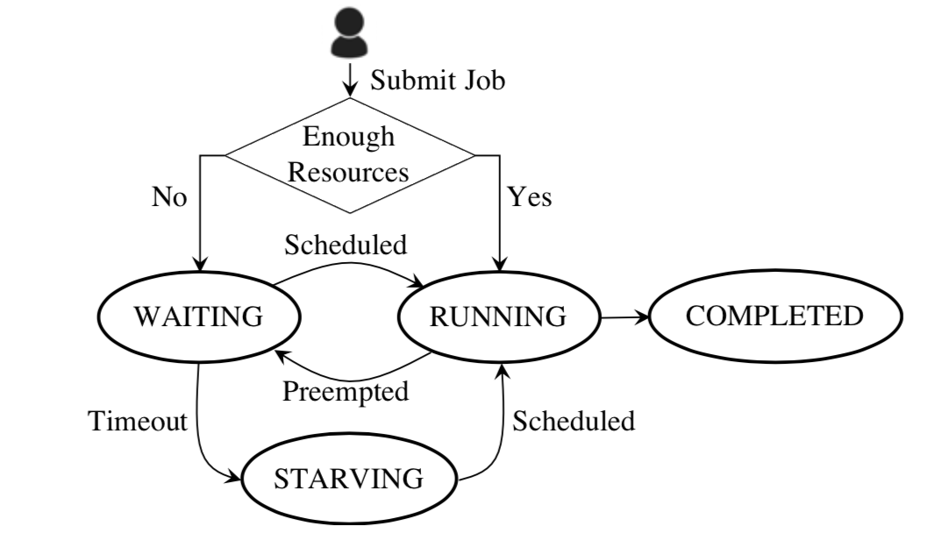
Priority Discretization

Slide 21
Components of the Manager

Slide 22
Placement & Profiler
The goal is to improve GPU Utilization (goal 2) ande reduce queueing time
Placement place job to GPUs according to the algorithm
Profiler decides whether job should be consolidated
(Consolidated means must deploy to minimum number of machines, if not available, pend the job)
Which jobs benefit a lot from consolidation?

Slide 23
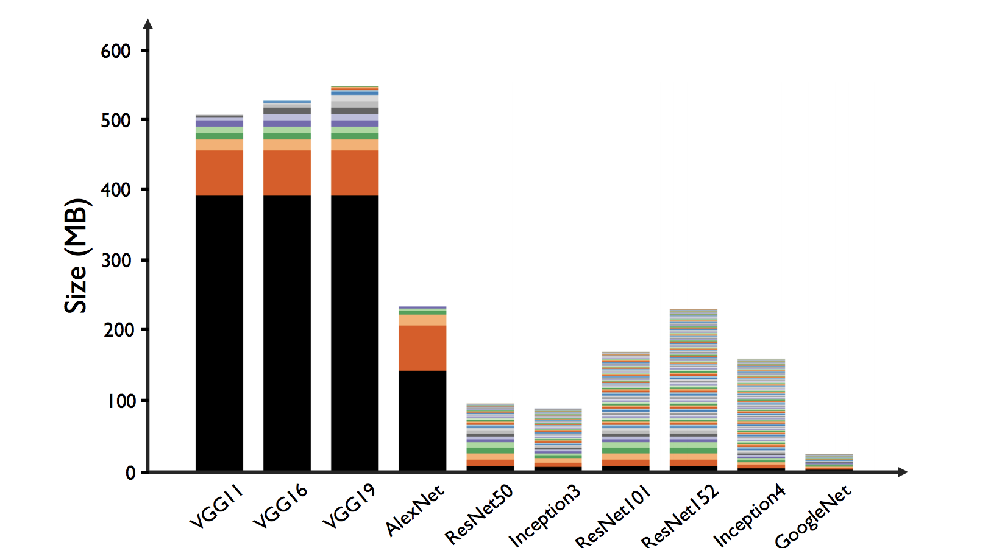
Placement & Profiler
Benefit a lot from consolidation

Slide 24
Placement & Profiler
Highly skewed in tensor size
Benefit a lot from consolidation

Slide 25
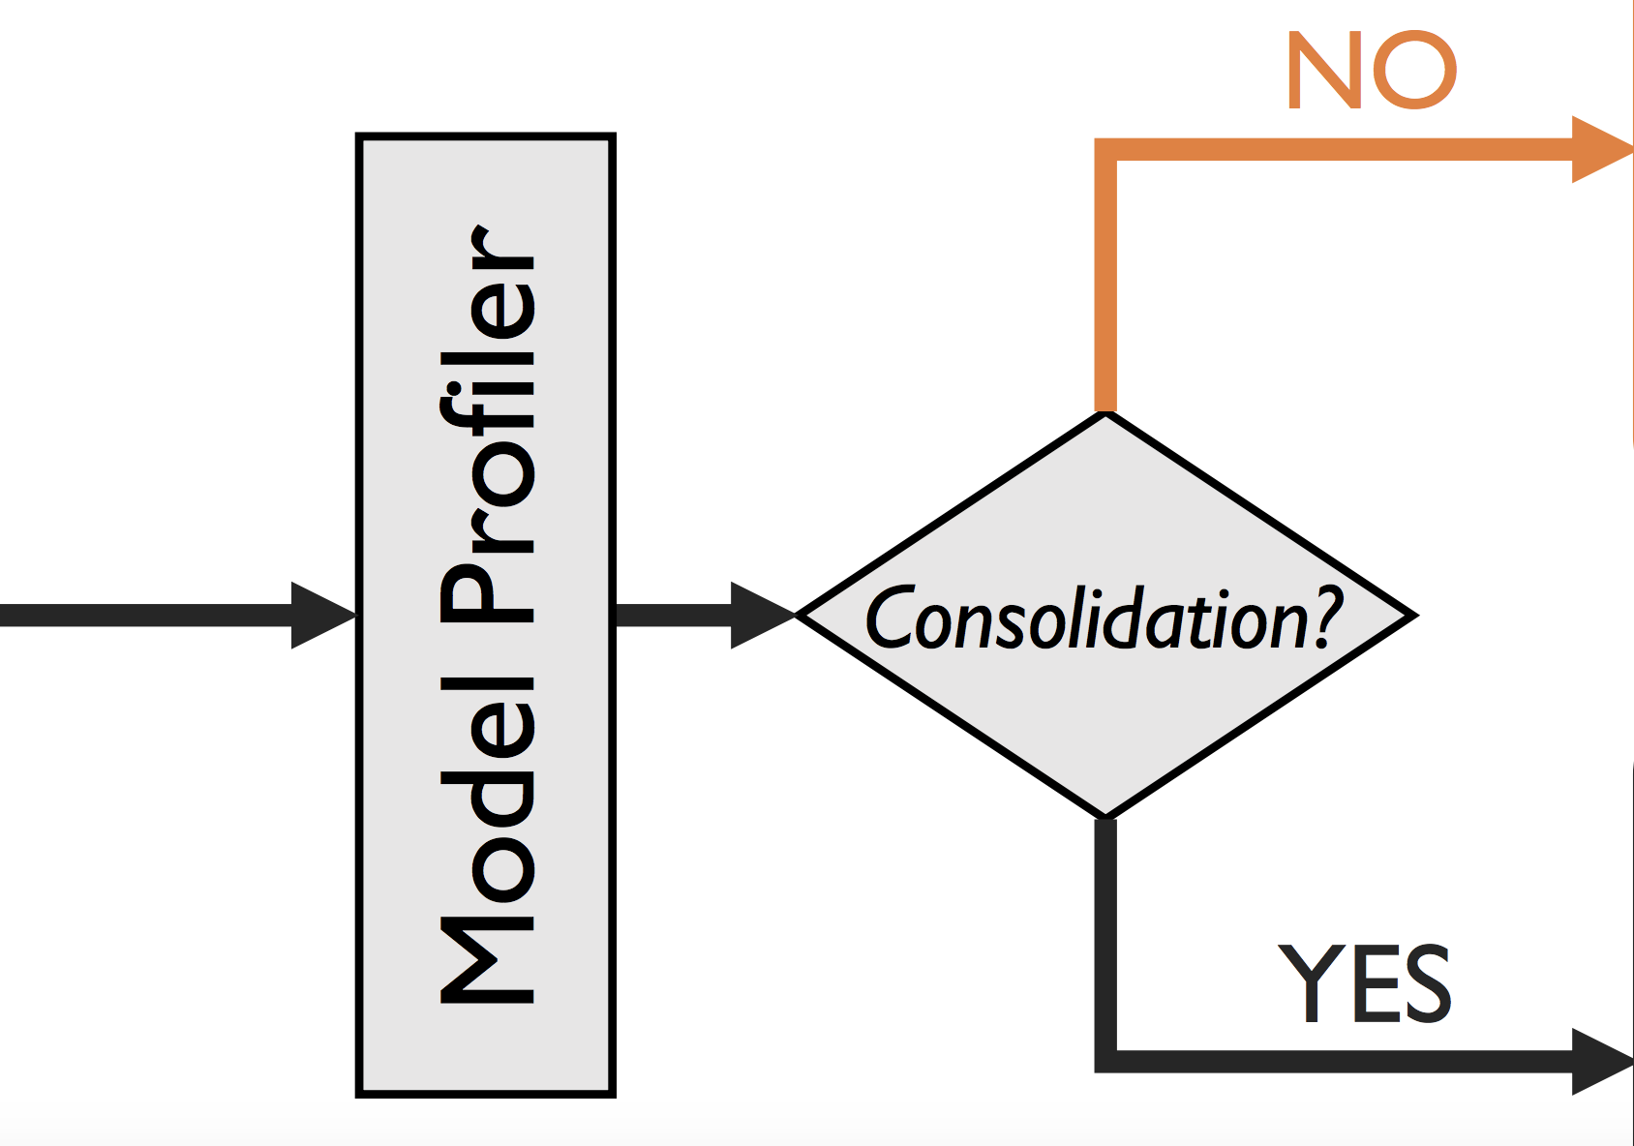
Placement & Profiler
Caculate skew level (Sj) of a model from the network communications
Sj > PACKLIMIT, do consolidation; For the rest, do decrease fragmentation
Use linear classifier to regularly update PACKLIMIT
decrease fragmentation
job
consolidation

Slide 26
Evaluation
Testbed - 15 machines (4 GPU each), 100 Gbps RDMA network
Work load - 480 DL/DDL jobs, each requiring (1,2,4,8,16,32) GPU
Traing time of each job varies from 2 min to 2 hours
Run jobs in data parallelism model using Tensorflow 1.3.1 with RDMA

Slide 27
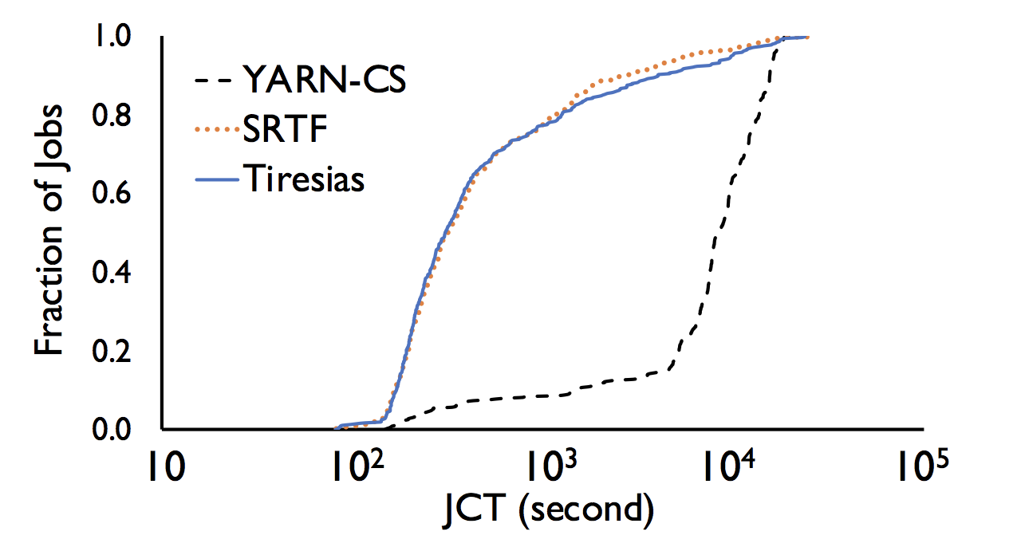
Evaluation
Individual JCTs

Slide 28
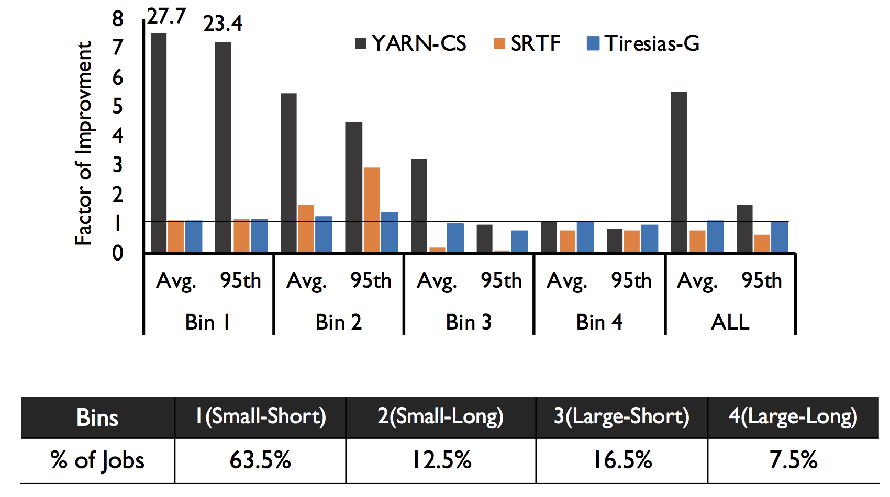
Evaluation
5.5

Slide 29
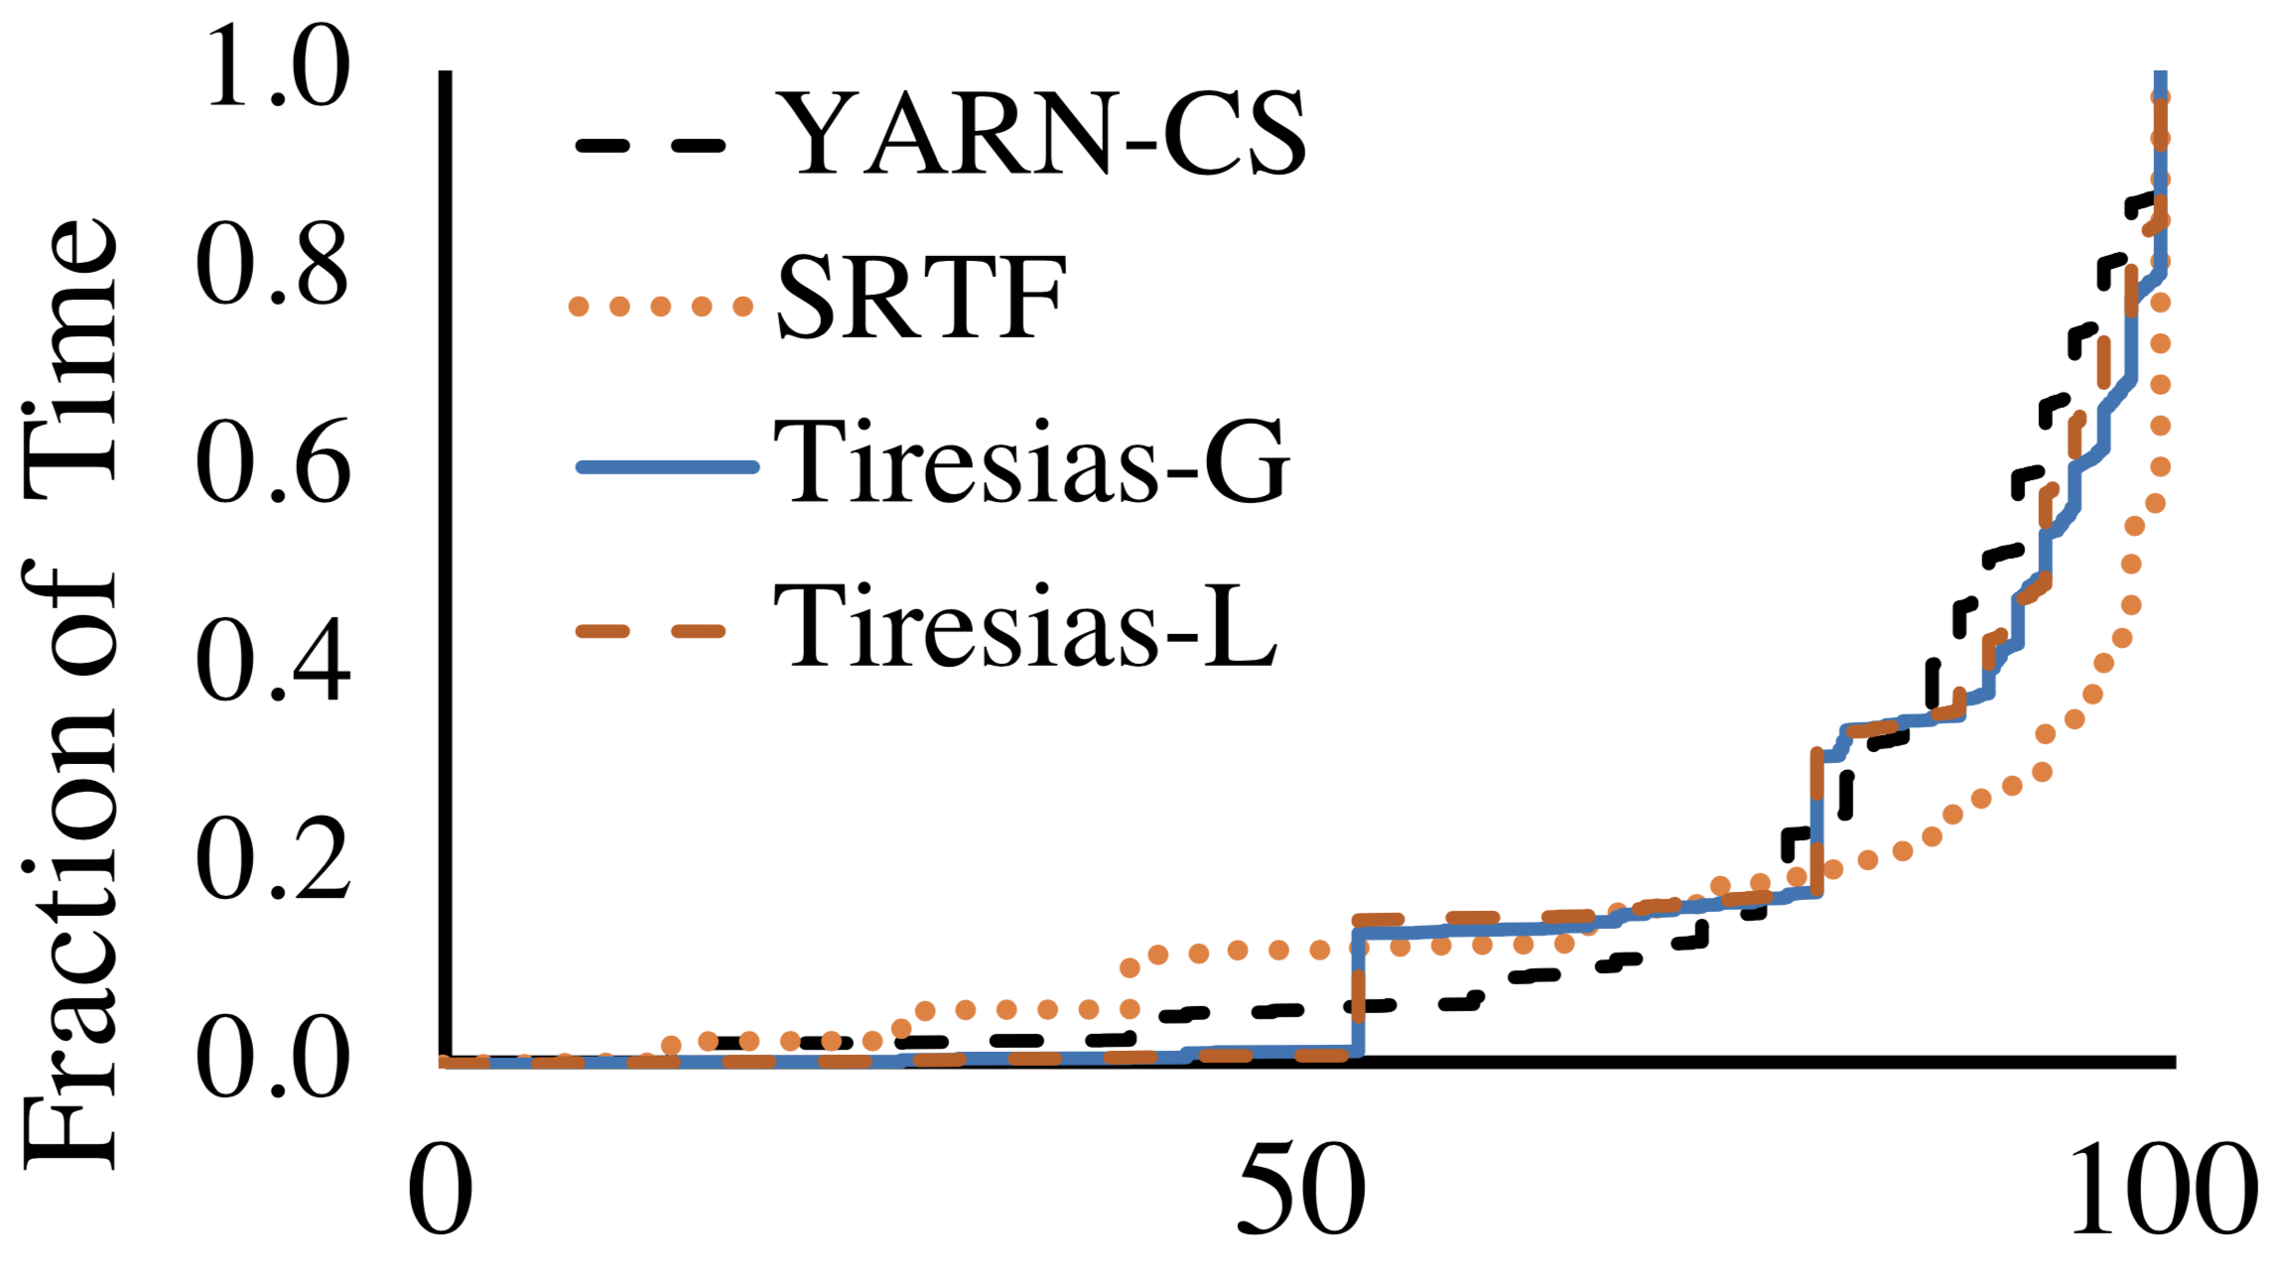
Evaluation
10s-averaged GPU utilization (%)

Slide 30
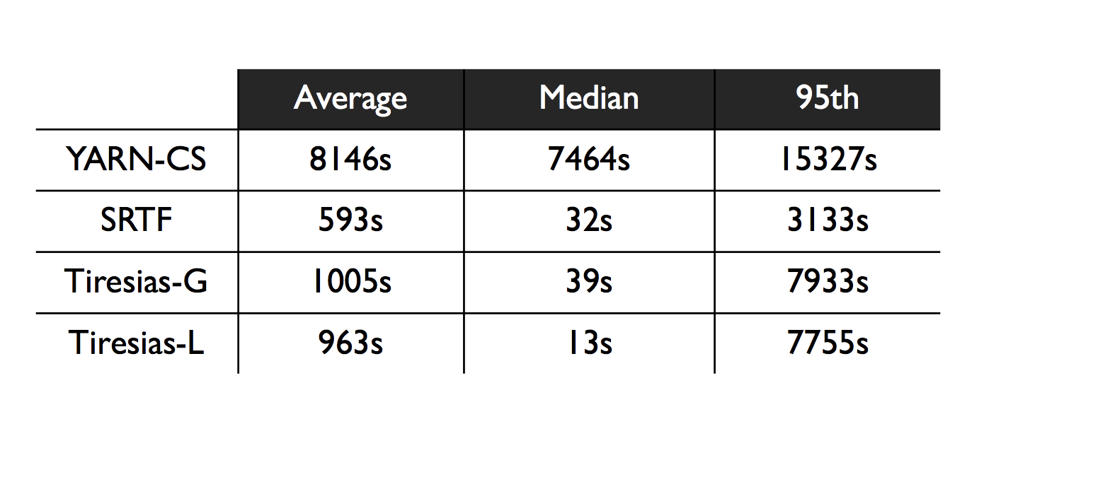
Evaluation
Queueing delay

Slide 31
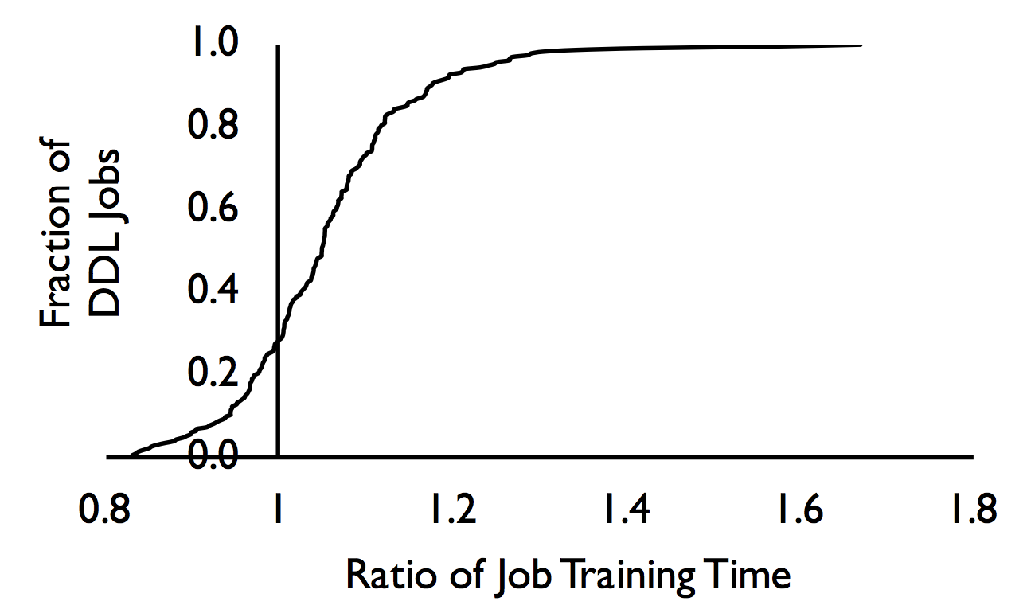
Evaluation
Job training time(different from JCT) with/without profiling
Ratio = JTT without profiling / JTT with profiling

Slide 32
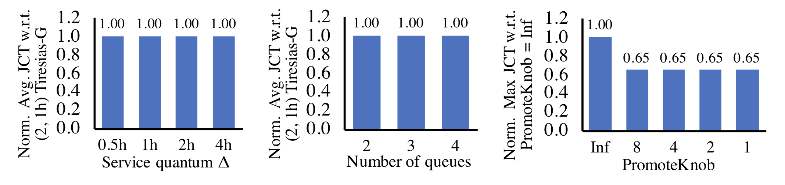
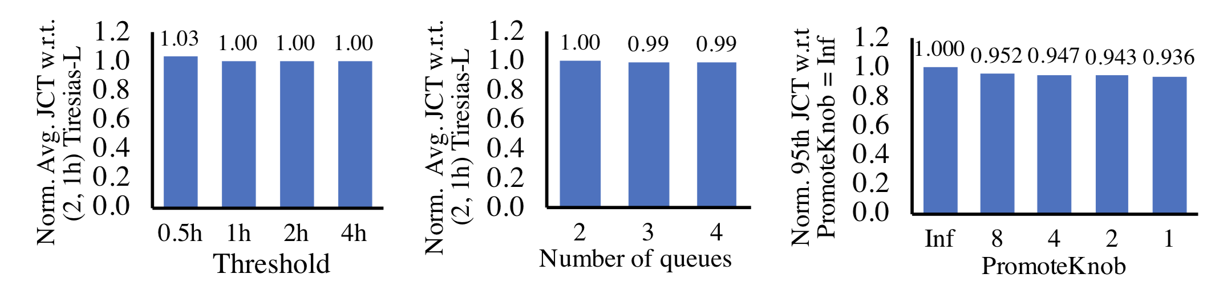
Evaluation
Impact of hyper-parameters

Slide 33
Future Work
Formal analysis considering applicability (cluster resources and job requiremets)
Lightweight preemption. Existing better preemption method needs framework modifications. And with lightweight preemption, many efficient network flow and CPU scheduling method can be applied to DDL jobs
Fine-grained job placement. Interferences within the server are not considered.

Slide 34
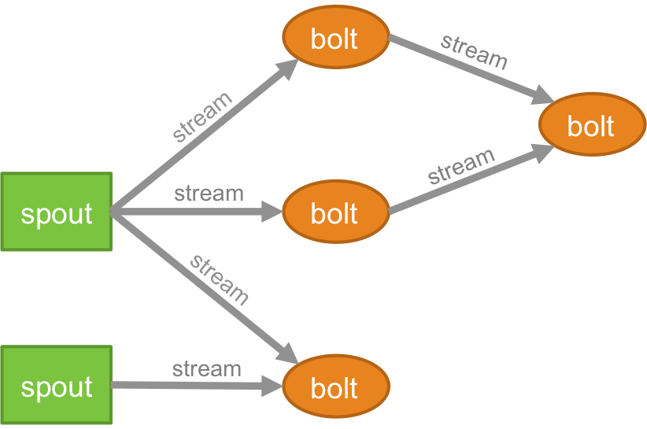
Some thoughts from this work
Distributed data streaming job scheduling (eg, Apache Storm)
Tuple latency (similar to JCT)
Execution time (similar to JTT)
For one tuple generating multiple tuple, also need to consider consolidation placement problems.

Slide 35
Q & A

