Slide 1
Neural Architecture Search
Weiyan Wang

Slide 2
NAS: Motivation
Popular CNN networks:
Alexnet, VGGNet, Inception, Resnet, Densenet …
Need experience and intuition to design good network for a specific task and condition
NAS: model the architecture as a learning problem
Learning to generate the child model for a task
The child model performance is the training signal for meta model
Example: image classification, language modeling

Slide 3
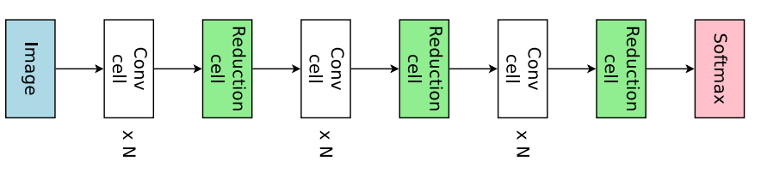
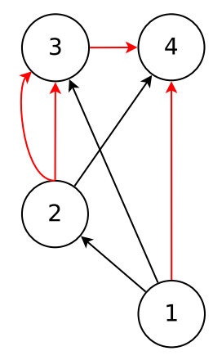
NAS: Search Space
Simplified Stacking Architecture:
Hierarchical architecture that a cell is stacked for multiple times
Cell: the DAG consists of the N nodes and edges
Node: has two branches edge, with each taking the output of one of the former nodes as the input
Edge: each edge applies one of 11 operations on the input

Slide 4
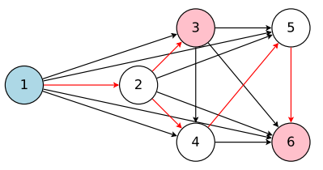


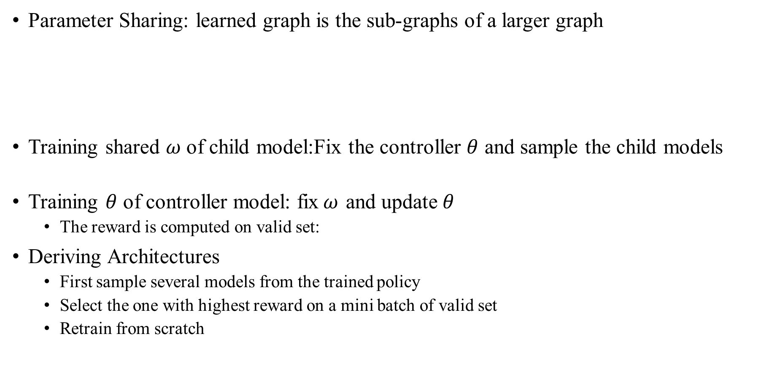
ENAS: RL + Parameter Sharing
Parameter Sharing: learned graph is the sub-graphs of a larger graph
Training shared $ω$ of child model:Fix the controller $θ$ and sample the child models
Training $θ$ of controller model: fix$ω$ and update$θ$
The reward is computed on valid set:
Deriving Architectures
First sample several models from the trained policy
Select the one with highest reward on a mini batch of valid set
Retrain from scratch

Slide 5
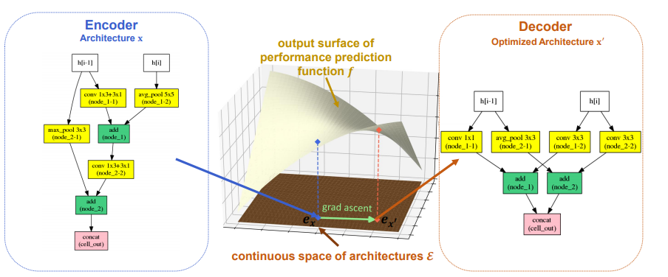
NAO: Neural Architecture Optimization
NAO: encoder+performance predictor+decoder

Slide 6
NAO
String Representation of Arch.
E.g “node-2 conv 3x3 node1 max-pooling 3x3 ” means the two branches of one node respectively takes the output of node −2 and node 1 as inputs
Encoder: 1 layer LSTM
takes the string sequence describing an architecture as input and map it into a continuous embedding
Predicter: accuracy on valid
Map the embedding to performance by a forward NN
Decoder: another LSTM
To generate a description from the continuous embedding space

Slide 7


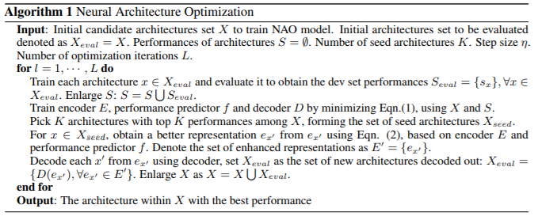
NAS: Training & Inference
Joint training loss
Inference to generate better arch.

Slide 8
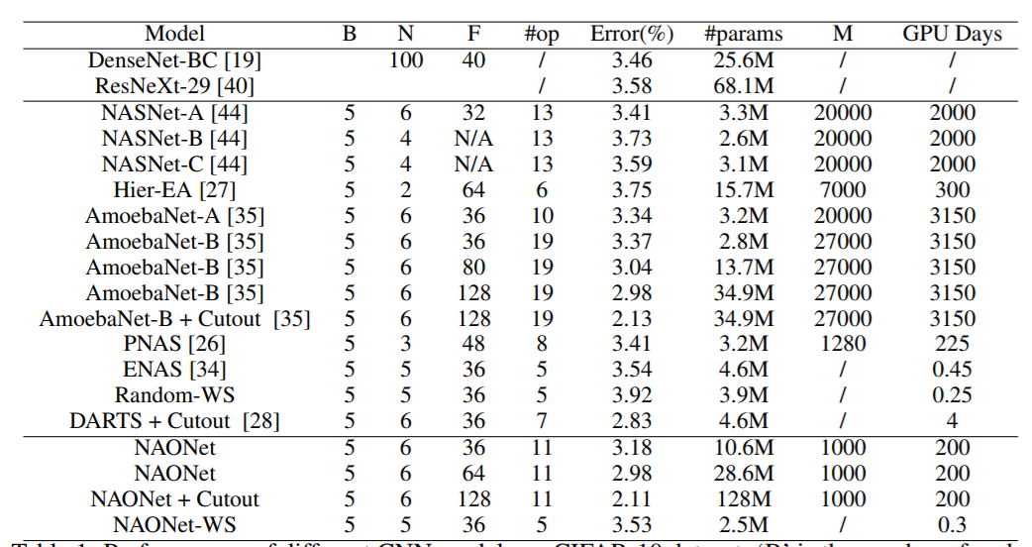
NAS: CIFAR10 Results

Slide 9
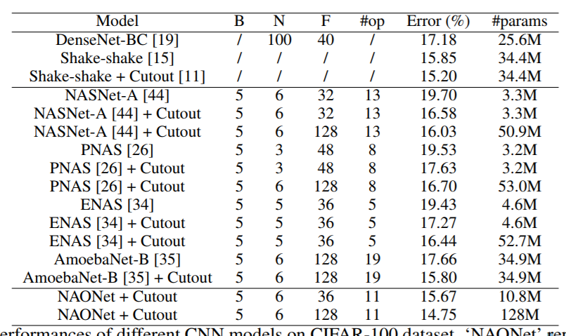
NAS:CIFAR100 Result
Directly use the best arch. In CIFAR10

Slide 10
Automatic Feature Generation
Please refer to the original website for the presentation record:https://www.leiphone.com/news/201707/IhGsmRXj8uXJq0ZS.html

