Slide 1
Multi-Organ CT Segmentation on SegTHOR
Mid-project presentation — esophagus, heart, trachea and aorta segmentation from thoracic CT
Team names · Group N
September 2026

Slide 2
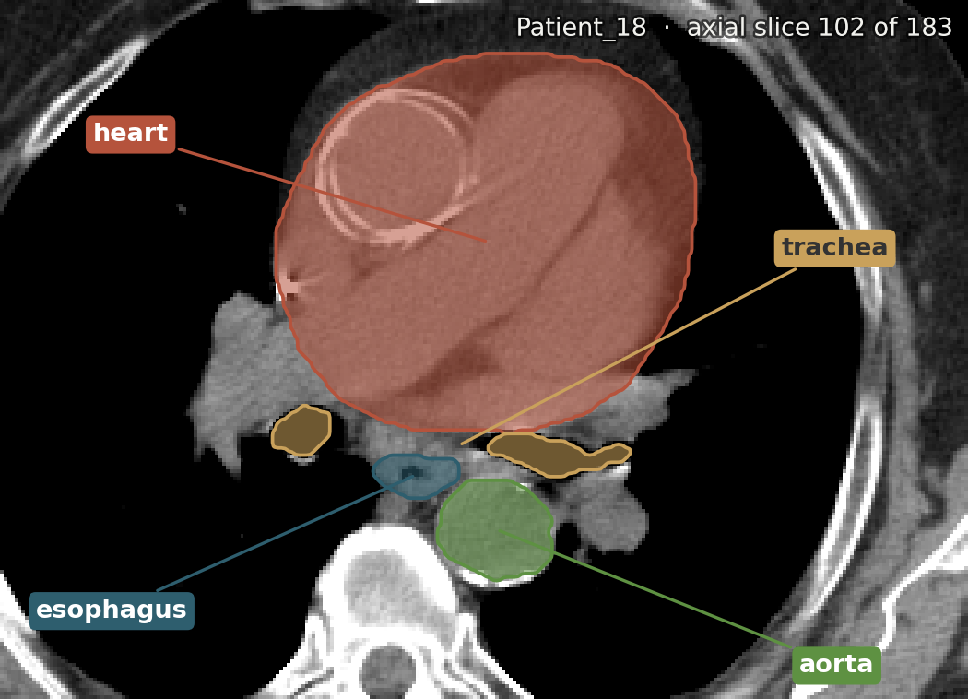
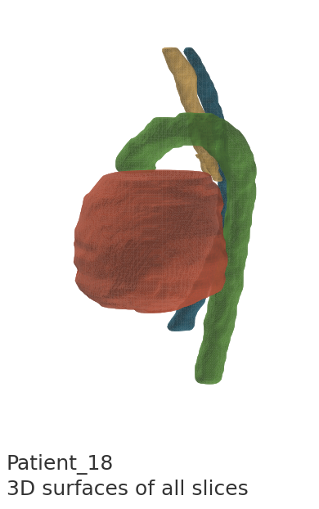
CLINICAL PROBLEM
0:40
Clinical Motivation: Organs at Risk in Thoracic CT
[TODO] why this matters clinically
  [TODO] the manual-contouring pain point, if using one
Task: 3D thoracic CT → esophagus, heart, trachea, aorta
TAKEAWAY
[TODO] one-sentence clinical takeaway
Patient_18: the four organs to segment, as an axial slice (102 of 183) and as 3D surfaces
01

Slide 3
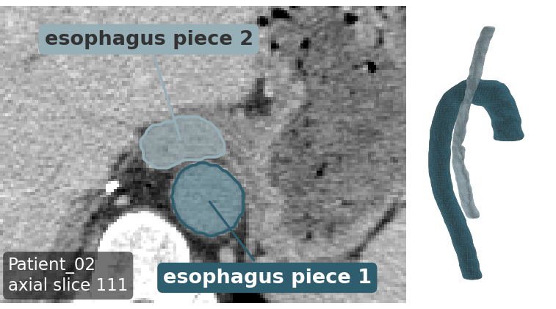
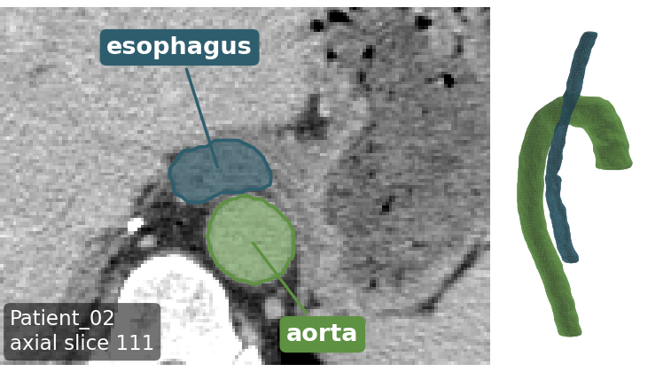
DATA INTEGRITY — STEP 0
0:35
Dataset Validation: Correcting the Aorta Label
WHAT IT SHOWS
BEFORE
AFTER
Patient_02: axial slice 111 and 3D view
Before: two pieces carry the esophagus label
After: one piece relabelled aorta
VALIDATION
[TODO] how the mislabeling was found and fixed
[TODO] real per-class voxel share, now corrected — as numbers, not a bar chart
[TODO] any other integrity checks run (e.g. alignment)
[TODO] fragmentation risk, if any
FINDING
Aorta (label 4) was mislabeled — 0 / 20 patients had it before the fix. Caught and corrected before any preprocessing or training ran on it.
02

Slide 4
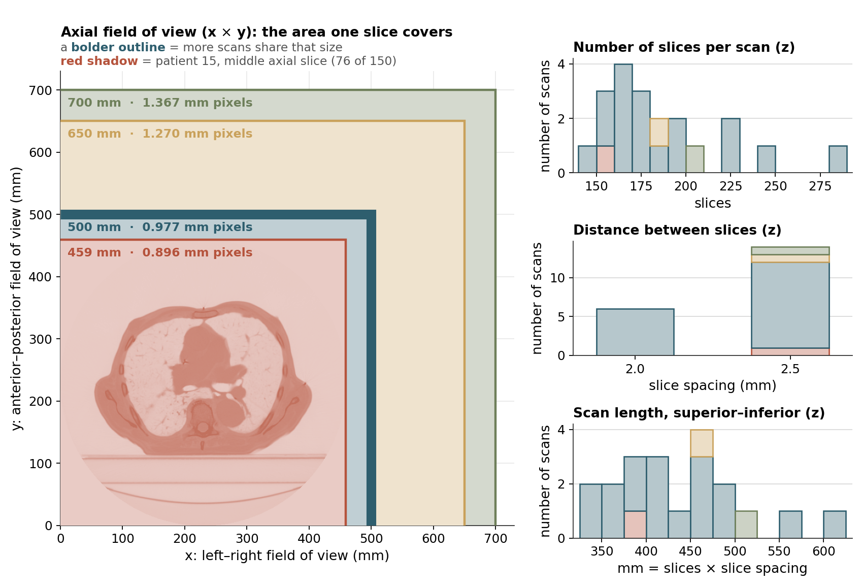
DATA EXPLORATION
0:35
Exploratory Analysis I: Scan Geometry for the 20 CT Scans
WHAT IT SHOWS
[TODO] voxel spacing across patients, slice count / scan length
[TODO]
[TODO]
HOW IT WAS MADE
[TODO] how it was measured
[TODO]
[TODO]
WHAT WE LEARN
[TODO] what this implies
03

Slide 5
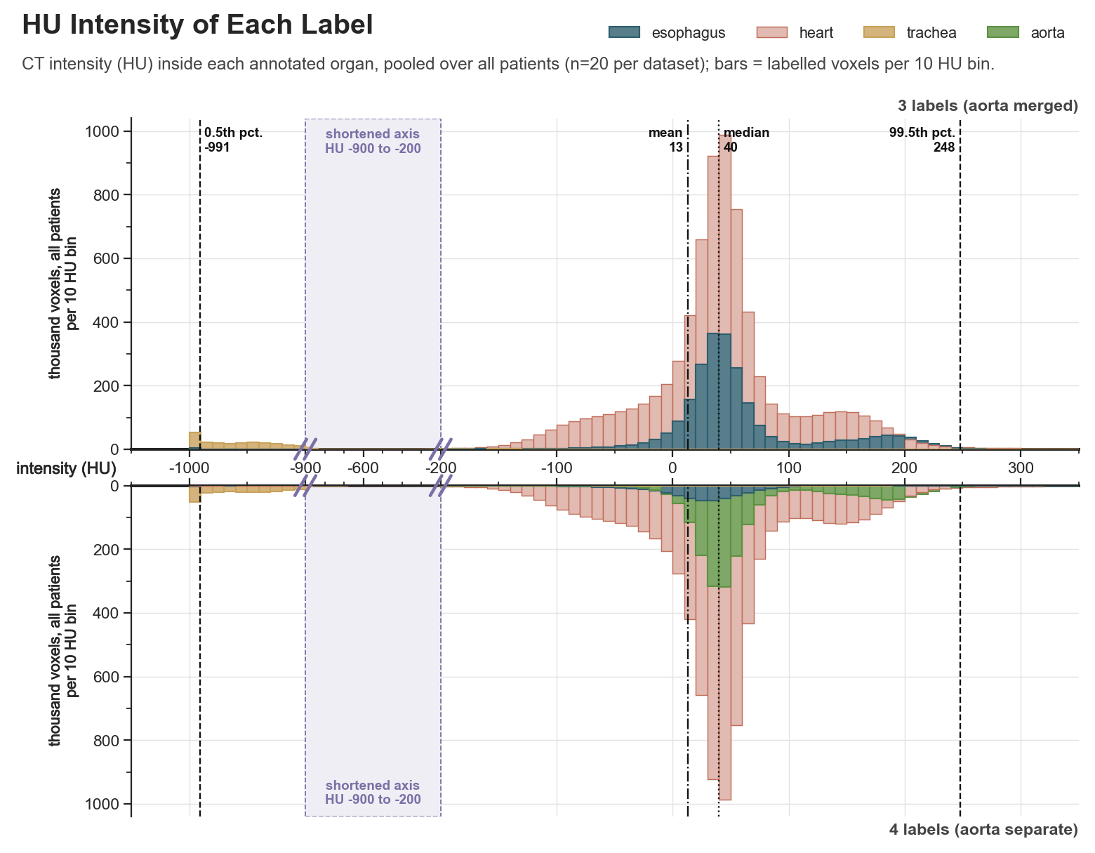
DATA EXPLORATION
0:35
Exploratory Analysis II: Organ HU Intensity, All Patients
WHAT IT SHOWS
HU inside each annotated organ, for all patients
Bars are labelled voxels per 10 HU bin
Top: original labels (aorta merged). Bottom: corrected labels (aorta separate)
AORTA VS. HEART
[TODO] aorta vs. heart in HU
[TODO]
[TODO]
WHAT WE LEARN
[TODO] what this implies
04

Slide 6
DATA EXPLORATION
0:50
Exploratory Analysis III: Spatial Layout & Label Adjacency
POSITION
EXTENT
ADJACENCY
[TODO] where each organ sits in 3D
[TODO]
[TODO]
[TODO] coverage along the body axis
[TODO]
[TODO]
[TODO] contact between label pairs
[TODO] which pairs matter most, now that aorta is real
[TODO]
WHY THIS MATTERS
[TODO] how position and extent inform the preprocessing decisions on the next slide.
05

Slide 7
PREPROCESSING PIPELINE
0:55
Preprocessing: From Measurement to Method
1
2
3
Step 1
Step 2
Step 3
[TODO], motivated by the geometry measurement (slide 3)
[TODO], motivated by the intensity measurement (slide 4)
[TODO], motivated by the position/extent measurement (slide 5)
06

Slide 8
BASELINE
0:35
Baseline Performance: Unmodified Pipeline (CE Loss, 25 Epochs)
Split: 15 train / 5 val — val = patients 01, 11, 15, 17, 19
  Scores below are means over these 5 held-out scans
POSITIVE-SLICE DICE (PATIENT MEANS)
Esophagus: 0.47
Heart: 0.58
Trachea: 0.50
07

Slide 9
MODIFICATION & RESULT — LARGEST RUBRIC WEIGHT
2:10
Proposed Modification: Motivation, Method & Preliminary Result
1
2
3
4
Motivation
Method
Result
Next steps
[TODO], tied back to an exploration finding (slides 3–5)
[TODO] the modification tried
[TODO] vs. baseline — from the run in progress
[TODO] one or two concrete next experiments
08

Slide 10
Status & Next Steps
Done: dataset validation, exploration, baseline, preprocessing pipeline
In progress: [TODO] first modified-loss / modified-preprocessing run
Next: [TODO] one or two concrete next experiments before the final deadline
Questions
09

Slide 11
APPENDIX A — BACKUP, NOT IN THE TIMED TALK
Appendix A: Label Shape Variability Across Patients
[TODO] what this figure shows, patient by patient
[TODO] where aorta fits into that pattern
  Backup only — pull in if a question opens the door
A1

