Slide 1

Ionic framework
Golnaz Mesbahi

Slide 2
Contents
What is Ionic?
1
Features,Advantages and Limitations
2
Hybrid vs Native Applications
3

Slide 3
Contents
What do you need to start with ionic?
4
How to start creating an app in ionic
5
Project folder structure
6

Slide 4
Contents
UI components
7
Ionic documentations
8
reference
9

Slide 5
What is ionic?
Ionic is open source framework used for developing mobile applications.
It provides tools and services for building Mobile UI with native look and feel.
Ionic framework needs native wrapper to be able to run on mobile devices.
Ionic is engineered to integrate seamlessly with all best frontend frameworks, including Angular, React, Vue, or even no framework at all with vanilla JavaScript.
Ionic is built on top of AngularJS and Apache Cordova, you will need to have basic knowledge about these technologies.

Slide 6
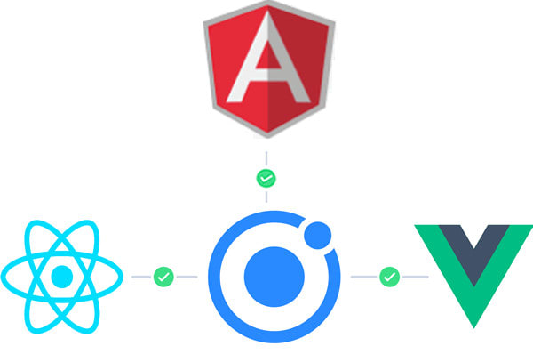

Slide 7
More about ionic
Ionic is a front-end HTML framework built on top of AngularJS and Cordova.
Ionic is an HTML5 Mobile App Development Framework targeted at building hybrid mobile apps.
Think of Ionic as the front-end UI framework that handles all the look and feel and UI interactions your app needs to be compelling.
Kind of like "Bootstrap for Native", but with the support for a broad range of common native mobile components, slick animations and a beautiful design.

Slide 8
Ionic framework features
AngularJS − Ionic is using AngularJS MVC architecture for building rich single page applications optimized for mobile devices
CSS components − With the native look and feel, these components offer almost all elements that a mobile application needs. The components’ default styling can be easily overridden to accommodate your own designs.
JavaScript components − These components are extending CSS components with JavaScript functionalities to cover all mobile elements that cannot be done only with HTML and CSS.
Cordova Plugins − Apache Cordova plugins offer API needed for using native device functions with JavaScript code.
Ionic CLI − This is NodeJS utility powered with commands for starting, building, running and emulating Ionic applications.
Ionic View − Very useful platform for uploading, sharing and testing your application on native devices.
Notes:
AngularJS − Ionic is using AngularJS MVC architecture for building rich single page applications optimized for mobile devices.
CSS components − With the native look and feel, these components offer almost all elements that a mobile application needs. The components’ default styling can be easily overridden to accommodate your own designs.
JavaScript components − These components are extending CSS components with JavaScript functionalities to cover all mobile elements that cannot be done only with HTML and CSS.
Cordova Plugins − Apache Cordova plugins offer API needed for using native device functions with JavaScript code.
Ionic CLI − This is NodeJS utility powered with commands for starting, building, running and emulating Ionic applications.
Ionic View − Very useful platform for uploading, sharing and testing your application on native devices.
Licence − Ionic is released under MIT license.

Slide 9
Ionic framework advantages
Ionic is used for Hybrid App Development. This means that you can package your applications for IOS, Android, Windows Phone and Firefox OS, which can save you a lot of working time.
Starting your app is very easy since Ionic provides useful pre-generated app setup with simple layouts.
The apps are built in a very clean and modular way, so it is very maintainable and easy to update.
Ionic Developers Team have a very good relationship with the Google Developers Team and they are working together to improve the framework. The updates are coming out regularly and Ionic support group is always willing to help when needed.

Slide 10
Ionic framework limitations
Testing can be tricky since the browser does not always give you the right information about the phone environment. There are so many different devices as well as platforms and you usually need to cover most of them.
It can be hard to combine different native functionalities. There will be many instances where you would run into plugin compatibility issues, which leads to build errors that are hard to debug.
Hybrid apps tend to be slower than the native ones. However, since the mobile technologies are improving fast this will not be an issue in the future.

Slide 11
Hybrid vs native applications
A native app is a smartphone application developed specifically for a mobile operating system
Hybrid applications are, at core, websites packaged into a native wrapper.
They look and feel like a native app, but ultimately outside of the basic frame of the application (typically restricted to the controls/navigational elements) they are fueled by a company’s website.
Basically, a hybrid app is a web app built using HTML5 and JavaScript, wrapped in a native container which loads most of the information on the page as the user navigates through the application (Native apps instead download most of the content when the user first installs the app).

Slide 12
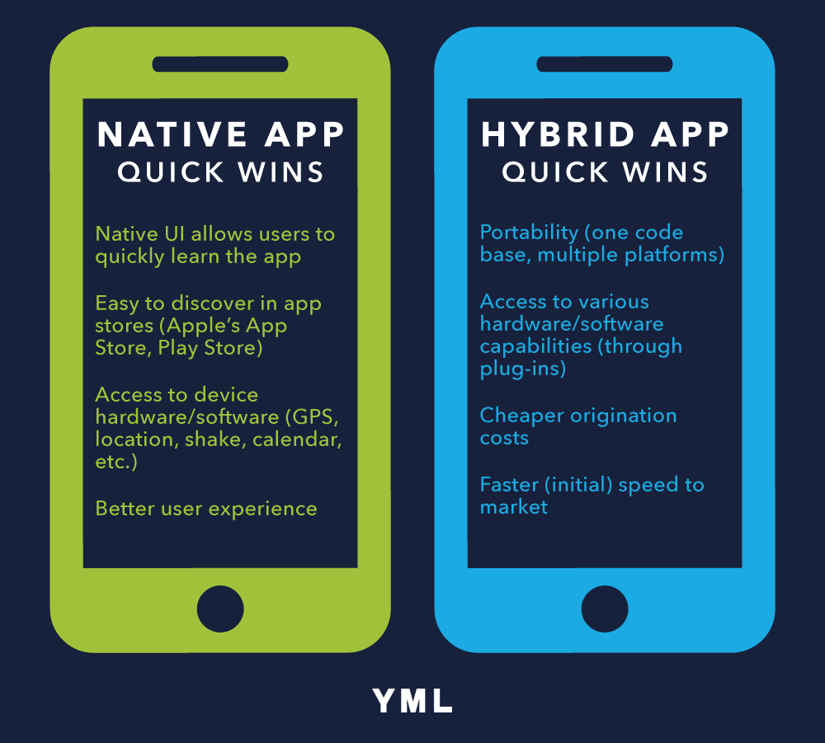

Slide 13



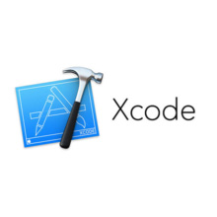
What do you need to start with ionic?
Nodejs
Android sdk
Xcode(if on mac)
Cordova and ionic
How to install ionic?
Open cmd
Npm install -g cordova(@version)
Npm install –g ionic(@version)
Notes:
Cordova : betoonim aaz android sdk estefade konim va plugin hayee ke be ma komak mikonan camera o ina ..
ionic(global you can access it from anywhere)

Slide 14
How to start creating an app in ionic?
You have 3 options:
Tabs App
Blank App
Side menu app
The commands that you should run in the command line:
cd desktop
ionic start myApp (tabs/blank/sidemenu)
cd myApp
ionic platform add android
ionic build android
ionic run android
Or you can run your application on a web browser:
Ionic serve(to open on web browser)
Notes:
Let us now add the Cordova project for the Android Platform and install the basic Cordova plugins as well. The following code allows us to run the app on the Android emulator or a device.
The next step is to build the app. If you have building errors after running the following command, you probably did not install the Android SDK and its dependencies.
The last step of the installation process is to run your app, which will start the mobile device, if connected, or the default emulator, if there is no device connected. Android Default Emulator is slow, so I suggest you to install Genymotion or some other popular Android Emulator.
Miposrs angular bashe ya react

Slide 15
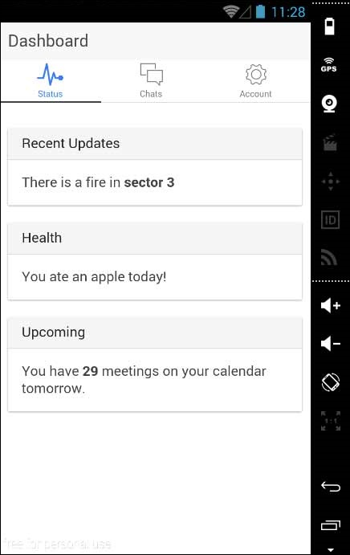
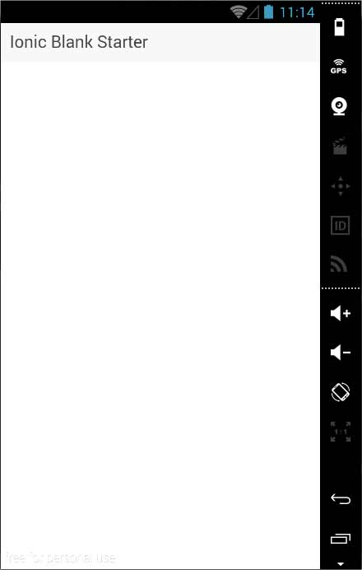
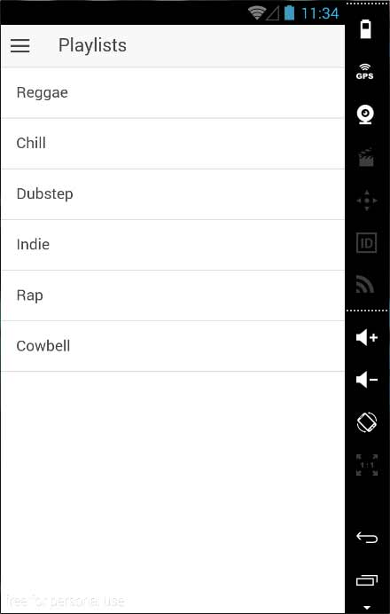
Tab/blank/side menu tab

Slide 16
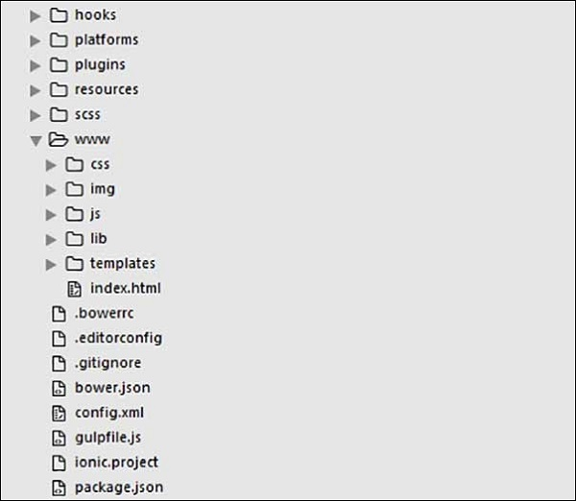
Project folder structure
Notes:
tozihh

Slide 17
Project structure
Hooks − Hooks are scripts that can be triggered during the build process. They are usually used for the Cordova commands customization and for building automated processes.
Platforms − This is the folder where Android and IOS projects are created. You might encounter some platform specific problems during development that will require these files, but you should leave them intact most of the time.
Plugins − This folder contains Cordova plugins. When you initially create an Ionic app, some of the plugins will be installed
Resources − This folder is used for adding resources like icon and splash screen to your project.
Scss − Since Ionic core is built with Sass, this is the folder where your Sass file is located.

Slide 18
Project structure
www − www is the main working folder for Ionic developers. They spend most of their time here. Ionic gives us their default folder structure inside 'www', but the developers can always change it to accommodate their own needs. When this folder is opened, you will find the following sub-folders −
The css folder, where you will write your CSS styling.
The img folder for storing images.
The js folder that contains the apps main configuration file (app.js) and AngularJS components (controllers, services, directives). All your JavaScript code will be inside these folders.
The libs folder, where your libraries will be placed.
The templates folder for your HTML files.
Index.html as a starting point to your app.

Slide 19
Project structure
.bowerrc is the bower configuration file.
.editorconfig is the editor configuration file.
.gitignore is used to instruct which part of the app should be ignored when you want to push your app to the Git repository.
bower.json will contain the bower components and dependencies, if you choose to use the bower package manager.
gulpfile.js is used for creating automated tasks using the gulp task manager
config.xml is the Cordova configuration file.
package.json contains the information about the apps, their dependencies and plugins that are installed using the NPM package manager.

Slide 20
UI components
Ionic apps are made of high-level building blocks called Components, which allow you to quickly construct the UI for your app. Ionic comes stock with a number of components, including cards, lists, and tabs.

Slide 21
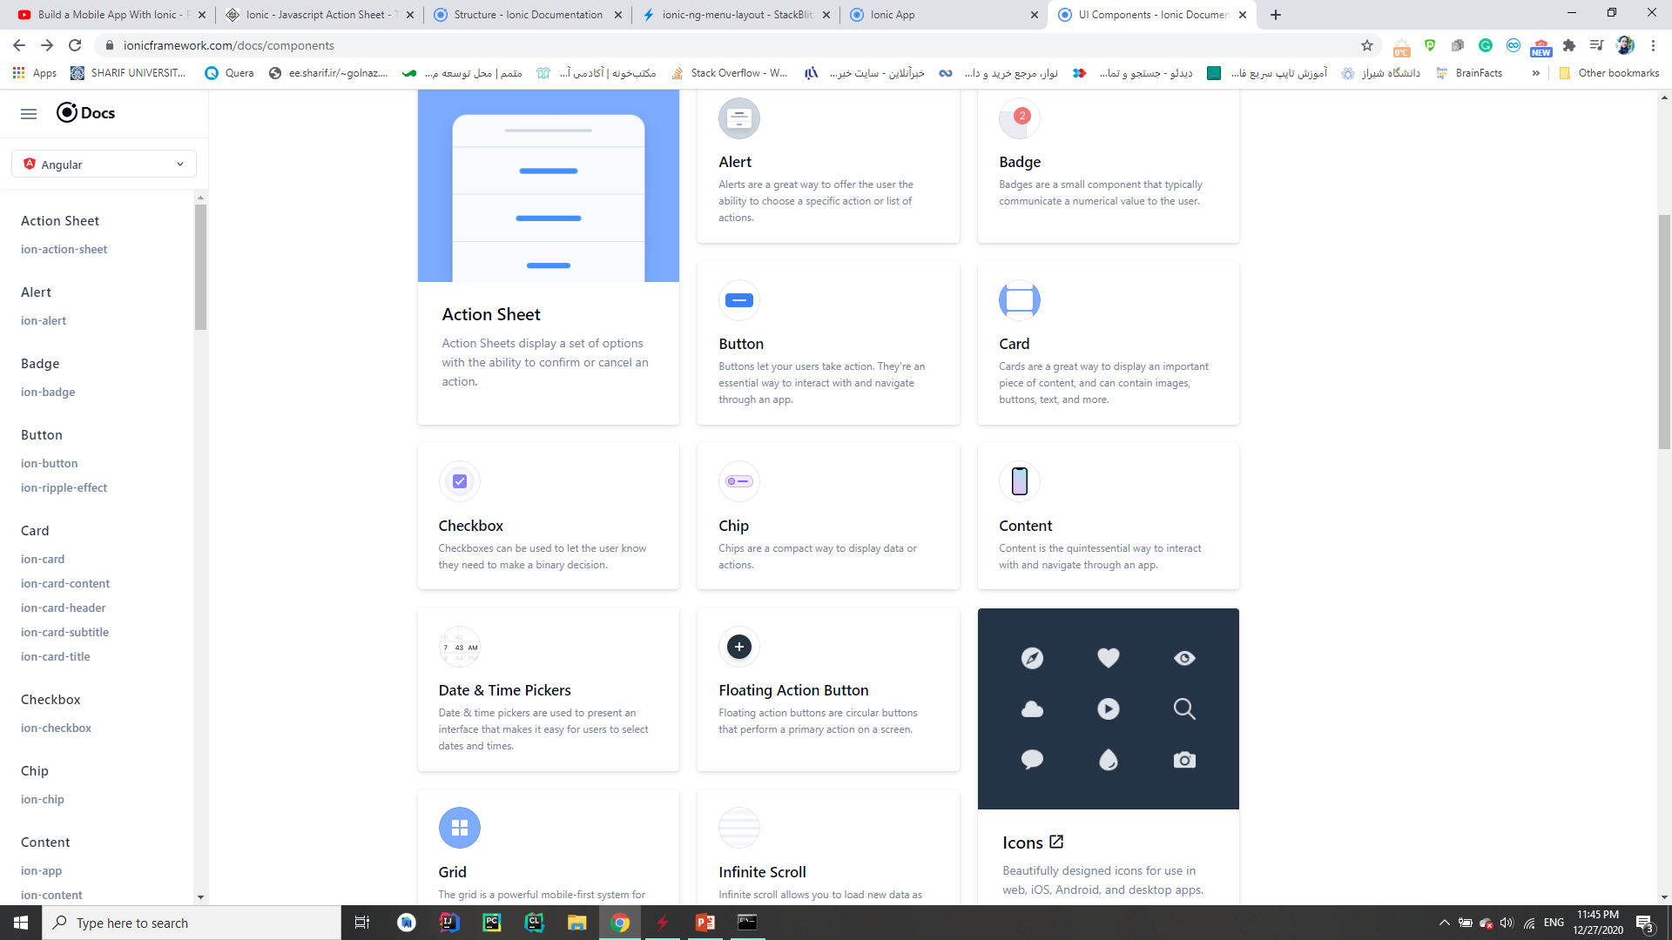

Slide 22
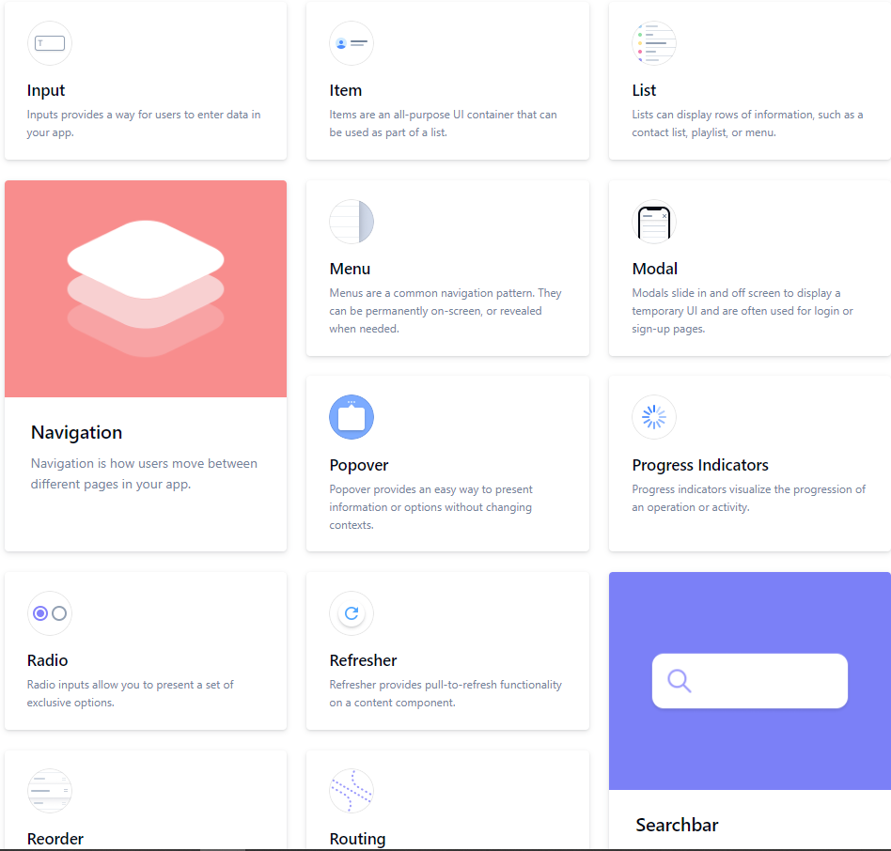

Slide 23
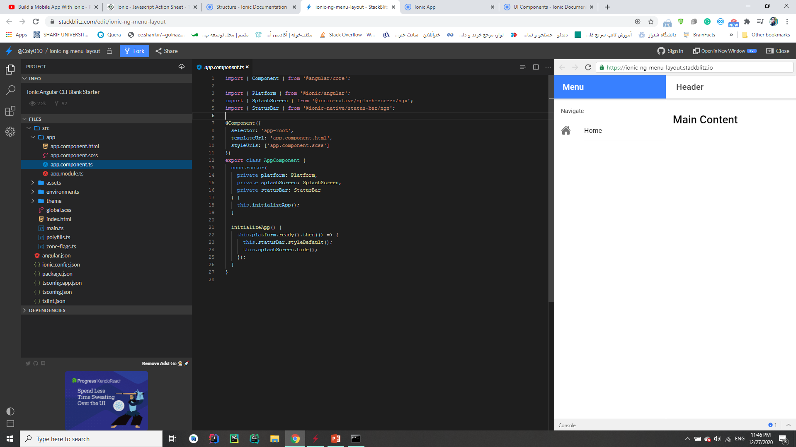
Ionic documentations

Slide 24
reference
Tutorialspoint
Ionicframework.com
Youtube videos
https://www.youtube.com/watch?v=gHPL_2IsZlI&pbjreload=101

