Slide 1
Strings
- By
Hemlata Kohin

Slide 2
Today’s Objectives
• To better understand the string data type
–Learn how they are represented
–Learn about and use some of their built-in methods
–Learn about and use some of their built-in methods
• Concatenation
• Escape sequences
• lower() and upper()
• strip() and whitespace
• split() and join()

Slide 3
Strings

Slide 4
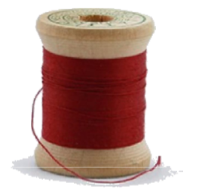
The String Data Type
• Text is represented in programs by the string data type
• A string is a sequence of characters enclosed within double quotes (") or single quotes (‘)
–Sometimes called quotation marks or apostrophes

Slide 5
Getting Strings as Input
• Using input() automatically gets a string
>>> firstName = input("Please enter your name: ")
Please enter your name: Kanye
>>> print(firstName, firstName)
Kanye Kanye

Slide 6
Accessing Individual Characters
• We can access the individual characters in a string through indexing
–Characters are the letters, numbers, spaces, and symbols that make
up a string
• The characters in a string are numbered starting from the left,
beginning with 0
–Just like in lists!

Slide 7
Syntax of Accessing Characters
• The general form is
strName[expression]
• Where strName is the name of the string variable and
expression determines which character is selected from the string

Slide 8
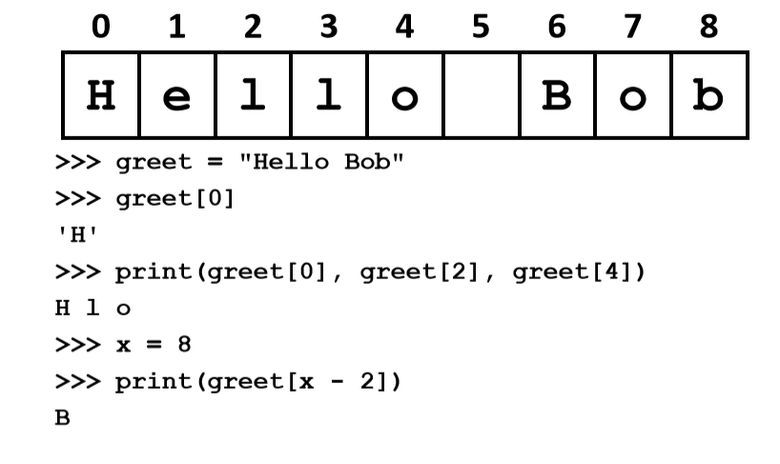
Example String

Slide 9
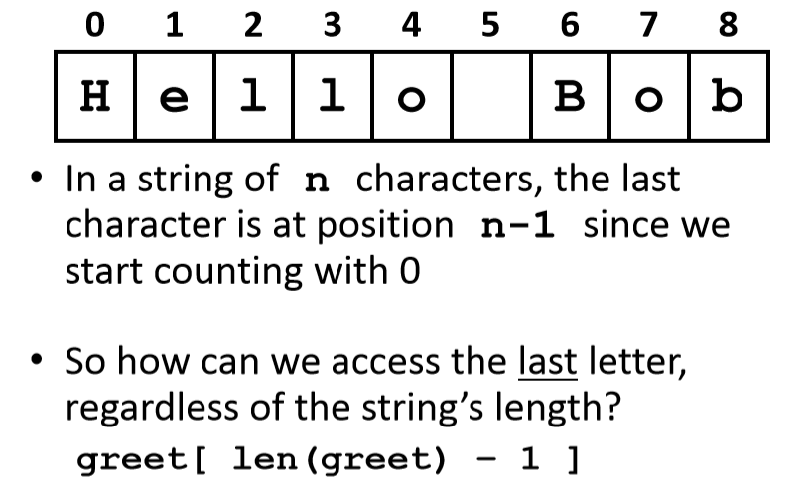
Example String

Slide 10
Changing String Case
• Python has many, many ways to interact with strings, and we will cover them in detail soon
• For now, here are two very useful methods:
s.lower() –copy of s in all lowercase letters
s.upper() –copy of s in all uppercase letters
• Why would we need to use these?
–Remember, Python is case-sensitive!

Slide 11
Concatenation

Slide 12
Forming New Strings -Concatenation
• We can put two or more strings together to form a longer string
• Concatenation “glues” two strings together
>>> "Peanut Butter" + "Jelly"
'Peanut ButterJelly’
>>> "Peanut Butter" + " & " + "Jelly"
'Peanut Butter & Jelly'

Slide 13
Rules of Concatenation
• Concatenation does not automatically include spaces between the strings >>> "Smash" + "together”
>>> "Smash" + "together"
'Smashtogether’
• Concatenation can only be done with strings!
–So how would we concatenate an integer?
>>> "CMSC " + str(201)
'CMSC 201'

Slide 14
Common Use for Concatenation
• input() only accepts a single string
–Can’t use commas like we do with print()
• In order to create a single string for input(),
you must use concatenation
classNum = 201
grade = input("Grade in " + str(classNum) + "? ")

Slide 15
Special Characters
• Just like Python has special keywords…
–and, while, True, etc.
• It also has special characters
–Single quote ('), double quote ("), etc.
• How can we print out a " as part of a string?
print("And I shouted "hey!" at him.")
–What’s going to happen here?
– SyntaxError: EOL while scanning string literal

Slide 16
Backslash: Escape Sequences
• The backslash character (\) is used to “escape” a special character in Python
–Tells Python not to treat it as special
• The backslash character goes in front of the character we want to “escape”
>>> print("And I shouted \"hey!\"")
And I shouted "hey!"

Slide 17
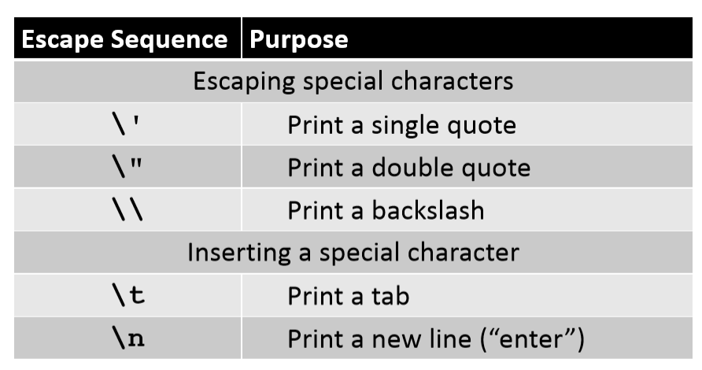
Common Escape Sequences

Slide 18
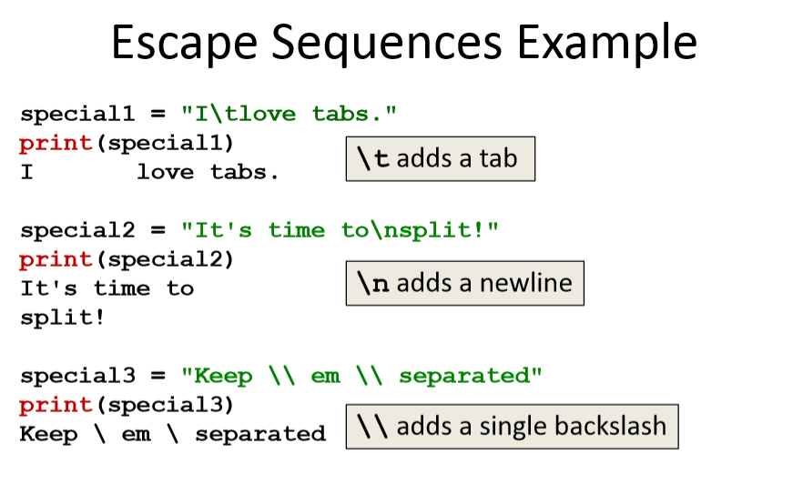

Slide 19
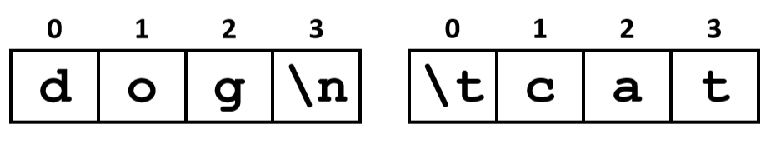
How Python Handles Escape Sequences
• Escape sequences look like two characters to us
• Python treats them as a single character
example1 = "dog\n"
example2 = "\tcat“

Slide 20
String Splitting

Slide 21
String Splitting
• We can also break a string into pieces
–Stored as a list of strings
• The method is called split(), and it has two ways it can be used:
–Break the string up by its whitespace
–Break the string up by a specific character

Slide 22
Splitting by Whitespace
• Calling split() with nothing inside the parentheses will split on all
whitespace
–Even the “interior” whitespace
>>> line = "hello world \n"
>>> line.split()
['hello', 'world’]
>>> love = "\t\nI love\t\t\nwhitespace\n “
>>> love.split()
['I', 'love', 'whitespace']

Slide 23
Splitting by Specific Character
• Calling split()with a string in it, we can remove a specific character
(or more than one)
>>> under = "once_twice_thrice”
>>> under.split("_")
['once', 'twice', 'thrice’]
>>> double = "hello how ill are all of your llamas?"
>>> double.split("ll")
['he', 'o how i', ' are a', ' of your ', 'amas?']
These character(s) that we want to remove are called the delimiter
A delimiter is one or more characters that separate text strings. Common delimiters are commas (,), semicolon (;), quotes ( ", ' ), braces ({}), pipes (|), or slashes ( / \ ).

Slide 24
Practice: Splitting
• Use split()to solve the following problems
• Split this string on its whitespace:
daft = "around \t the \nworld”
• Split this string on the double t’s (tt):
adorable = "nutty otters making lattes"

Slide 25
Practice: Splitting
• Split this string on its whitespace:
daft = "around \t the \nworld”
daft.split()
• Split this string on the double t’s (tt):
adorable = "nutty otters making lattes“
adorable.split("tt")

Slide 26
Looping over Split Strings
• Splitting a string creates a listof smaller strings
• Using a while loop and this list, we can iterate over each individual word (or token)
words = sentence.split()
index = 0
while index < len(words):
print(words[index])
index += 1

Slide 27
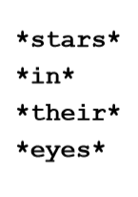
Example: Looping over Split Strings
lyrics = "stars in their eyes"
lyricWords = lyrics.split()
index = 0
while index < len(lyricWords):
print("*" + lyricWords[index] + "*")
index += 1
What does this line of code do?
append a “*” to the front and end of each list element, then print

Slide 28
String Joining

Slide 29
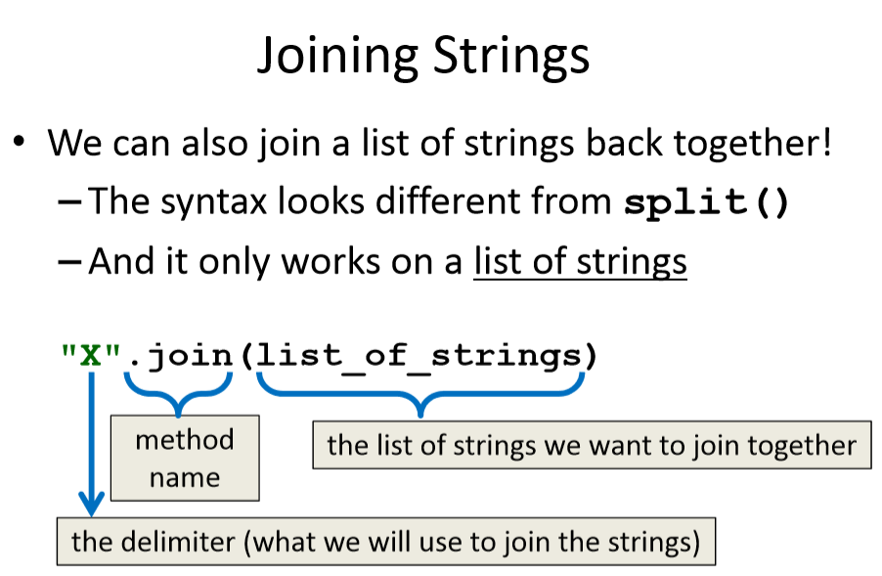

Slide 30
Example: Joining Strings
>>> names = ['Alice', 'Bob', 'Carl', 'Dana', 'Eve’]
>>> "_".join(names)
'Alice_Bob_Carl_Dana_Eve’
• We can also use more than one character as our delimiter if we want
>>> " <3 ".join(names)
'Alice <3 Bob <3 Carl <3 Dana <3 Eve'

Slide 31
split() vs join()
• The split() method
–Takes in a single string
–Creates a list of strings
–Splits on given character(s), or on all whitespace
• The join() method
–Takes in a list of strings
–Returns a single string
–Joins together with a user-chosen delimiter

Slide 32
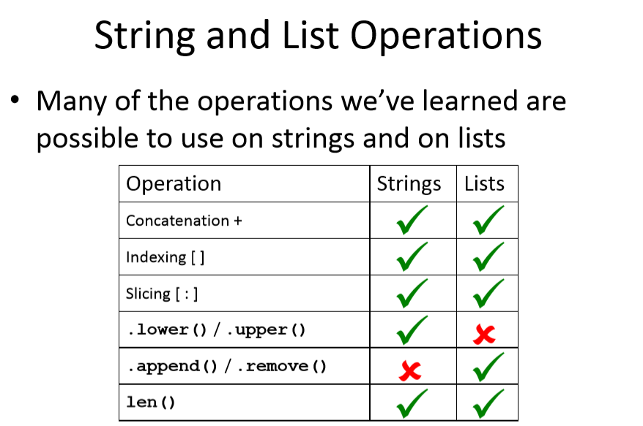
Note: You may Ignore slicing

Slide 33
Some More Useful Methods
Let us consider that we have a string called ‘phrase’
Phrase = “I am learning Python”
The words in Bold are methods
Phrase.upper() – This will convert the string to upper case
Syntax – phrase2= phrase.upper()
print (phase2)
Phrase.lower()- This will convert the string into lower case (If it is already in lower case, there would not be any changes made)
Syntax – phrase2= phrase.lower()
print (phrase2)

Slide 34
Some More Useful Methods
Phrase.isupper()- Checks if the string is in upper case or not
phrase = 'I love python’
phrase2=phrase.isupper()
print (phrase2)
Phrase.islower()- Checks if the string is in lowercase or not
phrase = 'I love python’
phrase2=phrase.islower()
print (phrase2)

Slide 35
Combination of two methods Example
Phrase.upper().isupper()
- Combination of two functions will First convert to upper then check if it is upper case or not)
phrase = 'i love python’
phrase2=phrase.upper().isupper()
print(phrase2)
This will always give a ‘True’ output. Why?

Slide 36
Methods Exercise
Phrase = “Upward Bound”
Print( len(phrase))
Print (phrase[0]) – This is print out the first letter in the string
Print (phrase.index(“U”)) – Print out the index number of that letter. Here it will print a 0
Print (phrase.index(“ bound”))- Print the index of bound which is 7
Print (phrase.replace (“Upward”, “Downward”))

Slide 37
Any Questions?

