Slide 1
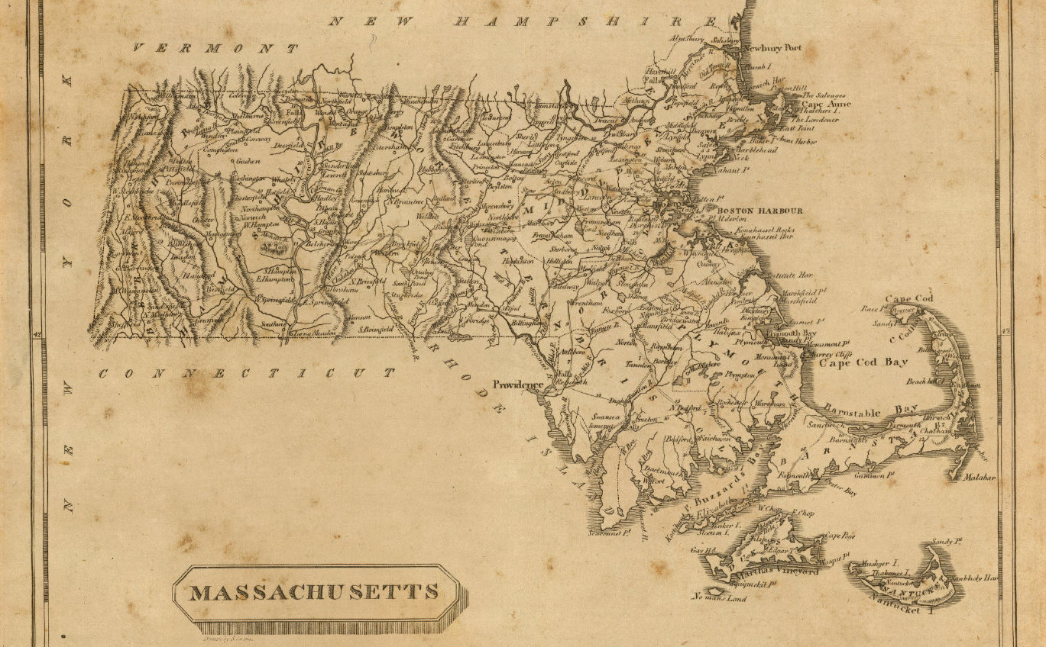
On Python and Positioning
An Introduction to Working with Geospatial Data in Python with GeoPandas
December 2020

Slide 2

This Evening’s Quest
Dataset Overview
Python Packages
Python Code Examples
Geospatial Ecosystem & Theory
Geospatial Enlightenment!
Sources: - Cover map: Massachusetts. Drawn by S. Lewis. (Boston: Published by Thomas & Andrews. 1812); David Rumsey Historical Map Collection - All clipart, except where noted, is from Clipart-library.com, licensed for personal use

Slide 3
Dataset Overview
There’s a 50 mile stretch of coastline along Cape Cod that has claimed over 3,000 vessels and is not-so-affectionately known as the “Ocean’s Graveyard”
Shipwrecks of MA
Wikipedia’s “Shipwrecks of Massachusetts” page
https://en.wikipedia.org/wiki/List_of_shipwrecks_of_Massachusetts
Data format: KML file converted into a shapefile
Dive Sites
DiveSites.com API for sites within 75 nautical miles of Boston, MA
http://api.divesites.com/docs/
Data format: JSON

Slide 4
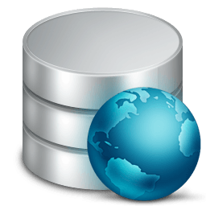

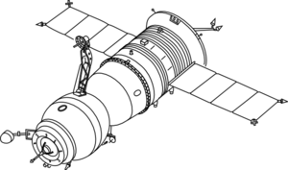

The Geospatial Ecosystem: Geographic Information Systems (GIS)
A GIS is a computer-based system to aid in the collection, maintenance, storage, analysis, output, and distribution of spatial data and information – this can include hardware, software, data, people, and industry protocols¹
Data Storage
Data Collection
GIS Software
Desktop Apps: QGIS, ArcGIS, others
OSGeo Projects: GDAL/OGR, GEOS
Python, R packages
Industry Protocols
Open Geospatial Consortium (OGC)
Note: 1. Bolstad, Paul. GIS Fundamentals: a First Text on Geographic Information Systems. 6th ed., XanEdu, 2019.

Slide 5
Geospatial Data Models
Description
File Format Examples
Vector
Discrete geometries
Points, lines, polygons
Shapefile (.shp/.dbf/.shx/.prj)
GeoJSON (.json), KML (.kml)
Geopackage (.gpkg)
Raster
Continuous, “gridded” data
Elevation, satellite images, ground cover
GeoTIFF (.TIF or .TIFF)
Image (.img)
Geopackage (.gpkg)
Data Attributes
Any attribute tied to a location
Example: Census data by county
CSV (.csv)

Slide 6
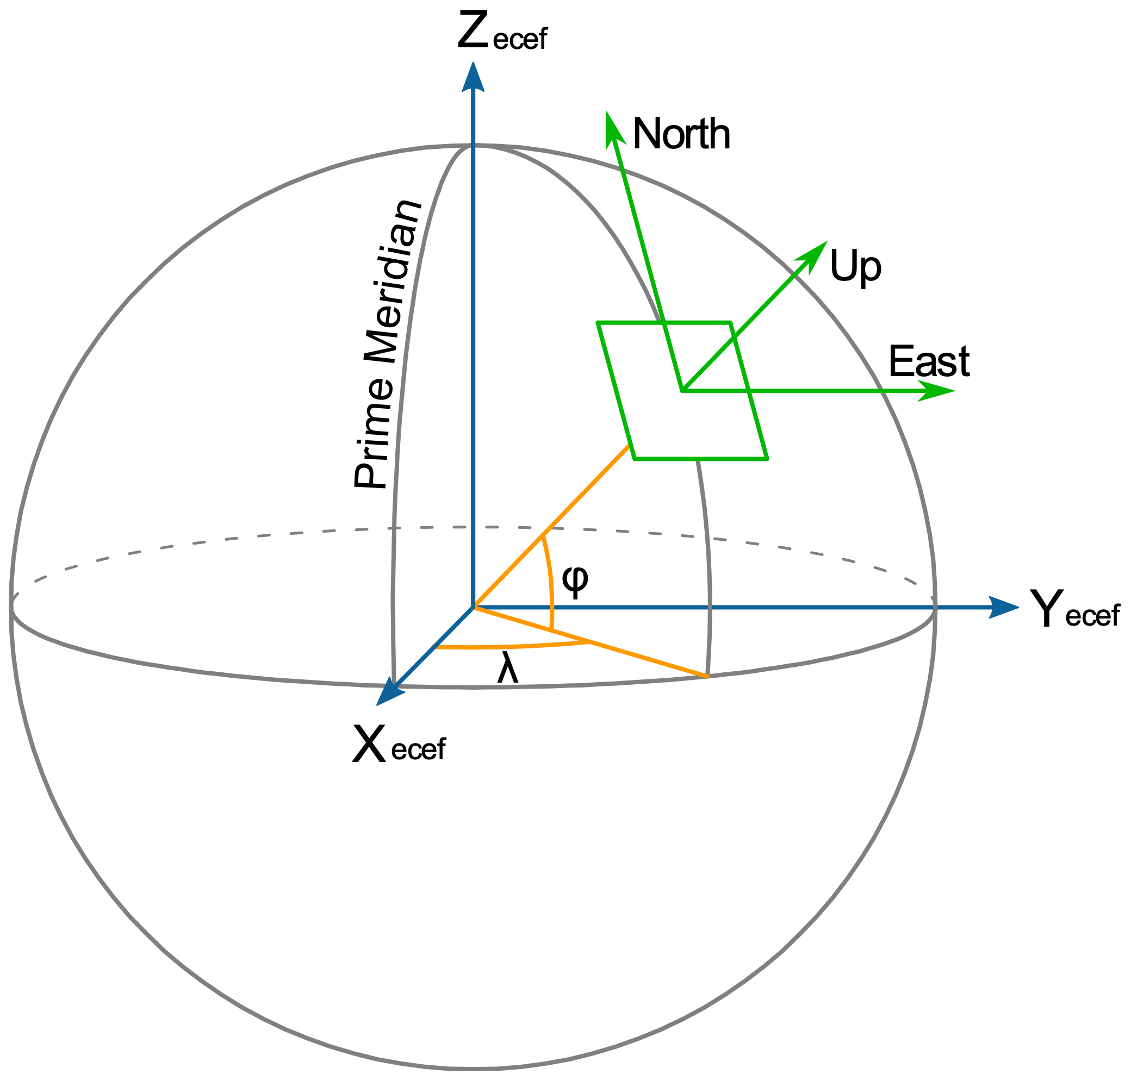

Coordinate Reference Systems
Coordinate Reference Systems (CRS) tie 3D coordinates to real world entities
Based on a Datum (geographic measurements of Earth and assumptions)
Golden rule: know thy data! Know the coordinate system used for your data and convert datasets into the same CRS before combining
The CRS is like the “unit” of geospatial data
Examples of coordinate reference systems:
WGS84: US-centric, used for GeoJSON and most web data
Others: NAD83, ITRF
Source: - Longitude and Latitude (left): By Mike1024 - Based on en:File:EarthTangentialPlane.png by en:User:Raffyl99 (public domain), Public Domain, https://commons.wikimedia.org/w/index.php?curid=9510652

Slide 7
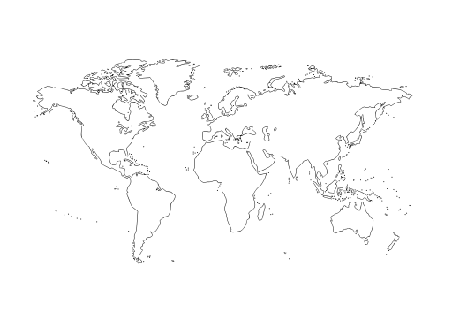
Projections: Translating 3D into 2D
A projection translates 3D coordinates into a 2D representation
As one might expect, all projections add an element of distortion
Different projections preserve/distort different aspects of the geographic features
Source: - Projected map: molumen on the Open Clip Art Library, CC0, via Wikimedia Commons

Slide 8




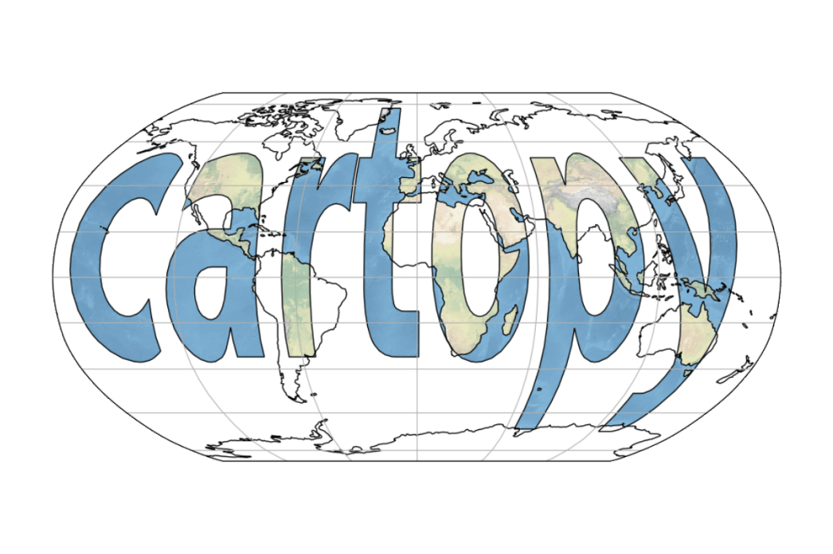

Python Geospatial Packages
General: GeoPandas, pySAL
Supporting Packages:
Fiona (vector I/O), Rasterio (raster I/O)
pyproj (CRS/projection transformations)
Shapely (implements GEOS geospatial functions)
Visualizations:
matplotlib, descartes
contextily (web tiles)
folium (leaflet.js)
Cartopy
Geocoding: geoPY

Slide 9

Code Demo Time!
Web Tiles
Python Magic
Data

Slide 10
APPENDIX A
Resources

Slide 11
Resources
GitHub project repository:
https://github.com/HKuz/Geospatial_Overview
Documentation:
GeoPandas: https://geopandas.org/index.html#
folium: https://python-visualization.github.io/folium/
Codes for most commonly used CRSs and projections:
www.spatialreference.org
Learn more with the Kaggle Geospatial Analysis course (free):
https://www.kaggle.com/learn/geospatial-analysis
Get help via the GIS stack exchange
https://gis.stackexchange.com/

