Slide 1
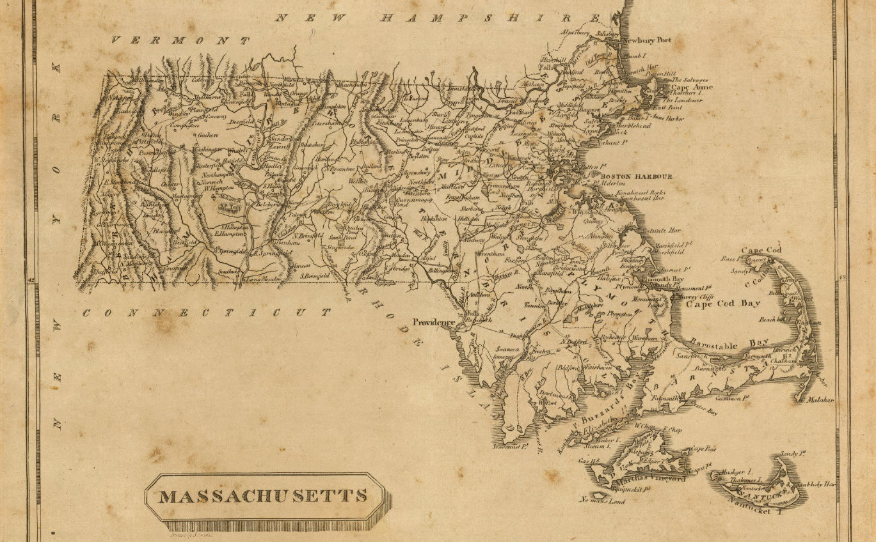
On Python and Positioning
An Introduction to Working with Geospatial Data in Python with GeoPandas
December 2020

Slide 2

This Evening’s Quest
Dataset Overview
Python Packages
Python Code Examples
Geospatial Ecosystem & Theory
Geospatial Enlightenment!
Cover map: Massachusetts. Drawn by S. Lewis. (Boston: Published by Thomas & Andrews. 1812); David Rumsey Historical Map Collection

Slide 3
Dataset Overview
Part of the Massachusetts coastline is known as the “Ocean’s Graveyard”
Shipwrecks of MA
Wikipedia’s “Shipwrecks of Massachusetts” page
https://en.wikipedia.org/wiki/List_of_shipwrecks_of_Massachusetts
Data format: KML file converted into a shapefile
Dive Sites
DiveSites.com API for sites within 50 nautical miles of Boston, MA
http://api.divesites.com/docs/
Data format: JSON

Slide 4


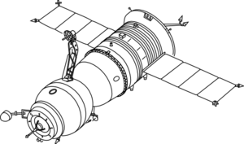

The Geospatial Ecosystem: Geographic Information Systems (GIS)
A GIS is a computer-based system to aid in the collection, maintenance, storage, analysis, output, and distribution of spatial data and information – this can include hardware, software, data, people, and industry protocols¹
Data Storage
Data Collection
GIS Software
QGIS, ArcGIS, others
OSGeo’s GDAL/OGR library
Python, R packages
Industry Protocols
Open Geospatial Consortium (OGC)
1. Bolstad, Paul. GIS Fundamentals: a First Text on Geographic Information Systems. 6th ed., XanEdu, 2019.

Slide 5
Geospatial Data Models
Description
File Format Examples
Vector
Discrete geometries
Points, lines, polygons, and multipolygons
Shapefile (.shp/.dbf/.shx/.prj)
GeoJSON (.json), KML (.kml)
Geopackage (.gpkg)
Raster
Continuous, “gridded” data
Elevation, satellite images, ground cover
GeoTIFF (.TIF or .TIFF)
Image (.img)
Geopackage (.gpkg)
Data Attributes
Any attribute tied to a location
Example: Census data by county
CSV (.csv)

Slide 6
Geospatial Data Models
Generally Supportive of Rule Change
Generally Opposed to Rule Change
Industry players who operate under these regulations
Landowners/property rights enthusiasts
Environment and conservation groups
Outdoor recreation industry
Generally concerned individuals
Politically Motivated Folks
Hate certain president and oppose whichever rule fell under their administration

Slide 7
Geospatial Data Models

Slide 8
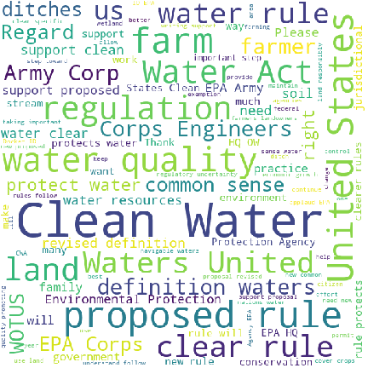
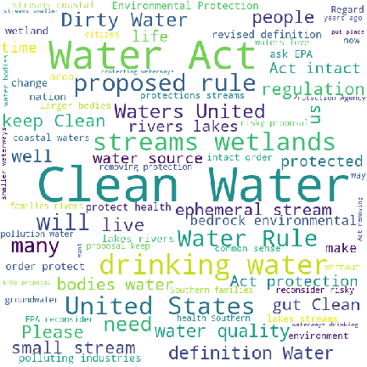
Word Clouds by Group
Supportive Comment Language
Opposed Comment Language

Slide 9
Comparison of Top 20 Words
Generally Supportive of Rule Change
Generally Opposed to Rule Change
Clear
Corp
Definition
Farm
Farmer
Land
Need
New
Quality
Regulation
Support
Unite
Community
Drink
Health
Lake
Pollution
Proposal
Protection
River
Small
Stream
Waterway
Wetland
Act
Clean
EPA
Propose
Protect
Rule
State
Water

Slide 10
Potential Hazard: Similar Language across Opposing Viewpoints
“
 | I support clean water. We need clear rules on how this is to be accomplished. I personally try hard to have as little erosion as possible. Terraces, grass waterways, contour farming, no-till, headlands, etc. As hard as I and other farmers try to conserve and keep waters clean, we need clear rules with common sense to provide us direction. Hopefully this is a step in that direction and we all can work together to feed the world.
 |  | ”
Example Supportive Comment
“
 | I stand for clean water! Clean and healthy waterways are key to western agriculture, recreation and tourist economies that support our communities. These wholesale changes to the Clean Water Act to limit its jurisdiction provide loopholes in the law and give polluters incentives to discharge dangerous pollutants into unprotected waterways. Please protect our water - the essence of life upon which we all depend!
 |  | ”
Example Opposed Comment

Slide 11
SECTION 2
Machine Learning and NLP in Python

Slide 12
What is Machine Learning?
In short, machine learning is building a model (with a twist)
Creating a simplified representation of a real-word system that still captures the main underlying rules, relationships, or patterns of that system
But the “learning” part is where it differs from traditional model building
Traditional Model Flow
MODEL: USER-DEFINED RULES OR FORMULAS
INPUT
OUTPUT

Slide 13
Machine Learning Model Flow
The machine learns the underlying relationships, structure, and patterns in the data based on examples (the input)
DATA (INPUT)
LABELS
MACHINE LEARNING!
NEW DATA
MODEL
PREDICTION/ CLUSTER/ TASK

Slide 14
General Machine Learning Tasks
SUPERVISED LEARNING
Prediction tasks
Classification (predicts a class) and Regression (predicts a numeric value)
UNSUPERVISED LEARNING
Clustering tasks (group examples by their similarity)
Dimensionality reduction tasks
OTHER
Recommender systems
Reinforcement learning
Self-supervised and semi-supervised learning

Slide 15
Where Does NLP Fit into Machine Learning?
Natural Language Processing (NLP) is a branch of Artificial Intelligence that helps computers to interpret and understand human language
Used for speech recognition, translation, text analysis
Languages are rule-based, but lots of exceptions
Text is everywhere and contains a lot of valuable information
News articles and blog posts
Forum discussions and comment threads
Social media posts
Product reviews
Etc…
Applying NLP techniques in a machine learning system helps access and leverage that information

Slide 16
How Do Machine Learning Models Consume Data?
Delicious!
________________ 10 … 0.045 9.4 12 … 0.162 5.0 …. … …. … 32 … 0.741 8.1 ________________
✓
MODEL
Ew, gross
________________ “The Clean Water Act is a bedrock environmental policy… ________________
MODEL
ML models are very picky about the type and format of data they can handle

Slide 17





Python Geospatial Packages
Data Analysis: NumPy, pandas, Jupyter
Visualizations: matplotlib, seaborn, WordCloud, pyLDAvis
NLP: spaCy
Models: scikit learn, XGBoost
Attributions:
Jupyter logo: By Cameron Oelsen - https://github.com/jupyter/jupyter.github.io/blob/master/assets/main-logo.svg, BSD, https://commons.wikimedia.org/w/index.php?curid=68763478

Slide 18
Project Workflow
Collect Data
Process Text
Run Models
Interpret Results
We hereby decree you: NLP CHAMPION!
Tokenize Text
Lemmatize Tokens
Remove Stop Words
“Bag of Words”
Vectorize Tokens
Pre-Trained Word Vectors

Slide 19
Vectorizer Overview
PROS
CONS
CountVectorizer
Simple to understand and explain
Saves vocab in memory
Doesn’t normalize counts for document length
TFIDFVectorizer
Normalizes count data for length of document and (optionally) inversely for how common a word is in the corpus
Saves vocab in memory
State associated with IDF calculation
HashingVectorizer
Portable, no state
No in-memory vocab
No way to reverse hashed value back to feature (token)
Pre-Trained Word Vectors
Leverages sophisticated pre-trained models that maintain word semantics
Good when little labeled data is available
Needs access to (potentially very large) language model

Slide 20
Sentiment Classification Overview
Supervised models require labeled data
Pick relevant evaluation metrics (to compare models): accuracy and F1
Two rounds:
Round I: five classes of models, various vectorized data for each
Top three models move on to round II
Round II: top models from round I tuned
Final evaluation on test data

Slide 21
Code Demo Time!
Comment
LogReg
Prediction

Slide 22
Conclusions
[TO COME]

Slide 23
APPENDIX A
Resources

Slide 24
Resources
GitHub project repository:
https://github.com/HKuz/Geospatial_Overview
GeoPandas documentation:
https://geopandas.org/index.html#
Kaggle Geospatial Analysis course (free):
https://www.kaggle.com/learn/geospatial-analysis
Codes for most commonly used projections:
www.spatialreference.org

