Slide 1
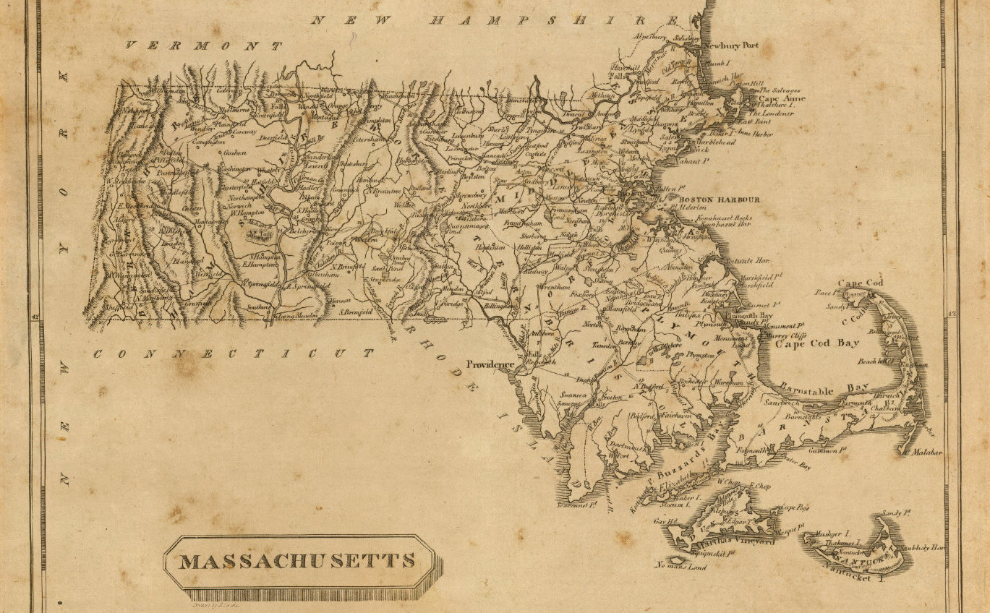
On Python and Positioning
An Introduction to Working with Geospatial Data in Python with GeoPandas
December 2020

Slide 2

This Evening’s Quest
Dataset Overview
Python Packages
Python Code Examples
Geospatial Ecosystem & Theory
Geospatial Enlightenment!
Sources: - Cover map: Massachusetts. Drawn by S. Lewis. (Boston: Published by Thomas & Andrews. 1812); David Rumsey Historical Map Collection - All clipart, except where noted, is from Clipart-library.com, licensed for personal use

Slide 3
Dataset Overview
There’s a 50 mile stretch of coastline along Cape Cod that has claimed over 3,000 vessels and is not-so-affectionately known as the “Ocean’s Graveyard”
Shipwrecks of MA
Wikipedia’s “Shipwrecks of Massachusetts” page
https://en.wikipedia.org/wiki/List_of_shipwrecks_of_Massachusetts
Data format: KML file converted into a shapefile
Dive Sites
DiveSites.com API for sites within 75 nautical miles of Boston, MA
http://api.divesites.com/docs/
Data format: JSON

Slide 4
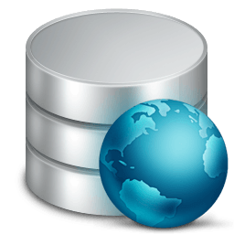

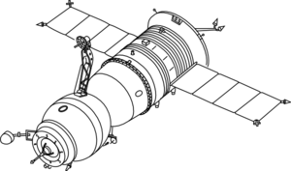

The Geospatial Ecosystem: Geographic Information Systems (GIS)
A GIS is a computer-based system to aid in the collection, maintenance, storage, analysis, output, and distribution of spatial data and information – this can include hardware, software, data, people, and industry protocols¹
Data Storage
Data Collection
GIS Software
Desktop Apps: QGIS, ArcGIS, others
OSGeo Projects: GDAL/OGR, GEOS
Python, R packages
Industry Protocols
Open Geospatial Consortium (OGC)
Note: 1. Bolstad, Paul. GIS Fundamentals: a First Text on Geographic Information Systems. 6th ed., XanEdu, 2019.

Slide 5
Geospatial Data Models
Description
File Format Examples
Vector
Discrete geometries
Points, lines, polygons
Shapefile (.shp/.dbf/.shx/.prj)
GeoJSON (.json), KML (.kml)
Geopackage (.gpkg)
Raster
Continuous, “gridded” data
Elevation, satellite images, ground cover
GeoTIFF (.TIF or .TIFF)
Image (.img)
Geopackage (.gpkg)
Data Attributes
Any attribute tied to a location
Example: Census data by county
CSV (.csv)

Slide 6
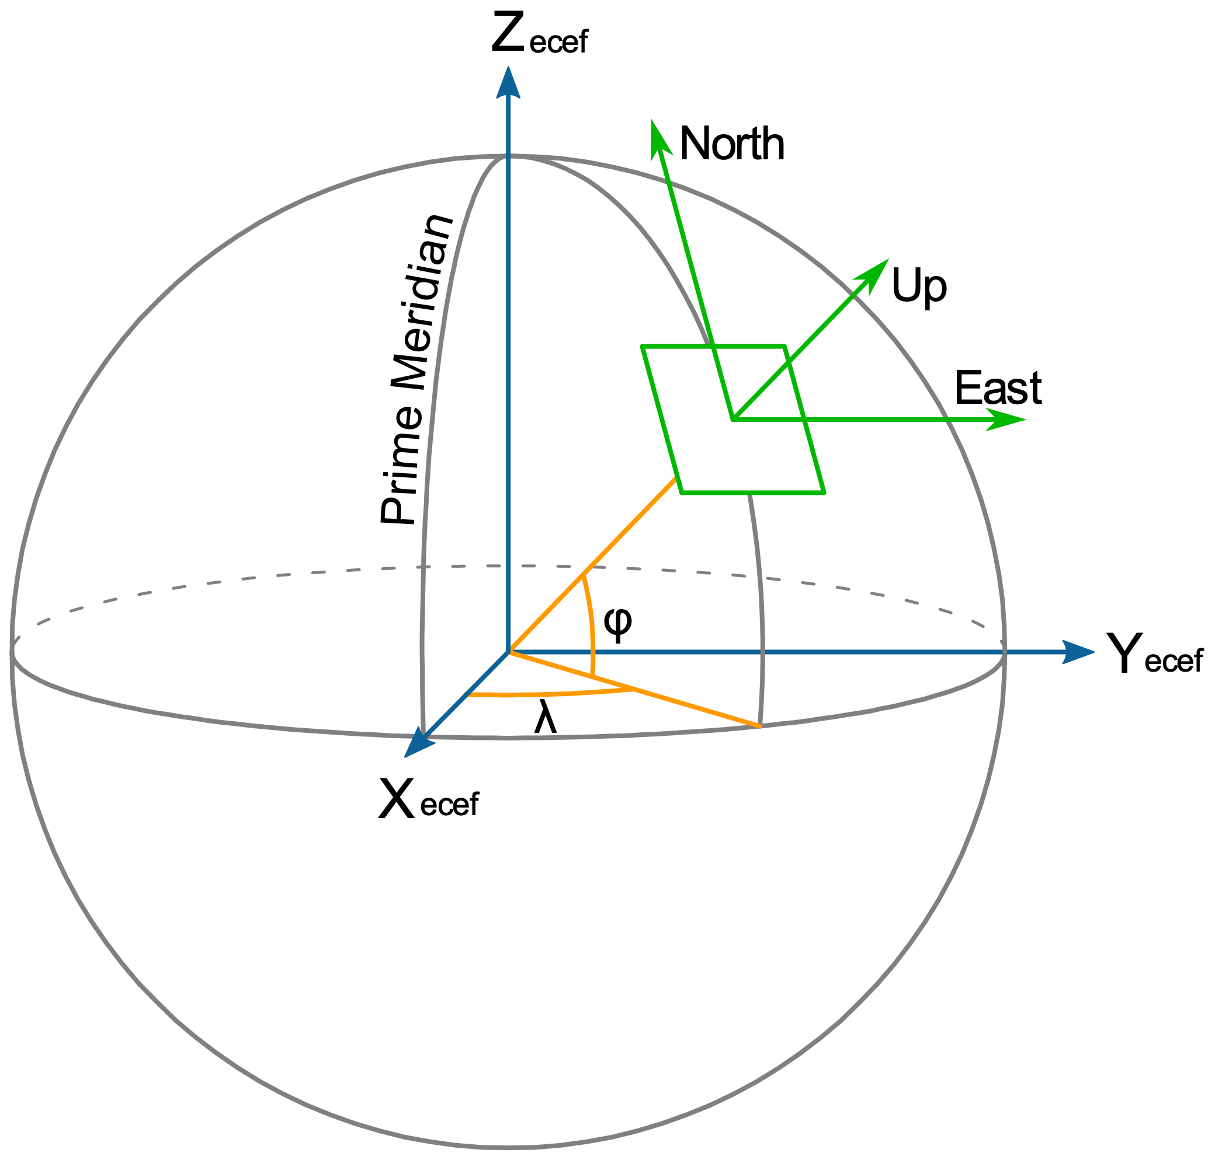

Coordinate Reference Systems
Coordinate Reference Systems (CRS) tie 3D coordinates to real world entities
Based on a Datum (geographic measurements of Earth and assumptions)
Examples of coordinate reference systems:
WGS84: US-centric, used for GeoJSON and most web data
Others: NAD83, ITRF
Golden rule: know thy data! Know the coordinate system used for your data and convert datasets into the same CRS before combining
The CRS is like the “unit” of geospatial data
Source: - Longitude and Latitude (left): By Mike1024 - Based on en:File:EarthTangentialPlane.png by en:User:Raffyl99 (public domain), Public Domain, https://commons.wikimedia.org/w/index.php?curid=9510652

Slide 7
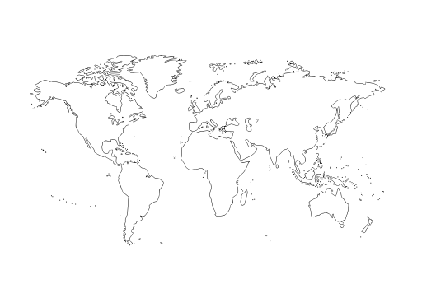
Projections: Translating 3D into 2D
A projection translates 3D coordinates into a 2D representation
As one might expect, all projections add an element of distortion
Different projections preserve/distort different aspects of the geographic features
Source: - Projected map: molumen on the Open Clip Art Library, CC0, via Wikimedia Commons

Slide 8


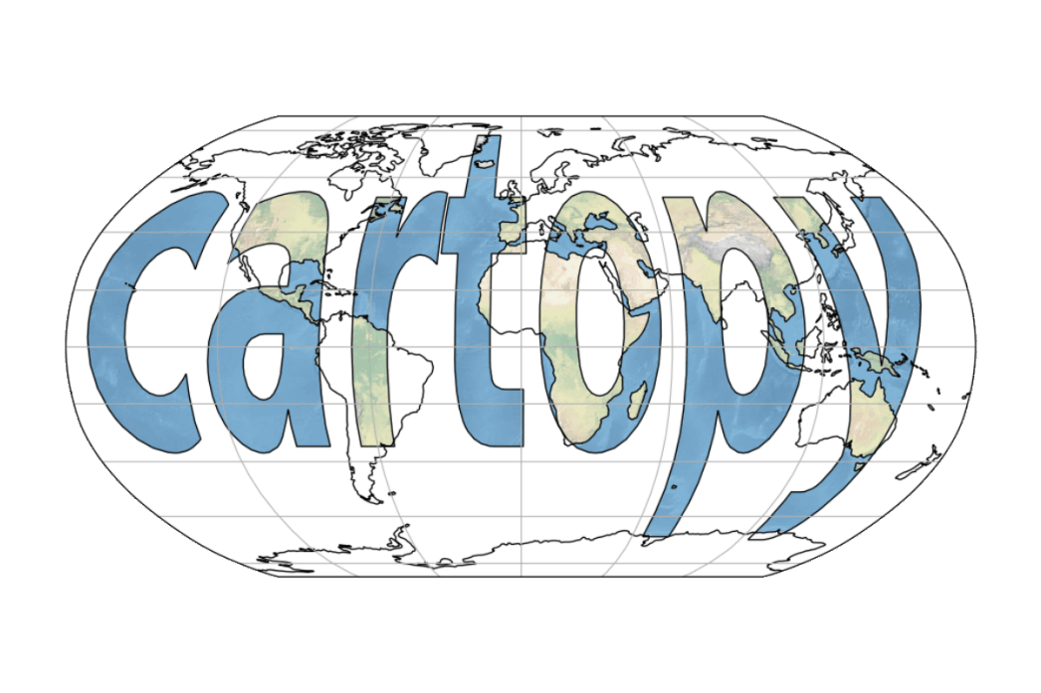



Python Geospatial Packages
General: GeoPandas, pySAL
Supporting Packages:
Fiona (vector I/O), Rasterio (raster I/O)
pyproj (CRS/projection transformations)
Shapely (implements GEOS geospatial functions)
Visualizations:
matplotlib, descartes
contextily (web tiles)
folium (leaflet.js), Cartopy
Geocoding: geoPY

Slide 9
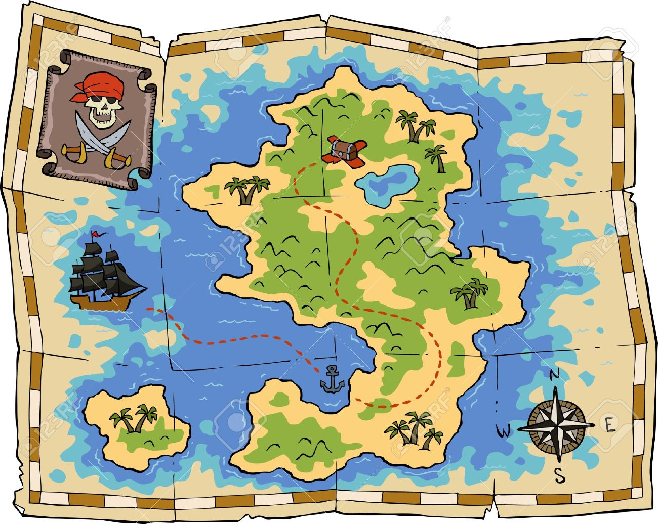
Code Demo Time!
Web Tiles
Python Magic
Data

Slide 10
APPENDIX A
Resources

Slide 11
Resources
GitHub project repository:
https://github.com/HKuz/Geospatial_Overview
Documentation:
GeoPandas: https://geopandas.org/index.html#
folium: https://python-visualization.github.io/folium/
Codes for most commonly used CRSs and projections:
www.spatialreference.org
Learn more with the Kaggle Geospatial Analysis course (free):
https://www.kaggle.com/learn/geospatial-analysis
Get help via the GIS stack exchange
https://gis.stackexchange.com/

