Slide 1
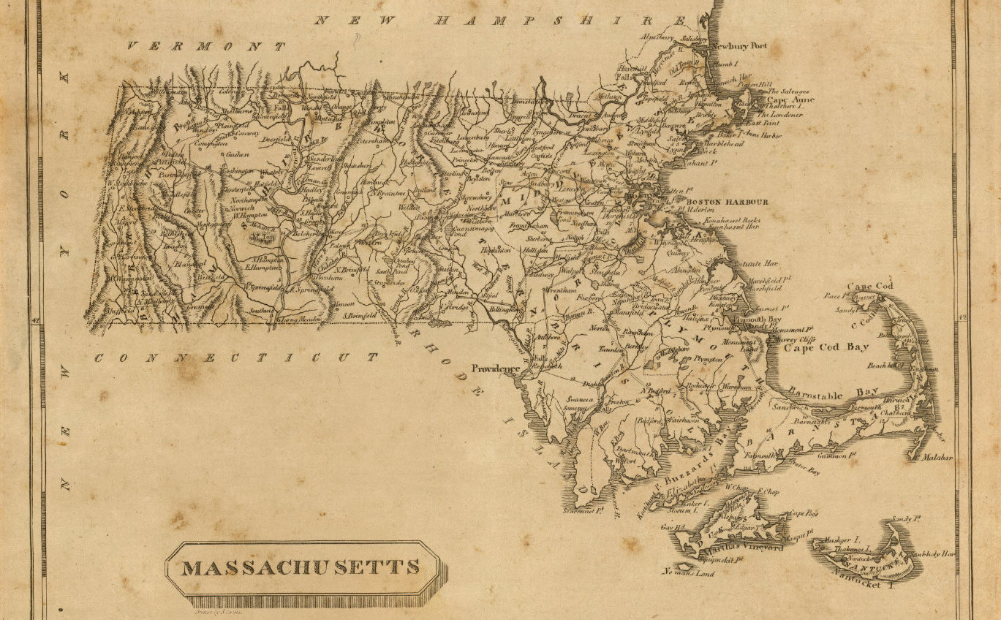
On Python and Positioning
An Introduction to Working with Geospatial Data in Python with GeoPandas
December 2020

Slide 2

This Evening’s Quest
Dataset Overview
Python Packages
Python Code Examples
Geospatial Ecosystem & Theory
Geospatial Enlightenment!
Cover map: Massachusetts. Drawn by S. Lewis. (Boston: Published by Thomas & Andrews. 1812); David Rumsey Historical Map Collection

Slide 3
Dataset Overview
Part of the Massachusetts coastline is known as the “Ocean’s Graveyard”
Shipwrecks of MA
Wikipedia’s “Shipwrecks of Massachusetts” page
https://en.wikipedia.org/wiki/List_of_shipwrecks_of_Massachusetts
Data format: KML file converted into a shapefile
Dive Sites
DiveSites.com API for sites within 50 nautical miles of Boston, MA
http://api.divesites.com/docs/
Data format: JSON

Slide 4


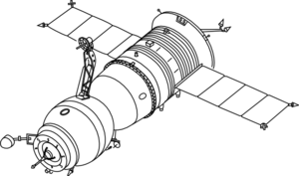

The Geospatial Ecosystem: Geographic Information Systems (GIS)
A GIS is a computer-based system to aid in the collection, maintenance, storage, analysis, output, and distribution of spatial data and information – this can include hardware, software, data, people, and industry protocols¹
Data Storage
Data Collection
GIS Software
QGIS, ArcGIS, others
OSGeo’s GDAL/OGR library
Python, R packages
Industry Protocols
Open Geospatial Consortium (OGC)
Bolstad, Paul. GIS Fundamentals: a First Text on Geographic Information Systems. 6th ed., XanEdu, 2019.
Image sources: clipart-library.com, licensed for personal use

Slide 5
Geospatial Data Models
Description
File Format Examples
Vector
Discrete geometries
Points, lines, polygons, and multipolygons
Shapefile (.shp/.dbf/.shx/.prj)
GeoJSON (.json), KML (.kml)
Geopackage (.gpkg)
Raster
Continuous, “gridded” data
Elevation, satellite images, ground cover
GeoTIFF (.TIF or .TIFF)
Image (.img)
Geopackage (.gpkg)
Data Attributes
Any attribute tied to a location
Example: Census data by county
CSV (.csv)

Slide 6

Coordinate Reference Systems
Coordinate Reference Systems (CRS) is a system used to locate and specify the position of real world entities
The “unit” of geospatial data
Examples of CRS:
US navigation systems: WGS84 (most web data and GeoJSON)
Other navigation systems: ITRF
Golden rule: know thy data! Know the coordinate system used for your data and convert datasets into the same CRS before combining

Slide 7
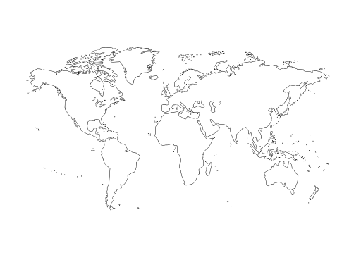
Projections: Translating 3D into 2D
A projection translates coordinates (3D or Cartesian) into a 2D representation
As one might expect, all projections add an element of distortion
Different projections preserve/distort different aspects of the geographic features
Sources: - Globe: Clipart-library.com, licensed for personal use - Projected map: molumen on the Open Clip Art Library, CC0, via Wikimedia Commons

Slide 8



Python Geospatial Packages
General: GeoPandas, Fiona, Shapely, pySAL
Visualizations: matplotlib, descartes, folium (leaflet.js), Cartopy
Geocoding: geoPY

Slide 9
What is Machine Learning?
In short, machine learning is building a model (with a twist)
Creating a simplified representation of a real-word system that still captures the main underlying rules, relationships, or patterns of that system
But the “learning” part is where it differs from traditional model building
Traditional Model Flow
MODEL: USER-DEFINED RULES OR FORMULAS
INPUT
OUTPUT

Slide 10
Machine Learning Model Flow
The machine learns the underlying relationships, structure, and patterns in the data based on examples (the input)
DATA (INPUT)
LABELS
MACHINE LEARNING!
NEW DATA
MODEL
PREDICTION/ CLUSTER/ TASK

Slide 11
How Do Machine Learning Models Consume Data?
Delicious!
________________ 10 … 0.045 9.4 12 … 0.162 5.0 …. … …. … 32 … 0.741 8.1 ________________
✓
MODEL
Ew, gross
________________ “The Clean Water Act is a bedrock environmental policy… ________________
MODEL
ML models are very picky about the type and format of data they can handle

Slide 12
Project Workflow
Collect Data
Process Text
Run Models
Interpret Results
We hereby decree you: NLP CHAMPION!
Tokenize Text
Lemmatize Tokens
Remove Stop Words
“Bag of Words”
Vectorize Tokens
Pre-Trained Word Vectors

Slide 13
Vectorizer Overview
PROS
CONS
CountVectorizer
Simple to understand and explain
Saves vocab in memory
Doesn’t normalize counts for document length
TFIDFVectorizer
Normalizes count data for length of document and (optionally) inversely for how common a word is in the corpus
Saves vocab in memory
State associated with IDF calculation
HashingVectorizer
Portable, no state
No in-memory vocab
No way to reverse hashed value back to feature (token)
Pre-Trained Word Vectors
Leverages sophisticated pre-trained models that maintain word semantics
Good when little labeled data is available
Needs access to (potentially very large) language model

Slide 14
Sentiment Classification Overview
Supervised models require labeled data
Pick relevant evaluation metrics (to compare models): accuracy and F1
Two rounds:
Round I: five classes of models, various vectorized data for each
Top three models move on to round II
Round II: top models from round I tuned
Final evaluation on test data

Slide 15
Code Demo Time!
Comment
LogReg
Prediction

Slide 16
Conclusions
[TO COME]

Slide 17
APPENDIX A
Resources

Slide 18
Resources
GitHub project repository:
https://github.com/HKuz/Geospatial_Overview
GeoPandas documentation:
https://geopandas.org/index.html#
Kaggle Geospatial Analysis course (free):
https://www.kaggle.com/learn/geospatial-analysis
Codes for most commonly used projections:
www.spatialreference.org
Get help on the GIS stack exchange
https://gis.stackexchange.com/

