Slide 1
PDDI CDS IG Update
Configurable CDS Hooks
(order-select and order-sign)

Slide 2
Review
Last fall we decided that the CDS Service should:
Allow for some level configuration to be passed in CDS Hooks requests
Enables more flexibility for the client systems
Maintain some concept of state
Enables coordination between order-select and order-sign as a strategy to avoid apparently duplicate alerts

Slide 3
Configuration Solution
A new structure definition for pddi-cds-configuration-options
Follows the ideas of the DaVinci Coverage Requirements Discovery (CRD)
http://hl7.org/fhir/us/davinci-crd/2018Sep/hooks.html#configuration-options
TODO: make available at DIKB.org

Slide 4
Configuration Structure Definition
“It will be a Configuration object that will contain an array of available options. Each option will include four mandatory elements:
A code that will be used when setting configuration during hook invocation
A data type for the parameter. At present, allowed values are “boolean” and “integer”
A display name for the configuration option to appear in the client’s user interface when performing configuration
A description providing a 1-2 sentence description of the effect of the configuration option”
http://hl7.org/fhir/us/davinci-crd/2018Sep/hooks.html#configuration-options0

Slide 5
Configuration Options in PDDI CDS PlanDefinitions
order-select:
https://git.rwth-aachen.de/binhphi109/pddi-cds/blob/connectathon-21-pddi/examples/pddi-cds/warfarin-nsaids-order-select/plandefinition-bundle.json
order-sign:
https://git.rwth-aachen.de/binhphi109/pddi-cds/blob/connectathon-21-pddi/examples/pddi-cds/warfarin-nsaids-order-sign/plandefinition-bundle.json

Slide 6
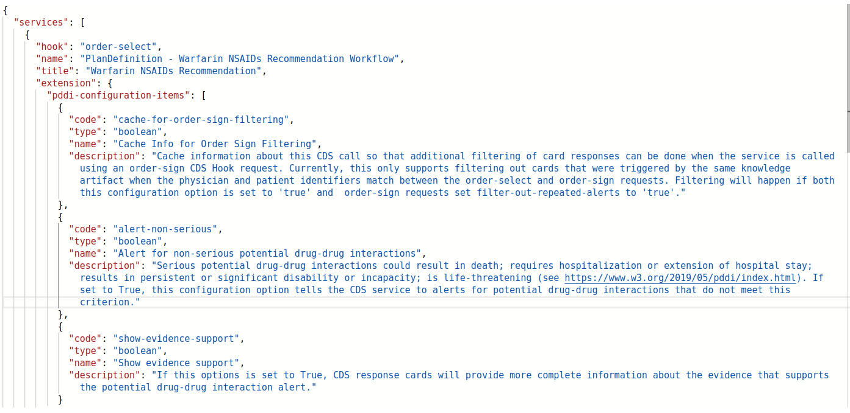
How Configuration Looks in CDS Hooks
GET http://localhost:2020/cds-services
RESPONSE (order-sign service):

Slide 7
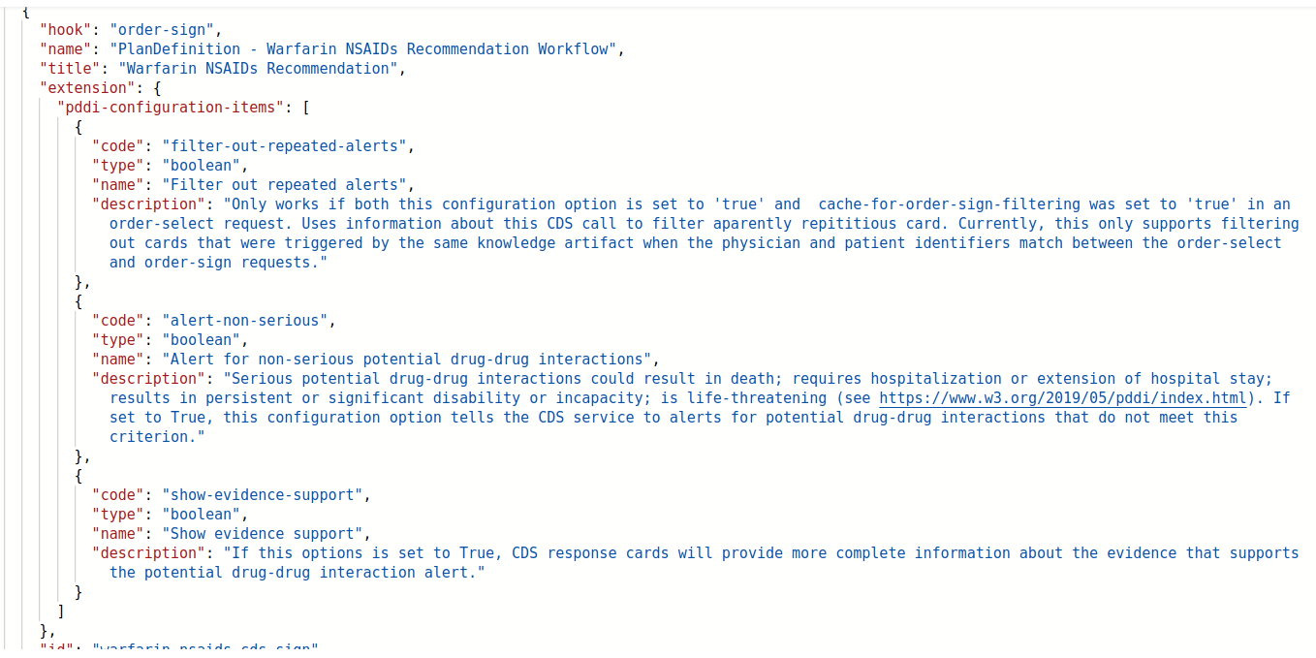
How Configuration Looks in CDS Hooks Continued
GET http://localhost:2020/cds-services
RESPONSE CONTINUED (order-select service):

Slide 8
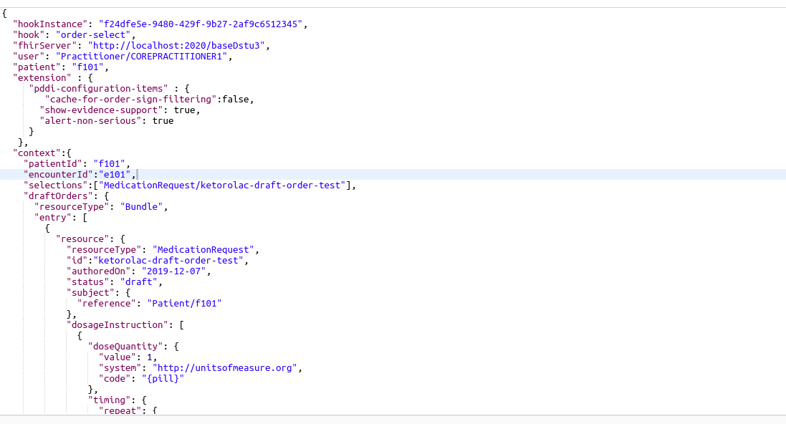
How Configuration Looks in CDS Hooks Continued
POST http://localhost:2020/cds-services/warfarin-nsaids-cds-select
REQUEST (Warfarin-NSAIDS order-select service):

Slide 9
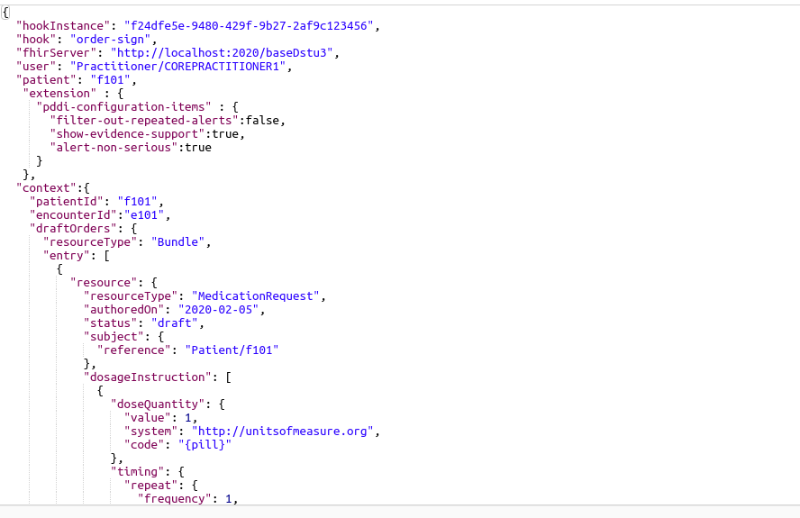
How Configuration Looks in CDS Hooks Continued
POST http://localhost:2020/cds-services/warfarin-nsaids-cds-sign
REQUEST (Warfarin-NSAIDS order-sign service):

Slide 10
Demonstration
1. GET services
2. order-select with alert-non-serious true/false
3. order-select with show-evidence-support true/false
4. order-select with cache-for-order-sign-filtering true/false

Slide 11
New Requirements to Support Configuration
If the CDS service supports configuration:
1. The service needs to be able to respond with available options for ‘pddi-configuration-items’
at the time of service registration (GET)
2. The client CDS Hooks POST requests need to include the extension
‘pddi-configuration-items’ and only those configuration options reported by the service
3. The service needs to validate the configuration items submitted and have a graceful way
to return an error (e.g., an information card)

Slide 12
New Requirements to Support Configuration Cont...
If the CDS service supports filtering alerts (the ‘filter-out-repeated-alerts’ config option)
1. The PlanDefinition for the service requires 1 and only 1 ‘relatedArtifact’ of
type ‘Documentation’ and this must include a unique and persistent URL to a
description of the knowledge artifact implemented by the PlanDefinition
2. The service must have mechanism to cache information from order-select requests
for use by the service when processing order-sign requests
- Currently testing cache of:
physician reference display, encounter id, patient id, and the URL
of the the relatedArtifact
- Might need to add other items such as the selected Medication resource in
‘draftOrders’
3. The service needs to have a graceful way to report both when filtering occurs and
when it does not occur e.g., due to an error (e.g., an information card)
4. The client needs to set cache-for-order-sign-filtering to true for POST order-select

Slide 13
Discussion (2/7)
Note: intent to ballot deadline 3 weeks away!
- We agreed that the mechanism for configuration and coordination is what we will
Ballot. Similar to CDS Hooks where the Hooks were examples to begin with, and the
later balloted separately – we would like to ballot the IG with example configuration
options (except for the two that enable coordination between order-select and order-sign)
and then ballot for standard configuration options separately.
- We agreed that further discussion with the broader CDS WG is necessary but that the
mechanism looks promising.
- Clarification needed on 1) why a URI to a PDDI knowledge artifact is needed to coordinate
Filtering, 2) will returning an information card mentioning filtering be normative, 3) the final
normative list of things necessary for filtering to work, 4) should we extend configuration
so it indicates optional vs required configs

Slide 14
TODOs (2/19):
- We agreed that the mechanism for configuration and coordination is what we will
ballot with example configuration options and the two required options that enable coordination between order-select and order-sign
- We agree to cache the URI of the plan definition at order select as the reference to knowledge artifact
- We agreed to add the order select “selected drug” ID to cache and use that at order sign so that filtering is based on the following: URI of knowledge artifact + encounter id + patient id + practitioner id + selected medication
- We agreed that the IG will provide clarification in the form of state and activity diagrams on how the server needs to coordinate filtering
- We agreed that we will SUGGEST returning an information card mentioning
- We will NOT extend configuration so it indicates optional vs required configs

