Slide 1
Concepts
ID for draft MedicationRequest at order-select
Is the EHR creating or asking the server to create a FHIR resource at order initiation? Is it reasonable to expect the EHR to generate a resource on order initiation? If not, are we accepting other data structures than FHIR (e.g., CDA)? What about resource versioning?
ID for service-generated DetectedIssue resource
GUID and use “create” in response for EHR/FHIR server to generate DetectedIssue
Referencing draft MedicationRequest in DetectedIssue with Contained resource
DetectedIssue/implicated only has reference without extension
Passing DetectedIssue at order-sign for service processing
Service suggesting actions based on DetectedIssue/mitigation/actions taken by clinician

Slide 2
Questions:
At order-select, what type of resource and minimum information can be expected for medication orders?
How should a DetectedIssue resource be created, modified, and passed between the EHR and service?
How should a draft resource in the request context be referenced in response resource?

Slide 3
At order-select, what type of resource and minimum information can be expected for medication orders?
Propose:
FHIR resource generated at initiation of process (e.g., MedicationRequest when open CPOE)
MedicationRequest (minimum content) – draft status, local id, medicationCodeableConcept…(more?)

Slide 4
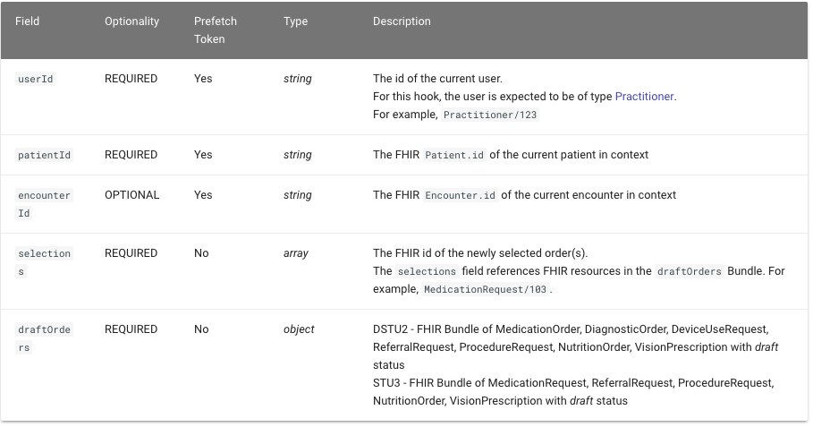
order-select – context
At order-select, what type of resource and minimum information can be expected for medication orders?
MedicationRequest draft assigned a local id (e.g., 103).
EHR populates selections element with MedicationRequest currently in process?
Or, do we want the service to process all draft orders?

Slide 5
2. How should a DetectedIssue resource be created, modified, and passed between the EHR and service?
Propose:
order-select response Card [suggestion/actions(create)/resource/DetectedIssue]
DetectedIssue with id=GUID and implicated medications (i.e., one or more from context and prefetch). GUID replaced with FHIR id when resource is generated after order-select response.
How do we specify, within the hooks spec, to create a DetectedIssue if it is available, not based on clinician action? (gap in Hooks spec)
EHR modifies mitigation/action of DetectedIssue based on clinician action to suggestion/action of card response.
DetectedIssue passed in context of order-sign request.
order-sign response Card now use update instead of create for DetectedIssue

Slide 6
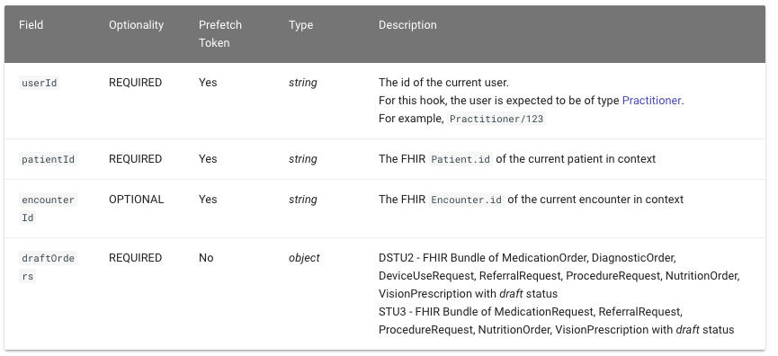
order-sign
2. How should a DetectedIssue resource be created, modified, and passed between the EHR and service?
DetectedIssue resource in Context?
Not specified in spec bundle
Depends if/when server or EHR assigns id the resource is stored
Service needs to process DetectedIssue/implicated against all context orders
Service needs to provide different information or no information based on DetectedIssue/mitigation/action at order-select.
Example:
If (DetecedIssue/implicated = Request/context/MedicationRequest)
then process DetectedIssue/mitigation
else if (DetecedIssue/mitigation/action = canceled order)
then use “create“ in response action for final DetectedIssue

Slide 7
3. How should a draft resource in the request context be referenced in response resource?
Propose:
Use contained resource in DetectedIssue to hold the MedicationRequest draft from context of order-select request
DetectedIssue/implicated(Reference)
When DetectedIssue modified from draft to final after order-sign response, change implicated reference from contained to local or global FHIR id.

Slide 8
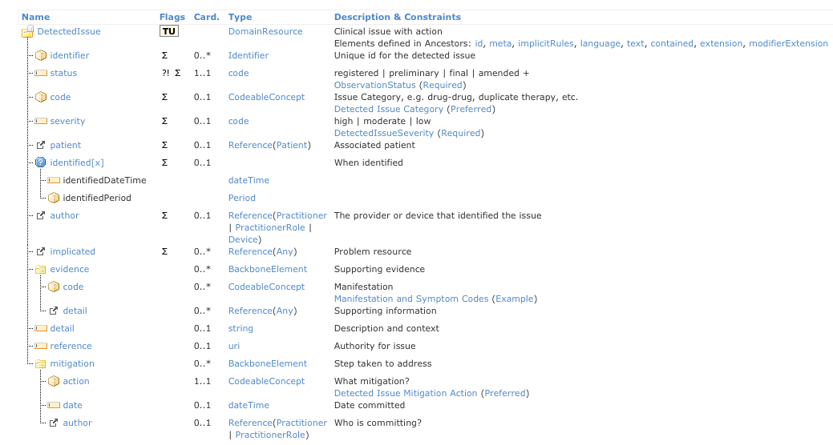
DetectedIssue
3. How should a draft resource in the request context be referenced in response resource?
Use contained resource to pass draft MedicationRequest (id : 103) resource back to EHR and to reference MedicationRequest (103) in DetectedIssue/implicated
Notes:
Suggested to just require an id and have the DetectedIssue reference that. There was a discussion about what happens if the order is canceled and if that documentation is needed. I think it goes back to providing rationale for saving DetectedIssue in the IG.

Slide 9
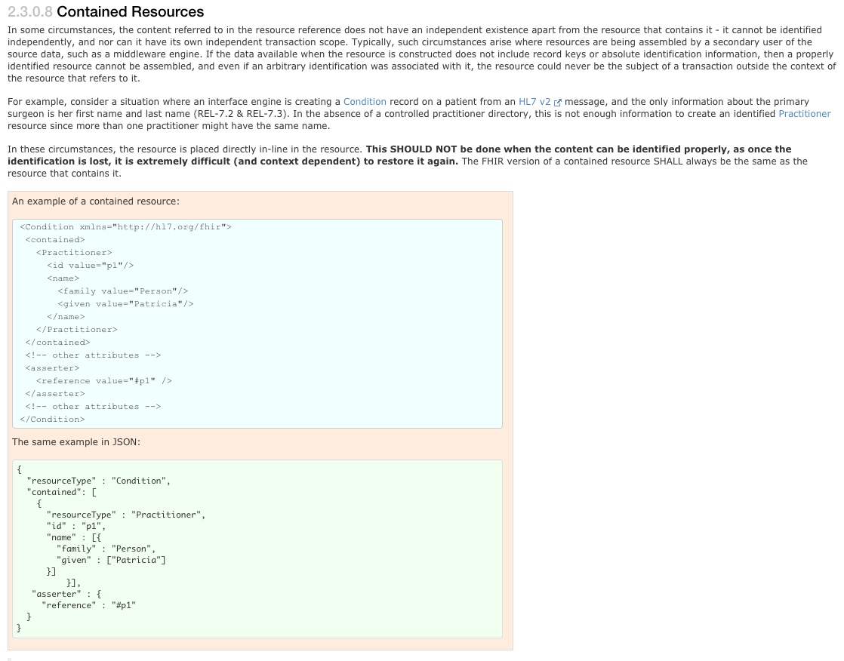
resourceType : DetectedIssue
contained : [MedicationRequest
id : 103]
asserter :
reference : #103
implicated
reference : #103 (contained reference)
display : naproxen 500 mg tablet
reference : global id (url)
display : warfarin 5 mg tablet
#

Slide 10
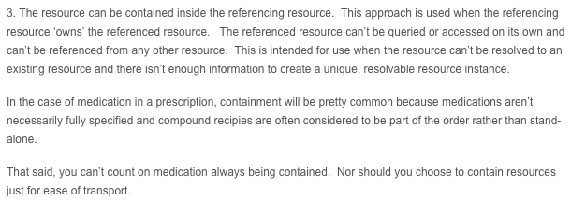
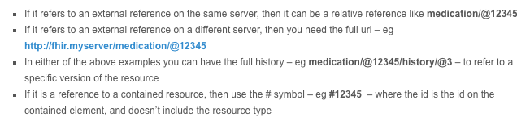
Contained continued
Accomplishes:
Allows DetectedIssue/implicated/reference to be used without extension
Allows DetectedIssue to retain state of resource/information when it was generated. This may not be the way the resource was intended to be used if there is a referenceable FHIR resource. For example, if the initiated order was canceled there may not be a way to reference that order if it wasn’t in the DetectedIssue contained
May allow EHR to send whatever it has (e.g., CDA) if the process is not to create a FHIR resource when initiating order. But this conflicts with CDS Hooks spec.
Lloyd:
Hay
https://fhirblog.com/2013/10/10/fhir-contained-resources/
http://www.hl7.org/implement/standards/fhir/references.html#contained

