Slide 1
Configurable CDS Hooks
(order-select and order-sign)

Slide 2
Goal
Demonstrate a method so that the CDS Service:
Allows for some level configuration to be passed in CDS Hooks requests
Enables more flexibility for the client systems
Maintain some concept of state
Enables coordination between order-select and order-sign as a strategy to avoid apparently duplicate alerts

Slide 3
Configuration Solution
A new structure definition for configuration options (pddi-cds-configuration-options)
Follows the ideas of the DaVinci Coverage Requirements Discovery (CRD)
http://hl7.org/fhir/us/davinci-crd/2018Sep/hooks.html#configuration-options
Example:
https://dikb.org/baseDstu3/StructureDefinition/pddi-cds-configuration-options

Slide 4
Configuration Structure Definition
“It will be a Configuration object that will contain an array of available options. Each option will include four mandatory elements:
A code that will be used when setting configuration during hook invocation
A data type for the parameter. At present, allowed values are “boolean” and “integer”
A display name for the configuration option to appear in the client’s user interface when performing configuration
A description providing a 1-2 sentence description of the effect of the configuration option”
http://hl7.org/fhir/us/davinci-crd/2018Sep/hooks.html#configuration-options0

Slide 5
Configuration Options in PDDI CDS PlanDefinitions
order-select:
https://dikb.org/baseDstu3/PlanDefinition/warfarin-nsaids-cds-select
order-sign:
https://dikb.org/baseDstu3/PlanDefinition/warfarin-nsaids-cds-sign

Slide 6
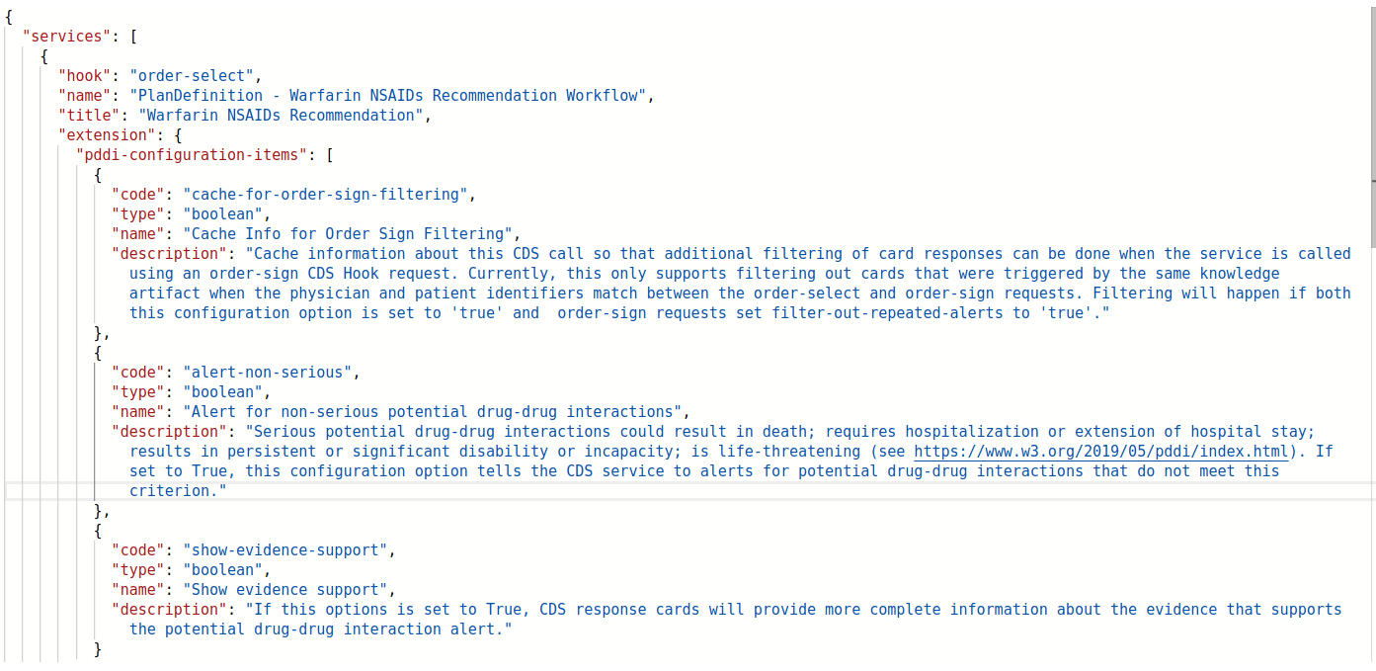
How Configuration Looks in CDS Hooks
GET http://dikb.org/cds-services
RESPONSE (order-select service):

Slide 7
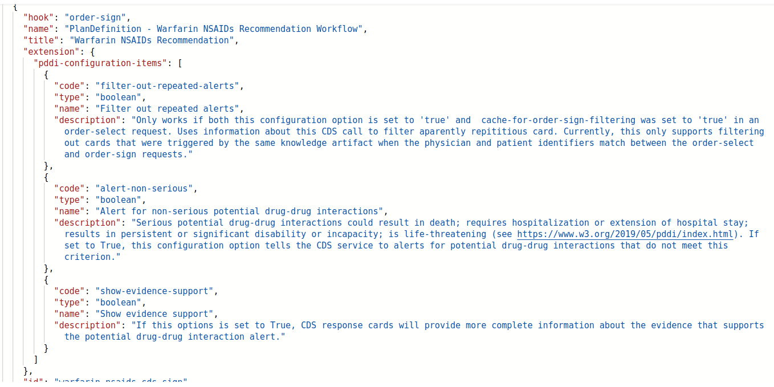
How Configuration Looks in CDS Hooks Continued
GET http://dikb.org/cds-services
RESPONSE CONTINUED (order-sign service):

Slide 8
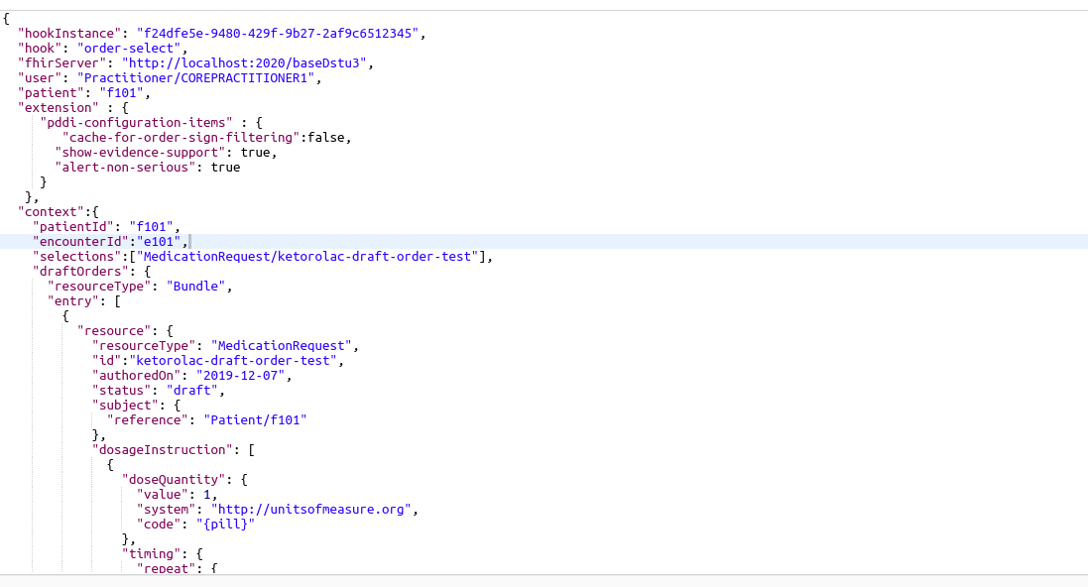
How Configuration Looks in CDS Hooks Continued
POST http://localhost:2020/cds-services/warfarin-nsaids-cds-select
REQUEST (Warfarin-NSAIDS order-select service):

Slide 9
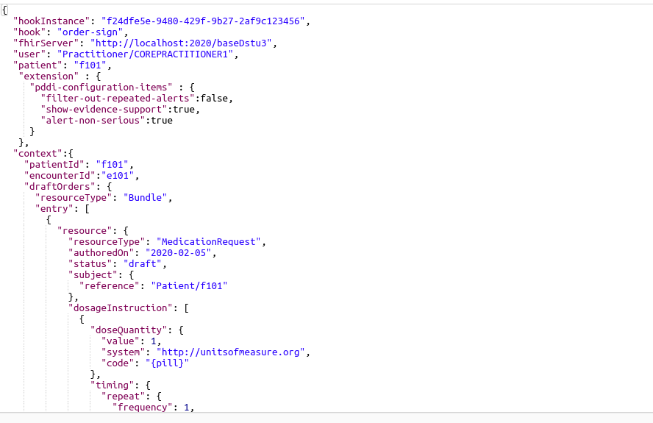
How Configuration Looks in CDS Hooks Continued
POST http://localhost:2020/cds-services/warfarin-nsaids-cds-sign
REQUEST (Warfarin-NSAIDS order-sign service):

Slide 10
Demonstration
1. GET services
2. order-select with no coordination to order-sign
- using:
cache-for-order-sign-filtering=false
filter-out-repeated-alerts=false
3. order-select coordinated to order-sign
- using:
cache-for-order-sign-filtering=true
filter-out-repeated-alerts=true

Slide 11
New Requirements to Support Configuration
If the CDS service supports configuration:
1. The service needs to be able to respond with available options from the configuration extension (in our case ‘pddi-configuration-items’) at the time of service registration (GET)
2. The client CDS Hooks POST requests need to include configuration object in the ‘extension’ attribute (in our case, named ‘pddi-configuration-items’) with only those configuration options reported by the service
3. The service needs to validate the configuration items submitted and have a graceful way
to return an error (e.g., an information card)

Slide 12
New Requirements to Support Coordination between
order-select and order-sign
1. The service must have mechanism to cache information from order-select requests
for use by the service when processing order-sign requests
- For our use case, we are currently caching [1]:
- Ordering physician (user)
- patient id
- encounter id
- the URL of the the relatedArtifact (PlanDefinition)
- medication id constructed from system + code from the Medication
Codeable Concept
- Base64 encoded Medication object
3. (order-select) The client needs to set cache-for-order-sign-filtering to true for POST
4. (order-sign) The client needs to set filter-out-repeated-alerts to true for POST
[1] http://localhost/~rdb20/PDDI-CDS/output/cds-service-spec.html#-360--cds-message-filtering

Slide 13
Discussion
-

