Slide 1
Update on Development of the Implementation Guide Potential Drug-Drug Interaction (PDDI) Clinical Decision Support (CDS)
HL7 CDS Workgroup Meeting 9/18/19

Slide 2

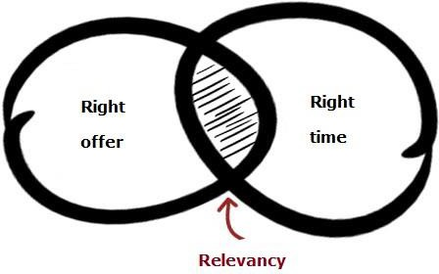
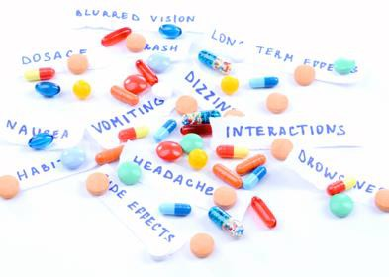


Potential Drug - Drug Interactions
… can be mitigated by clinical decision support (CDS)
with the relevant
reference information
presented
at appropriate times
Intelligently filtered

Slide 3

Potential Drug - Drug Interaction CDS
No broadly accepted standards
Authoring
Implementation
Sharing

Slide 4
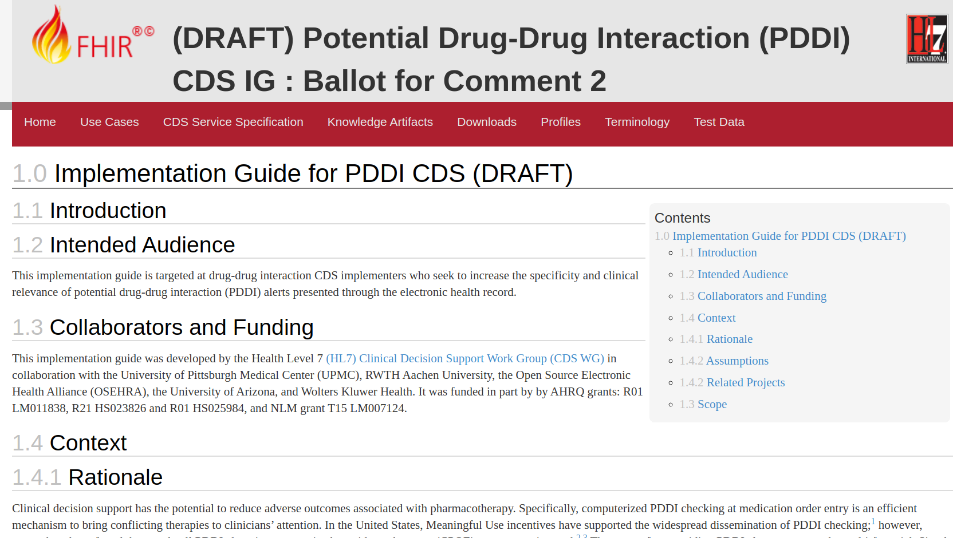
https://github.com/HL7/PDDI-CDS.git

Slide 5
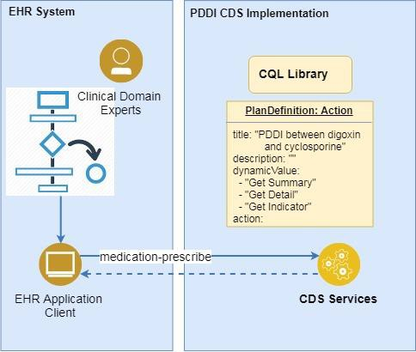
PDD CDS - Services Based Architecture
CDS Service: near real-time support
as remote services
Context based CDS
order-select:
at the time of order selection
order-sign:
at the time of order authorization
Basic actions
registering for CDS services,
calling those services,
receiving the response : cards
order-select

Slide 6
PDDI CDS Service - Discovery
Discovery Endpoint (CDS Services) :
Hosted at a stable endpoint, i.e.
{baseUrl}/cds-services
allows EHR to discover all available CDS
services
{baseUrl}/cds-services/warfarin-nsaids-cds-select
{baseUrl}/cds-services/warfarin-nsaids-cds-sign
Each service contains:
Description of the service
When it should be invoked
Any data that is requested to be prefetched

Slide 7
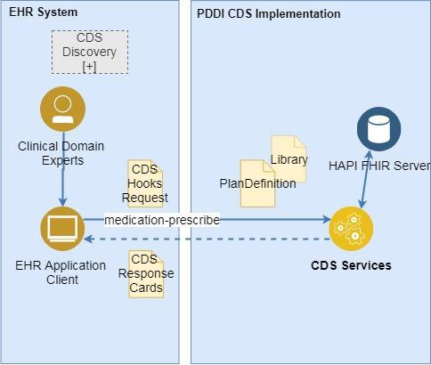
PDDI CDS Service – Mechanism: CDS Hooks
User activity inside the EHR triggers CDS hooks in real-time.
When a triggering activity occurs, the EHR notifies each CDS service registered for the activity. Each service gets:
context parameter: basic details about the EHR
prefect template parameter: service-specific data are required
Each CDS service can return any number of cards in response to the hook.
order-select

Slide 8
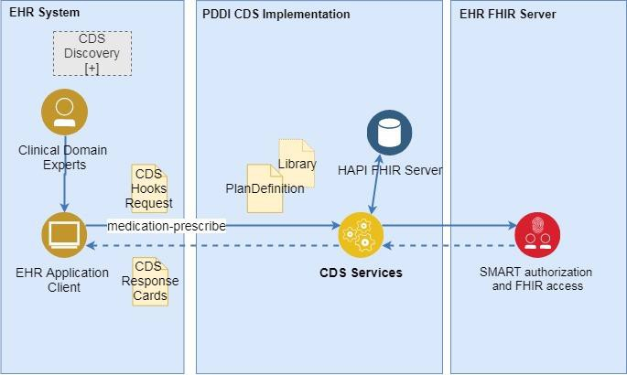
PDDI CDS Service – Data Model: FHIR
When a service is invoked, the request contains pre-queried data, called "prefetch"
If the CDS service does not receive prefetch data in the request, it will query the EHR FHIR Server
order-select

Slide 9
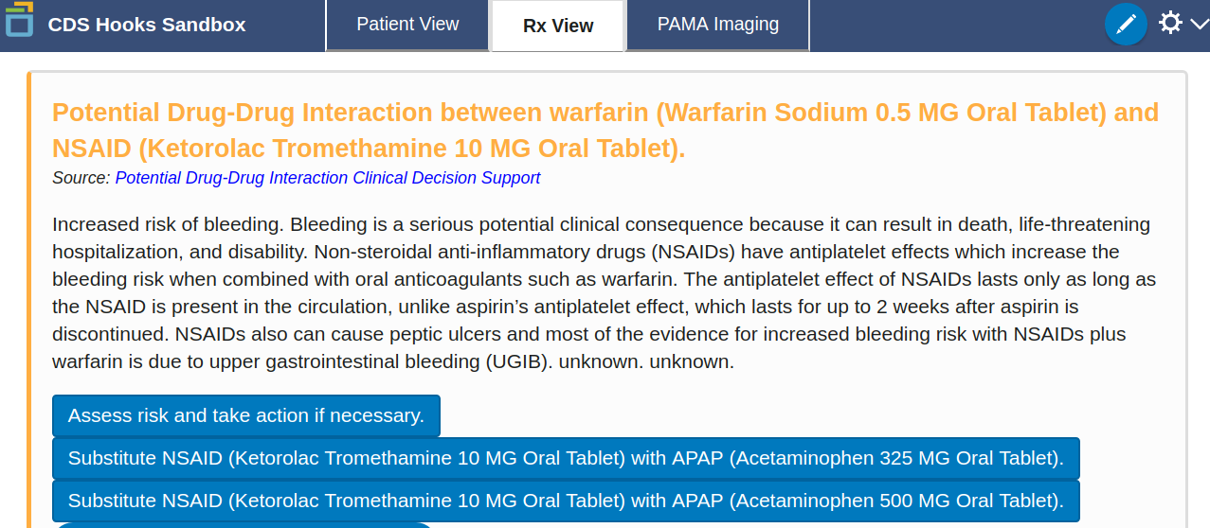
PDDI CDS Service – Response: CDS Hooks Cards

Slide 10
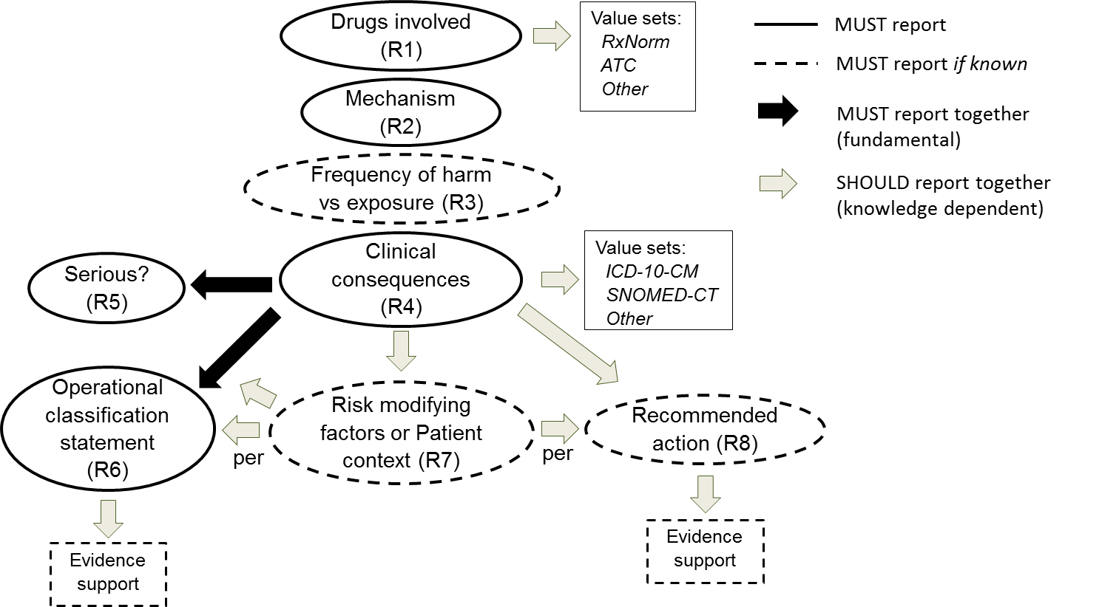
PDDI CDS Service – Response Information Model
https://w3id.org/hclscg/pddi

Slide 11
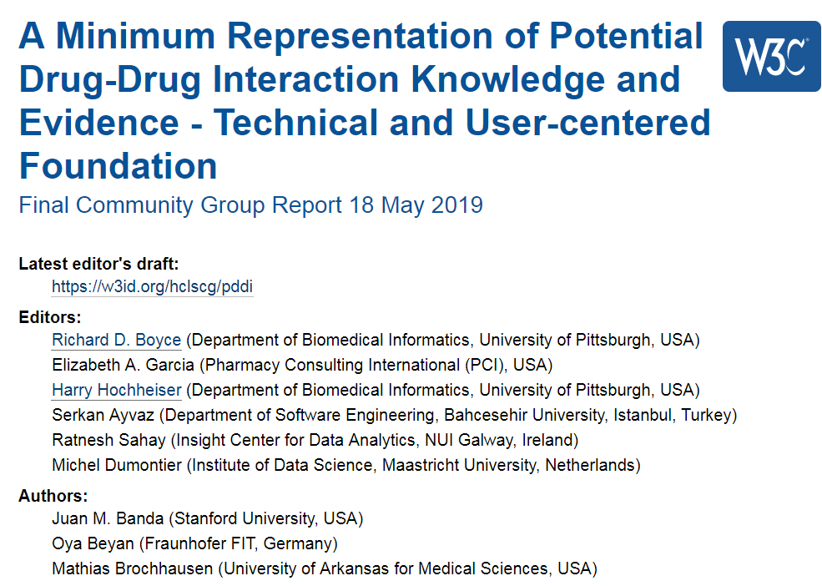
https://w3id.org/hclscg/pddi

Slide 12
PDDI CDS Service – Cards + Information Model
Specific drugs involved
Clinical consequences
Serious?
Mechanism
Operational Classification
Recommended Action

Slide 13
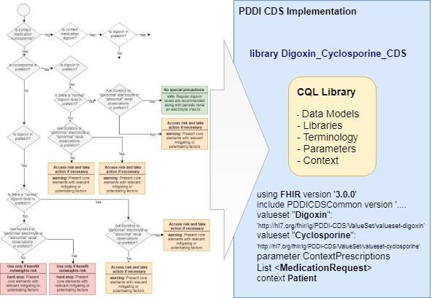
PDDI CDS Service – Knowledge Representation: Clinical Quality Language (CQL)
a high-level, domain-specific query language
can represent the PDDI information
combining rules to describe the available data
supports different data models – FHIR

Slide 14
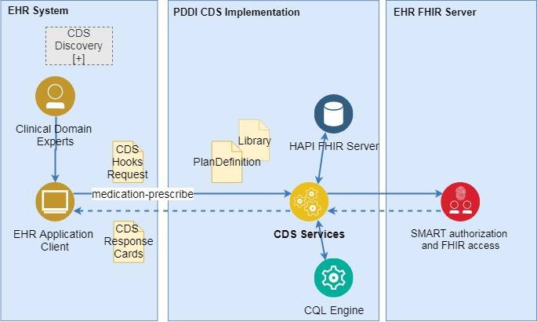
PDDI CDS Service: CQL Engine
PlanDefinition and Library resources are loaded from FHIR server
the CQL logic in the Library resource is decoded
evaluated by CQL engine
CDS Response Cards are generated and returned to the client.
order-select

Slide 15
PDDI CDS Implementation Guide - Status
Spring 2018 – Project start
Fall 2018 – First ballot for comments
Used CDS Hooks medication-prescribe
Distinguished “basic” and “advanced” CDS
Basic – CDS at order signing
Advanced – CDS at both order selection and order signing with the CDS service tracking state to avoid duplicate alerts

Slide 16
PDDI CDS Implementation Guide – Status Cont.
Spring 2019 – CDS Hooks 1.0
New CDS Hooks order-select and order-sign
The draft IG updated to refer to these hooks

Slide 17
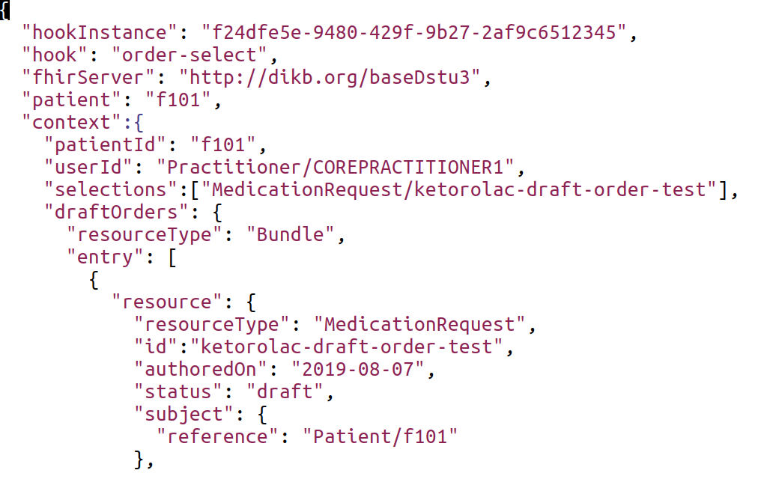
PDDI CDS - order-select

Slide 18
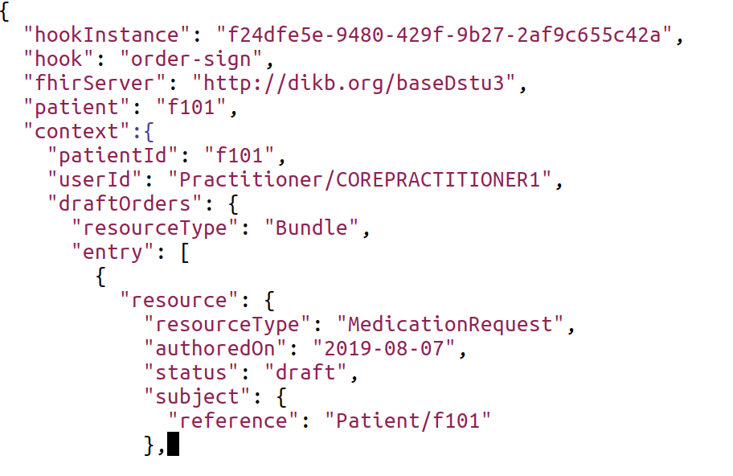
PDDI CDS - order-sign

Slide 19
PDDI CDS Implementation Guide – Status Cont.
Summer 2019
Decision to move away from having the CDS service retain state to avoid duplicate alerts
The IG updated to remove “basic” and “advanced”
Implication – EHRs will need some way to handle duplicate alerts between order-select and order-sign

Slide 20
One Possible Solution to Avoid Duplicate Alerts
The CDS Service references the component of the knowledge artifact that has triggered a card response
E.g., a URI link provided in the Link array of the card response
The client EHR stores the knowledge artifact component reference at order-select
The client EHR filters out cards that reference the same knowledge artifact component at order-sign

Slide 21
Possible Solution – warfarin-NSAIDs Example

Slide 22
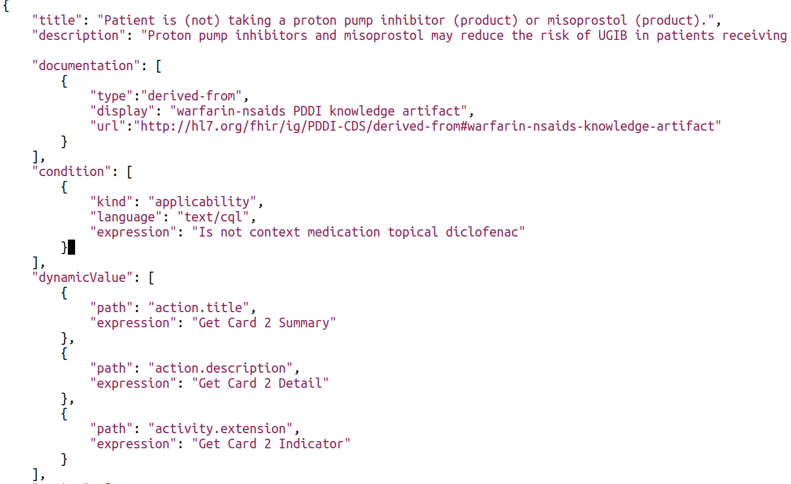
Possible Solution – warfarin-NSAIDs Example
Knowledge artifact component reference

Slide 23
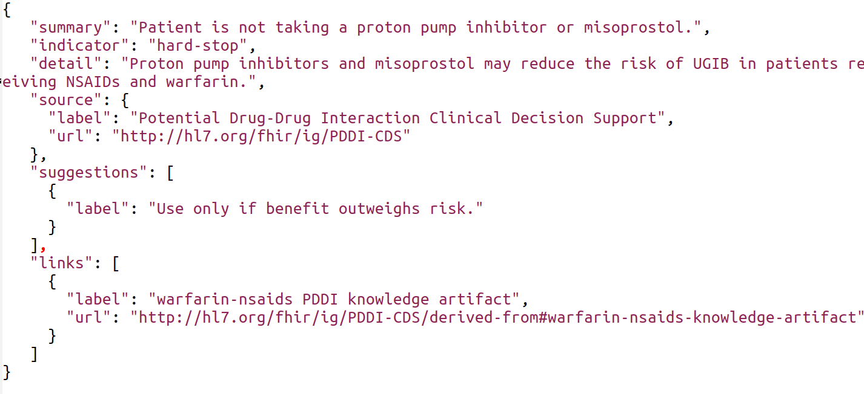
Possible Solution – warfarin-NSAIDs Example
CDS Hooks card response to order-select
Knowledge artifact component reference

Slide 24
PDDI CDS Implementation Guide – Status Cont.
Fall 2019
Discussion at the Connectathon
How do EHRs currently handle potential duplicate alerts between the selecting and signing steps of an ordering workflow?
https://tinyurl.com/yxa59jtt
Alternative ways of handling potential alert duplications
An active discussion for Hooks 1.1

Slide 25
PDDI CDS Implementation Guide – Next Steps
Fall/Winter 2019
Finish revising the draft IG with a recommended solution for referencing knowledge artifact components within Hooks 1.0
Determine usefulness for DetectedIssue resources
Spring 2020
Ballot the IG for comment

Slide 26
Discussion

