Slide 1

Toward Sharable Individualized Drug Interaction Alerts
Richard D. Boyce, PhD
University of Pittsburgh
OHDSI Community Call
July 18th 2017
Notes:
I am very privileged to have been invited to speak at your seminar. I would like to thank Dr. Lang Li for inviting me and all those who have helped arrange my visit.
The title of my talk is….

Slide 2
Disclosures
Neither myself or my spouse have any relevant financial relationships with commercial interests

Slide 3
Potential drug-drug interactions
Exposure two or more drugs that are known to interact
“potential” because exposure does not necessarily mean a clinically meaningful effect
Example: Fluconazole – simvastatin
Known pharmacokinetic interaction – inhibition of CYP3A4 metabolism
Might not be meaningful for the patient at low doses of fluconazole (≤ 200 mg/day)

Slide 4
Clues about the frequency of harm
Clinically important events attributable to drug-drug interactions [1]:
5.3% - 14.3% of inpatients
231,000 US emergency department visits
Hospital admissions associated with an adverse drug event attributable to drug-drug interactions [2]:
22.2% (interquartile range 16.6 - 36.0%)
Magro L, Moretti U, Leone R. Epidemiology and characteristics of adverse drug reactions caused by drug-drug interactions. Expert Opin Drug Saf. 2012;11(1):83-94. doi:10.1517/14740338.2012.631910
Dechanont S, Maphanta S, Butthum B, Kongkaew C. Hospital admissions/visits associated with drug-drug interactions: a systematic review and meta-analysis. Pharmacoepidemiol Drug Saf. 2014;23(5):489-497. doi:10.1002/pds.3592.

Slide 5
“When the Holes Line Up”
A + B
Prescriber’s Knowledge
Computer Screening
Pharmacist’s Knowledge
Patient Risk Factors
Drug Administration
Patient Education
Monitoring
Defenses
ADR
Latent Failures
Hansten PD, Horn JR. Modified from: James Reason, Human Error, 1990

Slide 6
PDDI knowledge and information sources
Prescriber knowledge is lacking^{1,2}
42.7% of drug pairs correctly identified¹
Information sources used by prescribers for PDDIs³
Pharmacists - 68.4%
Alerts - 10.8%
Other sources - 5.1%
Ko et al. Drug Saf. 2008;31(6):525-536.
Glassman. Med Care. 2002;40(12):1161-1171
Ko et al. Res Social Adm Pharm. 2008;4(4):355-366
Notes:
ePocrates Rx Formulary, Lexi-Drugs Platinum, mobileMICROMEDEX, and Tarascon ePharmacopoeia

Slide 7
Issues with using computers to screen for PDDIs
Drug interaction alerts have the potential to provide useful clinical decision support
Unfortunately, poor specificity overwhelms clinicians with information that is difficult to use for clinical decision making
Böttiger Y, Laine K, Andersson ML, et al. SFINX-a drug-drug interaction database designed for clinical decision support systems. Eur J Clin Pharmacol. 2009;65(6):627-633. doi:10.1007/s00228-008-0612-5.

Slide 8
Sensitivity of Computer Software to Detect PDDIs in Arizona Pharmacies (N=64)
Saverno et al. JAMIA; 2011:18:32-37

Slide 9
We have to avoid over-alerting!
Systems that provide PDDI alerts at the point of care often alert to PDDIs that have little potential clinical significance
frustrating clinicians
“Drug safety alerts are overridden by clinicians in 49% to 96% of cases” [1]
can lead to inappropriate responses
“An increased number of non-critical alerts…was the only variable associated with an inappropriate provider response” [2]
Van der Sijs H, Aarts J, Vulto A, Berg M. Overriding of drug safety alerts in computerized physician order entry. J Am Med Inform Assoc. 2006;13(2):138–147.
Miller AM, Boro MS, Korman NE, Davoren JB. Provider and pharmacist responses to warfarin drug-drug interaction alerts: a study of healthcare downstream of CPOE alerts. J Am Med Inform Assoc. 2011;18 Suppl 1:i45–50. PMCID: PMC3241165.
Notes:
Be sure to review the references and give a specific example

Slide 10
Ongoing efforts to improve PDDI decision support
Dr. Daniel Malone (U of Arizona) has led two multi-stakeholder conference series focused on how to address PDDI alert specificity
Both funded by the United States Agency for Healthcare Research and Quality
Hines LE, Malone DC, Murphy JE. Recommendations for Generating, Evaluating, and Implementing Drug-Drug Interaction Evidence. Pharmacotherapy: The Journal of Human Pharmacology and Drug Therapy. 2012;32(4):304–313. doi:10.1002/j.1875-9114.2012.01024.x
Scheife RT, Hines LE, Boyce RD, et al. Consensus recommendations for systematic evaluation of drug-drug interaction evidence for clinical decision support. Drug Saf. 2015;38(2):197-206. doi:10.1007/s40264-014-0262-8.
Payne TH, Hines LE, Chan RC, et al. Recommendations to improve the usability of drug-drug interaction clinical decision support alerts. J Am Med Inform Assoc. 2015;22(6):1243-1250. doi:10.1093/jamia/ocv011.
Tilson H, Hines LE, McEvoy G, Weinstein DM, Hansten PD, Matuszewski K, le Comte M, Higby-Baker S, Hanlon JT, Pezzullo L, Vieson K, Helwig AL, Huang SM, Perre A, Bates DW, Poikonen J, Wittie MA, Grizzle AJ, Brown M, Malone DC. Recommendations for selecting drug-drug interactions for clinical decision support. Am J Health Syst Pharm. 2016 Apr 15;73(8):576-85. doi: 10.2146/ajhp150565. PubMed PMID: 27045070; PubMed Central PMCID: PMC5064943.

Slide 11
Three outcomes of the conference series
Develop guidelines for systematic appraisal of PDDI evidence
Scheife RT, Hines LE, Boyce RD, et al. Consensus recommendations for systematic evaluation of drug-drug interaction evidence for clinical decision support. Drug Saf. 2015;38(2):197-206. doi:10.1007/s40264-014-0262-8
Notes:
This conference series is supported in part by grant #1R13HS021826-01 from the US HHS Agency for Healthcare Research and Quality (AHRQ). AHRQ’s goals are to promote effective, appropriate, high quality health care; increase access to care; and improve the way health services are organized, delivered, and financed. We also wish to thank the following companies for their generous support and commitment to the aims of this project. Cerner Epocrates First Databank Truven Health Analytics Wolters Kluwer

Slide 12
Three outcomes of the conference series cont.
Identify a process for determining the most relevant PDDIs & approaches to reduce alert fatigue
Tilson H, Hines LE, McEvoy G, Weinstein DM, Hansten PD, Matuszewski K, le Comte M, Higby-Baker S, Hanlon JT, Pezzullo L, Vieson K, Helwig AL, Huang SM, Perre A, Bates DW, Poikonen J, Wittie MA, Grizzle AJ, Brown M, Malone DC. Recommendations for selecting drug-drug interactions for clinical decision support. Am J Health Syst Pharm. 2016 Apr 15;73(8):576-85. doi: 10.2146/ajhp150565. PubMed PMID: 27045070; PubMed Central PMCID: PMC5064943.
Notes:
This conference series is supported in part by grant #1R13HS021826-01 from the US HHS Agency for Healthcare Research and Quality (AHRQ). AHRQ’s goals are to promote effective, appropriate, high quality health care; increase access to care; and improve the way health services are organized, delivered, and financed. We also wish to thank the following companies for their generous support and commitment to the aims of this project. Cerner Epocrates First Databank Truven Health Analytics Wolters Kluwer

Slide 13
Three outcomes of the conference series cont.
Establish preferred strategies for presenting PDDI alerts
Payne TH, Hines LE, Chan RC, et al. Recommendations to improve the usability of drug-drug interaction clinical decision support alerts. J Am Med Inform Assoc. 2015;22(6):1243-1250. doi:10.1093/jamia/ocv011.
Notes:
This conference series is supported in part by grant #1R13HS021826-01 from the US HHS Agency for Healthcare Research and Quality (AHRQ). AHRQ’s goals are to promote effective, appropriate, high quality health care; increase access to care; and improve the way health services are organized, delivered, and financed. We also wish to thank the following companies for their generous support and commitment to the aims of this project. Cerner Epocrates First Databank Truven Health Analytics Wolters Kluwer

Slide 14
What information should be present in a PDDI alert?
drugs involved,
seriousness,
clinical consequences,
mechanism of the interaction,
contextual information/modifying factors,
recommended action(s), and
evidence
Payne TH, Hines LE, Chan RC, Hartman S, Kapusnik-Uner J, Russ AL, Chaffee BW, Hartman C, Tamis V, Galbreth B, Glassman PA, Phansalkar S, van der Sijs H, Gephart SM, Mann G, Strasberg HR, Grizzle AJ, Brown M, Kuperman GJ, Steiner C, Sullins A, Ryan H, Wittie MA, Malone DC. Recommendations to improve the usability of drug-drug interaction clinical decision support alerts. J Am Med Inform Assoc. 2015 Nov;22(6):1243-50. doi: 10.1093/jamia/ocv011. Epub 2015 Mar 30. Review. PubMed PMID: 25829460.

Slide 15
A deeper dive into PDDI decision support information needs
Review and synthesis of:
77 journal articles
4 white papers from the AHRQ-funded PDDI Working Groups
6 semi-structured interviews
Romagnoli KM, Nelson SD, Hines L, Empey P, Boyce RD, Hochheiser H. Information needs for making clinical recommendations about potential drug-drug interactions: a synthesis of literature review and interviews. BMC Med Inform Decis Mak. 2017;17(1):21. doi:10.1186/s12911-017-0419-3

Slide 16
Information needs
Drug Information
Pharmacology
Mechanism of action
Formulation
Timing
…
Consequences
Adverse effect(s)
Reversibility
Frequency
Modifying and mitigating factors
…
Evidence
Study design
Reporting information (e.g., funding agency)
Causality assessment (case reports)
…
Recommendation
Monitor, change drugs, modify strength, adjust timing, etc
Strength of recommendation
Clinical Information
Seriousness
Severity
Time of onset
Manageability
…

Slide 17
Where does the information come from?
Pre-market studies
Post-market studies
Clinical experience
Rarely reported in
Reported in
Rarely reported in
Reported in
Scientific literature
Rarely reported in
Product labeling
Source for
Source for
Drug Compendia synthesize PDDI evidence into knowledge but
May fail to include important PDDIs
Often disagree about PDDI evidence and seriousness ranking
May include numerous PDDIs with little evidence for liability reasons

Slide 18
The potential role for large scale evidence generation
Clinical experience
Product labeling
Scientific literature
High priority PDDIs for research
A framework for representing PDDI evidence and supporting its synthesis into decision support
Evidence generation using observational data
Semantic annotation
Sharable individualized PDDI decision support
Reduced risk of a PDDI medication error!
Expected benefits:
More complete and accurate PDDI evidence
Better informed pharmacists and other clinicians
More effective PDDI alerting and decisions support systems

Slide 20
Individualized Drug Interaction Alerts (iDIA, AHRQ : HS023826)
Develop computable evidence-based clinical algorithms
consider each patient’s electronic health record information
provide a clinician with actionable information
tailored to the specific context

Slide 21
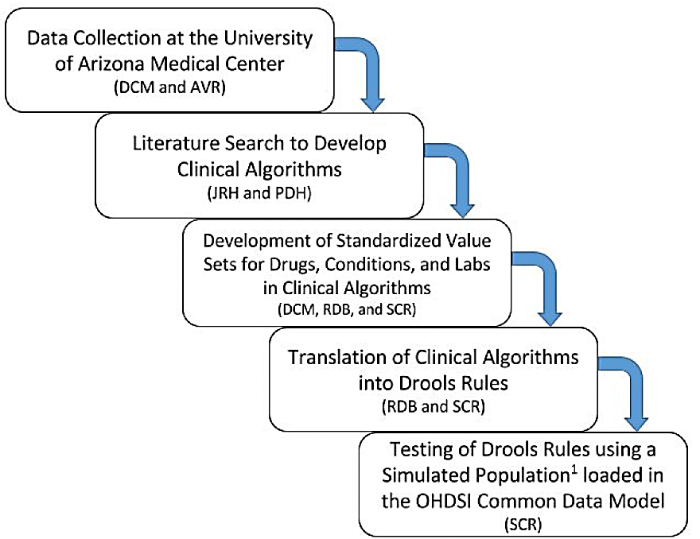
Acronyms:
DCM – Daniel C. Malone, RPh, PhD
AVR – Andrew V. Romero, PharmD
JRH – John R. Horn, PharmD
PDH – Philip Hansten, PharmD
RDB – Richard D. Boyce, PhD
SCR – Samuel C. Rosko, MS

Slide 22
Methods – Identifying frequent PDDI alerts
Data collected at the University of Arizona Medical Center over 90 days
Goal: Identify the most frequently overridden DDI pairs
Specifically, those with drug and patient- specific factors

Slide 23
Methods - Clinical Algorithm Development
Primary literature review
identify drug- and patient-specific factors that could alter the potential clinical impact of exposure to a PDDI
Clinical algorithms were developed in the form of decision trees
Implemented in two sharable ways:
FOL Rules
Computable cohort definitions

Slide 24
Results - frequent PDDI alerts
Selected 11 PDDIs to focus on and developed decision trees for all of them
Potential Drug-Drug Interaction | Severity | Total # Overridden
Opioids / Fluconazole | Severe | 4835
Warfarin / Salicylates | Severe | 2842
KCL / K-sparing Diuretics | Severe | 2545
Immunosuppressants / Azoles | Severe | 2306
Amiodarone / QT Prolonging Agents | Severe | 1739
Clonidine / Beta-Blockers | Severe | 1476
Warfarin / SSRIs; SNRIs | Severe | 1473
Ceftriaxone / Calcium | Severe | 1387
Metoclopramide / Antipsychotics | Severe | 1358
Epinephrine / Beta-Blockers | Severe | 1095
Warfarin / NSAIDs | Severe | 342

Slide 25
Results – Clinical algorithms
11 algorithms implemented as Drools rules
running against a simulated patient population stored in the OHDSI common data model
https://github.com/dbmi-pitt/iDIA_Rules
A Docker version of the whole stack
https://github.com/dbmi-pitt/docker-iDIA-Rules
3 computable cohort descriptions implemented using Atlas
warfarin – NSAIDS
potassium - potassium-sparing diuretics
immunosuppressants – azole-antifungals

Slide 26
A walk-through example of the rules and cohort descriptions
Warfarin + NSAIDS

Slide 27
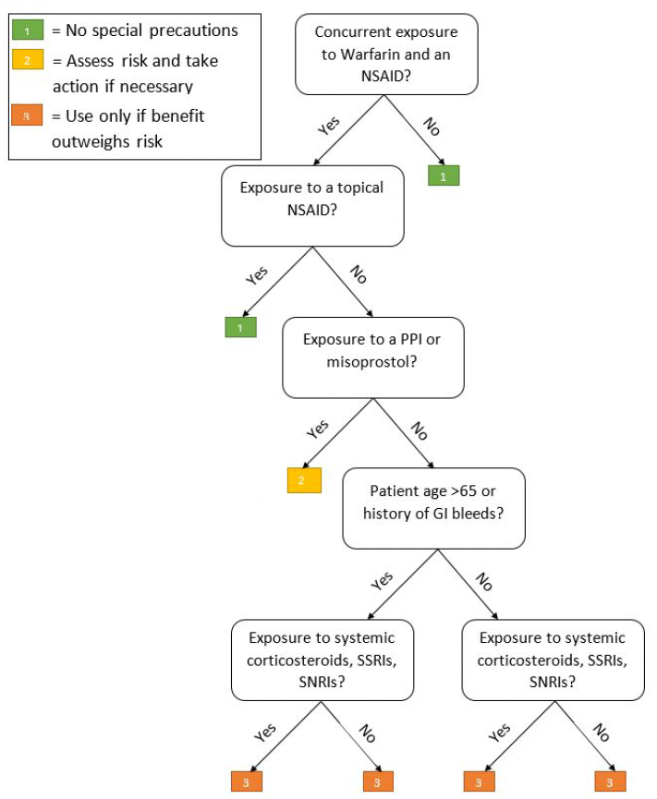

Slide 28
Step 1: Develop
concept sets

Slide 29
Example concept set protocol
https://goo.gl/1hWJVT
See them all here:
https://goo.gl/eRPK67
Examples in Atlas

Slide 30
Step 2: Write modular rules for each branch point

Slide 31
Basics of Rule Writing - lingo
IF A => B
Rule,
Production
LHS
RHS
premises
predicates
patterns
conditions
conclusions
actions

Slide 32
Step 2: Write modular rules for each branch point

Slide 33
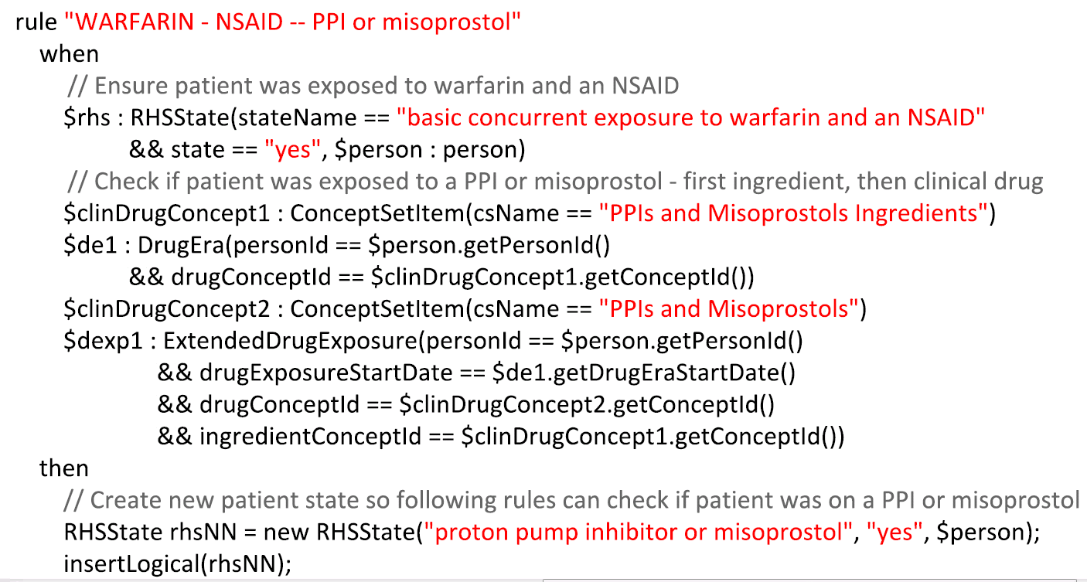

Slide 34

Step 3: Test the rules against simulated patients
OHDSI CDM +
Standard Vocabulary + WebAPI Schema
Multiple DBMS
Postgresql
SQL Server
Oracle
Load DE-SynPUF
Load other simulated data
Decision support algorithms implemented in Drools
Java-based
Drools
Hibernate
Controller application
Design and validate rules
https://github.com/dbmi-pitt/iDIA_Rules
https://github.com/dbmi-pitt/iDIA_Rules/tree/master/src/main/resources/rules_complete

Slide 35
Some tooling for loading simulated patients
https://goo.gl/7ndVCk

Slide 36
Step 4: Implement computable cohort definitions
OHDSI CDM +
Standard Vocabulary + WebAPI Schema
Multiple DBMS
Postgresql
SQL Server
Oracle
Load DE-SynPUF
Load other simulated data
Web API (REST)
Web Applications
OHDSI Atlas
Implement concept sets
Implement cohort definitions
https://github.com/dbmi-pitt/iDIA_Rules
https://github.com/dbmi-pitt/iDIA_Rules/tree/master/src/main/resources/rules_complete

Slide 37
Step 2: Write modular rules for each branch point

Slide 38
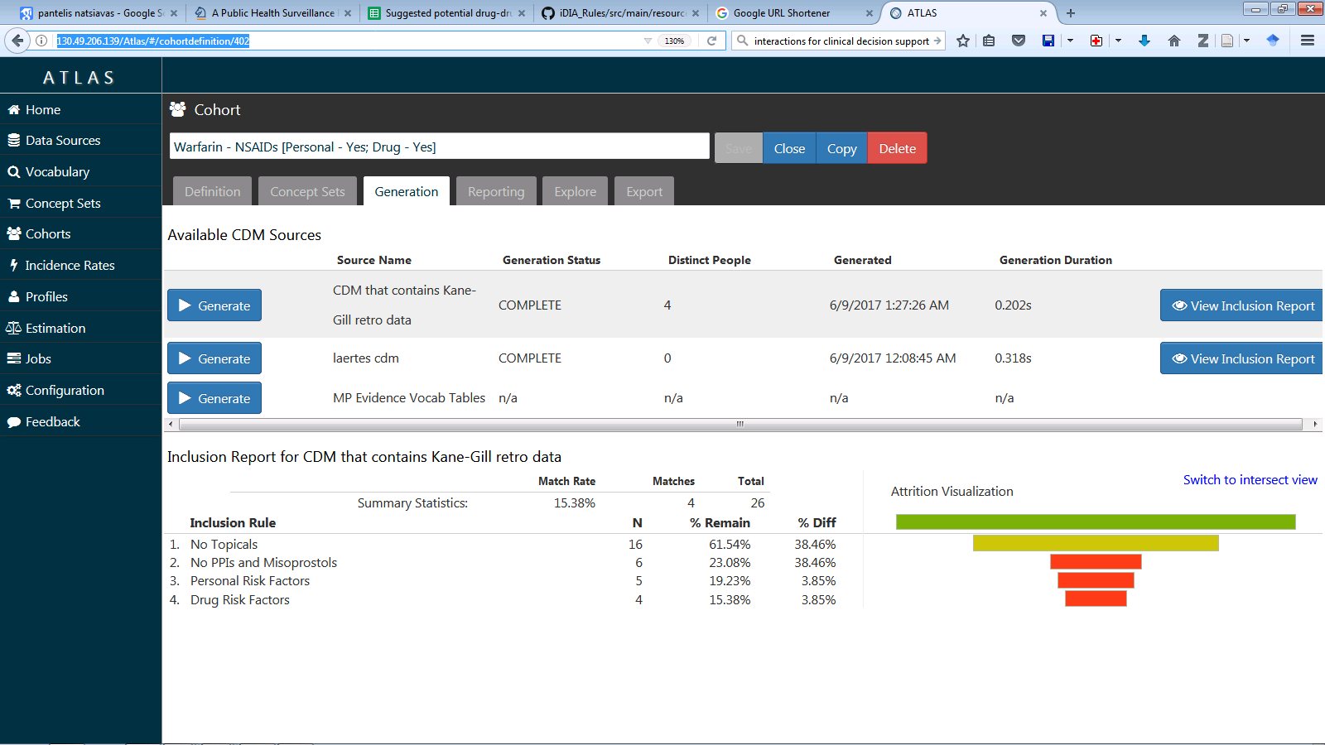

Slide 39
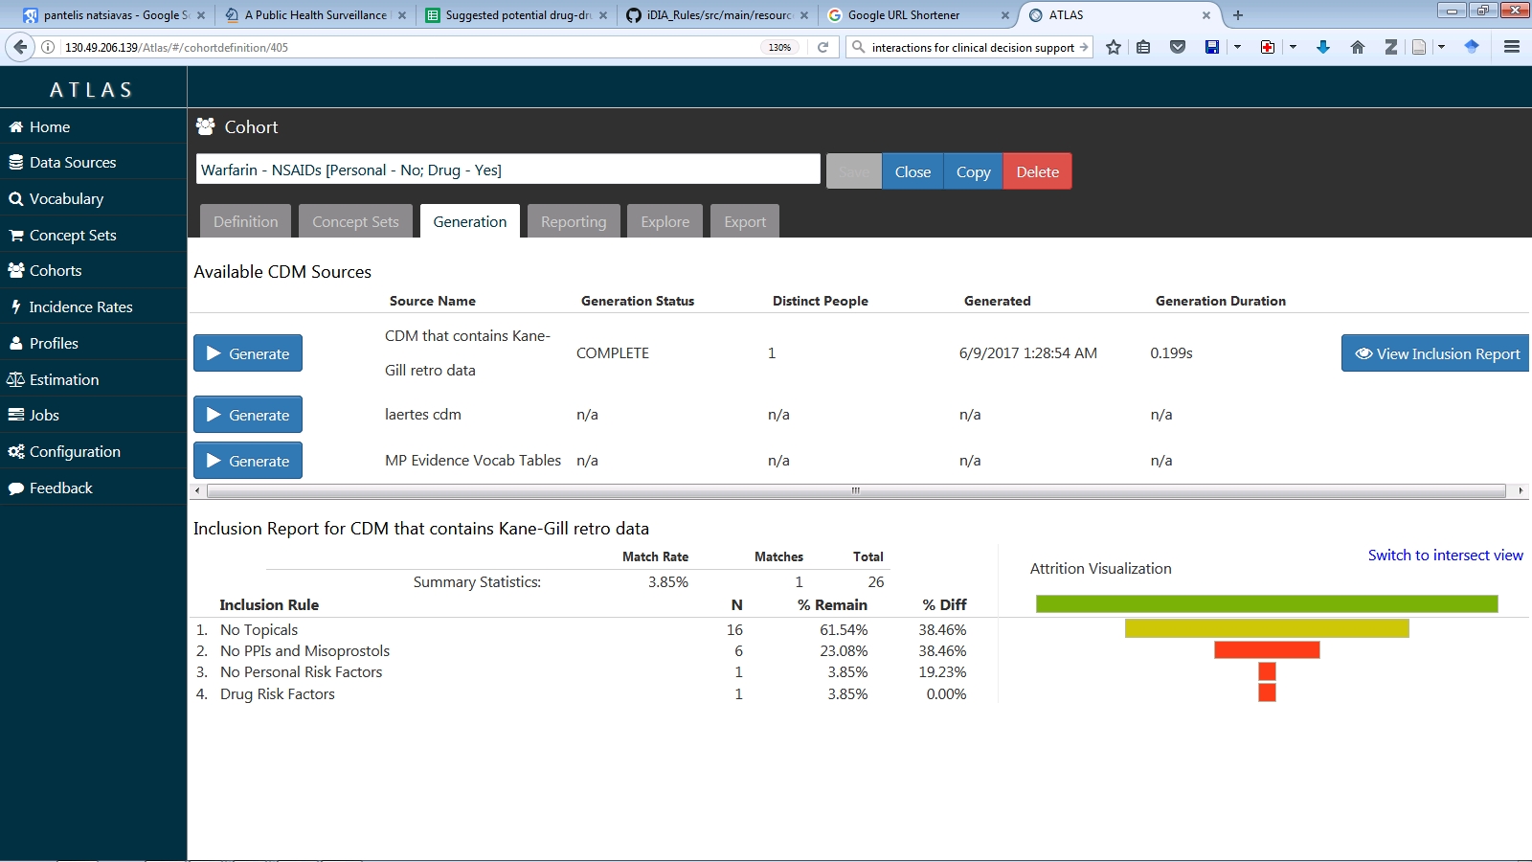

Slide 40
Code availability
https://github.com/dbmi-pitt/iDIA_Rules

Slide 41
The potential role for large scale evidence generation
Clinical experience
Product labeling
Scientific literature
High priority PDDIs for research
A framework for representing PDDI evidence and supporting its synthesis into decision support
Evidence generation using observational data
Semantic annotation
Sharable individualized PDDI decision support
Reduced risk of a PDDI medication error!
Expected benefits:
More complete and accurate PDDI evidence
Better informed pharmacists and other clinicians
More effective PDDI alerting and decisions support systems

Slide 42
Possible next steps
An OHDSI work group?
Where possible, test the ability of the algorithms to distinguish risk
Conduct observational studies to answer questions that arise while developing the rules

Slide 43
Discussion

Slide 44
Acknowledgements
The iDIA Team:
Dr. Daniel Malone, Dr. Philip Hansten, Dr. John Horn, Dr. Andrew Romero, Dr. Sheila Gephart, Sam Rosko
R21HS023826 from the Agency for Healthcare Research and Quality
R01LM011838 and T15LM007059 from the National Library of Medicine

