Slide 1
PDDI CDS IG Update
Configurable CDS Hooks
(order-select and order-sign)

Slide 2
Review
Last fall we decided that the CDS Service should:
Allow for some level configuration to be passed in CDS Hooks requests
Enables more flexibility for the client systems
Maintain some concept of state
Enables coordination between order-select and order-sign as a strategy to avoid apparently duplicate alerts

Slide 3
Configuration Solution
A new structure definition for pddi-cds-configuration-options
Follows the ideas of the DaVinci Coverage Requirements Discovery (CRD)
http://hl7.org/fhir/us/davinci-crd/2018Sep/hooks.html#configuration-options
TODO: make available at DIKB.org

Slide 4
Configuration Structure Definition
“It will be a Configuration object that will contain an array of available options. Each option will include four mandatory elements:
A code that will be used when setting configuration during hook invocation
A data type for the parameter. At present, allowed values are “boolean” and “integer”
A display name for the configuration option to appear in the client’s user interface when performing configuration
A description providing a 1-2 sentence description of the effect of the configuration option”
http://hl7.org/fhir/us/davinci-crd/2018Sep/hooks.html#configuration-options0

Slide 5
Configuration Options in PDDI CDS PlanDefinitions
order-select:
https://git.rwth-aachen.de/binhphi109/pddi-cds/blob/connectathon-21-pddi/examples/pddi-cds/warfarin-nsaids-order-select/plandefinition-bundle.json
order-sign:
https://git.rwth-aachen.de/binhphi109/pddi-cds/blob/connectathon-21-pddi/examples/pddi-cds/warfarin-nsaids-order-sign/plandefinition-bundle.json

Slide 6
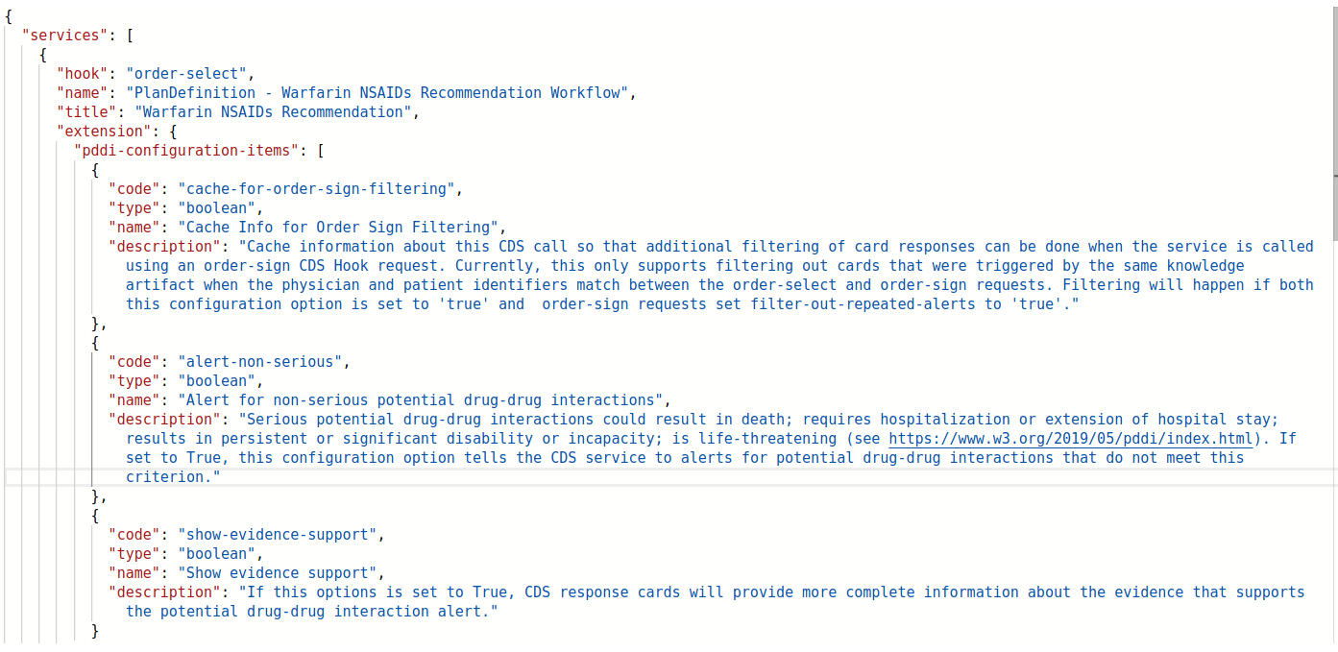
How Configuration Looks in CDS Hooks
GET http://localhost:2020/cds-services
RESPONSE (order-sign service):

Slide 7
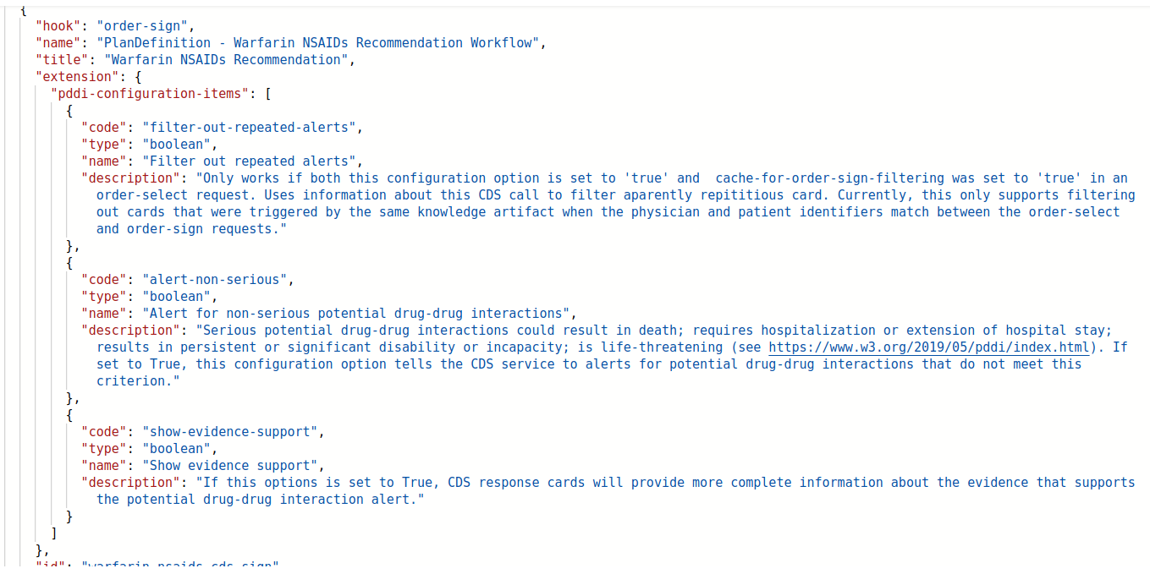
How Configuration Looks in CDS Hooks Continued
GET http://localhost:2020/cds-services
RESPONSE CONTINUED (order-select service):

Slide 8
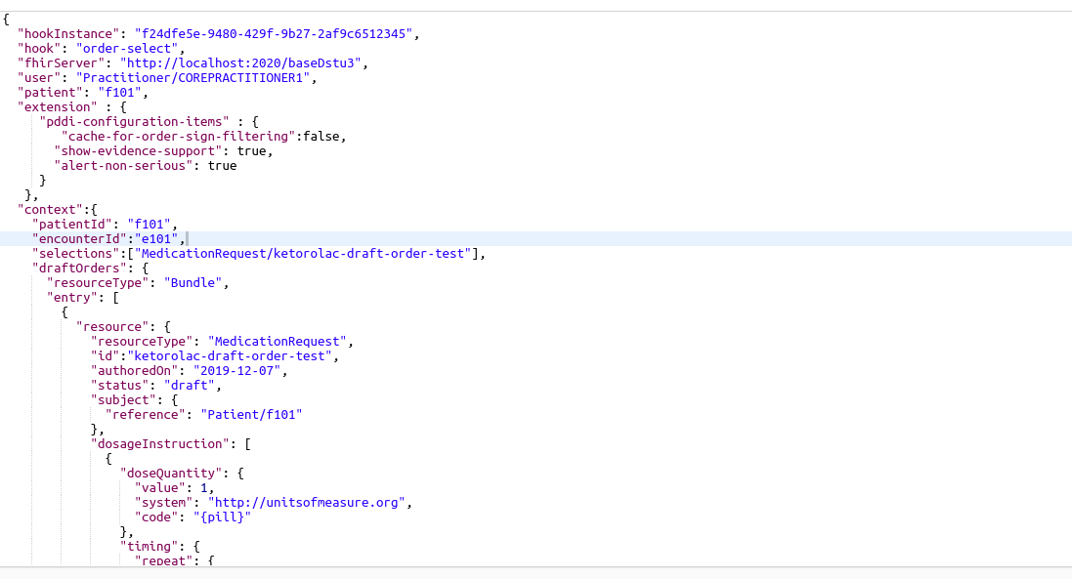
How Configuration Looks in CDS Hooks Continued
POST http://localhost:2020/cds-services/warfarin-nsaids-cds-select
REQUEST (Warfarin-NSAIDS order-select service):

Slide 9
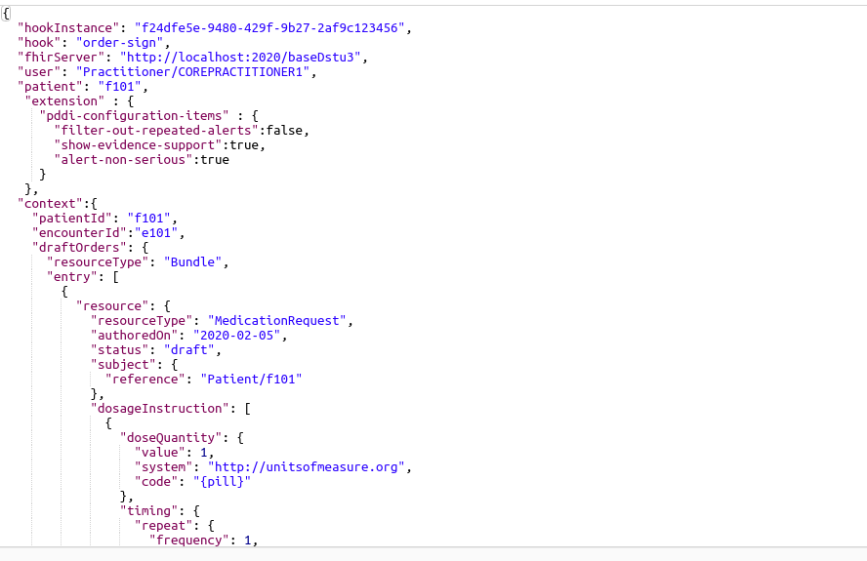
How Configuration Looks in CDS Hooks Continued
POST http://localhost:2020/cds-services/warfarin-nsaids-cds-sign
REQUEST (Warfarin-NSAIDS order-sign service):

Slide 10
Demonstration
1. GET services
2. order-select with alert-non-serious true/false
3. order-select with show-evidence-support true/false
4. order-select with cache-for-order-sign-filtering true/false

Slide 11
New Requirements to Support Configuration
If the CDS service supports configuration:
1. The service needs to be able to respond with available options for ‘pddi-configuration-items’
at the time of service registration (GET)
2. The client CDS Hooks POST requests need to include the extension
‘pddi-configuration-items’ and only those configuration options reported by the service
3. The service needs to validate the configuration items submitted and have a graceful way
to return an error (e.g., an information card)

Slide 12
New Requirements to Support Configuration Cont...
If the CDS service supports filtering alerts (the ‘filter-out-repeated-alerts’ config option)
1. The PlanDefinition for the service requires 1 and only 1 ‘relatedArtifact’ of
type ‘Documentation’ and this must include a unique and persistent URL to a
description of the knowledge artifact implemented by the PlanDefinition
2. The service must have mechanism to cache information from order-select requests
for use by the service when processing order-sign requests
- Currently testing cache of:
physician reference display, encounter id, patient id, and the URL
of the the relatedArtifact
- Might need to add other items such as the selected Medication resource in
‘draftOrders’
3. The service needs to have a graceful way to report both when filtering occurs and
when it does not occur e.g., due to an error (e.g., an information card)
4. The client needs to set cache-for-order-sign-filtering to true for POST order-select

Slide 13
Discussion
Note: intent to ballot deadline 3 weeks away!

