Slide 1
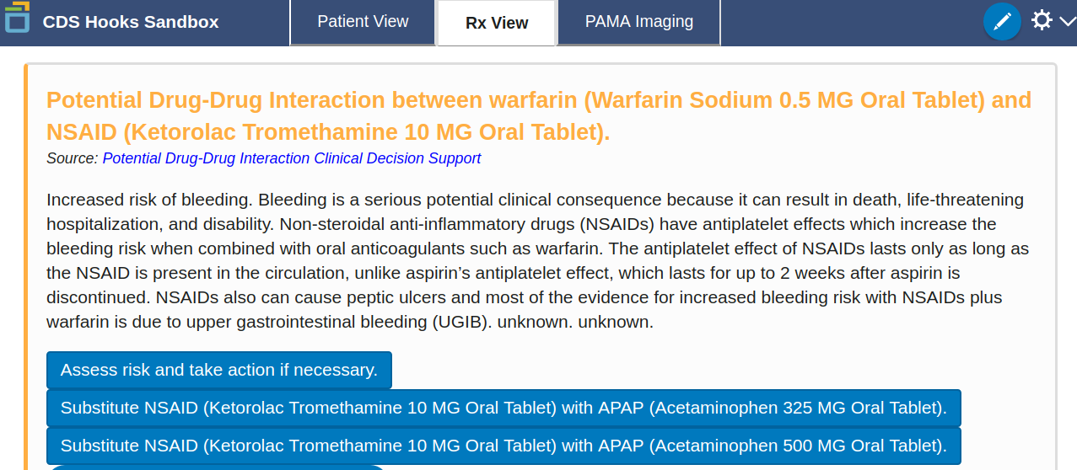
PDDI CDS Service – Response: CDS Hooks Cards

Slide 2
PDDI CDS Implementation Guide – Status Cont.
Summer 2019
Decision to move away from having the CDS service retain state to avoid duplicate alerts
The IG updated to remove “basic” and “advanced”
Implication – EHRs will need some way to handle duplicate alerts between order-select and order-sign

Slide 3
One Possible Solution to Avoid Duplicate Alerts
The CDS Service references the component of the knowledge artifact that has triggered a card response
E.g., a URI link provided in the Link array of the card response
The client EHR stores the knowledge artifact component reference at order-select
The client EHR filters out cards that reference the same knowledge artifact component at order-sign

Slide 4
Possible Solution – warfarin-NSAIDs Example

Slide 5
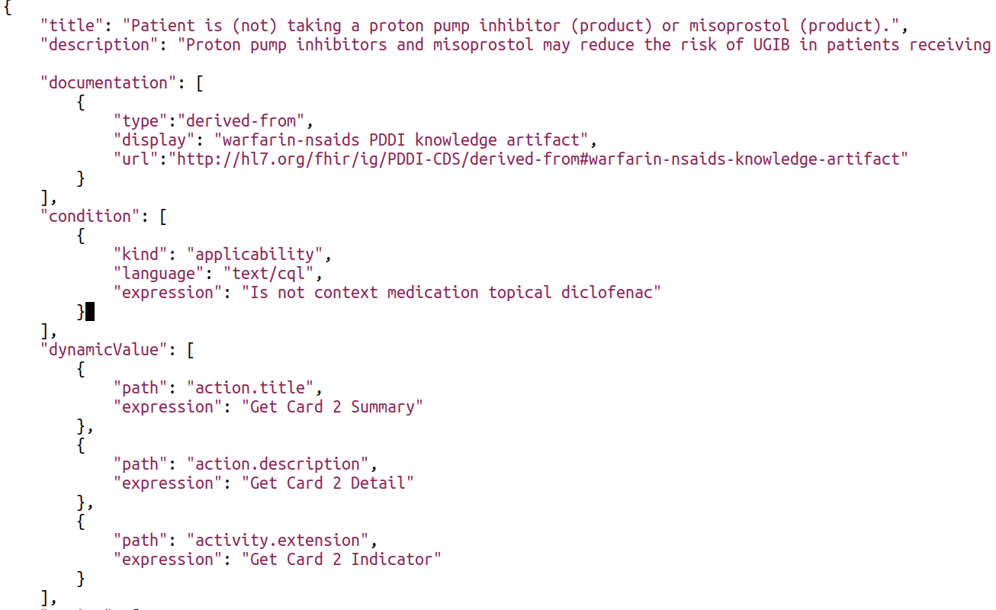
Possible Solution – warfarin-NSAIDs Example
Knowledge artifact component reference

Slide 6
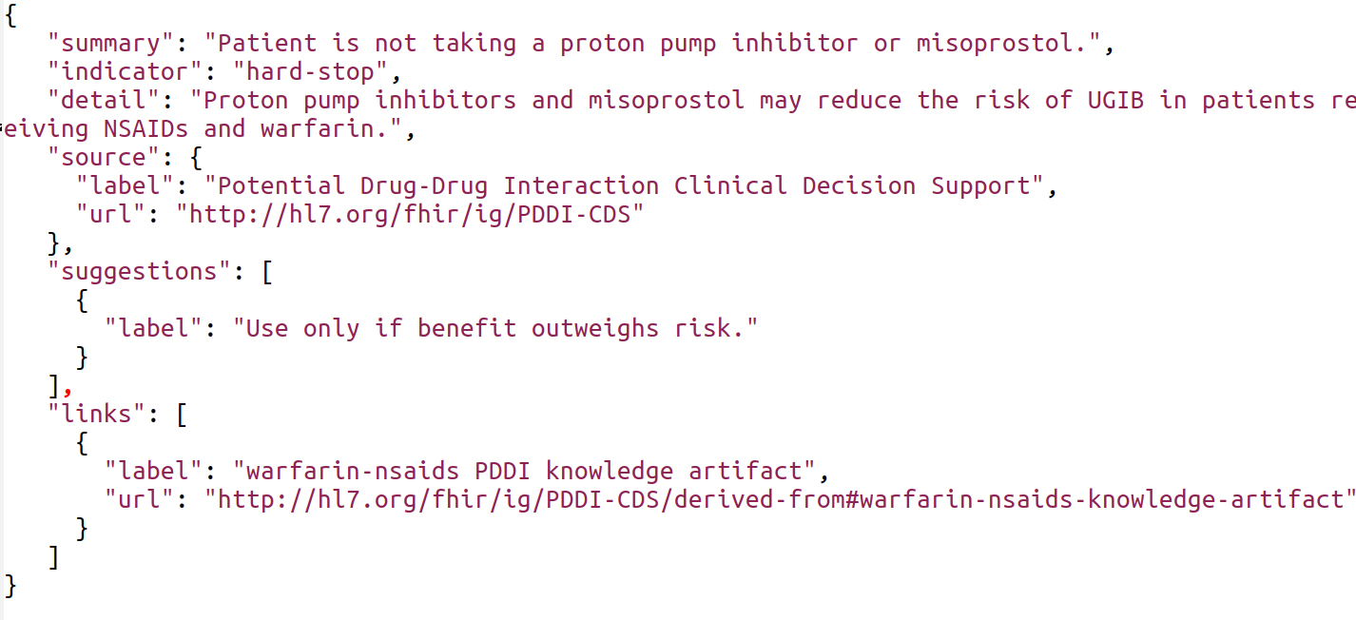
Possible Solution – warfarin-NSAIDs Example
CDS Hooks card response to order-select
Knowledge artifact component reference
Notes:
<number>

Slide 7
PDDI CDS Implementation Guide – Status Cont.
Fall 2019
Discussion at the Connectathon
How do EHRs currently handle potential duplicate alerts between the selecting and signing steps of an ordering workflow?
https://tinyurl.com/yxa59jtt
Alternative ways of handling potential alert duplications
An active discussion for Hooks 1.1

