Slide 1
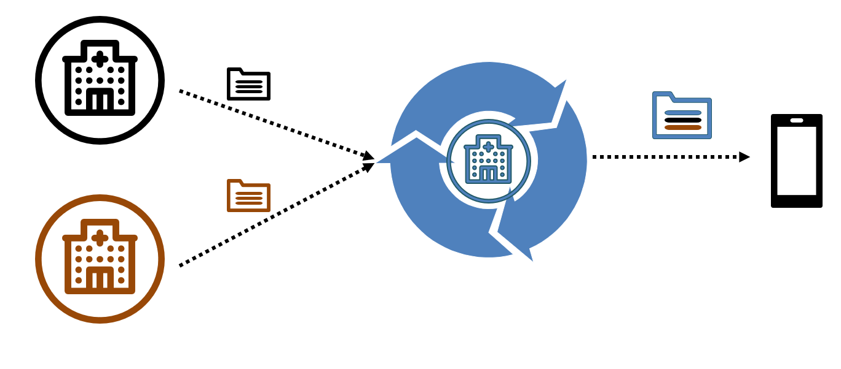
Allergy to peanuts - reaction hives
Author: Dr. Jones
Organization: Good Health
Date: 1/2018
Allergy to peanuts - reaction unknown
Author: Dr. Smith
Organization: Sunshine Health
Date: 9/2017

Slide 2
Allergy to peanuts - reaction hives
Author: Dr. Jones
Organization: Good Health
Date: 1/2018
Allergy to peanuts - reaction hives
Author: Dr. Reconciled
Organization: Future Health
Onset date: 2/2005
Recorded date: 5/15/2019
Allergy to peanuts - reaction hives
Author: Dr. Reconciled
Organization: Future Health
Onset date: 2/2005
Recorded date: 5/15/2019
Allergy to peanuts - reaction unknown
Author: Dr. Smith
Organization: Sunshine Health
Date: 9/2017

Slide 3


Slide 4
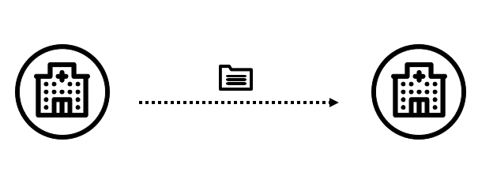



Slide 5
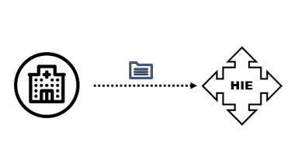
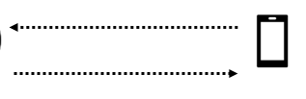

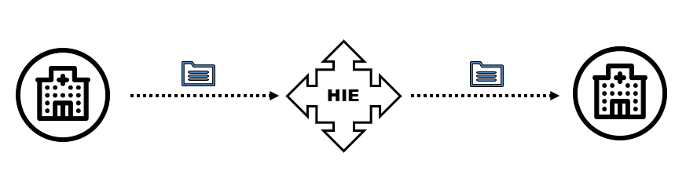

Slide 6
Allergy to peanuts - reaction hives
Author: Dr. Jones
Organization: Good Health
Date: 1/2018
Allergy to peanuts - reaction hives
Author: Dr. Jones
Organization: Good Health
Date: 1/2018
Notes:
HIE Redistriibution

Slide 7

HL7 V2
Allergy to peanuts - reaction hives
Author: Dr. Jones
Organization: Good Health
Date: 1/2018
Allergy to peanuts - reaction hives
Author: Dr. Jones
Organization: Good Health
Date: 1/2018
Notes:
HIE Transformation

Slide 8
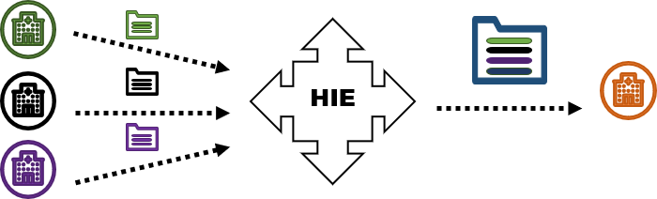

Slide 9
Payer

Slide 10
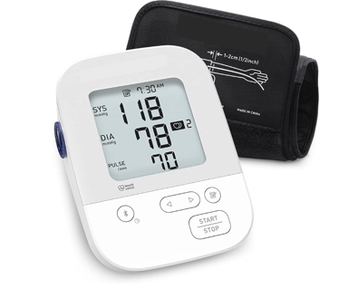
Since no clinical content is changed in the mobile app redistribution (PHR), the best scenario is a Provenance Record with:
OPTION A
Provenance.agent.type = composer
  Provenance.agent.who set to the device that authored the content (i.e., BP device, not the app)
Provenance.agent.type = assembler
  Provenance.agent.who set to the mobile app redistributing the data
  Provenance.agent.onBehalfOf set to the Patient
OPTION B
No Provenance Records
Observation.meta.system = http://www.fhir.org/guides/argonaut/argo-write/CodeSystem/tags
Observation.meta.value = uploaded-data

Slide 11
No Provenance information included from the mobile app redistribution (PHR):
Provenance.agent.type = author
  Provenance.agent.who.display set to the provider org that provided the data to the mobile app
  Provenance.agent.who.identifier.value (optional)url of the provider org
Provenanceagent.type = transmitter
  Provenance.agent.who set to the Patient
  CONSIDER?
Provenance.agent.type = assembler
  Provenance.agent.who set to the mobile app redistributing the data
  Provenance.agent.onBehalfOf set to the Patient

Slide 12
Scenario 3: HIE Transformation
Information is received (e.g. v2 lab, other CCDs) and transformed by an HIE, stored, and then passed in a new format (CCD). Source data is not manipulated beyond transforming into a new format.
  What additional information is captured when HIE transform the information into a new format?
  What does the receiving end-user expecting to see?
Would this be any different if it were a registry instead of an HIE?
HIE
Includes:
- Automated deduplication
- Adding translations
Notes:
Ask Affinity group if worth splitting out.
Consider
*3a – Change translations, code systems, automated deduplication.
*3b – ‘Data enrichment’ – Care gaps, potential manual deduplication.

Slide 13

Scenario 4: “Clinical Information Reconciliation and Incorporation (CIRI)”
  Provider stores information in their system – may have made changes.
  Patient or provider accesses information.

