Slide 1
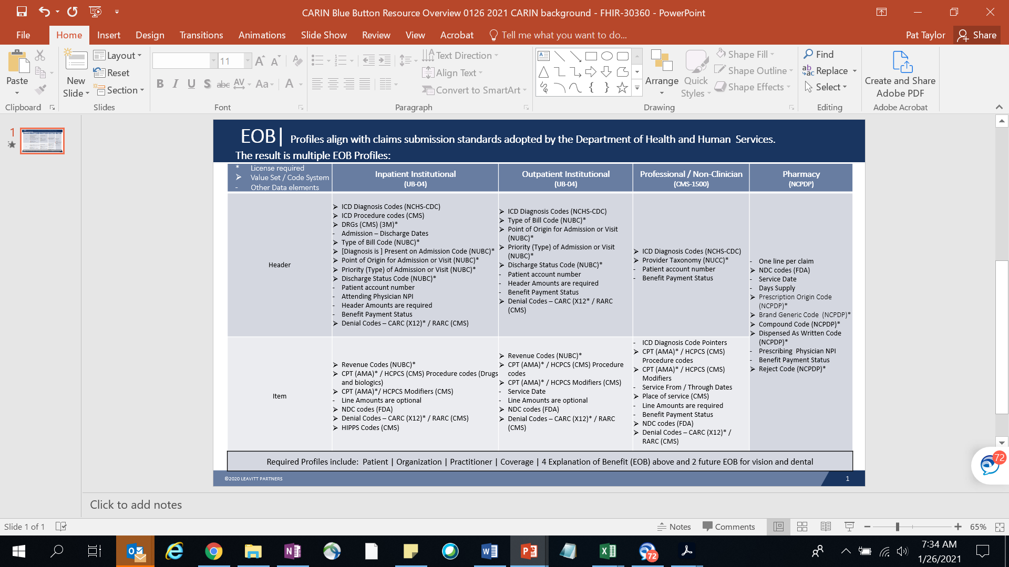
EOB Profiles Align with Dept of Health & Human Services Claim Submission Standards

