Slide 1
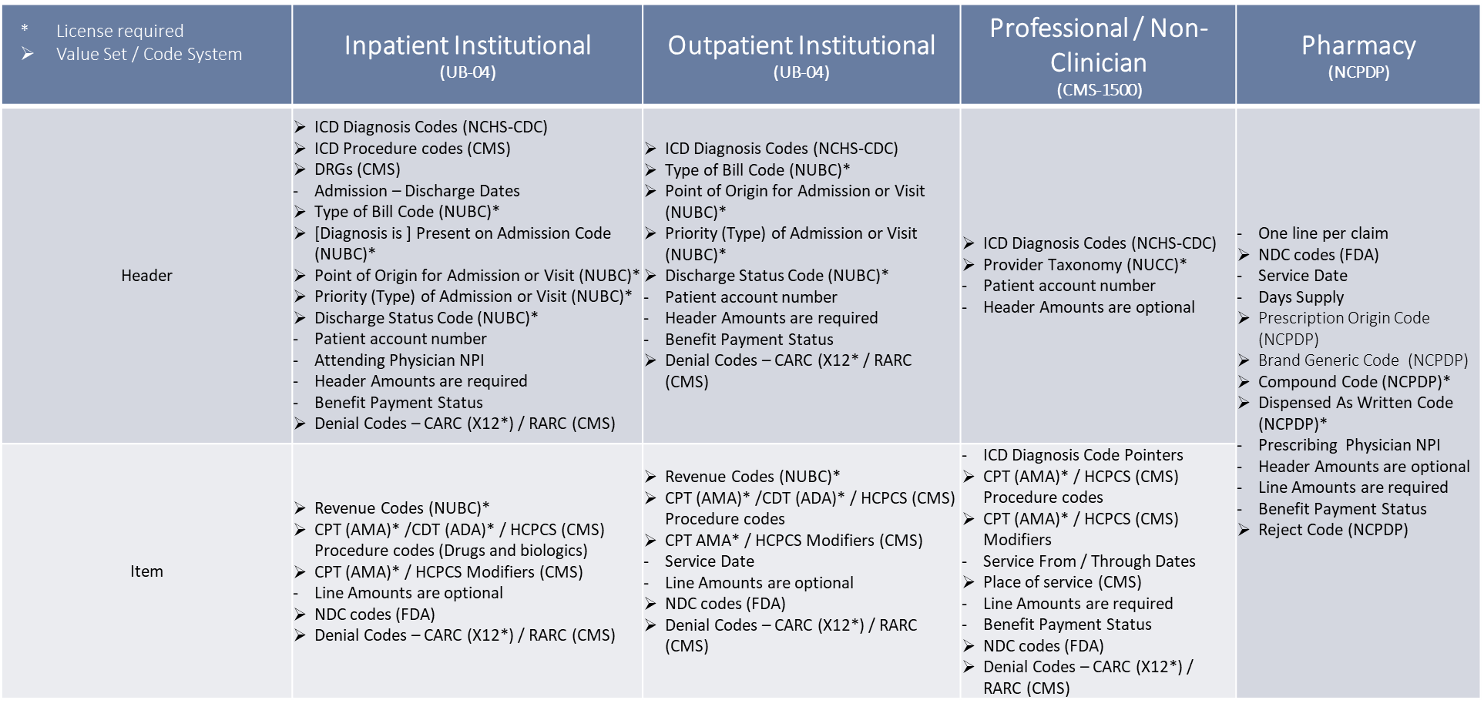
EOB Profiles Aligned with Dept of Health & Human Services Claim Submission Standards

