Slide 1
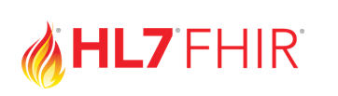
consumer or an authorized caregiver
3rd PARTY APP
Patient Access API
HEALTH CARE PAYER

