Slide 1
Option 1: CCDA on FHIR

Slide 2
Option 1: EICR
EICR CCDA
EICR CCDA on FHIR
Leverage CCDA 0n FHIR Implementation Guide for profiles on existing FHIR Resources
Bundle
Composition
Patient
etc
Technically Conversion of instances between them is a direct transform (XLST, or programmatically)

Slide 3
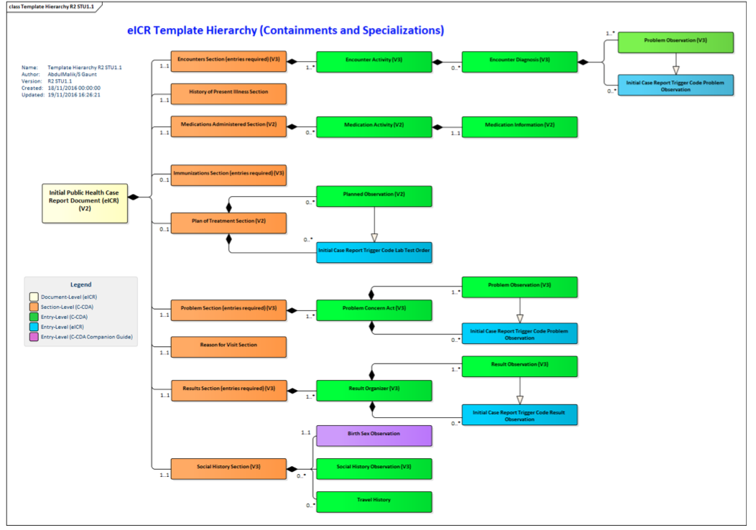
Multiple Transforms
EICR- CCDA
FHIR-Composition

Slide 4
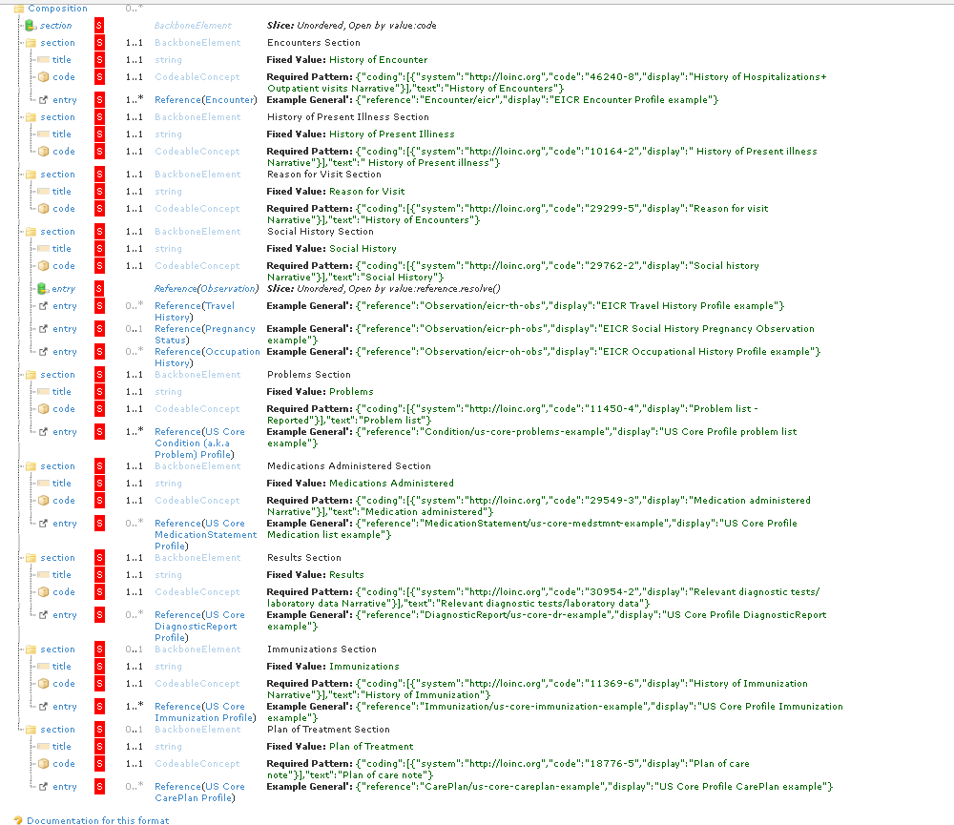
The EICR CCDA on FHIR Profile defined to the entry level
http://build.fhir.org/ig/Healthedata1/case-reporting/StructureDefinition-eicr-ccda-on-fhir.html

Slide 5
Option 1: RR
RR CCDA
EICR CCDA on FHIR
Same as above

Slide 6
Option 2: Create New FHIR Resource

Slide 7
Option 2: EICR
EICR CCDA
CaseReport resource
Create new resource based on the CSTE Date Elements and sample reports
Technically Conversion of instances between them is a series of transform (XLST, or programmatically)

Slide 8
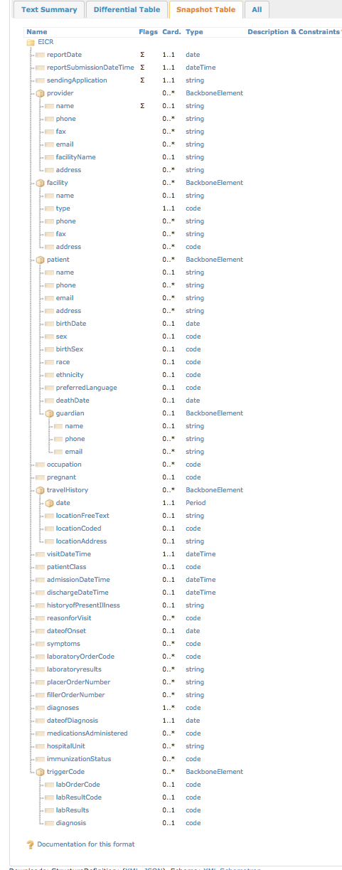
Multiple Transforms
EICR- CCDA
FHIR- Logical Model
http://build.fhir.org/ig/Healthedata1/case-reporting/StructureDefinition-EICR.html

Slide 9
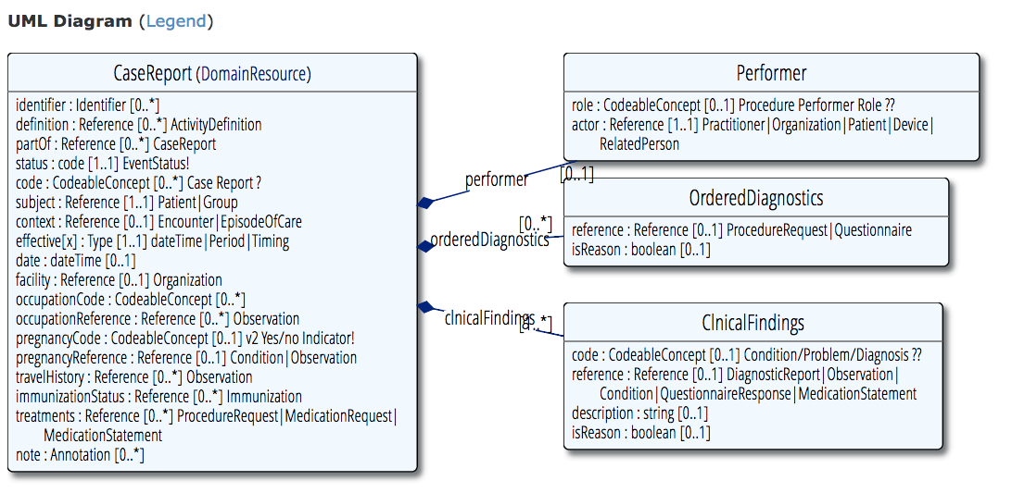
Multiple Transforms
FHIR- Logical Model
Draft CaseReport Resource
Not published online– available on request

Slide 10
Option 2: RR
RR CCDA
Reportability Report resource
Communication resource is already good fit - see option 3
NOT RECOMMENDED APPROACH

Slide 11
Option 3: Profiles Based on Existing Resource(s) – other than CCDA on FHIR

Slide 12
Option 3: EICR
EICR CCDA
FHIR Profiles?
No existing Resources seem likely candidates
NOT RECOMMENDED APPROACH

Slide 13
Option 3: RR
FHIR Communication
Profile
RR CCDA
Communication is good fit
RECOMMENDED APPROACH

