Slide 2
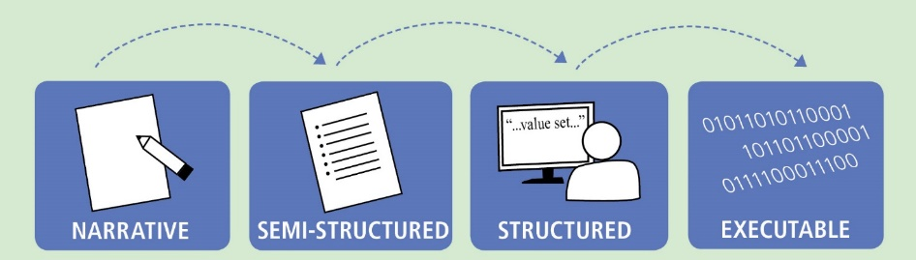
Translating Evidence to Executable CDS
L1
L2
L3
L4
Knowledge Level | Description | Example
L1 | Narrative | Guideline for a specific disease that is written in the format of a peer-reviewed journal article
L2 | Semi-structured | Flow diagram, decision tree, or other similar format that describes recommendations for implementation (HUMAN READABLE)
L3 | Structured | Standards-compliant specification encoding logic with data model(s), terminology/code sets, value sets that is ready to be implemented (COMPUTER/MACHINE READABLE)
L4 | Executable | CDS implemented and used in a local execution environment (e.g., CDS that is live in an electronic health record (EHR) production system) or available via web services
Adapted from: Boxwala, AA, et al.. A multi-layered framework for disseminating knowledge for computer-based decision support. J Am Med Inform Assoc 2011(18) i132-i139.

Slide 3

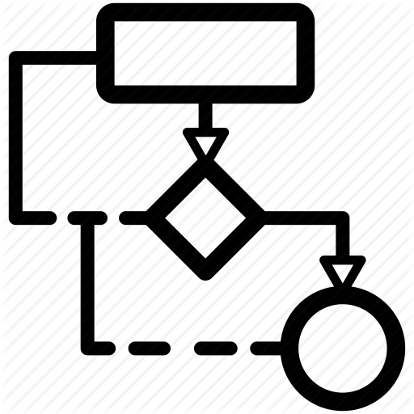

Tiers of Functionality
T1
T2
T3
Tier | Description | Example
T1 | Data | Glossaries, data elements and dictionaries, terminologies, data access services
T2 | Logic | Guideline narrative, workflows, libraries, application services
T3 | Forms | Use cases, personas, questionnaires, and user-interfaces
Adapted from: Boxwala, AA, et al.. A multi-layered framework for disseminating knowledge for computer-based decision support. J Am Med Inform Assoc 2011(18) i132-i139.

Slide 4






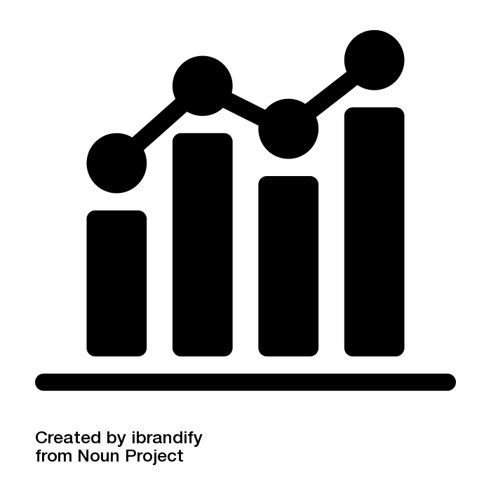










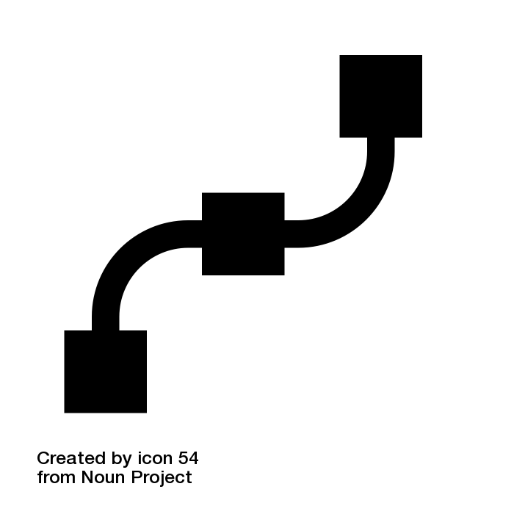
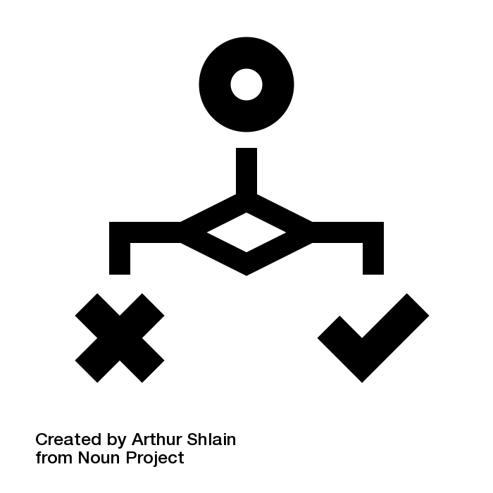


Content IGs
HEDIS
CDC Opioid Prescribing
WHO ANC
Model IGs
Specification IGs
IPS
US Core
QI Core
DEQM
QM
SDC
CPG-on-FHIR
EBM-on-FHIR
Foundation
Conformance
Administration
Clinical
Reasoning
FHIRPath
CQL
CDS Hooks
SMART
Notes:
FHIR-based Knowledge Representation Specifications
This diagram depicts 4 categories of specifications, with representative examples of each category, illustrating how the various pieces can be used together to deliver shareable clinical reasoning artifacts such as quality measures and decision support rules.
Along the bottom of the diagram are the foundational standards, including FHIR, with the 5 layers of Foundation, Conformance, Administration, Clinical, and Reasoning, as well as expression language and integration standards including FHIRPath, Clinical Quality Language, CDS Hooks, and SMART-on-FHIR.
In the middle left are the Model Implementation Guides, typically derived from Administration and Clinical resources such as Patient, Encounter, and MedicationRequest. Model IGs are typically built to address a broad range of use cases, focused on a particular target realm or domain.
In the middle right are the Specification Implementation Guides, which derive from the FHIR Clinical Reasoning resources to provide implementation guidance and conformance requirements for the creation, distribution, evaluation, and maintenance of shareable clinical knowledge. For example, the Quality Measure IG provides guidance on and conformance requirements for the use of the FHIR Measure and Library resources to create and share clinical quality measures, Data Exchange for Quality Measures (DEQM) provides guidance for reporting quality measures, and the Clinical Practice Guidelines IG (CPG-on-FHIR) demonstrates how to build shareable computable guideline content.
And finally, at the top of the diagram, the Content Implementation Guides are FHIR Implementation Guides, but not necessarily balloted as HL7 standards, rather these use the FHIR publication toolchain to support authoring and distribution, but the content is stewarded by separate authorities such as quality agencies and guideline developers; groups that have their own governance and maintenance policies. For example, the HEDIS IG contains HEDIS quality measures expressed using FHIR Measure and Library resources, and conforming to the Quality Measure IG profiles, while the CDC Opioid Prescribing IG and WHO Antenatal Care IGs contain decision support content to streamline guideline implementation. The content IGs conform to the specification IGs, and typically make use of the model IGs to define content focused on a particular realm.
The Foundation layer of FHIR defines the core data exchange protocol. The Conformance layer defines how resources, profiles, and terminologies are represented and used. The Administration layer defines individuals, locations, organizations, and encounters. The Clinical layer defines clinical information such as observations, medications, procedures, and orders. And the Reasoning layer provides definitional artifacts like plan and activity definitions, libraries, and measures.
FHIRPath is a simple, yet powerful, model-independent expression language that is used extensively throughout FHIR to describe paths to elements on resources, and define invariants on profiles.
CQL is a superset of FHIRPath that provides an author-friendly format for the description of clinical logic, as well as a machine-friendly format for processing the logic.
CDS Hooks is an HL7 standard specification for integrating decision support services with clinical systems. It is primarily focused on provide-facing remote decision support within an EMR.
SMART-on-FHIR is an HL7 standard specification for integrating clinical applications into EMRs using FHIR.
International Patient Summary (IPS) is a set of internationally applicable FHIR profiles used to share patient information across international boundaries. As a result, it forms an excellent foundation for expressing universally applicable content guidelines such as the WHO Antenatal Care (WHO ANC).
US Core is a set of profiles focused on enabling exchange of the US Clinical Data for Interoperability (US CDI), and is supported by a broad range of EMR vendors within the US.
QI Core is a set of profiles that derives from US Core to enable quality improvement use cases such as quality measurement and decision support within the US.

Slide 5
Tiers of Functionality
T3 – Forms
T2 – Logic
T1 – Data
Notes:
L1 – Narrative content, so paper forms, guidelines, dictionaries, and other supportive documentation
L2 – Semi-structured, so personas, use cases, flow diagrams, questionnaires, data dictionaries, and indicator descriptions

Slide 6
Requirements -> Running Code
L1 – Narrative
L2 – Semi-Structured
L3 – Structured
L4 – Executable
T3 – Forms
Narrative questions
Paper forms
Use Cases
Personas
Questionnaire (SDC)
User-interface Forms
Workflows
Decision Trees
Triggers
Library (CQL)
ActivityDefinition
PlanDefinition
Application Services
Health Record Systems
Decision Services
T2 – Logic
Guideline narrative
Terminologies
Data Dictionary
Indicators
CodeSystem
ValueSet
StructureDefinition
Measure
Systems of Record
Registries and Exchanges
Data Services
T1 – Data
Glossaries
Indicator descriptions
Notes:
L1 – Narrative content, so paper forms, guidelines, dictionaries, and other supportive documentation
L2 – Semi-structured, so personas, use cases, flow diagrams, questionnaires, data dictionaries, and indicator descriptions

Slide 7
Guideline Development
Knowledge Engineering
Implementation
L1 – Narrative
L2 – Semi-Structured
L3 – Structured
L4 – Executable
T3 – Forms
Narrative questions
Paper forms
Use Cases
Personas
Questionnaire (SDC)
User-interface Forms
Workflows
Decision Trees
Triggers
Library (CQL)
ActivityDefinition
PlanDefinition
Application Services
Health Record Systems
Decision Services
T2 – Logic
Guideline narrative
Terminologies
Data Dictionary
Indicators
CodeSystem
ValueSet
StructureDefinition
Measure
Systems of Record
Registries and Exchanges
Data Services
T1 – Data
Glossaries
Indicator descriptions
Notes:
L1 – Narrative content, so paper forms, guidelines, dictionaries, and other supportive documentation
L2 – Semi-structured, so personas, use cases, flow diagrams, questionnaires, data dictionaries, and indicator descriptions

Slide 8
Guideline Development
Knowledge Engineering
Implementation
L1 – Narrative
L2 – Semi-Structured
L3 – Structured
L4 – Executable
T3 – Forms
Narrative questions
Paper forms
Use Cases
Personas
Questionnaire (SDC)
User-interface Forms
Workflows
Decision Trees
Triggers
Library (CQL)
ActivityDefinition
PlanDefinition
Application Services
Health Record Systems
Decision Services
T2 – Logic
Guideline narrative
Terminologies
Data Dictionary
Indicators
CodeSystem
ValueSet
StructureDefinition
Measure
Systems of Record
Registries and Exchanges
Data Services
T1 – Data
Glossaries
Indicator descriptions
Notes:
L1 – Narrative content, so paper forms, guidelines, dictionaries, and other supportive documentation
L2 – Semi-structured, so personas, use cases, flow diagrams, questionnaires, data dictionaries, and indicator descriptions

Slide 9
Levels of Representation x Tiers of Functionality
L1 – Narrative
L2 – Semi-Structured
L3 – Structured
L4 – Executable
Case Examples
Paper Forms
User Stories
Personas
User-interface Forms
Visualizations
Interaction Model
T3 – Forms
Wire Frames
Flow Diagrams
Questionnaire
Adaptive Form (SDC)
Workflows
Decision Trees, Tables, and Flows
Triggers
Concept Maps
Application Services
Health Record Systems
Decision Services
Rules Engine
Guideline narrative
Evidence Summaries
Tables & Figures
Library (CQL)
ActivityDefinition
PlanDefinition
Inferred CaseFeatures
T2 – Logic
Glossaries
Domain Concepts
Indicator descriptions
Terminologies
Data Dictionary
Indicators
CodeSystem
ValueSet
StructureDefinition
Data Requirements
Systems of Record
Registries & Exchanges
Data Services
Data Warehouse
T1 – Data
“We have developed a multi-layered knowledge representation framework for structuring guideline recommendations for implementation in a variety of CDS contexts.” Boxwala, A. A., Rocha, B. H., Maviglia, S., Kashyap, V., Meltzer, S., Kim, J., Tsurikova, R., Wright, A., Paterno, M. D., Fairbanks, A., & Middleton, B. (2011). A multi-layered framework for disseminating knowledge for computer-based decision support. Journal of the American Medical Informatics Association : JAMIA, 18 Suppl 1(Suppl 1), i132–i139. https://doi.org/10.1136/amiajnl-2011-000334
http://build.fhir.org/ig/HL7/cqf-recommendations/documentation-approach-06-01-levels-of-knowledge-representation.html
Notes:
L1 – Narrative content, so paper forms, guidelines, dictionaries, and other supportive documentation
L2 – Semi-structured, so personas, use cases, flow diagrams, decision trees, data dictionaries, and indicator descriptions
L3 – Structured, so Questionnaire, Library, ActivityDefinition, PlanDefinition, terminology resources, CQL logic, Measure
L4 – Running systems

Slide 10
Methods of Implementation
Use CQL as a specification (manual development)
Developers will still need to hand code own code based off of that published “L3” CQL. Although, the most time consuming option, this is still faster than starting from the narrative artifacts “L1”
1
Translate CQL (automated translation)
Translate “L3” CQL into the code base used in the current legacy system
2
Consume CQL (native implementation)
Directly intake “L3” CQL artifacts natively
3

Slide 11
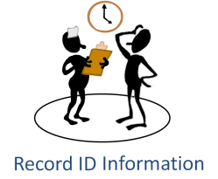



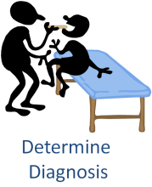
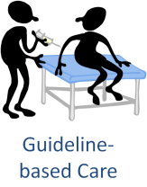

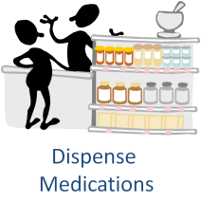


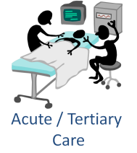
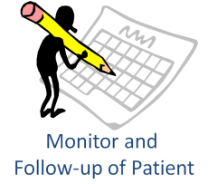



Common Processes

Slide 13
Shareable
Computable
Publishable
Executable
Design-time/ authoring
Publishing/distribution
Runtime/implementation

Slide 14


Service Integration
Clinical Reasoning Implementation
CDS Hooks Request with Patient Data
CQL Libraries
PlanDefinition
EHR
order-select
$apply operation
CDS Hooks API
CarePlan with RequestGroup
CDS Hooks Response

Slide 15


CQL Ingestion Integration
Clinical Reasoning-enabled EMR/CDR
Recommendations
Clinician Workflow
CQL
Evaluation
PlanDefinition
Import/Ingest
CQL Libraries
Clinical data/transactions
Data Requirements
EMR
CDR
ETL/warehousing

