Slide 2
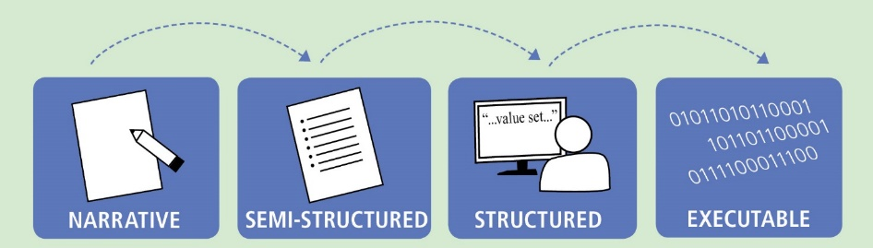
Translating Evidence to Executable CDS
L1
L2
L3
L4
Knowledge Level | Description | Example
L1 | Narrative | Guideline for a specific disease that is written in the format of a peer-reviewed journal article
L2 | Semi-structured | Flow diagram, decision tree, or other similar format that describes recommendations for implementation (HUMAN READABLE)
L3 | Structured | Standards-compliant specification encoding logic with data model(s), terminology/code sets, value sets that is ready to be implemented (COMPUTER/MACHINE READABLE)
L4 | Executable | CDS implemented and used in a local execution environment (e.g., CDS that is live in an electronic health record (EHR) production system) or available via web services
Adapted from: Boxwala, AA, et al.. A multi-layered framework for disseminating knowledge for computer-based decision support. J Am Med Inform Assoc 2011(18) i132-i139.

Slide 3

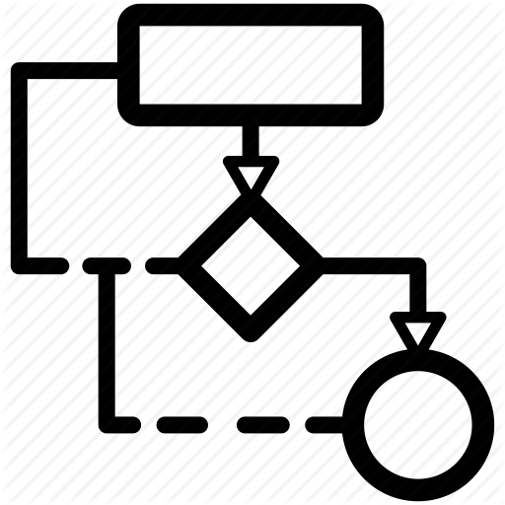

Tiers of Functionality
T1
T2
T3
Tier | Description | Example
T1 | Data | Glossaries, data elements and dictionaries, terminologies, data access services
T2 | Logic | Guideline narrative, workflows, libraries, application services
T3 | Forms | Use cases, personas, questionnaires, and user-interfaces
Adapted from: Boxwala, AA, et al.. A multi-layered framework for disseminating knowledge for computer-based decision support. J Am Med Inform Assoc 2011(18) i132-i139.

Slide 4
Tiers of Functionality
T3 – Forms
T2 – Logic
T1 – Data
Notes:
L1 – Narrative content, so paper forms, guidelines, dictionaries, and other supportive documentation
L2 – Semi-structured, so personas, use cases, flow diagrams, questionnaires, data dictionaries, and indicator descriptions

Slide 5
Requirements -> Running Code
L1 – Narrative
L2 – Semi-Structured
L3 – Structured
L4 – Executable
T3 – Forms
Narrative questions
Paper forms
Use Cases
Personas
Questionnaire (SDC)
User-interface Forms
Workflows
Decision Trees
Triggers
Library (CQL)
ActivityDefinition
PlanDefinition
Application Services
Health Record Systems
Decision Services
T2 – Logic
Guideline narrative
Terminologies
Data Dictionary
Indicators
CodeSystem
ValueSet
StructureDefinition
Measure
Systems of Record
Registries and Exchanges
Data Services
T1 – Data
Glossaries
Indicator descriptions
Notes:
L1 – Narrative content, so paper forms, guidelines, dictionaries, and other supportive documentation
L2 – Semi-structured, so personas, use cases, flow diagrams, questionnaires, data dictionaries, and indicator descriptions

Slide 6
Guideline Development
Knowledge Engineering
Implementation
L1 – Narrative
L2 – Semi-Structured
L3 – Structured
L4 – Executable
T3 – Forms
Narrative questions
Paper forms
Use Cases
Personas
Questionnaire (SDC)
User-interface Forms
Workflows
Decision Trees
Triggers
Library (CQL)
ActivityDefinition
PlanDefinition
Application Services
Health Record Systems
Decision Services
T2 – Logic
Guideline narrative
Terminologies
Data Dictionary
Indicators
CodeSystem
ValueSet
StructureDefinition
Measure
Systems of Record
Registries and Exchanges
Data Services
T1 – Data
Glossaries
Indicator descriptions
Notes:
L1 – Narrative content, so paper forms, guidelines, dictionaries, and other supportive documentation
L2 – Semi-structured, so personas, use cases, flow diagrams, questionnaires, data dictionaries, and indicator descriptions

Slide 7
Guideline Development
Knowledge Engineering
Implementation
L1 – Narrative
L2 – Semi-Structured
L3 – Structured
L4 – Executable
T3 – Forms
Narrative questions
Paper forms
Use Cases
Personas
Questionnaire (SDC)
User-interface Forms
Workflows
Decision Trees
Triggers
Library (CQL)
ActivityDefinition
PlanDefinition
Application Services
Health Record Systems
Decision Services
T2 – Logic
Guideline narrative
Terminologies
Data Dictionary
Indicators
CodeSystem
ValueSet
StructureDefinition
Measure
Systems of Record
Registries and Exchanges
Data Services
T1 – Data
Glossaries
Indicator descriptions
Notes:
L1 – Narrative content, so paper forms, guidelines, dictionaries, and other supportive documentation
L2 – Semi-structured, so personas, use cases, flow diagrams, questionnaires, data dictionaries, and indicator descriptions

Slide 8
Levels of Representation x Tiers of Functionality
L1 – Narrative
L2 – Semi-Structured
L3 – Structured
L4 – Executable
Case Examples
Paper Forms
User Stories
Personas
User-interface Forms
Visualizations
Interaction Model
T3 – Forms
Wire Frames
Flow Diagrams
Questionnaire
Adaptive Form (SDC)
Workflows
Decision Trees, Tables, and Flows
Triggers
Concept Maps
Application Services
Health Record Systems
Decision Services
Rules Engine
Guideline narrative
Evidence Summaries
Tables & Figures
Library (CQL)
ActivityDefinition
PlanDefinition
Inferred CaseFeatures
T2 – Logic
Glossaries
Domain Concepts
Indicator descriptions
Terminologies
Data Dictionary
Indicators
CodeSystem
ValueSet
StructureDefinition
Data Requirements
Systems of Record
Registries & Exchanges
Data Services
Data Warehouse
T1 – Data
“We have developed a multi-layered knowledge representation framework for structuring guideline recommendations for implementation in a variety of CDS contexts.” Boxwala, A. A., Rocha, B. H., Maviglia, S., Kashyap, V., Meltzer, S., Kim, J., Tsurikova, R., Wright, A., Paterno, M. D., Fairbanks, A., & Middleton, B. (2011). A multi-layered framework for disseminating knowledge for computer-based decision support. Journal of the American Medical Informatics Association : JAMIA, 18 Suppl 1(Suppl 1), i132–i139. https://doi.org/10.1136/amiajnl-2011-000334
http://build.fhir.org/ig/HL7/cqf-recommendations/documentation-approach-06-01-levels-of-knowledge-representation.html
Notes:
L1 – Narrative content, so paper forms, guidelines, dictionaries, and other supportive documentation
L2 – Semi-structured, so personas, use cases, flow diagrams, decision trees, data dictionaries, and indicator descriptions
L3 – Structured, so Questionnaire, Library, ActivityDefinition, PlanDefinition, terminology resources, CQL logic, Measure
L4 – Running systems

Slide 9
Methods of Implementation
Use CQL as a specification (manual development)
Developers will still need to hand code own code based off of that published “L3” CQL. Although, the most time consuming option, this is still faster than starting from the narrative artifacts “L1”
1
Translate CQL (automated translation)
Translate “L3” CQL into the code base used in the current legacy system
2
Consume CQL (native implementation)
Directly intake “L3” CQL artifacts natively
3

Slide 10




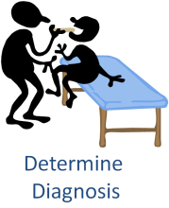





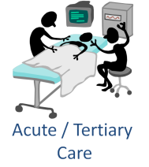




Common Processes

Slide 12
Shareable
Computable
Publishable
Executable
Design-time/ authoring
Publishing/distribution
Runtime/implementation

