Slide 1
To create the figures for CodeX RT
select contents to be included in the figure
right-click
and select “Save as Picture …”
Save as *.svg

Slide 2
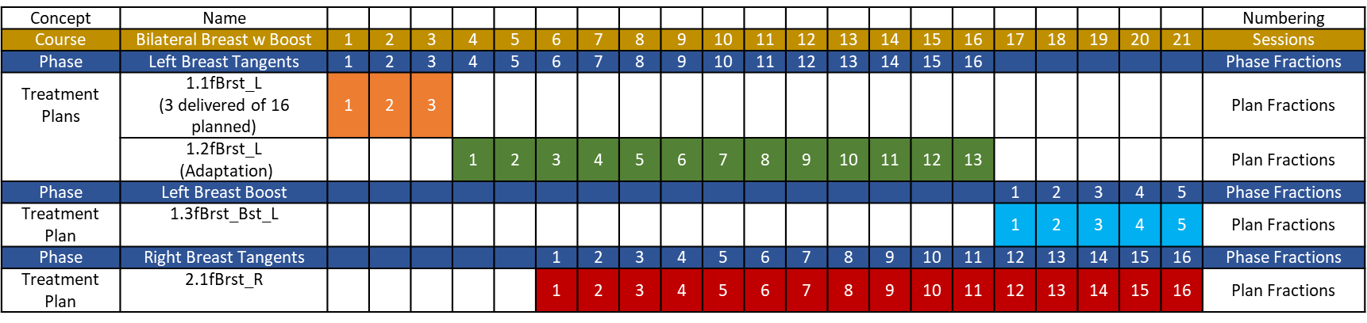
Course Summary
Left Breast : 4256 cGy in 16 sessions
Left Axillary Nodes, SC and IMN: 4256 cGy in 16 sessions
Left Breast Surgical Bed: 5256 cGy in 20 sessions
Right Breast: 4256 cGy in 16 sessions
All treated in 20 sessions over 26 days
Bilateral Breast with Plan Adaptation
Treated Phase
Phase Name: Left Breast Tangents
Target Volumes
Left Breast : 4256 cGy
Left Breast Surgical Bed : 4256 cGy
Left Axillary Nodes, SC and IMN: 4256 cGy
Treated in 16 phase fractions
Using Photons 3D
Phase Name: Left Breast Boost
Target Volumes
Left Breast Surgical Bed: 1000 cGy
Treated in 4 phase fractions
Using Electrons 3D
Phase Name: Right Breast Tangents
Target Volumes
Right Breast : 4256 cGy
Treated in 16 phase fractions
Using Photons 3D
Treated Plan
Breast_L_Tang
(3 delivered
of 16 planned)
Breast_L_Tang:1
Adaptation
(13 fractions delivered of 13 planned)
Breast_L_Boost
(4 fractions delivered of 4 planned)
Breast_R_Tang
(16 fractions delivered of 16 planned)

Slide 3
Previous version
and
unused figures

Slide 4
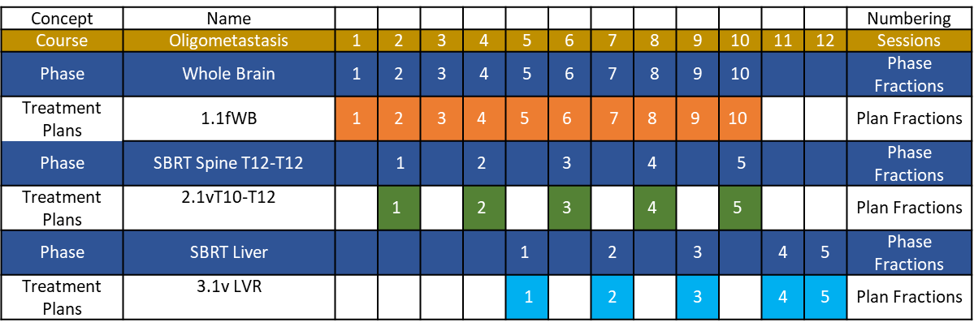
Course Summary
Whole Brain: 3000 cGy in 10 fractions
Spine T12-T10: 4000 cGy in 5 fractions
Liver Metastasis: 5000 cGy treated in 5 fractions
All treated in 13 sessions
Over 49 days
Oligometastatic Sites with Asynchronous
Starts and Timing Gaps
Phase Summary
Phase Name: Whole Brain
Target Volumes
Whole Brain: 3000 cGy
Treated in 10 fractions
Using Photons 3D
Phase Name: SBRT Spine T12-T10
Target Volumes
Spine T12-T12: 4000 cGy
Treated in 5 fractions
Using Photons IMRT
Phase Name: SBRT Liver
Target Volumes:
Liver Metastasis:5000
Treated in 5 fractions
Using Photons VMAT
Test this definition of Phase – Prescription differing from others to same set of Target Volumes by use of modality, technique, or dose/per fraction to target (PTV) volumes.
Whole Brain
(10 fractions Delivered out of 10 planned )
SBRT Spine T12-T10
(5 fractions delivered of 5 planned treated every other day
SBRT Liver
(Split Course- treat 3 fractions then wait a month and treat 2 more after evaluating response)
Delivered Treatment Plan

Slide 5
Course Summary
Left Breast : 4256 cGy in 16 sessions
Left Axillary Nodes, SC and IMN: 4256 cGy in 16 sessions
Left Breast Surgical Bed: 5256 cGy in 20 sessions
Right Breast: 4256 cGy in 16 sessions
All treated in 20 sessions over 26 days
Bilateral Breast with Plan Adaptation
Treated Phase
Phase Name: Left Breast Tangents
Target Volumes
Left Breast : 4256 cGy
Left Breast Surgical Bed : 4256 cGy
Left Axillary Nodes, SC and IMN: 4256 cGy
Treated in 16 phase fractions
Using Photons 3D
Phase Name: Left Breast Boost
Target Volumes
Left Breast Surgical Bed: 1000 cGy
Treated in 4 phase fractions
Using Electrons 3D
Phase Name: Right Breast Tangents
Target Volumes
Right Breast : 4256 cGy
Treated in 16 phase fractions
Using Photons 3D
Treated Plan
Breast_L_Tang
(3 delivered of 16 planned)
Breast_L_Tang:1
Adaptation
(13 fractions delivered of 13 planned)
Breast_L_Boost
(4 fractions delivered of 4 planned)
Breast_R_Tang
(16 fractions delivered of 16 planned )

Slide 6
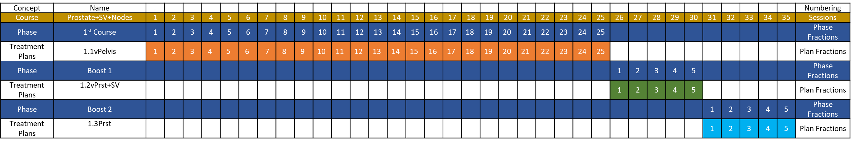
Course Summary
Prostate: 7000 cGy in 35 fractions
SV: 6000 cGy in 30 fractions
Pelvic Nodes: 4500 cGy in 25 fractions
All treated in 35 sessions
Over 49 days
Prostate
Phase Summary
Phase Name: 1st course
Target Volumes
Prostate: 5000cGy
SV: 5000 cGy
Pelvic Nodes: 4500 cGy
Treated in 25 phase fractions
using Photons VMAT
Phase Name: Boost 1
Target Volumes
Prostate: 1000 cGy
SV: 1000 cGy
Treated in 5 phase fractions
using Photons VMAT
Rx Phase Name: Boost 2
Target Volumes
Prostate: 1000
Treated in 5 phase fractions
using Photons VMAT
Delivered Treatment Plan
Pelvis
(25 delivered of 25 planned)
Prostate + SV
(5 fractions delivered out of 5 planned)
Prostate
(5 fractions delivered of 5 planned)

