Slide 1
Knowledge artifact Specification Status & recommendations
Hl7 Working group meeting, Jan 31st, 2018

Slide 2
Overview
Background
Engagement Points
Conceptual Model
HeD KAS
Composite KNART
Ballot Timelines

Slide 3
background
Clinical Decision Support Knowledge Artifact Specification, Release 1 (KNART) was published as a DSTU in July 2015
3 STU Update releases - currently at STU Release 1.3
STU comment period extended to Sept 2018.
2 projects ongoing
PSS 931 Knowledge Artifact Specification STU Release 2, sponsored by CDS, CQI and ITS
PSS 1374 Knowledge Artifact Conceptual Model, sponsored by CDS, CQI and CIMI
Weekly calls at 11 ET on Thursdays

Slide 4
Engagement points
Weekly calls at 11 ET on Thursdays
listserv knart@lists.hl7.org
Repositories:
https://github.com/HL7/composite-knart
http://wiki.hl7.org/index.php?title=Composite_KNART
https://gforge.hl7.org/gf/project/soageneral/scmsvn/?action=browse&path=%2Ftrunk%2FModels%2F
Requirements and input drawn from VA HL7 Knowledge Artifacts project

Slide 5
Conceptual Model approach
Extract concepts from existing physical representations
Review and align with API4KP
Extend to cover concepts identified from clinical use cases in whitepaper delivered last cycle
In particular, metadata around context and governance

Slide 6
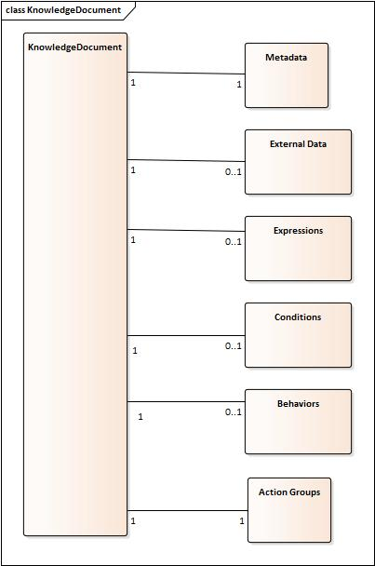
Hed diagram

Slide 7
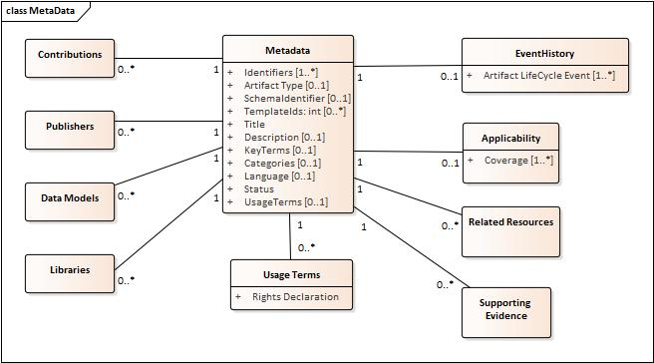
Hed metadata

Slide 8
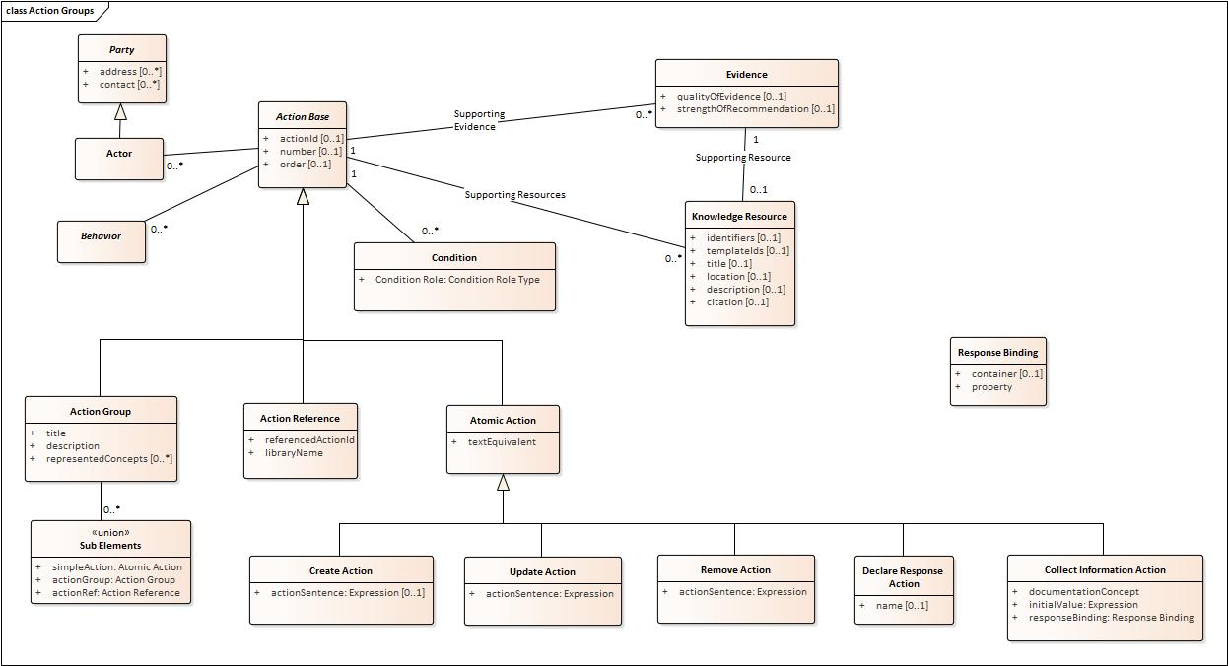
Hed action Group

Slide 9
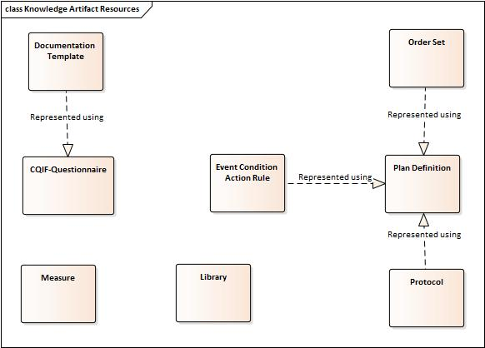
Fhir diagram

Slide 10
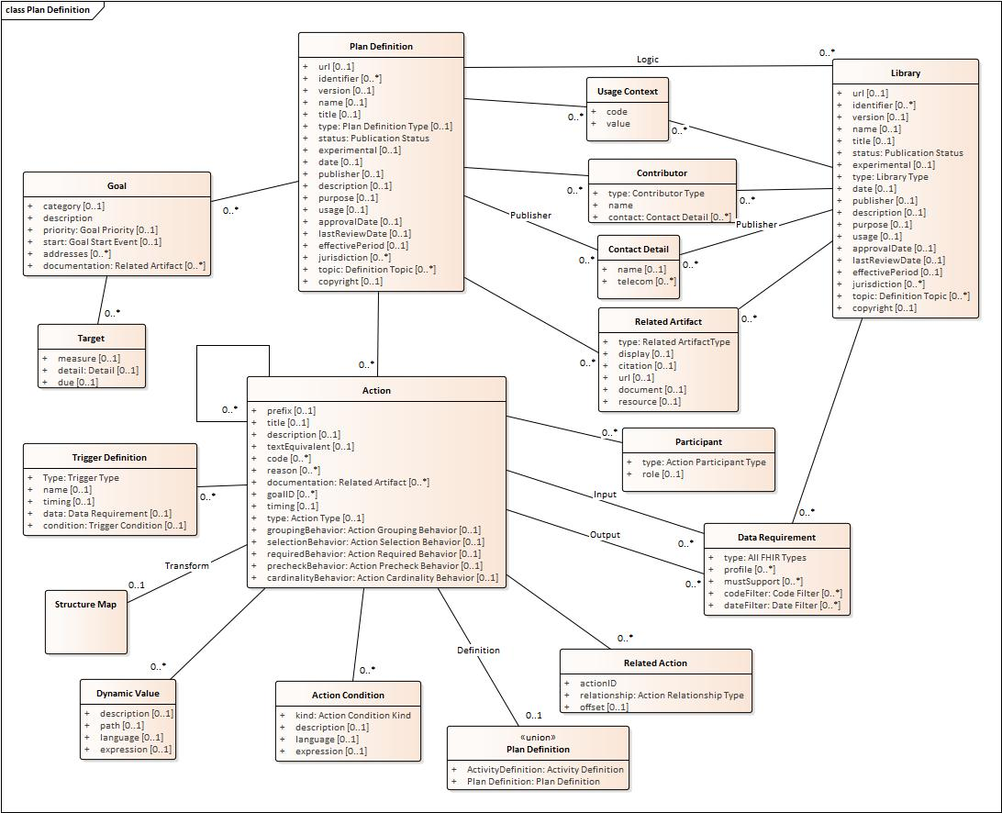
Plan definition

Slide 11
Hed kas
34 STU comments in queue
8 will be addressed in the Conceptual Model work
11 are candidates for an errata or STU update
8 are feature requests for STU release 2, including support for composition
Remainder are new entries not reviewed yet
STU Comment page:
http://www.hl7.org/dstucomments/showdetail.cfm?dstuid=156

Slide 12
Composite knarts
Design principles
Singleton knarts as a standalone entity
Container model for composite, which handles the knowledge of structure, relationships and behavior
Metadata, intra-artifact referencing, context, orchestration, conceptual models of context activation

Slide 13
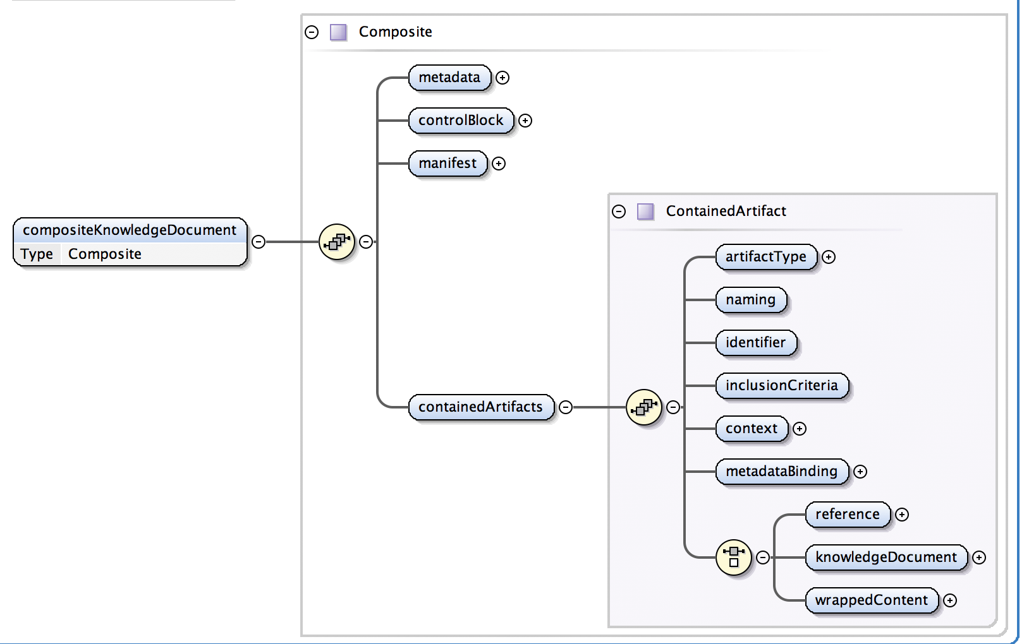
Proposed design

Slide 14
Ballot Timelines
May ballot final content deadline is April 1st
Workstreams:
Apply approved changes from STU comments
Extend HeD design to support composition
Prepare STU ballot for HeD KAS
Prepare ballot for conceptual model

Slide 15
Proposed Schedule
Bandwidth for full ballot by May limited
Suggest aiming for a STU update release with errrata by May
Target September for ballot of STU update and Conceptual Model

Slide 16
Questions?

